Slide 1
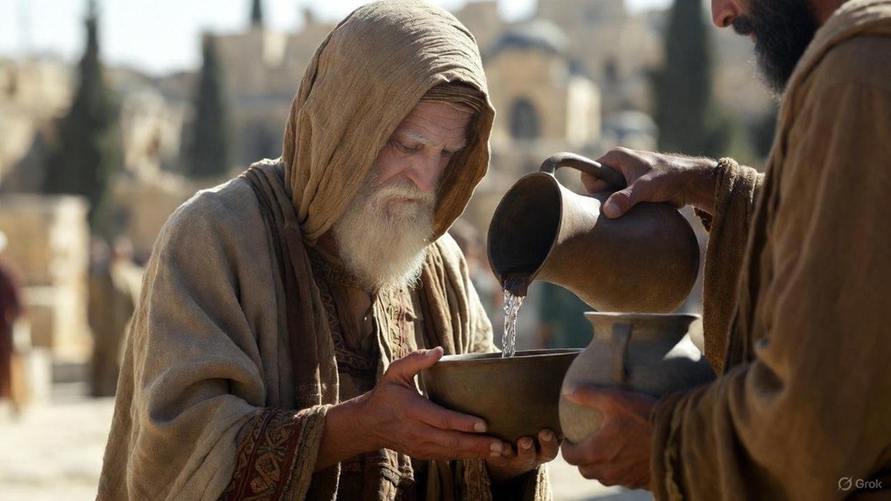

.
We Would See Jesus
J
THE
BOOK
of
OHN
Chapter 12:20-50

Slide 2
.
We would See Jesus…with Real Faith
Challenge of Faith: Willing to pay a heavy price

Slide 3
.
“And He was saying to them all, ‘If anyone wishes to come after Me, let him deny himself, & take up his cross daily & follow Me. For whoever wishes to save his life will lose it, but whoever loses his life for My sake, he is the one who will save it… (cont)
Luke 9:23-26

Slide 4
.
(cont) …For what is a man profited if he gains the whole world, & loses or forfeits himself? For whoever is ashamed of Me & My words, the Son of Man will be ashamed of him when He comes in His glory, & the glory of the Father & of the holy angels.”
Luke 9:23-26

Slide 5
.
We would See Jesus…with Real Faith
Challenge of Faith: Willing to pay a heavy price
Place of Faith: Relying on Jesus’ work on the cross

Slide 6
.
“But the Advocate, the Holy Spirit, whom the Father will send in My name, He will teach you all things, & bring to your remembrance all that I said to you.”
John 14:26

Slide 7
.
We would See Jesus…with Real Faith
Challenge of Faith: Willing to pay a heavy price
Place of Faith: Relying on Jesus’ work on the cross

Slide 8
.
“And as Moses lifted up the serpent in the wilderness, even so must the Son of Man be lifted up; so that whoever believes will in Him have eternal life.”
John 3:14-15

Slide 9
.
“Do you not know that when you go on presenting yourselves to someone as slaves for obedience, you are slaves of the one whom you obey, either of sin leading to death, or of obedience leading to righteousness? But thanks be to God that though you were slaves of sin, you obeyed from the heart that pattern of teaching to which you were given over, & having been freed from sin, you became slaves of righteousness.”
Romans 6:16-18

Slide 10
.
We would See Jesus…with Real Faith
Challenge of Faith: Willing to pay a heavy price
Place of Faith: Relying on Jesus’ work on the cross
Leap of Faith: Moved from evidence to willing to live it
Substance of Faith: Get the details right

Slide 11
.
“For God did not send the Son into the world to judge the world, but that the world might be saved through Him. He who believes in Him is not judged; he who does not believe has been judged already, because he has not believed in the name of the only begotten Son of God.”
John 3:17-19

Slide 12
.
We would See Jesus…with Real Faith
Challenge of Faith: Willing to pay a heavy price
Place of Faith: Relying on Jesus’ work on the cross
Leap of Faith: Moved from evidence to willing to live it
Substance of Faith: Get the details right

