Slide 1
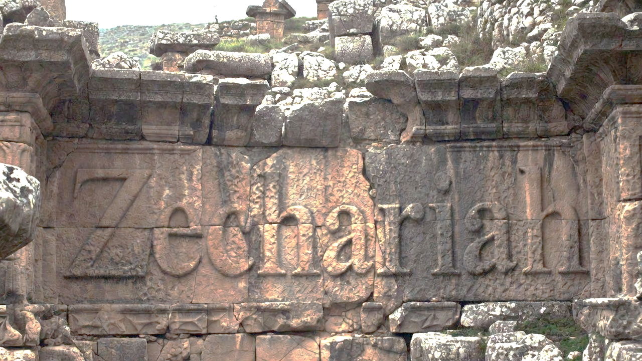


Envisioning God’s Unstoppable Plan
Part 1 of 2

Slide 2
Envisioning God’s Unstoppable Plan
Providing for Israel’s Re-establishment
    Four Men on Horses

Slide 3
Jeremiah 25:11
“This whole land will be a waste place & an object of horror, & these nations will serve the king of Babylon seventy years.”

Slide 4
Envisioning God’s Unstoppable Plan
Providing for Israel’s Re-establishment
    Four Men on Horses
Protection from the Enemy
    Four Horns & Craftsmen
Preparing for the Influx of People
    A Man with a Measuring Device

Slide 5
Ezekiel 38:11
“And you will say, ‘I [Russia] will go up against the land of unwalled villages. I will go against those who dwell quietly, that live securely, all of them living without walls & having no bars or gates.”

Slide 6
Ephesians 5:14
“For this reason it says, ‘Awake, sleeper, & arise from the dead, & Christ will shine on you.’”

Slide 7
Revelation 18:4
“I heard another voice from heaven, saying, ‘Come out of her, my people, so that you will not participate in her sins and receive of her plagues.’”

Slide 8
Envisioning God’s Unstoppable Plan
Providing for Israel’s Re-establishment
    Four Men on Horses
Protection from the Enemy
    Four Horns & Craftsmen
Preparing for the Influx of People
    A Man with a Measuring Device

Slide 9
John 10:16
“And I have other sheep, which are not from this fold; I must bring them also, & they will hear My voice; & they will become one flock with one shepherd.”

Slide 10
Envisioning God’s Unstoppable Plan
Providing for Israel’s Re-establishment
    Four Men on Horses
Protection from the Enemy
    Four Horns & Craftsmen
Preparing for the Influx of People
    A Man with a Measuring Device
Promotion of the Branch Jesus
    The High Priest & the Branch

Slide 11
Chiastic Structure of Zec 1-6
Vision 1 – Provide Re-establishment
Vision 2 – Protect from the enemy
Vision 3 – Prepare for influx of people
Vision 4 – Promote the Branch Jesus
Vision 5 – Empowered by the Spirit
Vision 6 – Expiate the people
Vision 7 – Extradite the enemy
Vision 8 – Eliminate the enemy
Control the Situation
Exalt God
Overthrow Enemy
Prepare People

Slide 12
The Chiastic Structure of Noah
Gen 6:10-22 – Noah told to build ark
Gen 7:1-9 – They enter the ark
Gen 7:10-16 – Flood begins
Gen 7:17-24 – Waters rise
Gen 8:1 – ‘But God remembered Noah’
Gen 8:2-5 – Waters recede
Gen 8:6-14 – The earth dries
Gen 8:15-19 – They leave the ark
Gen 8:20-9-19 – Noah worships God
Relation with God
Movement for God
God changes all
Future Preparation
Pinnacle

Slide 13
Envisioning God’s Unstoppable Plan
Providing for Israel’s Re-establishment
    Four Men on Horses
Protection from the Enemy
    Four Horns & Craftsmen
Preparing for the Influx of People
    A Man with a Measuring Device
Promotion of the Branch Jesus
    The High Priest & the Branch

