Slide 1
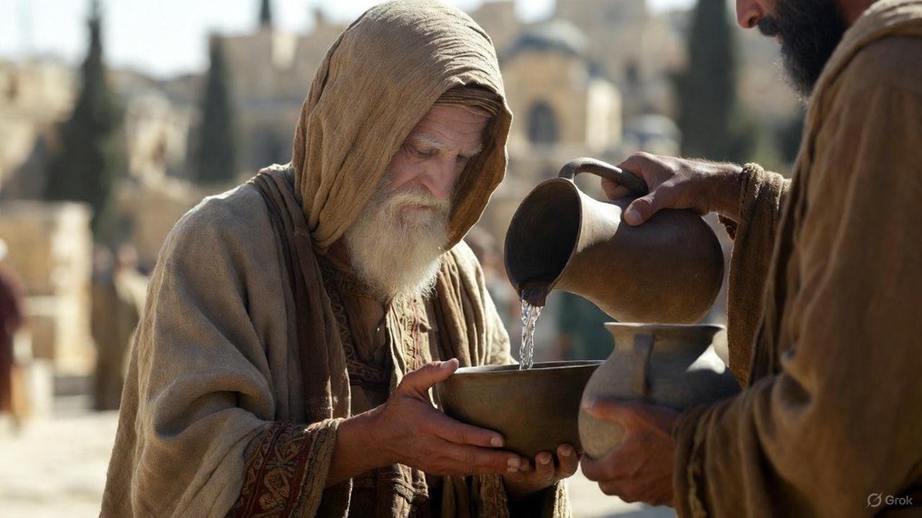

.
Love Til The End
J
THE
BOOK
of
OHN
Chapter 13

Slide 2
.
Love Til The End…Like Jesus
How To Serve: Wash them in the Word

Slide 3
.
“So then, while we have opportunity, let us do good to all people, & especially to those who are of the household of the faith.”
Galatians 6:10

Slide 4
.
Love Til The End…Like Jesus
How To Serve: Wash them in the Word

Slide 5
.
“Brothers, even if anyone is caught in any transgression, you who are spiritual, restore such a one in a spirit of gentleness, each of you looking to yourself, so that you too will not be tempted. Bear one another’s burdens, & so fulfill the law of Christ.”
Galatians 6:1-2

Slide 6
.
“He saved us, not by works which we did in righteousness, but according to His mercy, through the washing of regeneration & renewing by the Holy Spirit, whom He poured out upon us richly through Jesus Christ our Savior.”
Titus 3:5-6

Slide 7
.
Love Til The End…Like Jesus
How To Serve: Wash them in the Word

Slide 8
.
“I am the true vine, & My Father is the vine-grower. Every branch in Me that does not bear fruit, He takes away; & every branch that bears fruit, He cleans it so that it may bear more fruit. You are already clean because of the word which I have spoken to you.”
John 15:1-3

Slide 9
.
“Husbands, love your wives, just as Christ also loved the church & gave Himself up for her, so that He might sanctify her, having cleansed her by the washing of water with the word.”
Ephesians 5:25-26

Slide 10
.
Love Til The End…Like Jesus
How To Serve: Wash them in the Word

Slide 11
.
“By being of the same mind toward one another, not being haughty in mind, but associating with the humble. Do not be wise in your own mind.”
Romans 12:16

Slide 12
.
Love Til The End…Like Jesus
How To Serve: Wash them in the Word
Who Deserves: Love even the lowest

Slide 13
.
“And being deeply grieved, they each one began to say to Him, “Surely not I, Lord?”
Matthew 26:22

Slide 14
.
Love Til The End…Like Jesus
How To Serve: Wash them in the Word
Who Deserves: Love even the lowest
What To Preserve: A reputation of reconciliation

Slide 15
.
“For I consider that the sufferings of this present time are not worthy to be compared with the glory that is to be revealed to us.”
Romans 8:18

Slide 16
.
“Therefore if anyone is in Christ, he is a new creation; the old things passed away; behold, new things have come. Now all these things are from God, who reconciled us to Himself through Christ & gave us the ministry of reconciliation.”
II Corinthians 5:17-18

Slide 17
.
Love Til The End…Like Jesus
How To Serve: Wash them in the Word
Who Deserves: Love even the lowest
What To Preserve: A reputation of reconciliation
What to Observe: Our need of Christ’s powerful love within us

