Slide 1
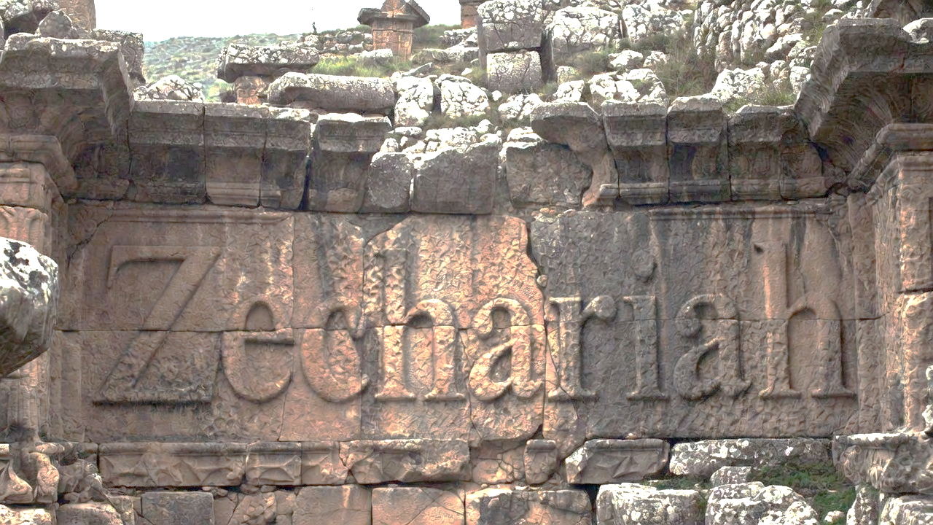


Envisioning God’s Unstoppable Plan
Part 2 of 2

Slide 2
Chiastic Structure of Zec 1-6
Vision 1 – Provide Re-establishment
Vision 2 – Protect from the enemy
Vision 3 – Prepare for influx of people
Vision 4 – Promote the Branch Jesus
Vision 5 – Empowered by the Spirit
Vision 6 – Expiate the people
Vision 7 – Extradite the enemy
Vision 8 – Eliminate the enemy
Control the Situation
Exalt God
Overthrow Enemy
Prepare People

Slide 3
The Chiastic Structure of Noah
Gen 6:10-22 – Noah told to build ark
Gen 7:1-9 – They enter the ark
Gen 7:10-16 – Flood begins
Gen 7:17-24 – Waters rise
Gen 8:1 – ‘But God remembered Noah’
Gen 8:2-5 – Waters recede
Gen 8:6-14 – The earth dries
Gen 8:15-19 – They leave the ark
Gen 8:20-9-19 – Noah worships God
Relation with God
Movement for God
God changes all
Future Preparation
Pinnacle

Slide 4
Envisioning God’s Unstoppable Plan
Providing for Israel’s Re-establishment
    Four Men on Horses
Protection from the Enemy
    Four Horns & Craftsmen
Preparing for the Influx of People
    A Man with a Measuring Device
Promotion of the Branch Jesus
    The High Priest & the Branch

Slide 5
Envisioning God’s Unstoppable Plan
Empowerment of the Spirit
    The Golden Lampstand

Slide 6
Revelation 11:3-4
“And I will give authority to my two witnesses, & they will prophesy for 1,260 days, clothed in sackcloth. These are the two olive trees & the two lampstands that stand before the Lord of the earth.”

Slide 7
Revelation 11:6
“These have the authority to shut up the sky, so that rain will not fall during the days of their prophesying; they also have authority over the waters to turn them into blood, & to strike the earth with every plague, as often as they wish.”

Slide 8
Envisioning God’s Unstoppable Plan
Empowerment of the Spirit
    The Golden Lampstand
Expiation (Purification) of the People
    The Flying Scroll
Extradition of the Enemy
    The Woman in the Basket
Elimination of the Enemy
    The Four Chariots

Slide 9
Ephesians 2:19-22
“So then you are no longer strangers & sojourners, but you are fellow citizens with the saints, & are of God’s household, having been built on the foundation of the apostles & prophets, Christ Jesus Himself being the corner stone, in whom the whole building, being joined together, is growing into a holy sanctuary in the Lord, in whom you also are being built together into a dwelling of God in the Spirit.”

Slide 10
Envisioning God’s Unstoppable Plan
Providing for Israel’s Re-establishment
    Four Men on Horses
Protection from the Enemy
    Four Horns & Craftsmen
Preparing for the Influx of People
    A Man with a Measuring Device
Promotion of the Branch Jesus
    The High Priest & the Branch

Slide 11
Envisioning God’s Unstoppable Plan
Empowerment of the Spirit
    The Golden Lampstand
Expiation (Purification) of the People
    The Flying Scroll
Extradition of the Enemy
    The Woman in the Basket
Elimination of the Enemy
    The Four Chariots

