Slide 1
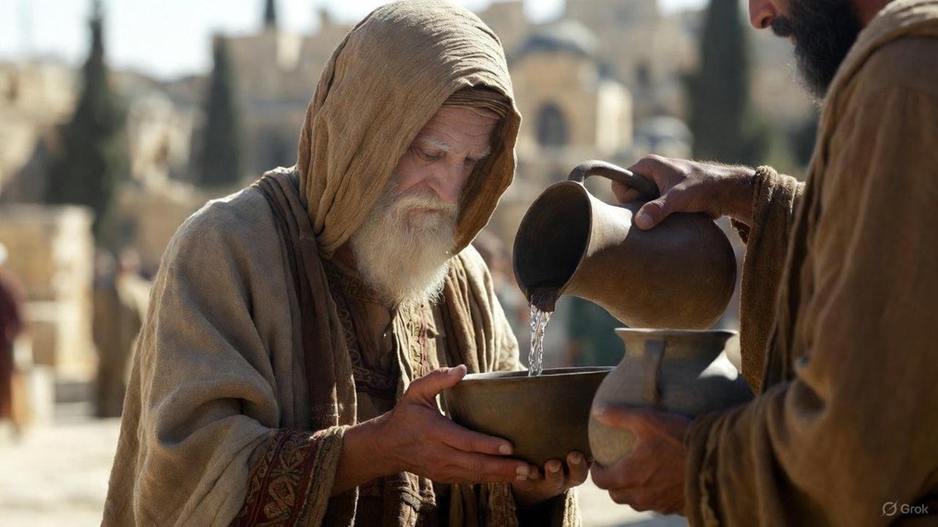

.
Accepting Jesus’ Departure
J
THE
BOOK
of
OHN
Chapter 14

Slide 2
.
We Can Accept Jesus’ Departure b/c…
Jesus has given us the way to Life with the Father

Slide 3
.
Jewish Wedding Phases
Ketubah/Betrothal – Price paid
  Jesus’ 1st Coming
Separation & coming together again
  The Church Age
Marriage Consummation
  7-year Tribulation on earth
Bride & Groom presented together
  Jesus’ 2nd Coming

Slide 4
.
We Can Accept Jesus’ Departure b/c…
Jesus has given us the way to Life with the Father
Jesus has empowered us to do great works in His name by the Holy Spirit

Slide 5
.
“And He said, ‘To you it has been granted to know the mysteries of the kingdom of God, but to the rest it is in parables, so that seeing they may not see, and hearing they may not understand.’”
Luke 8:10

Slide 6
.
We Can Accept Jesus’ Departure b/c…
Jesus has given us the way to Life with the Father
Jesus has empowered us to do great works in His name by the Holy Spirit
We have His Word that brings hope

Slide 7
.
“These things I have spoken to you, so that in Me you may have peace. In the world you have tribulation, but take courage; I have overcome the world.”
John 16:33

Slide 8
.
We Can Accept Jesus’ Departure b/c…
Jesus has given us the way to Life with the Father
Jesus has empowered us to do great works in His name by the Holy Spirit
We have His Word that brings hope

