Slide 1
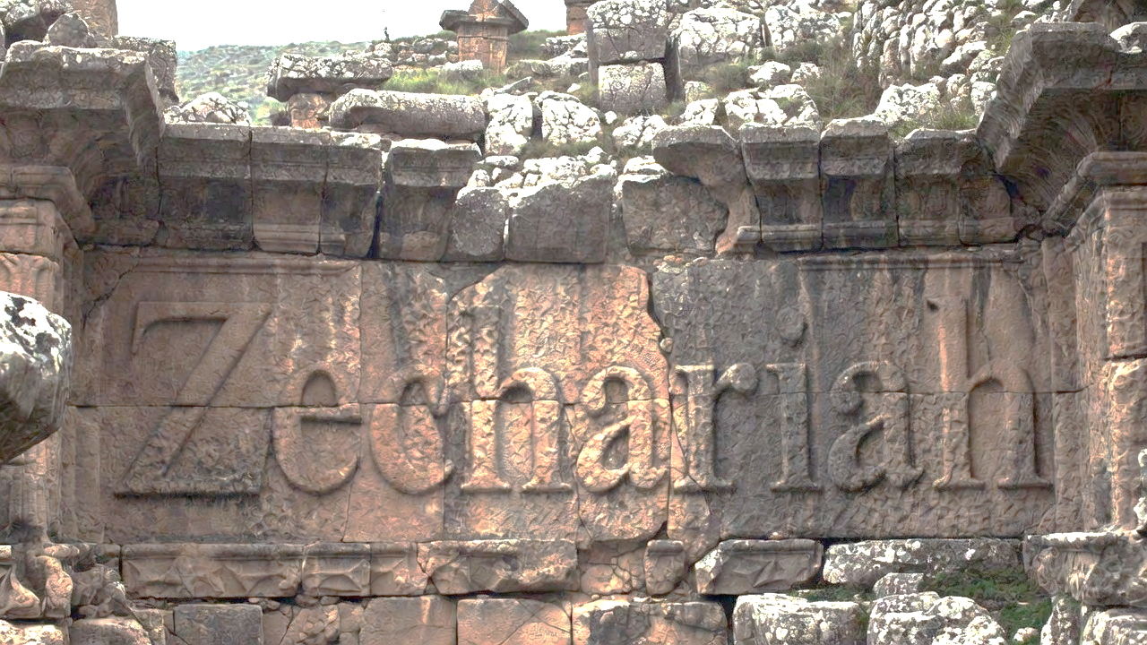


Calling Hearts Out Of Dead Religion

Slide 2
Calling You out of Dead Religion
Focus on a right heart or the ritual is hollow
Make meaningful character changes
Ask for Jesus’ power in your midst
Expect joy & abundance to come

Slide 3
Four Added Jewish Fasts
Event | Date | Justification of Date
Jerusalem Siege Starts | 10-10-588 BC | II Kings 25:1
Jerusalem’s Walls are Breached | 4-9-586 BC | II Kings 25:3-4
Temple Burned to the Ground | 5-9-586 BC | II Kings 25:8-9
Gedaliah’s Murder | 7-3-586 BC | Jeremiah 41:1

Slide 4
Jeremiah 25:11
“This whole land will be a waste place & an object of horror, & these nations will serve the king of Babylon seventy years.”

Slide 5
Both Halves of Jerimiah’s 70 years
Serve for 70 years &
Land is desolate for 70 years
(Jeremiah 25:11)
Event | Which Half? | Start | End
Nebuchadrezzar takes over | Servitude | 605 BC (Dan 1) | 537 BC (Dan 9)
Siege Begins | Land | 10-10-588 BC (II Kin 25) | 9-4-518 BC (Zec 7)
City Captured | Land | 586 BC (II Kin 25) | 516 BC (Ezra 6)

Slide 6
Calling You out of Dead Religion
Focus on a right heart or the ritual is hollow
Make meaningful character changes

Slide 7
Micah 6:8
“He has told you, O man, what is good; And what does Yahweh require of you but to do justice, to love lovingkindness, and to walk humbly with your God?”

Slide 8
Calling You out of Dead Religion
Focus on a right heart or the ritual is hollow
Make meaningful character changes
Ask for Jesus’ power in your midst

Slide 9
Jeremiah 32:17
“Ah Lord Yahweh! Behold, You have made the heavens and the earth by Your great power and by Your outstretched arm! Nothing is too difficult for You.”

Slide 10
Calling You out of Dead Religion
Focus on a right heart or the ritual is hollow
Make meaningful character changes
Ask for Jesus’ power in your midst
Expect joy & abundance to come

Slide 11
Romans 11:11
“I say then, did they [Israel] stumble so as to fall? May it never be! But by their transgression salvation has come to the Gentiles, to make them jealous.”

Slide 12
Calling You out of Dead Religion
Focus on a right heart or the ritual is hollow
Make meaningful character changes
Ask for Jesus’ power in your midst
Expect joy & abundance to come

