Slide 1
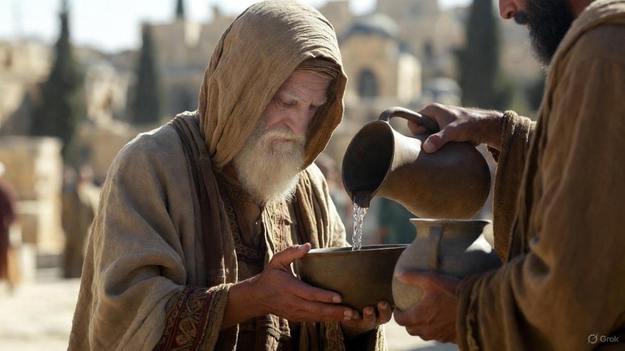

.
Producing What Jesus Desires
J
THE
BOOK
of
OHN
Chapter 15

Slide 2
.
Producing What Jesus Desires
Bear Fruit: by abiding in Jesus thru His Word

Slide 3
.
Jewish Wedding Phases
The Vine – Spiritual Privileges
  Psm 80, Isa 5, Jer 2, Eze 15, John 15
Fig Tree – National Privileges
  Hos 9, Jer 24, Matt 20, 21, 24
Olive Tree – Religious Privileges
  Hos 14, Isa 17, 24, Psm 52, 128, Rom 11

Slide 4
.
Producing What Jesus Desires
Bear Fruit: by abiding in Jesus thru His Word

Slide 5
.
“He saved us, not by works which we did in righteousness, but according to His mercy, through the washing of regeneration and renewing by the Holy Spirit.”
Titus 3:5

Slide 6
.
“Husbands, love your wives, just as Christ also loved the church and gave Himself up for her, so that He might sanctify her, having cleansed her by the washing of water with the word.”
Ephesians 5:25-26

Slide 7


.
“It sounds like you’re saying that Jesus came to make bad people good?”
“Jesus didn’t come to make bad people good. He came to make good people better.”
Bill Bright
Robert Schuller

Slide 8
.
Producing What Jesus Desires
Bear Fruit: by abiding in Jesus thru His Word

Slide 9
.
“Delight yourself in Yahweh; and He will give you the desires of your heart.”
Psalm 37:4

Slide 10
.
Producing What Jesus Desires
Bear Fruit: by abiding in Jesus thru His Word
Bear Children: by loving people how Jesus loved us

Slide 11
.
“For while we were still weak, at the right time Christ died for the ungodly. For one will hardly die for a righteous man, though perhaps for the good man someone would dare even to die. But God demonstrates His own love toward us, in that while we were yet sinners, Christ died for us.”
Romans 5:6-8

Slide 12
.
Producing What Jesus Desires
Bear Fruit: by abiding in Jesus thru His Word
Bear Children: by loving people how Jesus loved us
Bear Witness: by expecting the world’s hatred

Slide 13
.
“I say to you, everyone who confesses Me before men, the Son of Man will confess him also before the angels of God, but he who denies Me before men will be denied before the angels of God.”
Luke 12:8-9

Slide 14
.
“And this is the judgment, that the Light has come into the world, and men loved the darkness rather than the Light, for their deeds were evil.”
John 3:19

Slide 15
.
“Now we know that whatever the Law says, it speaks to those who are in the Law, so that every mouth may be shut and all the world may become accountable to God.”
Romans 3:19

Slide 16
.
Producing What Jesus Desires
Bear Fruit: by abiding in Jesus thru His Word
Bear Children: by loving people how Jesus loved us
Bear Witness: by expecting the world’s hatred

Slide 17
.
“For our momentary, light affliction is working out for us an eternal weight of glory far beyond all comparison.”
II Corinthians 4:17

Slide 18
.
Producing What Jesus Desires
Bear Fruit: by abiding in Jesus thru His Word
Bear Children: by loving people how Jesus loved us
Bear Witness: by expecting the world’s hatred

