Slide 1
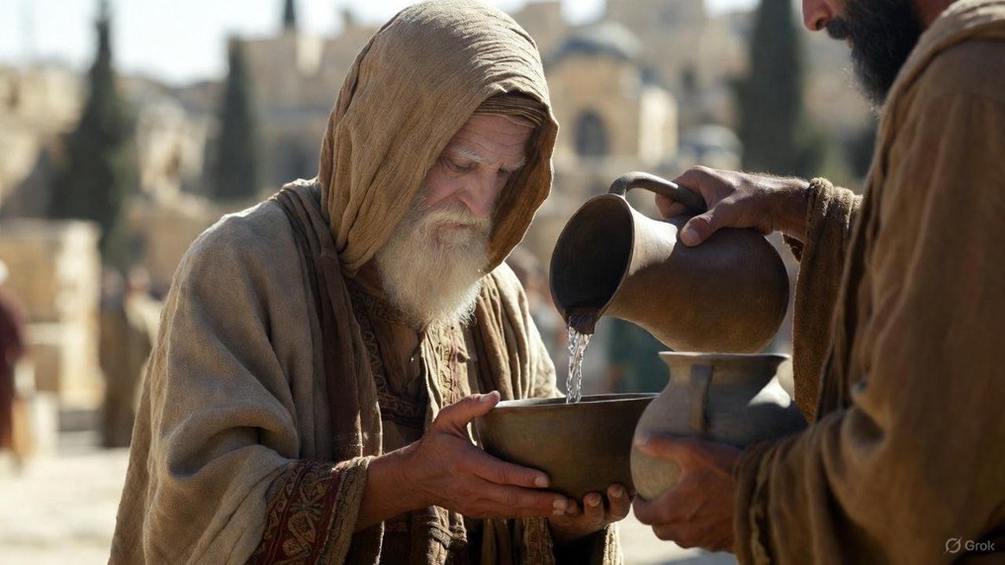

.
Governed By God: Flipping Everything Over
J
THE
BOOK
of
OHN
Chapter 16

Slide 2
.
Jesus’ Intimate Discourse
(John 14-16)
His Gifting – John 14
  The Way to life
  The Holy Spirit
  His Word
His Goals – John 15
  Bear Fruit
  Bear Children
  Bear Witness
His Governance – John 16

Slide 3
.
Flipped Over When Governed By God
Confusion is flipped over to make way for TRUTH
Sorrow is flipped over to make way for JOY
Trouble is flipped over to make way for PEACE

