Slide 1
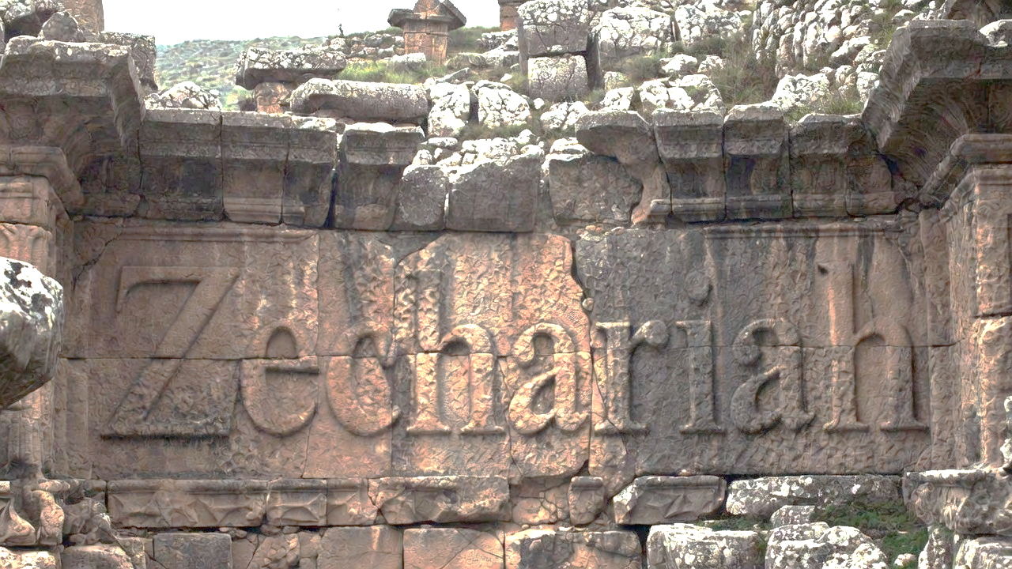


The Shepherd King Cometh

Slide 2
The Shepherd King Comes To Prepare The Sheepfold
He subdues the enemies of the sheep
He gathers the sheep for blessing
Rejecting the Good Shepherd results in slaughter

Slide 3
Jeremiah 31:31-32
“Behold, days are coming, declares Yahweh, when I will cut a new covenant with the house of Israel and with the house of Judah, not like the covenant which I cut with their fathers in the day I took them by the hand to bring them out of the land of Egypt, My covenant which they broke, but I was a husband to them,” declares Yahweh.”

Slide 4
The Shepherd King Comes To Prepare The Sheepfold
He subdues the enemies of the sheep
He gathers the sheep for blessing
Rejecting the Good Shepherd results in slaughter
Choosing the wrong shepherd is fatal

Slide 5
Matthew 13:44
“The kingdom of heaven is like a treasure hidden in the field, which a man found & hid again; & from joy over it he goes & sells all that he has & buys that field.”

Slide 6
John 5:43
“I have come in My Father’s name, & you do not receive Me; if another comes in his own name, you will receive him.”

Slide 7
The Shepherd King Comes To Prepare The Sheepfold
He subdues the enemies of the sheep
He gathers the sheep for blessing
Rejecting the Good Shepherd results in slaughter
Choosing the wrong shepherd is fatal

