Slide 1
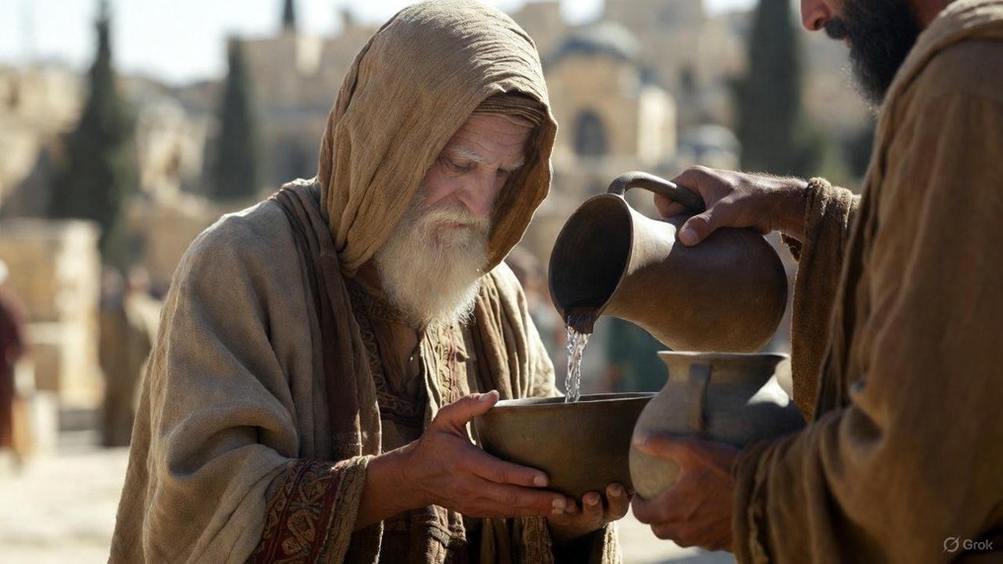

.
The Lord’s Prayer
J
THE
BOOK
of
OHN
Chapter 17

Slide 2
.
Jesus’ Intimate Discourse
(John 14-16)
His Gifting – John 14
  The Way to life
  The Holy Spirit
  His Word
His Goals – John 15
  Bear Fruit
  Bear Children
  Bear Witness
His Governance – John 16
  Confusion turned to Truth
  Sorrow turned to Joy
  Trouble turned to Peace

Slide 3
.
The Lord’s Prayer
J
THE
BOOK
of
OHN
Chapter 17

Slide 4
.
The Lord’s Prayer – Just Before The Cross
He prays for Himself – To be glorified by bringing us eternal life
He prays for the Disciples – To be sanctified & protected by the truth

Slide 5
.
“But do not be called Rabbi; for One is your Teacher, & you are all brothers. And do not call anyone on earth your father; for One is your Father, He who is in heaven. Do not be called instructors; for One is your Instructor, that is, Christ.”
Matthew 23:8-10

Slide 6
.
The Lord’s Prayer – Just Before The Cross
He prays for Himself – To be glorified by bringing us eternal life
He prays for the Disciples – To be sanctified & protected by the truth
He prays for you & me – To be united in God’s love & glory

Slide 7
.
“There are six things which Yahweh hates, Even seven which are an abomination to Him: Haughty eyes, a lying tongue, & hands that shed innocent blood, a heart that devises wicked thoughts, Feet that hasten to run to evil, a false witness who breathes out lies, & one who spreads strife among brothers.”
Proverbs 6:16-19

Slide 8
.
The Lord’s Prayer – Just Before The Cross
He prays for Himself – To be glorified by bringing us eternal life
He prays for the Disciples – To be sanctified & protected by the truth
He prays for you & me – To be united in God’s love & glory

