Slide 1
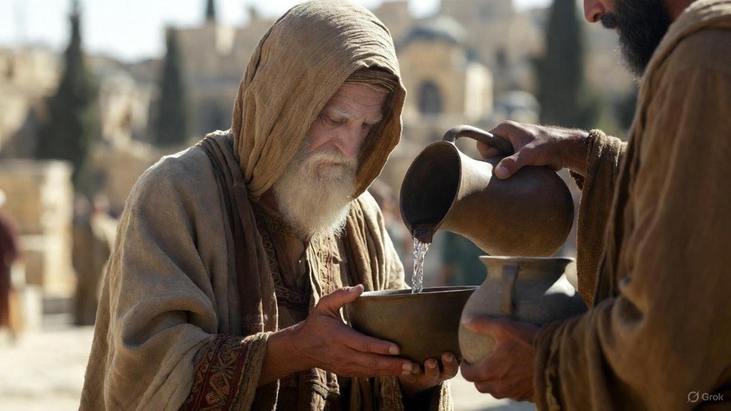

.
Embracing Our Godly Identity
J
THE
BOOK
of
OHN
Chapter 18:1-27

Slide 2
.
Embracing Our Godly Identity
Jesus willfully espoused it, while Peter rejected it

Slide 3
.
“So because you are lukewarm, and neither hot nor cold, I will spit you out of My mouth.”
Revelation 3:16

Slide 4
.
Embracing Our Godly Identity
Jesus willfully espoused it, while Peter rejected it
Jesus fully enveloped Himself in it, while Peter retreated from it

Slide 5
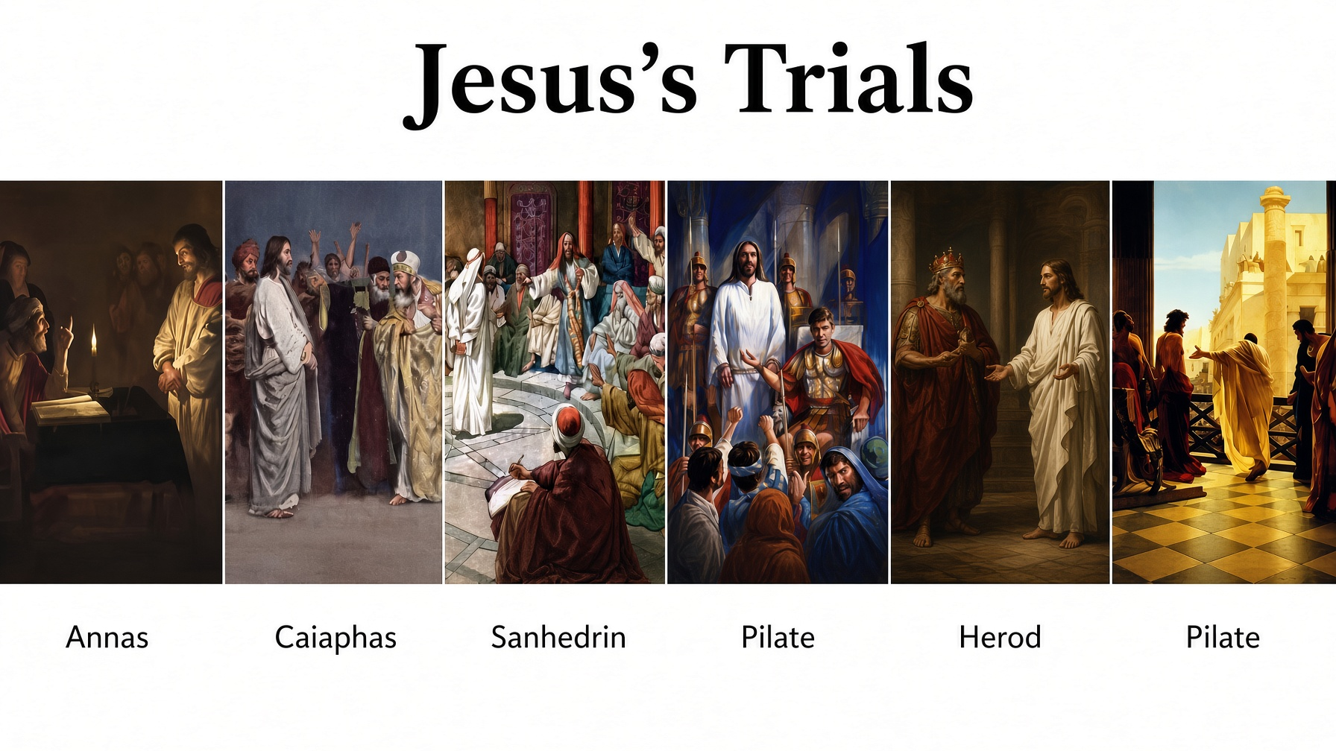

Slide 6
.
Embracing Our Godly Identity
Jesus willfully espoused it, while Peter rejected it
Jesus fully enveloped Himself in it, while Peter retreated from it

Slide 7
.
“Jesus answered, Will you lay down your life for Me? Truly, truly, I say to you, a rooster will not crow until you deny Me three times.”
John 13:38

Slide 8
.
Embracing Our Godly Identity
Jesus willfully espoused it, while Peter rejected it
Jesus fully enveloped Himself in it, while Peter retreated from it
Jesus forcefully expressed it, while Peter recanted it

Slide 9
.
“Now the chief priests & the whole Sanhedrin kept trying to obtain false testimony against Jesus, so that they might put Him to death. And they did not find any, even though many false witnesses came forward.”
Matthew 26:59-60a

Slide 10
.
“Just as many were appalled at you, My people, So His appearance was marred more than any man and His form more than the sons of men.”
Isaiah 52:14

Slide 11
.
Embracing Our Godly Identity
Jesus willfully espoused it, while Peter rejected it
Jesus fully enveloped Himself in it, while Peter retreated from it
Jesus forcefully expressed it, while Peter recanted it

