Slide 1
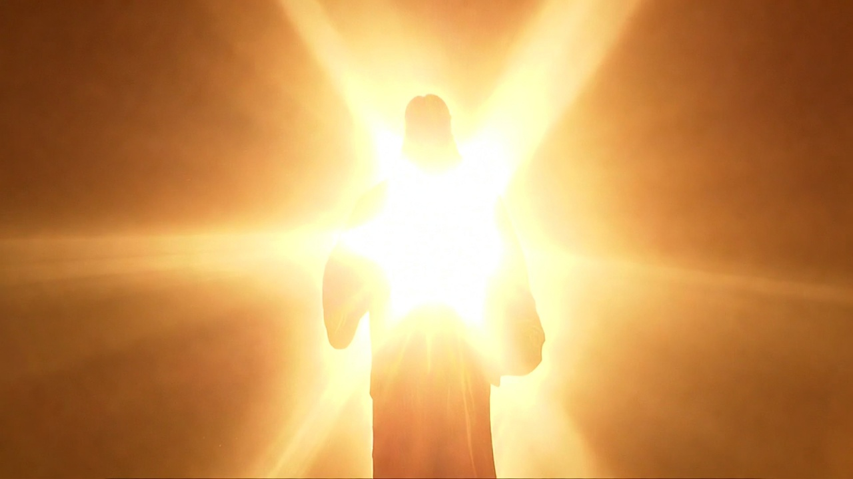


Chapter 1:1-3:5
Malachi
Not A Factory But A Family Episode 1 of 2

Slide 2
Israel’s ‘Factory-mindset’ Questions
How have we seen Your love?
I’ve restored them to the land
How have we despised You?
By bringing less than your best
How have we wearied You?
By profaning the Sanctuary
with internal betrayal

