Slide 1
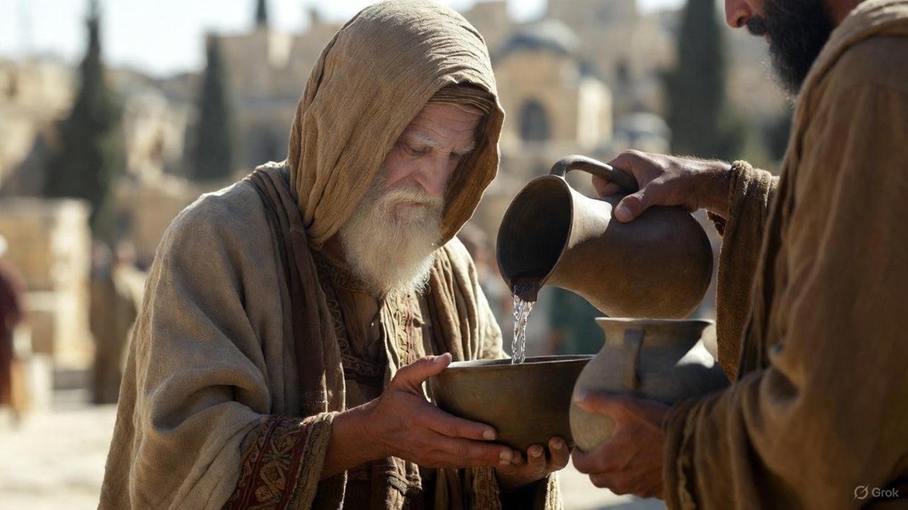

.
When Confronted With Jesus
J
THE
BOOK
of
OHN
Chapter 18:28-19:16

Slide 2
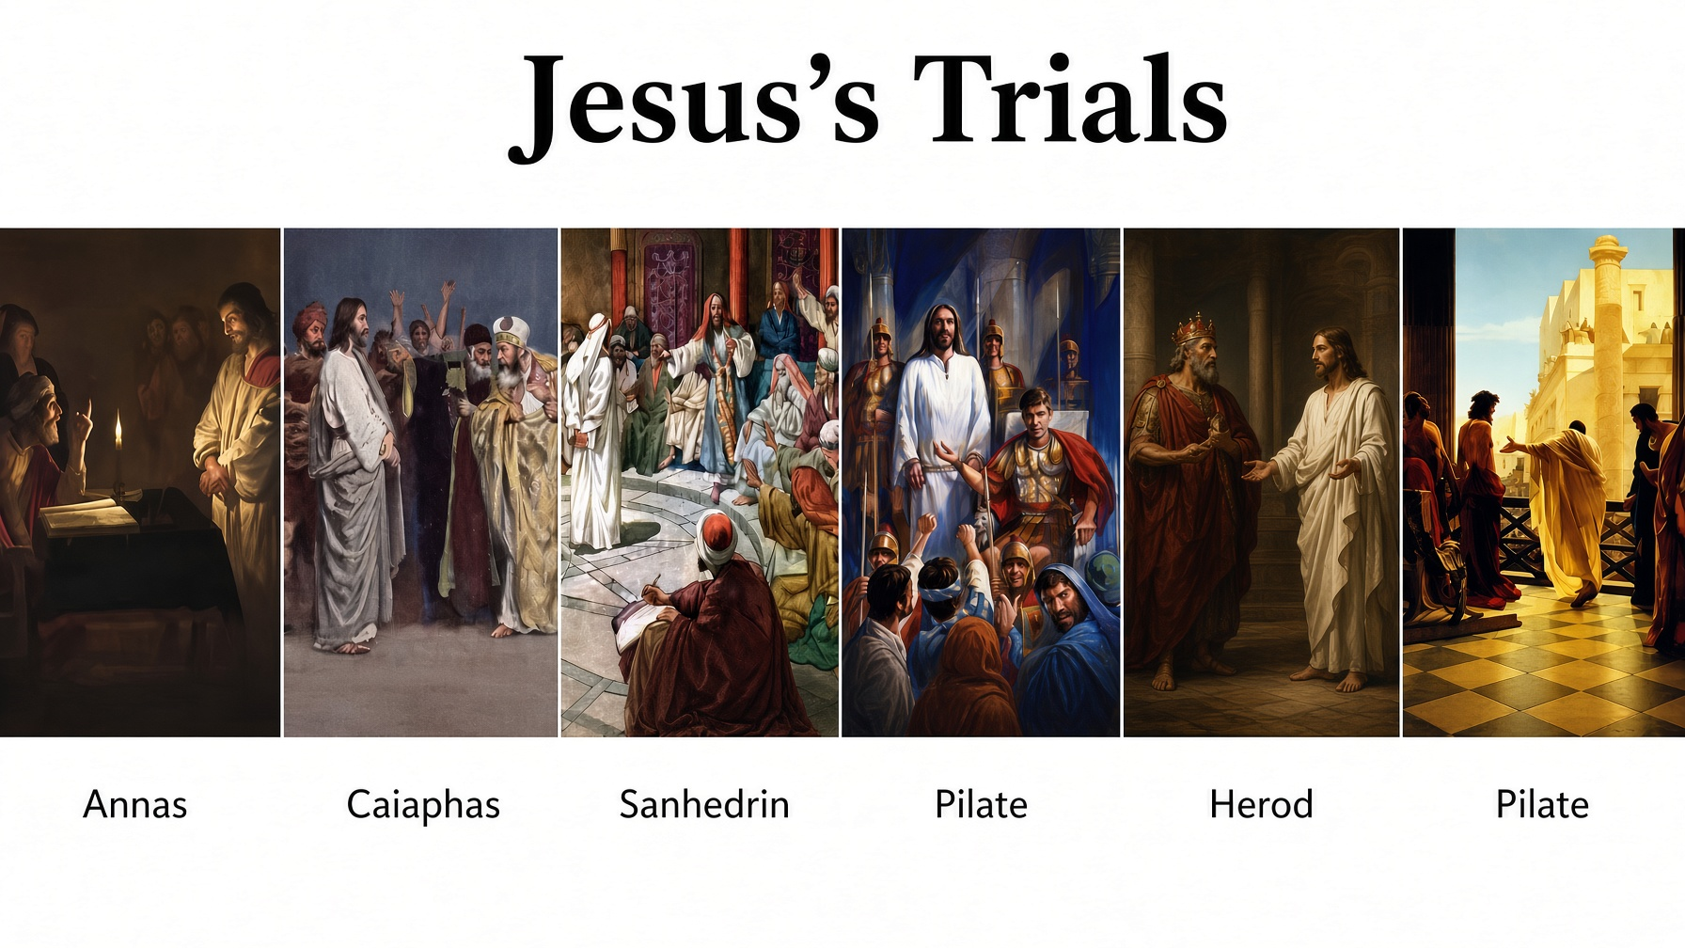

Slide 3
.
When Confronted With Jesus
J
THE
BOOK
of
OHN
Chapter 18:28-19:16

Slide 4
.
Confronted With Jesus
What’s the accusation about Jesus?

Slide 5
Lamb was gotten on 1st month 10th day
(Exodus 12:3)
Evening & Day | Hebrew Date | Biblical Events
Sunday | Nisan 10 | Triumphal Entry (Palm Sunday)
Sunday Evening | Nisan 11
Monday | Nisan 11 | Cursing the Fig Tree Temple Cleansing
Monday Evening | Nisan 12
Tuesday | Nisan 12 | Jesus Challenged
Tuesday Evening | Nisan 13
Wednesday | Nisan 13
Wednesday Evening | Nisan 14 | Passover Meal & Jewish Trials
Thursday | Nisan 14 | Roman Trials & the Cross
Thursday Evening | Nisan 15
Friday | Nisan 15 | High Sabbath (1st day of Feast of Unleavened Bread – Lev 23:7)
Friday Evening | Nisan 16
Saturday | Nisan 16 | Weekly Sabbath
Saturday Evening | Nisan 17
Sunday | Nisan 17 | Resurrection
The Passion Week Timeline
Lamb was killed on 1st month 14th day
(Exodus 12:6)
Jesus said He’d be 3 days & 3 nights gone
(Matt 12:40)

Slide 6
.
Confronted With Jesus
What’s the accusation about Jesus?
Who is Jesus?
What is truth?

Slide 7
.
“Thomas said to Him, ‘Lord, we do not know where You are going. How do we know the way?’ Jesus said to him, ‘I am the way, & the truth, & the life. No one comes to the Father but through Me.’”
John 14:5-6

Slide 8
.
“Nicodemus answered & said to Him, ‘How can these things be?’ …As Moses lifted up the serpent in the wilderness, even so must the Son of Man be lifted up; so that whoever believes will in Him have eternal life.”
John 3:9, 14-15

Slide 9
.
Enemies Spoke of Jesus’s Innocence
Thief on the cross – “nothing amiss” (Luke 23:41)
Judas – “innocent blood” (Matt 27:4)
Herod – “No fault” (Luke 23:15)
Pilate’s wife – “righteous man” (Matt 27:19)
Centurion at cross – “righteous man, God’s Son” (Luke 23:47)
Pilate – “No fault” (John 18:38)

Slide 10
.
Confronted With Jesus
What’s the accusation about Jesus?
Who is Jesus?
What is truth?
What should I do about Jesus?
Who is my authority?

