Slide 1
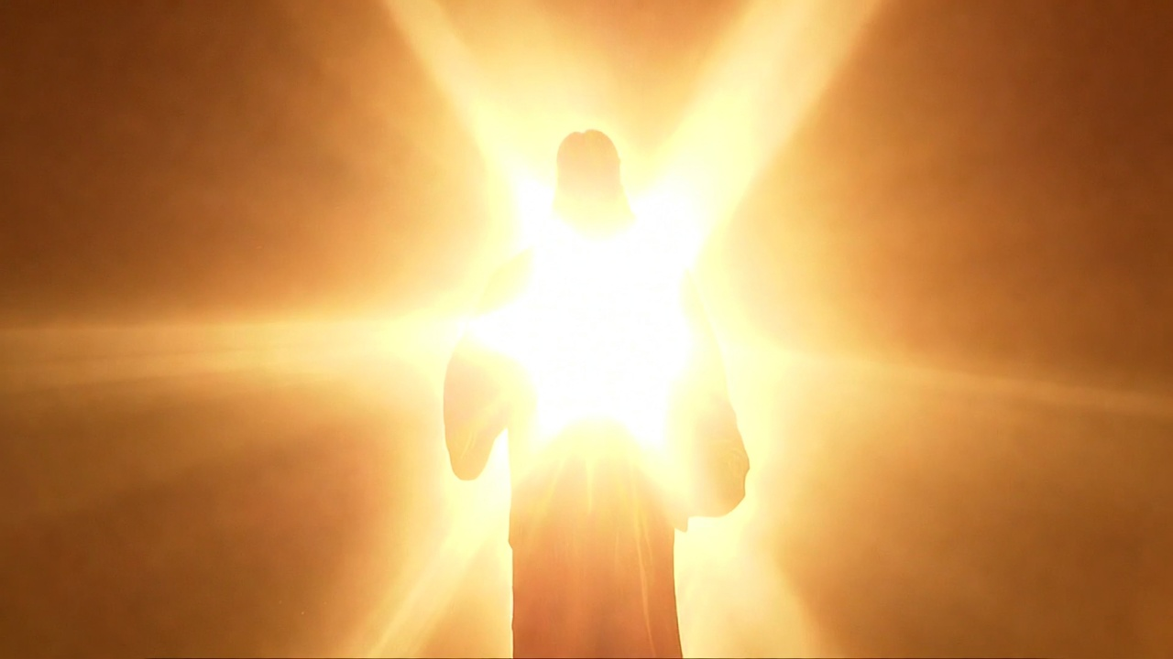


Chapter 3:6-4:6
Malachi
Not A Factory But A Family Episode 2 of 2

Slide 2
Israel’s ‘Factory-mindset’ Questions
How have we seen Your love?
I’ve restored them to the land
How have we despised You?
By bringing less than your best
How have we wearied You?
By profaning the Sanctuary
with internal betrayal

Slide 3
Israel’s ‘Factory-mindset’ Questions
How have we robbed You?
By not bringing My tithes &
your offerings

Slide 4
“The elders who lead well are to be considered worthy of double honor, especially those who labor at preaching the word and teaching. For the Scripture says, ‘You shall not muzzle the ox while it is threshing,’ & ‘the laborer is worthy of his wages.’”
I Timothy 5:17-18 4:3

Slide 5
“Now this I say, he who sows sparingly will also reap sparingly, and he who sows with blessing will also reap with blessing. Each one must do just as he has purposed in his heart, not grudgingly or under compulsion, for God loves a cheerful giver… (cont)
II Corinthians 9:6-8

Slide 6
(cont) …And God is able to make every grace abound to you, so that in everything at every time having every sufficiency, you may have an abundance for every good deed.”
II Corinthians 9:6-8

Slide 7
“And my God will fulfill all your needs according to His riches in glory in Christ Jesus.”
Philippians 4:19

Slide 8
Israel’s ‘Factory-mindset’ Questions
How have we robbed You?
By not bringing My tithes &
your offerings
How have we spoken against You?
By arrogant, prideful words

Slide 9
“For all the prophets & the Law prophesied until John. And if you are willing to accept it, John himself is Elijah who was to come.”
Matthew 11:13-14

Slide 10
“His disciples asked Him, saying, ‘Why then do the scribes say that Elijah must come first? And He answered & said, “Elijah is coming & will restore all things… (cont)
Matthew 17:10-13

Slide 11
(cont) “…but I say to you that Elijah already came, & they did not recognize him, but did to him whatever they wished. So also the Son of Man is going to suffer at their hands. Then the disciples understood that He had spoken to them about John the Baptist.”
Matthew 17:10-13

Slide 12
Israel’s ‘Factory-mindset’ Questions
How have we seen Your love?
I’ve restored them to the land
How have we despised You?
By bringing less than your best
How have we wearied You?
By profaning the Sanctuary
with internal betrayal

Slide 13
Israel’s ‘Factory-mindset’ Questions
How have we robbed You?
By not bringing My tithes &
your offerings
How have we spoken against You?
By arrogant, prideful words

