Slide 1
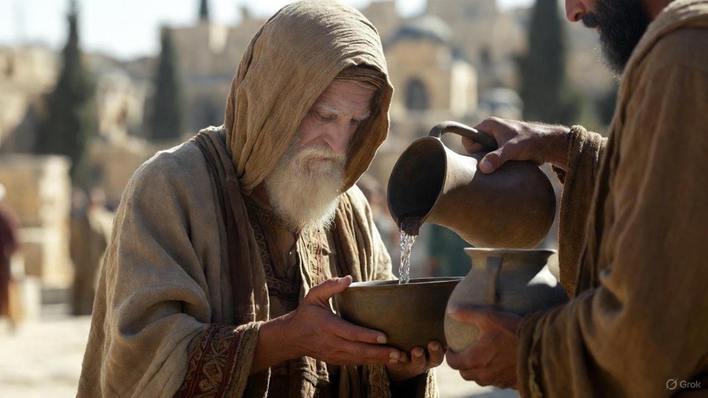

.
Even In Death… He Is
J
THE
BOOK
of
OHN
Chapter 19:17-42

Slide 2
.
Even In Death…Christ Displays Greatness
Selflessness: Others Over Ourselves

Slide 3
.
“Then Jesus said to His disciples, ‘If anyone wishes to come after Me, let him deny himself, and take up his cross and follow Me.’”
Matthew 16:24

Slide 4
.
Even In Death…Christ Displays Greatness
Selflessness: Others Over Ourselves

Slide 5
.
“He made Him who knew no sin to be sin on our behalf, so that we might become the righteousness of God in Him.”
II Corinthians 5:21

Slide 6
.
“This Man [Jesus], delivered over by the predetermined plan & foreknowledge of God, you nailed to a cross by the hands of lawless men & put Him to death.”
Acts 2:23

Slide 7
.
Even In Death…Christ Displays Greatness
Selflessness: Others Over Ourselves
Commitment: Complete The Calling

Slide 8
.
“They also gave me gall for my food and for my thirst they gave me vinegar to drink.”
Psalm 69:21

Slide 9
.
Even In Death…Christ Displays Greatness
Selflessness: Others Over Ourselves
Commitment: Complete The Calling
Power: Prove The Point By Living Out Prophecy

Slide 10
.
“Joseph of Arimathea came, a prominent Council member, who himself was waiting for the kingdom of God; & he gathered up courage & went in before Pilate, & asked for the body of Jesus.”
Mark 15:43

Slide 11
.
Even In Death…Christ Displays Greatness
Selflessness: Others Over Ourselves
Commitment: Complete The Calling
Power: Prove The Point By Living Out Prophecy

Slide 12
Lamb was gotten on 1st month 10th day
(Exodus 12:3)
Evening & Day | Hebrew Date | Biblical Events
Sunday | Nisan 10 | Triumphal Entry (Palm Sunday)
Sunday Evening | Nisan 11
Monday | Nisan 11 | Cursing the Fig Tree Temple Cleansing
Monday Evening | Nisan 12
Tuesday | Nisan 12 | Jesus Challenged
Tuesday Evening | Nisan 13
Wednesday | Nisan 13
Wednesday Evening | Nisan 14 | Passover Meal & Jewish Trials
Thursday | Nisan 14 | Roman Trials & the Cross
Thursday Evening | Nisan 15
Friday | Nisan 15 | High Sabbath (1st day of Feast of Unleavened Bread – Lev 23:7)
Friday Evening | Nisan 16
Saturday | Nisan 16 | Weekly Sabbath
Saturday Evening | Nisan 17
Sunday | Nisan 17 | Resurrection
The Passion Week Timeline
Lamb was killed on 1st month 14th day
(Exodus 12:6)
Jesus said He’d be 3 days & 3 nights gone
(Matt 12:40)

