Slide 1
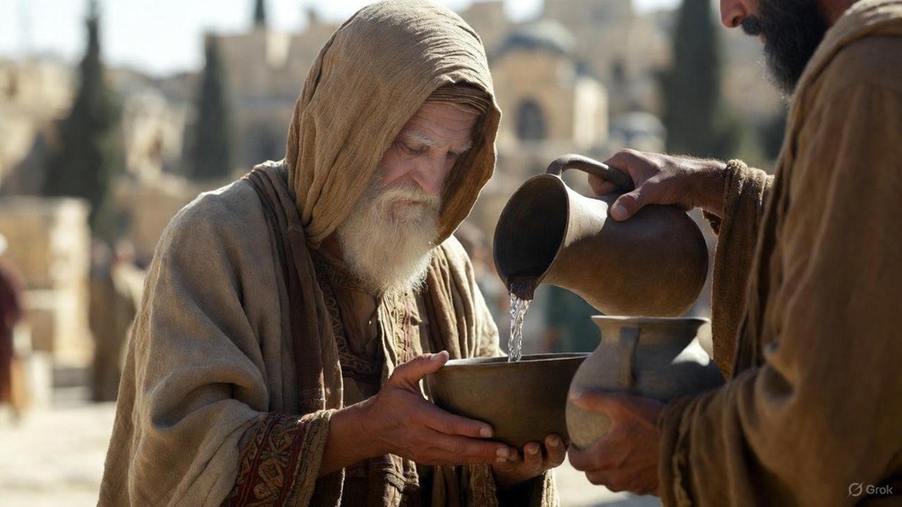

.
It’s Time To Believe The Evidence
J
THE
BOOK
of
OHN
Chapter 20

Slide 2
.
It’s Time To Believe The Evidence
What Jesus Has Done: He’s already performed miracles (Raising of Lazarus)

Slide 3
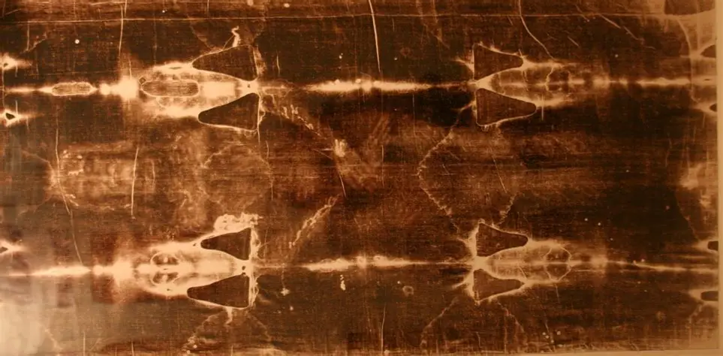
.
Shroud of Turin

Slide 4
.
It’s Time To Believe The Evidence
What Jesus Has Done: He’s already performed miracles (Raising of Lazarus)
What Jesus Has Said: He’s already said miraculous words that came to pass (Withered the Fig Tree)

Slide 5
.
“It happened that while they were perplexed about this, behold, two men suddenly stood near them in dazzling clothing, & when the women were terrified & bowed their faces to the ground, the men said to them, ‘Why do you seek the living One among the dead? He is not here, but He has risen. Remember how He spoke to you while He was still in Galilee.’”
Luke 24:4-6

Slide 6
.
It’s Time To Believe The Evidence
What Jesus Has Done: He’s already performed miracles (Raising of Lazarus)
What Jesus Has Said: He’s already said miraculous words that came to pass (Withered the Fig Tree)

Slide 7
.
“After that, He appeared in a different form to two of them while they were walking along on their way to the countryside.”
Mark 16:12

Slide 8
.
“Without faith it is impossible to please Him, for he who draws near to God must believe that He is & that He is a rewarder of those who seek Him.”
Hebrews 11:6

Slide 9
.
It’s Time To Believe The Evidence
What Jesus Has Done: He’s already performed miracles (Raising of Lazarus)
What Jesus Has Said: He’s already said miraculous words that came to pass (Withered the Fig Tree)

Slide 10
.
“Not through the blood of goats & calves, but through His [Jesus] own blood, He entered the holy places once for all, having obtained eternal redemption. For if the blood of goats & bulls…sanctify for the cleansing of the flesh, how much more will the blood of Christ, who through the eternal Spirit offered Himself without blemish to God, cleanse your conscience from dead works to serve the living God?”
Hebrews 9:12-14

Slide 11
.
“Therefore, brothers, since we have confidence to enter the holy places by the blood of Jesus, by a new & living way which He inaugurated for us through the veil, that is, His flesh.”
Hebrews 10:19-20

Slide 12
.
“Therefore, He had to be made like His brothers in all things, so that He might become a merciful & faithful high priest in things pertaining to God, to make propitiation for the sins of the people. For since He Himself was tempted in that which He has suffered, He is able to come to help those who are tempted.”
Hebrews 2:17-18

Slide 13
.
It’s Time To Believe The Evidence
What Jesus Has Done: He’s already performed miracles (Raising of Lazarus)
What Jesus Has Said: He’s already said miraculous words that came to pass (Withered the Fig Tree)
Who Jesus Has Changed: He’s already shown power to change people (Demoniac)

Slide 14
.
“And they stood up that very hour and returned to Jerusalem, and found gathered together the eleven and those with them.”
Luke 24:33

Slide 15
.
“But this He spoke of the Spirit, whom those who believed in Him were going to receive; for the Spirit was not yet given, because Jesus was not yet glorified.”
John 7:39

Slide 16
.
“Peter said to them, “Repent, & each of you be baptized in the name of Jesus Christ for the forgiveness of your sins; & you will receive the gift of the Holy Spirit.”
Acts 2:38

Slide 17
.
It’s Time To Believe The Evidence
What Jesus Has Done: He’s already performed miracles (Raising of Lazarus)
What Jesus Has Said: He’s already said miraculous words that came to pass (Withered the Fig Tree)
Who Jesus Has Changed: He’s already shown power to change people (Demoniac)
What Jesus Has Promised: He’s already promised to bless the faithful (Beatitudes – Matt 5)

