Slide 1
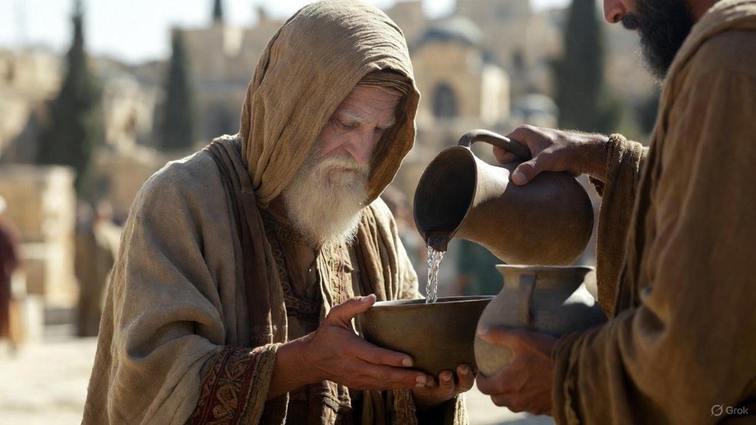

.
Restore To The Core
J
THE
BOOK
of
OHN
Chapter 21

Slide 2
.
Restore To The Core
Repeating the lessons for the repentant
Hammering simplicity for the humble

Slide 3
.
“He who loves father or mother more than Me is not worthy of Me; and he who loves son or daughter more than Me is not worthy of Me.”
Matthew 10:37

Slide 4
.
Restore To The Core
Repeating the lessons for the repentant
Hammering simplicity for the humble
Devotion to Jesus for the disciple

