Slide 1
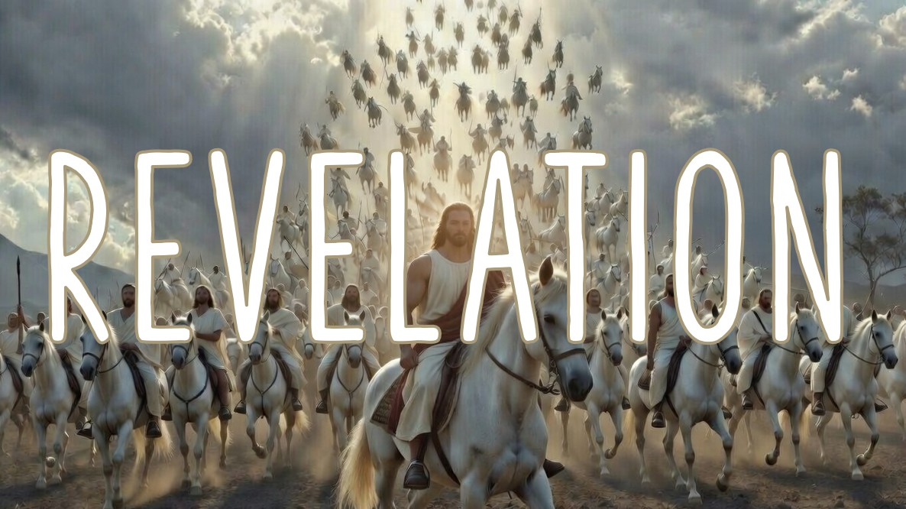

.
Understanding The Unveiling
Chapter 1

Slide 2
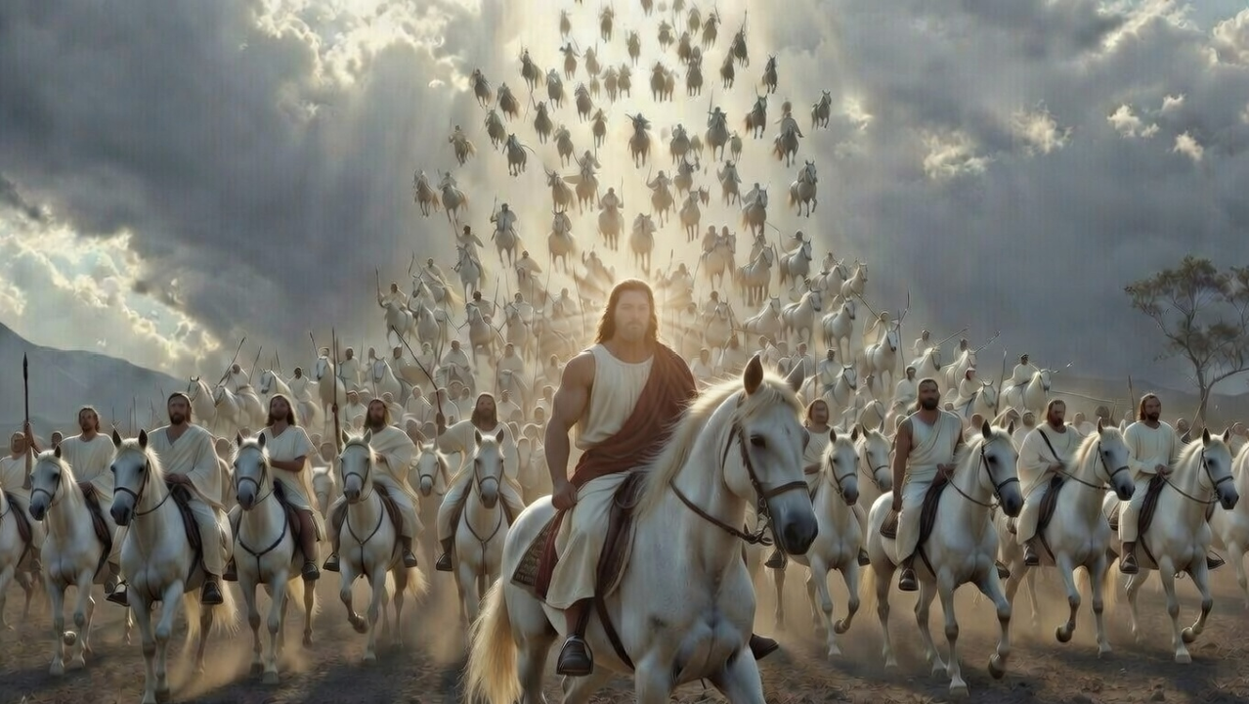
.
Intro To End Times (Eschatology)
The sequence of events

Slide 3
.
“And they will fall by the edge of the sword, & will be led captive into all the nations, & Jerusalem will be trampled under foot by the Gentiles until the times of the Gentiles are fulfilled.”
Luke 21:24

Slide 4
.
“For I do not want you, brothers, to be uninformed of this mystery—so that you will not be wise in your own estimation—that a partial hardening has happened to Israel until the fullness of the Gentiles has come in.”
Romans 11:25

Slide 5
.
“Behold, I tell you a mystery: we will not all sleep, but we will all be changed, in a moment, in the twinkling of an eye, at the last trumpet. For the trumpet will sound, & the dead will be raised incorruptible, & we will be changed.”
I Corinthians 15:51-52

Slide 6
.
“For the Lord Himself will descend from heaven with a shout, with the voice of the archangel & with the trumpet of God, & the dead in Christ will rise first. Then we who are alive & remain will be caught up together with them in the clouds to meet the Lord in the air, & so we shall always be with the Lord.”
I Thessalonians 4:16-17

Slide 7
.
“For God has not appointed us for wrath, but for obtaining salvation through our Lord Jesus Christ.”
I Thessalonians 5:9

Slide 8
.
Intro To End Times (Eschatology)
The sequence of events
God uses symbols & types to portray a greater meaning
God has appointed a day to judge evil, it’ not unending

Slide 9
.
“He who believes in the Son has eternal life; but he who does not obey the Son will not see life, but the wrath of God abides on him.”
John 3:36

Slide 10
.
Intro To End Times (Eschatology)
The sequence of events
God uses symbols & types to portray a greater meaning
God has appointed a day to judge evil, it’ not unending

Slide 11
.
Understanding The Book Of Revelation
The Motivation:
You’re blessed if you read it
The Center Focus:
Worship of Jesus

Slide 12
.
“When the Advocate comes, whom I [Jesus] will send to you from the Father, the Spirit of truth who proceeds from the Father, He will bear witness about Me.”
John 15:26

Slide 13
.
Understanding The Book Of Revelation
The Motivation:
You’re blessed if you read it
The Center Focus:
Worship of Jesus

Slide 14
.
“Therefore, since we have so great a cloud of witnesses surrounding us, laying aside every weight & the sin which so easily entangles us, let us run with endurance the race that is set before us…”
Hebrews 12:1

Slide 15
.
“But Enoch, in the seventh generation from Adam, also prophesied about these men, saying, ‘Behold, the Lord came with many thousands of His holy ones.’”
Jude 14

Slide 16
.
Understanding The Book Of Revelation
The Motivation:
You’re blessed if you read it
The Center Focus:
Worship of Jesus

Slide 17
.
“Thus says Yahweh, the King of Israel & his Redeemer, Yahweh of hosts: ‘I am the first, and I am the last, and there is no God besides Me.’”
Isaiah 44:6

Slide 18
.
Understanding The Book Of Revelation
The Motivation:
You’re blessed if you read it
The Center Focus:
Worship of Jesus
The Book’s Outline:
Past, Present, and Future

