Slide 1
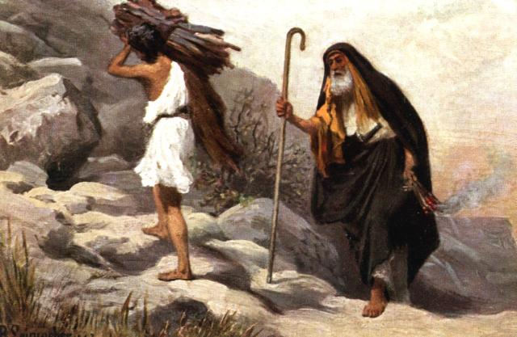
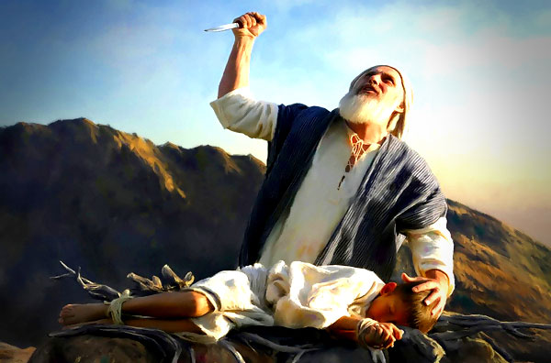
Tests and Trials Questions and Answers /Freedom
July 7, 2021

Slide 2
Abraham’s Learning Experiences
  Life’s Troubles and Tribulations
TROUBLE
Affliction; calamity; disturbance of mind; agitation, commotion of spirit; perplexity; a word of very extensive application.

Slide 3
Abraham’s Learning Experiences
  Life’s Troubles and Tribulations
Job 5:6-7, 14:1 (NIV)
For hardship does not spring from the soil, nor does trouble sprout from the ground. Yet man is born to trouble as surely as sparks fly upward.
“Man born of woman is of few days and full of trouble.

Slide 4
Abraham’s Learning Experiences
  Life’s Troubles and Tribulations
2 Corinthians 2:3-5 (NIV)
I wrote as I did so that when I came I should not be distressed by those who ought to make me rejoice. I had confidence in all of you, that you would all share my joy. For I wrote you out of great distress and anguish of heart and with many tears, not to grieve you but to let you know the depth of my love for you.

Slide 5
Abraham’s Learning Experiences
  Lucifer’s Temptations
TEMPTATION
Is the incitement of luring people to evil. The devil is the great tempter. His single purpose is to harass the people and destroy the work of God.

Slide 6
Abraham’s Learning Experiences
  Lucifer’s Temptations
Matt 4:1 (NIV)
Then Jesus was led by the Spirit into the desert to be tempted by the devil.

Slide 7
Abraham’s Learning Experiences
  The Lord’s Tests
TESTS
According to biblical traditions, a spiritual test is a life situation, provided by God, to evaluate man’s individual moral character and obedience to his laws. Also, to determine his faithfulness unto him.

Slide 8
Abraham’s Learning Experiences
  The Lord’s Tests
Genesis 12:4 (NIV)
So Abram left, as the Lord had told him; and Lot went with him. Abram was seventy-five years old when he set out from Haran.

Slide 9
Abraham’s Learning Experiences
  The Lord’s Tests
Genesis 22:1-2 (NIV)
Some time later God tested Abraham. He said to him, “Abraham!” “Here I am,” he replied. Then God said, “Take your son, your only son, Isaac, whom you love, and go to the region of Moriah. Sacrifice him there as a burnt offering on one of the mountains I will tell you about.”

Slide 10
The Meaning of Freedom
John 8:31-32 (NIV)
To the Jews who had believed him, Jesus said, “If you hold to my teaching, you are really my disciples. Then you will know the truth, and the truth will set you free.”

Slide 11
Genesis 1:26
LET US MAKE MAN IN OUR IMAGE, AFTER OUR LIKENESS: AND LET THEM HAVE DOMINION OVER THE FISH OF THE SEA, AND OVER THE FOWL OF THE AIR AND OVER THE FOWL OF THE AIR AND OVER THE CATTLE, AND OVER ALL THE EARTH, AND OVER EVERY CREEPING THING THAT CREEPETH UPON THE EARTH.

Slide 12
Freedom
TRUE FREEDOM IS THEREFORE THE LIBERTY TO DOMINATE THE EARTH THROUGH ONE UNIQUE GIFTS AND TALENTS IN FULFILMENT OF GOD’S PURPOSE FOR ONE!
“There is no way to walk into freedom without shouldering its responsibility.”
From “The Burden of Freedom” by Myles Munroe
A person who is truly free is responsible and accountable.

Slide 13
Deliverance
“Deliverance is the physical liberation from physical restrictions. Deliverance is the removal of the slave from the environment of the slave master. Deliverance is not freedom. Deliverance prepares you for freedom. A change in one’s position does not mean that there has been a change in his or her disposition.”
From “The Burden of Freedom” by Myles Munroe

Slide 14
Deliverance Versus Freedom
Deliverance simply opens the door for freedom. The essential ingredients toward freedom is mental “transformation.”
Romans 12:2
Do not conform any longer to the pattern of this world, but be transformed by the renewing of your mind.
The only one who can change you, is you!
Proverbs 23:7 (KJV)
For as he thinketh in his heart, so is he: Eat and drink, saith he to thee; but his heart is not with thee.
From “The Burden of Freedom” by Myles Munroe

Slide 15
Freedom
Freedom at its best embraces the will of a sovereign God. Therefore, stewardship is the greatest indicator of a truly free person.
From “The Burden of Freedom” by Myles Munroe

Slide 16
FAT
Faithful | Available | Trainable
Conversion Conviction Compassion | Courage Commitment Talent Time Treasure | Consciousness Competence

Slide 17
Tests and Trials
Questions and Answers
Do trials only come by God?
  a. Can we put ourselves through trials or do we just create “problems” or “situations”?

Slide 18
Tests and Trials
Questions and Answers
2. Is every test followed by a trial?
  a. Can you have a test without a trial?

Slide 19
Tests and Trials
Questions and Answers
3. What is the difference between your conscience and the Holy Spirit?
  We know that only believers have the Holy Spirit, but we all have a conscience. When people say “my conscience wouldn’t let me do it,” or “the Holy Spirit convicted them when they were about to do something that wasn’t Christlike or right.
  How do you distinguish between the two?

Slide 20
Tests and Trials
Questions and Answers
4. Is it wrong to pray for strength?
  Someone said that our strength comes through test and trials, and we don’t pray for strength. Is this true?

Slide 21
Announcements
Drop off children at the Springfield Multipurpose Complex (old Pine Street School) for children ages 4-14 years of age for Children’s Church and Jr. Church beginning at 9:30AM – pick them up after the 10AM Service ends. Teen Church – ages 15-19 will be held at the RSC Building.
We will have both services on Sunday. Live streaming will be done during the 10am service.
Rev. Henderson Roberson, Jr. Funeral is on Sunday, July 11, 2021, at 1pm in the sanctuary.
Chevalla Wilson’s sister, Linda Omondi, services will be graveside on July 10, 2021, at 10am at Kennedy Memorial Gardens on River Road, Ellenwood, GA 30294.
Church School will be at 5pm on Sunday.

