Slide 1
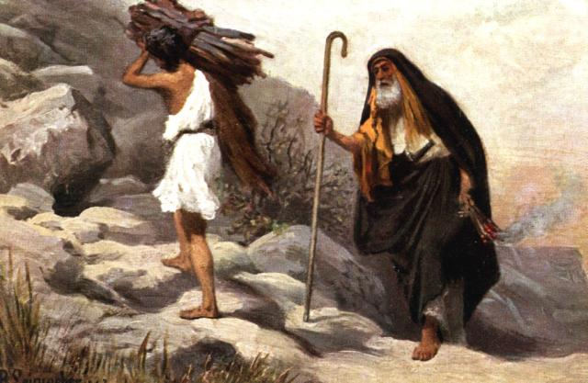
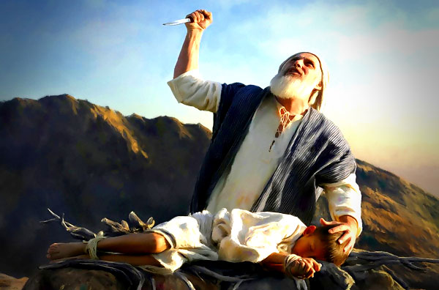
Abraham’s Learning Experiences
June 16, 2021

Slide 2
Abraham’s Learning Experiences
  Life’s Troubles and Tribulations
TROUBLE
Affliction; calamity; disturbance of mind; agitation, commotion of spirit; perplexity; a word of very extensive application.

Slide 3
Abraham’s Learning Experiences
  Life’s Troubles and Tribulations
Job 5:6-7, 14:1 (NIV)
For hardship does not spring from the soil, nor does trouble sprout from the ground. Yet man is born to trouble as surely as sparks fly upward.
“Man born of woman is of few days and full of trouble.

Slide 4
Abraham’s Learning Experiences
  Life’s Troubles and Tribulations
2 Corinthians 2:3-5 (NIV)
I wrote as I did so that when I came I should not be distressed by those who ought to make me rejoice. I had confidence in all of you, that you would all share my joy. For I wrote you out of great distress and anguish of heart and with many tears, not to grieve you but to let you know the depth of my love for you.

Slide 5
Abraham’s Learning Experiences
  Lucifer’s Temptations
TEMPTATION
Is the incitement of luring people to evil. The devil is the great tempter. His single purpose is to harass the people and destroy the work of God.

Slide 6
Abraham’s Learning Experiences
  Lucifer’s Temptations
Genesis 12:11-12 (NIV)
As he was about to enter Egypt, he said to his wife Sarai, “I know what a beautiful woman you are. When the Egyptians see you they will say, “This is his wife.” Then they will kill me but will let you live.

Slide 7
Abraham’s Learning Experiences
  Lucifer’s Temptations
Genesis 16:4-5 (KJV)
And he went in unto Hagar, and she conceived: and when she saw that she had conceived, her mistress was despised in her eyes. And Sarai said unto Abram, My wrong be upon thee: I have given my maid into thy bosom; and when she saw that she conceived, I was despised in her eyes: the Lord judge between me and thee.

Slide 8
Abraham’s Learning Experiences
  Lucifer’s Temptations
Matt 4:1 (NIV)
Then Jesus was led by the Spirit into the desert to be tempted by the devil.

Slide 9
Abraham’s Learning Experiences
  The Lord’s Tests
TESTS
According to biblical traditions, a spiritual test is a life situation, provided by God, to evaluate man’s individual moral character and obedience to his laws. Also, to determine his faithfulness unto him.

Slide 10
Abraham’s Learning Experiences
  The Lord’s Tests
Genesis 12:4 (NIV)
So Abram left, as the Lord had told him; and Lot went with him. Abram was seventy-five years old when he set out from Haran.

Slide 11
Abraham’s Learning Experiences
  The Lord’s Tests
Genesis 22:1-2 (NIV)
Some time later God tested Abraham. He said to him, “Abraham!” “Here I am,” he replied. Then God said, “Take your son, your only son, Isaac, whom you love, and go to the region of Moriah. Sacrifice him there as a burnt offering on one of the mountains I will tell you about.”

Slide 12
Announcements
NAACP Juneteenth Celebration is on Saturday, June 19, 2021, 1pm-5pm at Pitts Street Park. Come out for fun, food and fellowship. Encourage all to support this community event.
Drop off children at the Springfield Multipurpose Complex (old Pine Street School) for children ages 4-14 years of age for Children’s Church and Jr. Church beginning at 9:30AM – pick them up after the 10AM Service ends. Teen Church – ages 15-19 will be held at the RSC Building.
We will have both services on Sunday with Communion. You may come to the church to pick up your communion supplies or get them when you enter the sanctuary. Live streaming with Communion will be done during the 10am service.
Church School will be at 5pm on Sunday.

