Slide 1
Seeking – Discipline Prayer
Finding time each day to spend with God to acknowledge or define our strongholds.

Slide 2

Luke 11:1 (NIV)
One day Jesus was praying in a certain place. When he finished, one of his disciples said to him, “Lord, teach us to pray, just as John taught his disciples.”

Slide 3
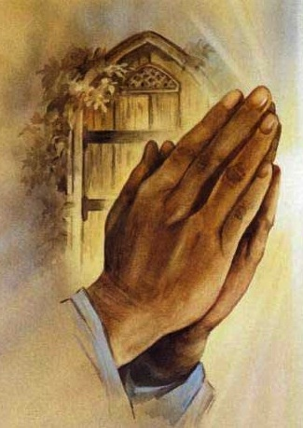
Steps to Discipline Prayer
Prayer should be secret and not seen. (Matthew 6: 5-6)
Prayer should be sincere not superficial (fake). (Matthew 6:7)
Prayer should be sacred not secular. (Matthew 6:9-13)
Adoration (v.9-10)
Supplication (v.11)
Confession (v.12)
Thanksgiving (v.13)
Prayer should be structured not slack
a. Timely
b. Tactful

Slide 4
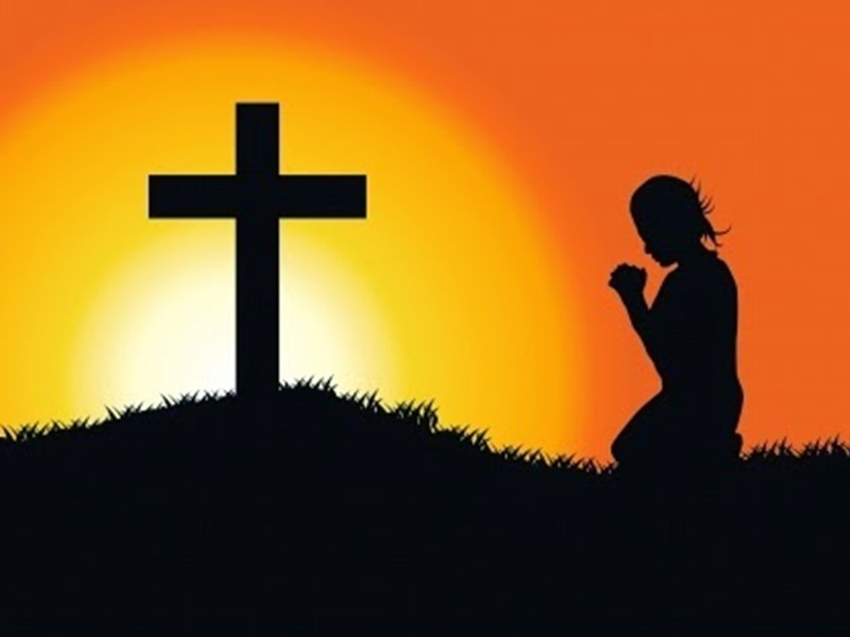
Matthew 6:5 (MSG)
“And when you come before God, don’t turn that into a theatrical production either. All these people making a regular show out of their prayers, hoping for stardom! Do you think God sits in a box seat?

Slide 5
Matthew 6:6 (MSG)
“Here’s what I want you to do: Find a quiet, secluded place so you won’t be tempted to role-play before God. Just be there as simply and honestly as you can manage. The focus will shift from you to God, and you will begin to sense his grace.

Slide 6
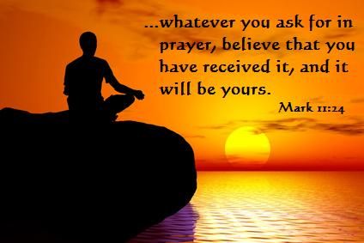
Matthew 6:7 (MSG)
“The world is full of so-called prayer warriors who are prayer-ignorant. They’re full of formulas and programs and advice, peddling techniques for getting what you want from God.
This Photo by Unknown Author is licensed under CC BY-SA-NC

Slide 7
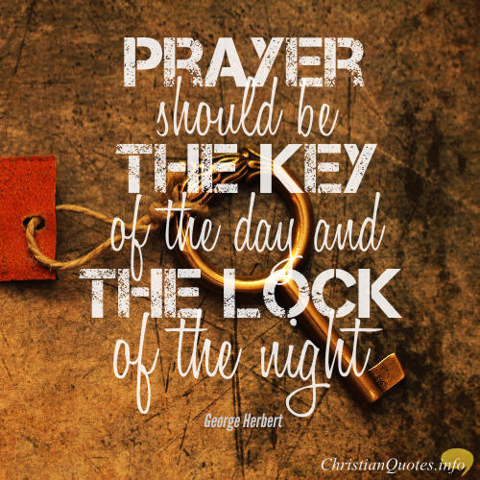
Matthew 6:8 (MSG)
Don’t fall for that nonsense. This is your Father you are dealing with, and he knows better than you what you need.

Slide 8

Matthew 6:9 – 10 (MSG)
With a God like this loving you, you can pray very simply. Like this: Our Father in heaven, Reveal who you are. Set the world right; Do what’s best—as above, so below.

Slide 9
Matthew 6:11 (MSG)
Keep us alive with three square meals.

Slide 10
Matthew 6:12 (MSG)
Keep us forgiven with you and forgiving others.

Slide 11
Matthew 6:13 (MSG)
Keep us safe from ourselves and the Devil. You’re in charge! You can do anything you want! You’re ablaze in beauty! Yes. Yes. Yes.

Slide 12

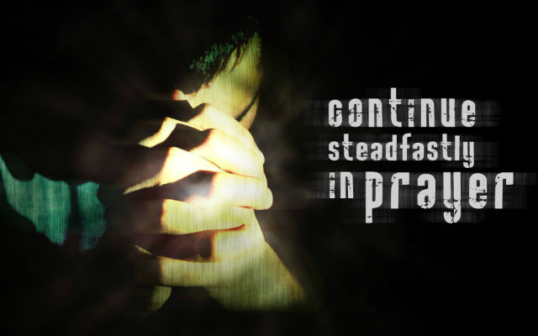
As ADORATION – Praise for who God is and his love for us.
The THANKSGIVING – Gratitude for our blessings.
Christian CONFESSION – Admitting our sins and burdens.
I INTERCESSION – Praying for others.
Pray PETITION – Praying for ourselves.

Slide 13
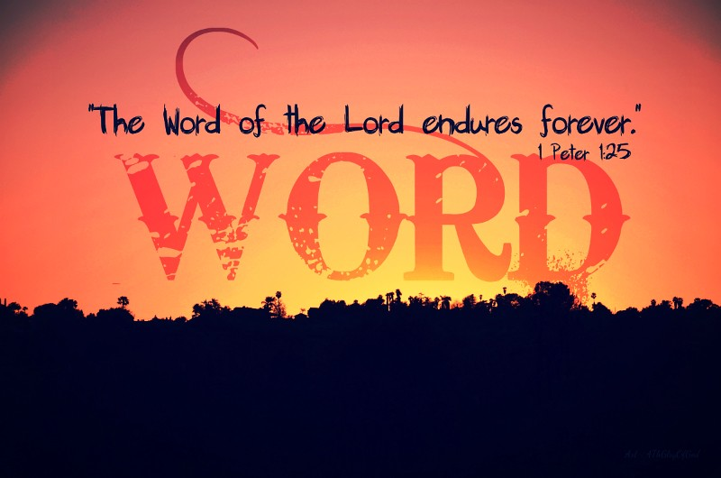
Psalms 26:2 (NIV)
Test me, O Lord, and try me, examine my heart and my mind;

Slide 14
Psalm 50:1-6 (MSG)
The God of gods—it’s God!—speaks out, shouts, “Earth!” welcomes the sun in the east, farewells the disappearing sun in the west. From the dazzle of Zion, God blazes into view. Our God makes his entrance, he’s not shy in his coming. Starbursts of fireworks precede him. He summons heaven and earth as a jury, he’s taking his people to court: “Round up my saints who swore on the Bible their loyalty to me.” The whole cosmos attests to the fairness of this court, that here God is judge.

Slide 15
Psalm 50:7- 11 (MSG)
“Are you listening, dear people? I’m getting ready to speak; Israel, I’m about ready to bring you to trial. This is God, your God, speaking to you. I don’t find fault with your acts of worship, the frequent burnt sacrifices you offer. But why should I want your blue-ribbon bull, or more and more goats from your herds? Every creature in the forest is mine, the wild animals on all the mountains. I know every mountain bird by name; the scampering field mice are my friends.

Slide 16
Psalm 50:12 - 18 (MSG)
If I get hungry, do you think I’d tell you? All creation and its bounty are mine. Do you think I feast on venison? Or drink draughts of goats’ blood? Spread for me a banquet of praise, serve High God a feast of kept promises, And call for help when you’re in trouble—I’ll help you, and you’ll honor me.” Next, God calls up the wicked: “What are you up to, quoting my laws, talking like we are good friends? You never answer the door when I call; you treat my words like garbage. If you find a thief, you make him your buddy; adulterers are your friends of choice.

Slide 17
Psalm 50:19 - 23 (MSG)
Your mouth drools filth; lying is a serious art form with you. You stab your own brother in the back, rip off your little sister. I kept a quiet patience while your did these things; you thought I went along with your game. I’m calling you on the carpet, now, laying your wickedness out in plain sight. “Time’s up for playing fast and loose with me. I’m ready to pass sentence, and there’s no help in sight! It’s the praising life that honors me. As soon as you set your foot on the Way, I’ll show you my salvation.”

Slide 18
Psalms 51: 1-6 (MSG)
Generous in love—God, give grace! Huge in mercy—wipe out my bad record. Scrub away my guilt, soak out my sins in your laundry. I know how bad I’ve been; my sins are staring me down. You’re the One I’ve violated, and you’ve seen it all, seen the full extent of my evil. You have all the facts before you; whatever you decide about me is fair. I’ve been out of step with you for a long time, in the wrong since before I was born. What you’re after is truth from the inside out. Enter me, then; conceive a new, true life.

Slide 19

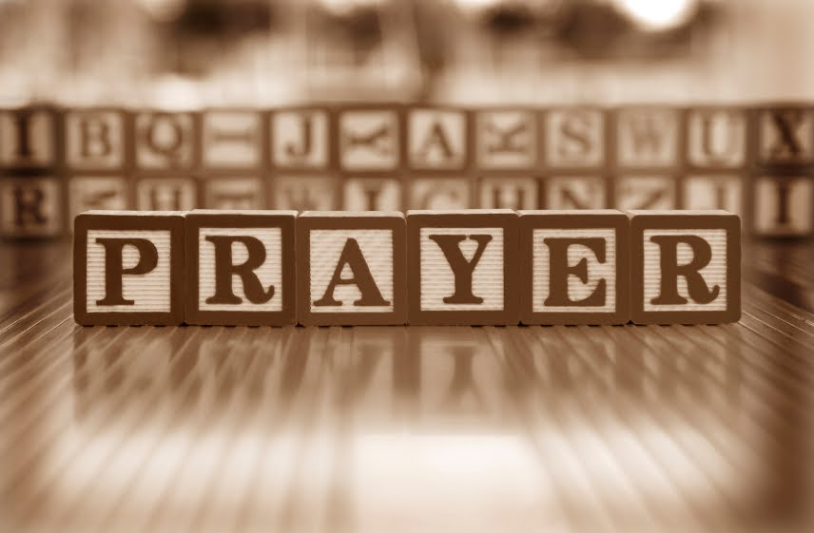
When and Why God Does Not Hear Prayer

Slide 20
Praying Amiss
When we have unconfessed sin in our lives
If we confess our sins, he is faithful and just to forgive us our sins and to cleanse us from all unrighteousness. 1 John 1:9 (ESV)
2. If we are not a believer
We know that God does not listen to sinners, but if anyone is a worshipper of God and does his will, God listens to him. John 9:31 (ESV)
3. When we are just praying to be seen
Ye ask, and receive not, because ye ask amiss, that ye may consume it upon your lusts. James 4:3 (KJV)
Ye ask and do not receive, because you ask wrongly, to spend it on your passions. James 4:3 (ESV)
4. When our prayers are not sincere

Slide 21
Praying Amiss
1 John 5:14-15 (ESV)
And this is the confidence that we have toward him, that if we anything according to his will he hears us. And if we know that he hears us in whatever we ask, we know that we have the requests that we have asked of him.
John 15:7 (ESV)
If you abide in me, and my words abide in you, ask whatever you wish, and it will be done for you.
Isaiah 59:2 (ESV)
But your iniquities have made a separation between you and your God, and your sins have hidden his face from you so that he does not hear.

Slide 22
Prayers of Thanksgiving
1 Timothy 2:1-2(ESV)
First of all, then, I urge that supplications, prayers, intercessions, and thanksgivings be made for all people, for kings and all who are in high positions, that we may lead a peaceful and quiet life, godly and dignified in every way.
Philippians 4:6
Do not be anxious about anything, but in everything by prayer and supplication with thanksgiving let your requests be made known to God.
Colossians 4:2 (ESV)
Continue steadfastly in prayer, being watchful in it with thanksgiving.

Slide 23
Prayers of Thanksgiving
Ephesians 6:18 (ESV)
Praying at all times in the Spirit, with all prayer and supplication. To that end keep alert with all perseverance, making supplication for all the saints,
Matt 5:44 (ESV)
But I say to you, Love your enemies and pray for those who persecute you,
Luke 6:27-28 (ESV)
“But I say to you who hear, Love your enemies, do good to those who hate you, bless those who curse you, pray for those who abuse you.
Luke 18:1
And he told them a parable to the effect that they ought always to pray and not lose heart.

Slide 24


We are giving away the “Y” Blessing Boxes on February 13, 2021 from 10am – 12 Noon. Distribution will be on a first-come, first served basis.
We are still soliciting people to sign up for the Diabetes class sponsored by the Balm of Gilead. Classes began on February 2, 2021 @ 6:30pm. There is still time to become a part of the class. Call the Program Director, Patricia Yates-Rand at 706-496-1036 to sign-up.
There will be a Zoom meeting for Middle and High Schoolers on February 15, 2021 at 3pm. We need good contact numbers to reach these children. Please call the church with contact information for your middle or high schooler.

