Slide 1
Springfield Baptist Church
Destroying Satanic Strongholds
1 Corinthians 10:4-5
Based On - Pulling Down Strongholds: Strategies from Ancient and Modern Israel Messiah Conference 2000
Lesson 2

Slide 2
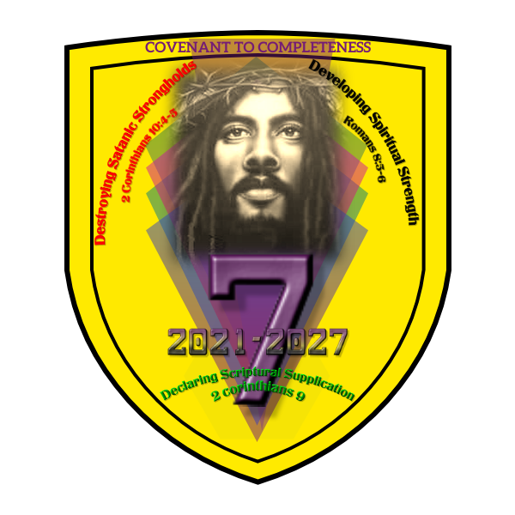

Slide 3
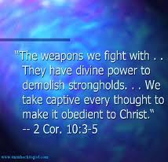
2 Cor. 10:3-5

Slide 4
Categories of Strongholds
Ideological strongholds
II. Personal strongholds

Slide 5
Ideological Strongholds
Ideological Strongholds are built around systems of thought and ideas that are embodied in cultures and that exert pressure on members of that culture. Through this influence, which the Bible calls the world, a whole society begins to hold certain values. What Satan does to individuals through the flesh, he does to society through the world. Over time personal strongholds become embodied in cultures as strongholds.
In the world you find “arguments and every pretension that sets itself up against the knowledge of God” (2 Cor. 10:5). The world includes the following:
Philosophical Systems Educational Systems
Value Systems Religious Systems
Economic Systems Political Systems
Avery T. Willis – “Disciple’s Personality

Slide 6
Personal Strongholds
Watchman Nee defines flesh as “any attitude or action done without total dependence on the Lord Jesus Christ.”
Personal strongholds are areas of our lives in which we are most vulnerable to Satan’s attacks.
Satan first attacks the flesh, which is the inner tendency and capacity to sin. Through the flesh Satan influences the mind, the will, and the emotions. He wants us to depend on ourselves and on our own strength.
Avery T. Willis – “Disciple’s Victory

Slide 7
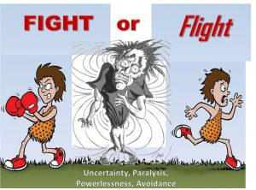


Strongholds Can BE Pulled Down If You Are Willing To Fight
Do you just want to give up?
Do you have gumption?
Are you willing to fight?

Slide 8


Slide 9



Slide 10
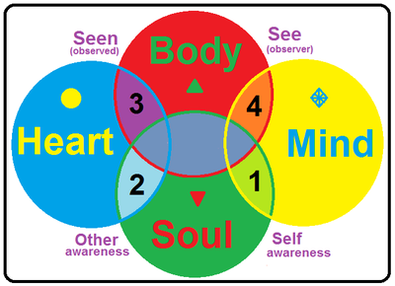

Strongholds Are Places NOT People
Strongholds are apart of the flesh
Strongholds impact the soul
Our soul is comprised of Three Major Parts
a. The mind (Prov. 23:7)
b. The heart (Rom. 8:5-6)
c. The will

Slide 11

Psalms 26:2 (NIV)
Test me, O Lord, and try me, examine my heart and my mind;

Slide 12
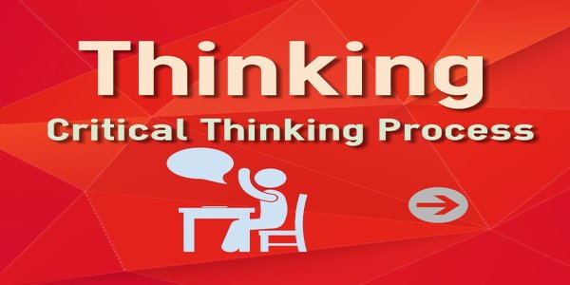
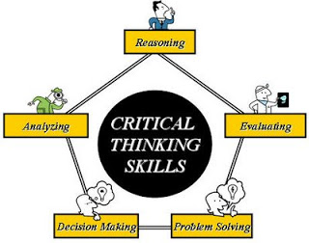
The Natural Mind
“When I talk about the natural mind, I am referring to the thinking process that is limited to human reasoning and resources.”
Avery T. Willis – “Disciple’s Personality

Slide 13

Romans 8:5-6 (NIV)
Those who live according to the sinful nature have their minds set on what that nature desires; but those who live in accordance with the Spirit have their minds set on what the Spirit desires. The mind of sinful man is death, but the mind controlled by the Spirit is life and peace;

Slide 14
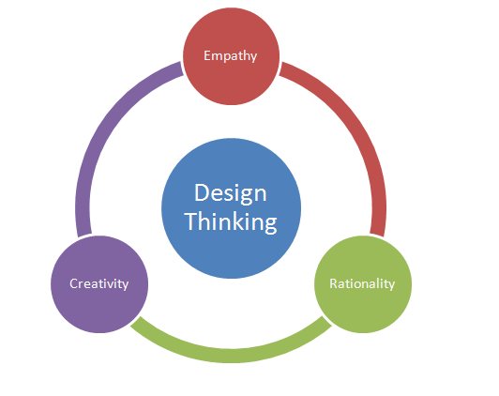
The Depraved Mind – Romans 1:28-31
“Furthermore, since they did not think it worthwhile to retain the knowledge of God, he gave them over to a depraved mind, to do what ought not to be done. They have become filled with every kind of wickedness, evil, greed and depravity. They are full of envy, murder, strife, deceit and malice. They are gossips, slanderers, God-haters, insolent, arrogant and boastful; they invent ways of doing evil; they disobey their parents; they are senseless, faithless, heartless, ruthless.”
Avery T. Willis – “Disciple’s Personality

Slide 15

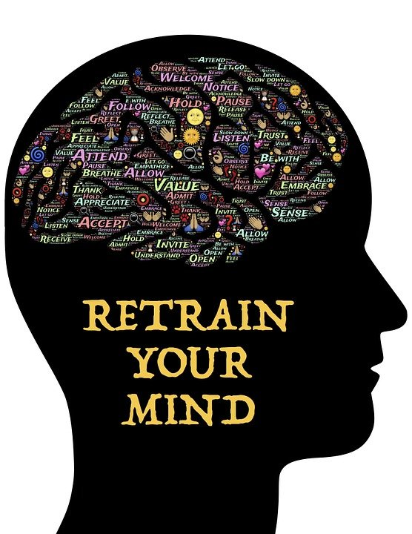
List of Mind
Lying
Stealing
Corrupt communication
Gossiping
Religious rituals
False teaching
Cunningness
Deception
Lack of faith
No vision
Spiritual blindness
Lack of knowledge
Murder
Wrath
Fornication
Drunkenness
Heresies
Sedition
Strife
Idolatry
Variance
Witchcraft
Evil thoughts
Slothfulness

Slide 16

Emotions
“Emotions are God-given feelings of pleasantness or unpleasantness. They are reactions to internal and external stimuli. Emotions are not good or bad; you make the choice of whether to honor Christ to harm yourself or others.”
Avery T. Willis – “Disciple’s Personality

Slide 17
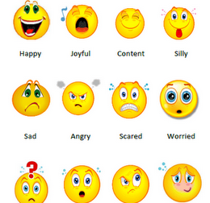
List of Emotions
Fearful
Needy
Lost
Self-Pity
Pessimistic
Hysteria
Withdrawal
Doubtful
Sorrow
Guilt
Horrified
Overwhelmed
Anxious
Terrified
Challenged
Jealous
Stressed
Agony
Desperate
Confused

Slide 18
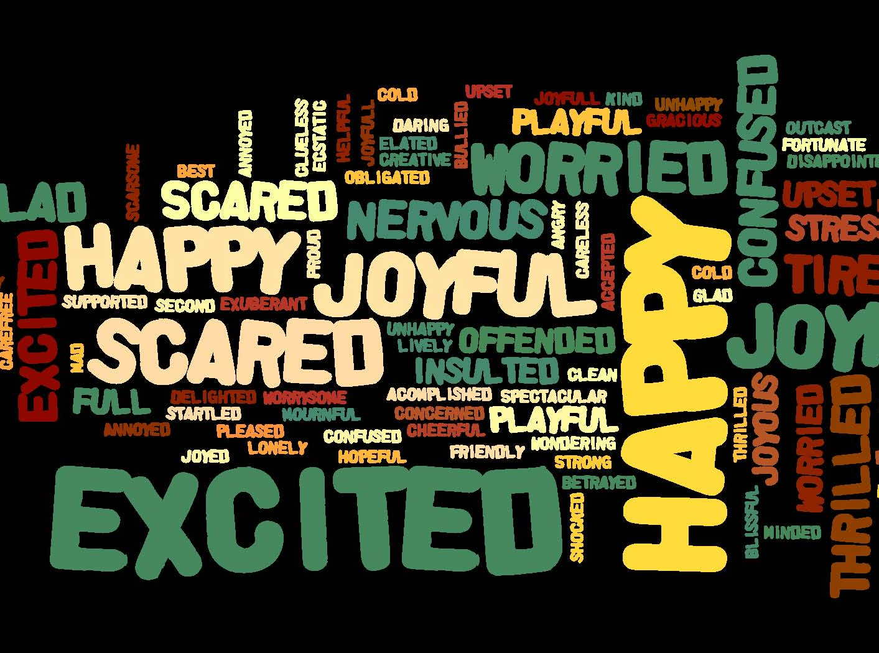
List of Emotions Continued
Alone
Paranoid
Sadness
Unhappy
Emptiness
Apathetic
Defeated
Pity
Submissive
Depressed
Worn out
Cowardly
Disappointed
Vulnerable
Remorse
Distress
Bitter
Infuriated

Slide 19
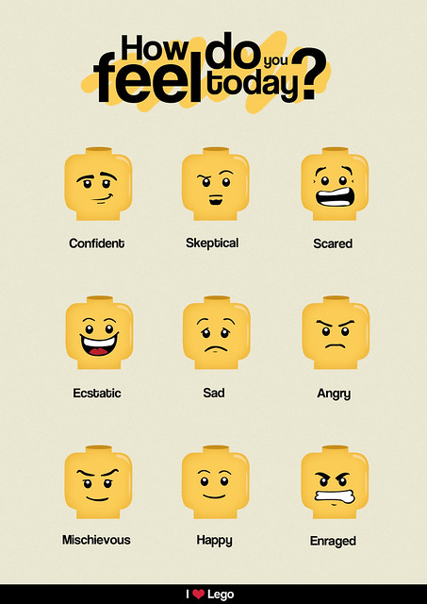

List of Emotions Continued
Rage
Vengeful
Animosity
Cold
Envy
Hopeless
Hatred
Lazy
Aggressive
Obsessed
Defensive
Destructive

Slide 20
Seven Strategies for Recognizing and Destroying Satanic Strongholds
1. Seeking – Disciplined Prayer – Finding time each day to spend with God to acknowledge or define our strongholds.
2. Sacrifice – Divine Fasting – To deny oneself of food for a certain period of time as to be determined by the one who is fasting.
3. Surrendering – Devotional Meditation – Meditation is spending time with God in carrying out the following essential steps: reading scripture, believing God’s word, reflecting on God’s intentions, discerning his will, and applying his principles. This should be done along with God and in a quiet place although you might listen to spiritual music. Meditate using the Book of Psalms starting with Chapter 1.

Slide 21
Seven Strategies for Recognizing and Destroying Satanic Strongholds
4. Studying – Dedicated Discipleship – This is simply learning the principles of God’s word as shared by one who has the gift of teaching.
5. Sharing – Distinct Stewardship – Utilizing time, treasure and talents for God.
6. Searching – Directed Companions – Asking God to give you a circle of seven people who are filled with the Holy Ghost so that they might pray and spend time with you for your spiritual growth.
7. Shouting – Deliberate Praise – To pour out from one’s spirit and soul as it is expressed through one’s body, truth and spiritual devotion to glorify God.

Slide 22
Surrendering – Devotional Meditation
Meditation is spending time with God in carrying out the following essential steps: reading scripture, believing God’s word, reflecting on God’s intentions, discerning his will, and applying his principles. This should be done along with God and in a quiet place although you might listen to spiritual music. Meditate using the Book of Psalms starting with Chapter 1.

Slide 23


Essential Steps of Meditation
Reading Scripture
Believing God’s Word
Reflecting on God’s Intentions
Discerning His Will
Applying His Principles

Slide 24


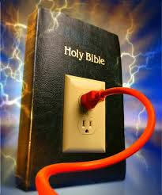
Scripture

Slide 25



Believing God’s Word

Slide 26




Reflecting on God’s Intentions

Slide 27
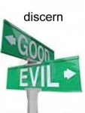
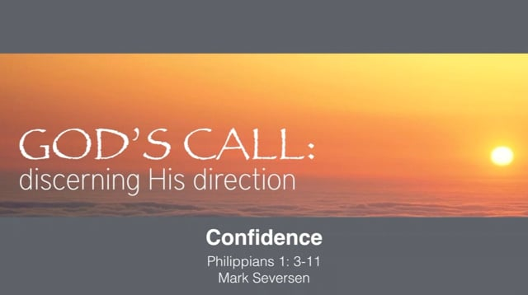


Discerning His Will

Slide 28





Applying His Principles

Slide 29
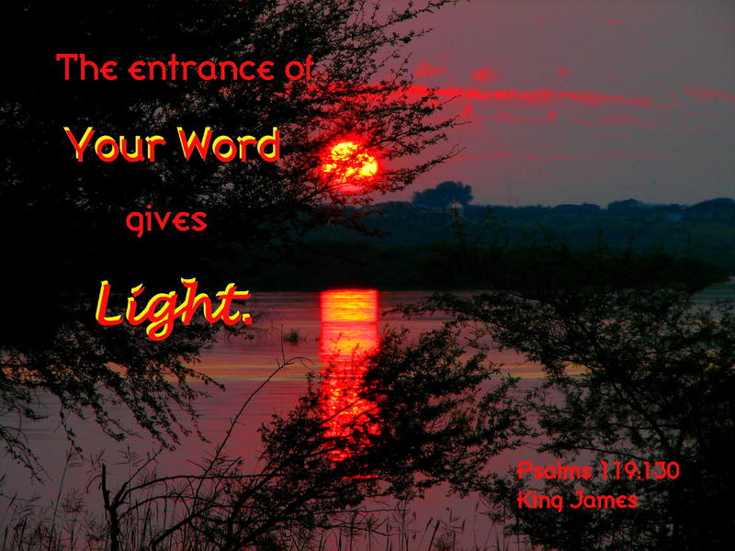
Ephesians 5:11 (NIV)
Have nothing to do with the fruitless deeds of darkness, but rather expose them.

Slide 30

1 Corinthians 2:16 (NIV)
“For who has known the mind of the Lord that he may instruct him?” But we have the mind of Christ.

