Slide 1
Springfield Baptist Church
Destroying Satanic Strongholds
1 Corinthians 10:4-5
Based On - Pulling Down Strongholds: Strategies from Ancient and Modern Israel Messiah Conference 2000
Lesson 1

Slide 2
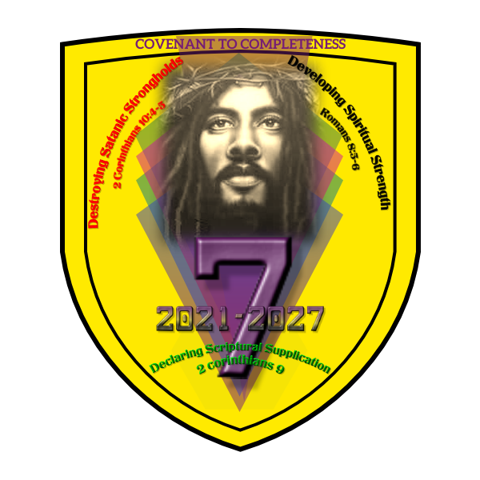

Slide 3
Covenant
The conditional promises made to humanity by God, as revealed in scripture. God promised to protect Israel if they kept his law and were faithful to him. God made covenants with individuals, families, and nations.

Slide 4
There are Seven Covenants in the Bible
Edenic Covenant
Noahic Covenant
Abrahamic Covenant
Mosaic Covenant
Priestly Covenant
Davidic Covenant
New Covenant (Christians)

Slide 5
The number Seven (7) represents completeness and perfection
Creation in 7 days
The sabbath year is 7 years
Jubilee year comes after the Seventh Sabbath year
Seven plaques on Egypt
Seven deadly sins
Seven Holy Days
In the Book of Revelation – Seven seals, Seven Candles and Seven Churches
Joshua is charged to march around Jericho for 7 days and on the 7th day 7 times
The covenant made with Noah was the rainbow and it had seven colors

Slide 6
Springfield Baptist Church Theme
Covenant to Completeness
2021 – 2027
Our church family will seek God for individual and collective spiritual growth over the next 7 years. This will be done in line with our overall mission and vision. We will employ certain strategies to bring God’s desires for us to fruition. The hope we share is that our church family and individual members will walk in victory as we work toward God’s promises.

Slide 7


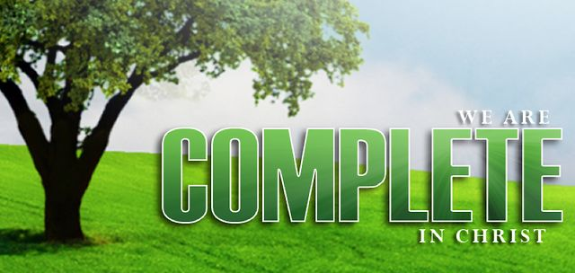
Covenant (rainbow) is an agreement with God
Rainbow is representative of a covenant
7 (Seven) – Biblical teaching on completeness
Picture represents Christ
Three Requests of the Covenant
Destroying Satanic Strongholds – 2 Corinthians 10:4-5
Developing Spiritual Strengths – Romans 8:5-6
Declaring Scriptural Supplication – 2 Corinthians 9

Slide 8
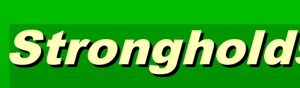
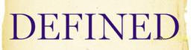

Slide 9
Stronghold is literally a defensive structure like a cliff (or other lofty or inaccessible place); a fort, a tower that can also be a storage place for holding food, water, or weapons. A stronghold is a place and not a person. Strongholds can be either satanic or sacred.

Slide 10
A spiritual stronghold is a habitual pattern of thought, built into one’s thought life. A stronghold is a way of thinking and feeling that has developed a life of its own in a person.

Slide 11
Satanic Strongholds
Satan and his demons want to capture the minds of people. The mind is the citadel of the soul. He who controls the mind, controls a very strategic place.

Slide 12
Examples of Satanic Strongholds
Satanic strongholds can be the works of the flesh like pride, idolatry, witchcraft, hatred, heresies, drunkenness, sexual immortality, etc. Moreover, satanic strongholds such as lack of faith, fear, hopelessness, slothfulness are exceedingly displeasing to God.

Slide 13
How Satanic Strongholds Can Impact Your Life
Habitually bad temper
Rut of depression
Recurring unbelief
Provoke others to reject you
Resentment
Worthlessness
Create negative thoughts

Slide 14
Seven Strategies for Recognizing and Destroying Satanic Strongholds
1. Seeking – Disciplined Prayer – Finding time each day to spend with God to acknowledge or define our strongholds.
2. Sacrifice – Divine Fasting – To deny oneself of food for a certain period of time as to be determined by the one who is fasting.
3. Surrendering – Devotional Meditation – Meditation is spending time with God in carrying out the following essential steps: reading scripture, believing God’s word, reflecting on God’s intentions, discerning his will, and applying his principles. This should be done along with God and in a quiet place although you might listen to spiritual music. Meditate using the Book of Psalms starting with Chapter 1.

Slide 15
Seven Strategies for Recognizing and Destroying Satanic Strongholds
4. Studying – Dedicated Discipleship – This is simply learning the principles of God’s word as shared by one who has the gift of teaching.
5. Sharing – Distinct Stewardship – Utilizing time, treasure and talents for God.
6. Searching – Directed Companions – Asking God to give you a circle of seven people who are filled with the Holy Ghost so that they might pray and spend time with you for your spiritual growth.
7. Shouting – Deliberate Praise – To pour out from one’s spirit and soul as it is expressed through one’s body, truth and spiritual devotion to glorify God.

