Slide 1



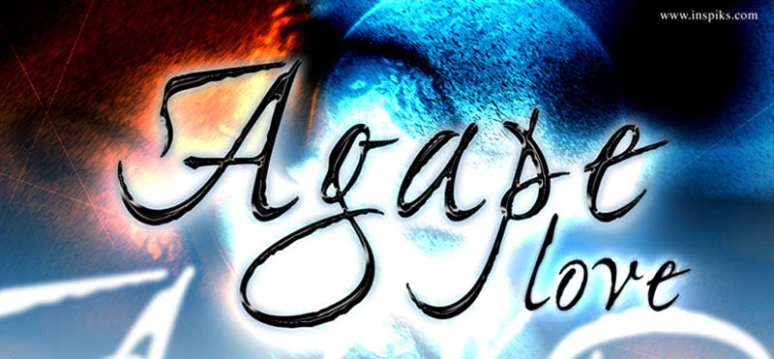
SBC 2022 Theme – Walking in God’s Agape
The Importance of Spiritual Knowledge
Equipping Hour
March 30, 2022

Slide 2





Slide 3
BIBLICAL MEANING OF KNOWLEDGE
THE HEBREW WORD YADA AND THE GREEK WORDS OIDA AND GINOSKO HAVE A WIDER SWEEP THAN OUR ENGLISH WORD KNOW. IN OTHER WORDS, THE DEFINITION IN MIRIAM-WEBSTER DICTONARY DOES NOT RENDER THE APPROIATE BIBLICAL MEANING.
DEFINITION OF KNOWLEDGE
OBEYING THE STIPULATIONS OF HIS COVENANT AND LIVING IN CONFORMITTY WITH HIS WILL! THUS, THE OPPOSITE OF KNOWLEDGE IS NOT IGNORANCE, BUT REBELLION ! (col.3:9-12)(col.2:8 deceptive philosophy) matt.4 every word)

Slide 4
BIBLICAL USES
Realizations: Grief (Isa. 53:3); Guilt (Jer.3:13); Conversion (John 17:3); Truth (John 8:32); Judgement (Ezek.25:14)
Distinguish: Good and Evil (Gen3:5; Isa.7-15); Right hand from left (Jon.4-11); Wise and Foolish (Eccles. 2-19); Desirable and Undesirable (2Sam. 19:35) Life and Death (2Sam.12:22-23)
Reflection of skills and professional abilities (BRANCH KNOWLEDGE) Hunting (Gen.25:27); Sailing (1Kings 9:27); Instruments (1Sam. 16:16, Psa. 150); Grief Counselors (Amos 5:16); Reading (Isa. 29:11-12); Shepherds and Farmers (Gen. 3:2); Fishermen (Matthew 4:19); Lawyers and Judges (Matt. 22:35; Judges); Military (Psa. 271-3); Philosophy (Acts 17:18); Government (Roman13:12) Doctors/Medicine (Jerem. 8:22; Matt.9-12)
Source: Baker Theological Dictionary

Slide 5























































































































































































































































Military
Army
Navy
Air Force
Marines
Government
Local
State
National
Technology
Cyber
Engineering
IT
Law
Attorneys
Offices
Judges
Social Sciences
Psychology
Sociology
Philosophy
Secular
Religious
Education
Elementary
Middle
High School
Graduate
Fishing
Hunting
Sailing
Business
Economics
Banking
Corporate
Medicine
Doctors
Cardiologists
Neurologists
Arts
Music
Drama
Band
Sales
Cashiers
Stock People
Inventory
S
P
I
R
I
T
U
A
L
K
N
O
W
L
E
D
G
E
Numerous
Other
Fields
Of Interest
Manufacturing
Plants
Industry
Athletics
Sports
Gymnastics
Tennis
Vocational
Farming
Mechanics
Welding
Environmental
Climate
Weather People
Science
Math
Biology
Chemistry

Slide 6
The Quality of our Knowledge is Equal to the Quality of our Development
Take a Multiplier X Multiplicand = Product
(God’s Talents) X (Knowledge)

Slide 7
ESSENCE AND SOUL DEFINITIONS
Essence is the most important ingredient the intrinsic or indispensable property that serves to characterize or identify something. The core.. the direct descendants ..originals or aboriginal. Origin the beginning (alpha and omega)
Soul the animating and vital principle in man…animus …gives life…soul thought, will and emotion …house in the body made of dust…manifest through physical body weak to contain for a thousand years, but we can carry more than 40-100 yrs…dying too young because we don’t know how to follow the life principle….
Image love(agape); righteousness, justice, surrendered will;

Slide 8
Exodus 19:3-8 (KJV)
³ And Moses went up unto God, and the Lord called unto him out of the mountain, saying, Thus shalt thou say to the house of Jacob, and tell the children of Israel;
⁴ Ye have seen what I did unto the Egyptians, and how I bare you on eagles' wings, and brought you unto myself.
⁵ Now therefore, if ye will obey my voice indeed, and keep my covenant, then ye shall be a peculiar treasure unto me above all people: for all the earth is mine:
⁶ And ye shall be unto me a kingdom of priests, and an holy nation. These are the words which thou shalt speak unto the children of Israel.
⁷ And Moses came and called for the elders of the people, and laid before their faces all these words which the Lord commanded him.
⁸ And all the people answered together, and said, All that the Lord hath spoken we will do. And Moses returned the words of the people unto the Lord.

Slide 9
Deut. 5:31 (AMP)
³¹ But as for you, stand here by Me, and I will tell you all the commandments and the statutes and the judgments which you shall teach them, so that they may obey them in the land which I give them to possess.’

Slide 10
Deut. 6:1-3 (AMP)
Obey God and Prosper
6 “Now this is the command; the statutes and the judgments (precepts) which the Lord your God has commanded me to teach you, so that you might do (follow, obey) them in the land which you are crossing over [the Jordan] to possess, ² so that you and your son and your grandson may fear and worship the Lord your God [with awe-filled reverence and profound respect], to keep [and actively do] all His statutes and His commandments which I am commanding you, all the days of your life, so that your days may be prolonged. ³ Therefore listen, O Israel, and be careful to do them, that it may go well with you and that you may increase greatly [in numbers], as the Lord, the God of your fathers, has promised you, in a land ^{[a]}flowing with milk and honey.

Slide 11
Rom. 2:17-20 (KJV)
¹⁷ Behold, thou art called a Jew, and restest in the law, and makest thy boast of God,
¹⁸ And knowest his will, and approvest the things that are more excellent, being instructed out of the law;
¹⁹ And art confident that thou thyself art a guide of the blind, a light of them which are in darkness,
²⁰ An instructor of the foolish, a teacher of babes, which hast the form of knowledge and of the truth in the law.

Slide 12
John 3:3 (KJV)
³ Jesus answered and said unto him, Verily, verily, I say unto thee, Except a man be born again, he cannot see the kingdom of God.

Slide 13
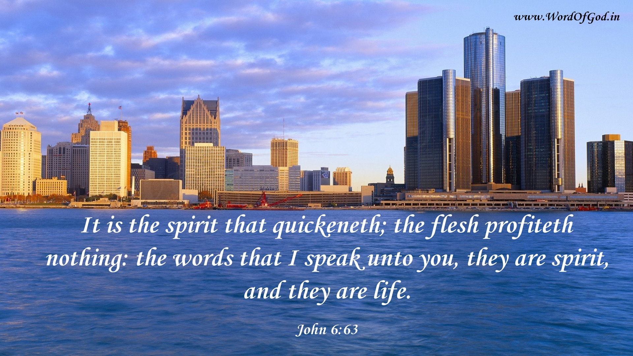
John 6:63 (KJV)
⁶³ It is the spirit that quickeneth; the flesh profiteth nothing: the words that I speak unto you, they are spirit, and they are life.

Slide 14
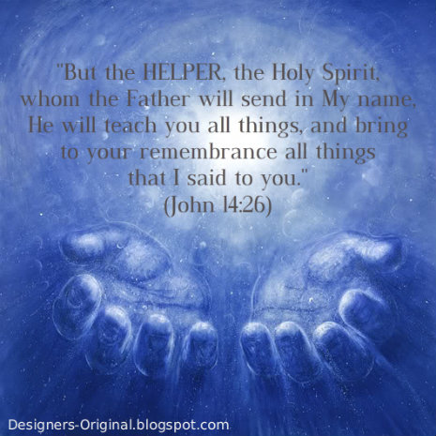
John 14:26 (AMP)
But the Helper (Comforter, Advocate, Intercessor—Counselor, Strengthener, Standby), the Holy Spirit, whom the Father will send in My name [in My place, to represent Me and act on My behalf], He will teach you all things. And He will help you remember everything that I have told you.

Slide 15
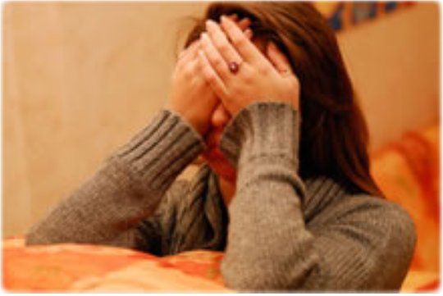
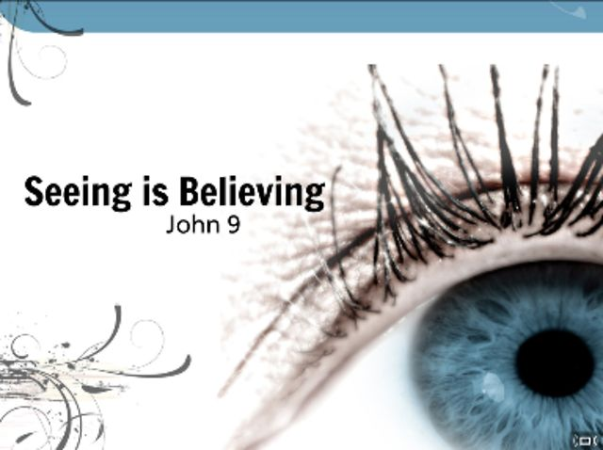
Spiritual Blindness

Slide 16
1 Cor. 2:10-13 (AMP)
¹⁰ For God has unveiled them and revealed them to us through the [Holy] Spirit; for the Spirit searches all things [diligently], even [sounding and measuring] the [profound] depths of God [the divine counsels and things far beyond human understanding]. ¹¹ For what person knows the thoughts and motives of a man except the man’s spirit within him? So also no one knows the thoughts of God except the Spirit of God. ¹² Now we have received, not the spirit of the world, but the [Holy] Spirit who is from God, so that we may know and understand the [wonderful] things freely given to us by God. ¹³ We also speak of these things, not in words taught or supplied by human wisdom, but in those taught by the Spirit, combining and interpreting spiritual thoughts with spiritual words [for those being guided by the Holy Spirit].

Slide 17
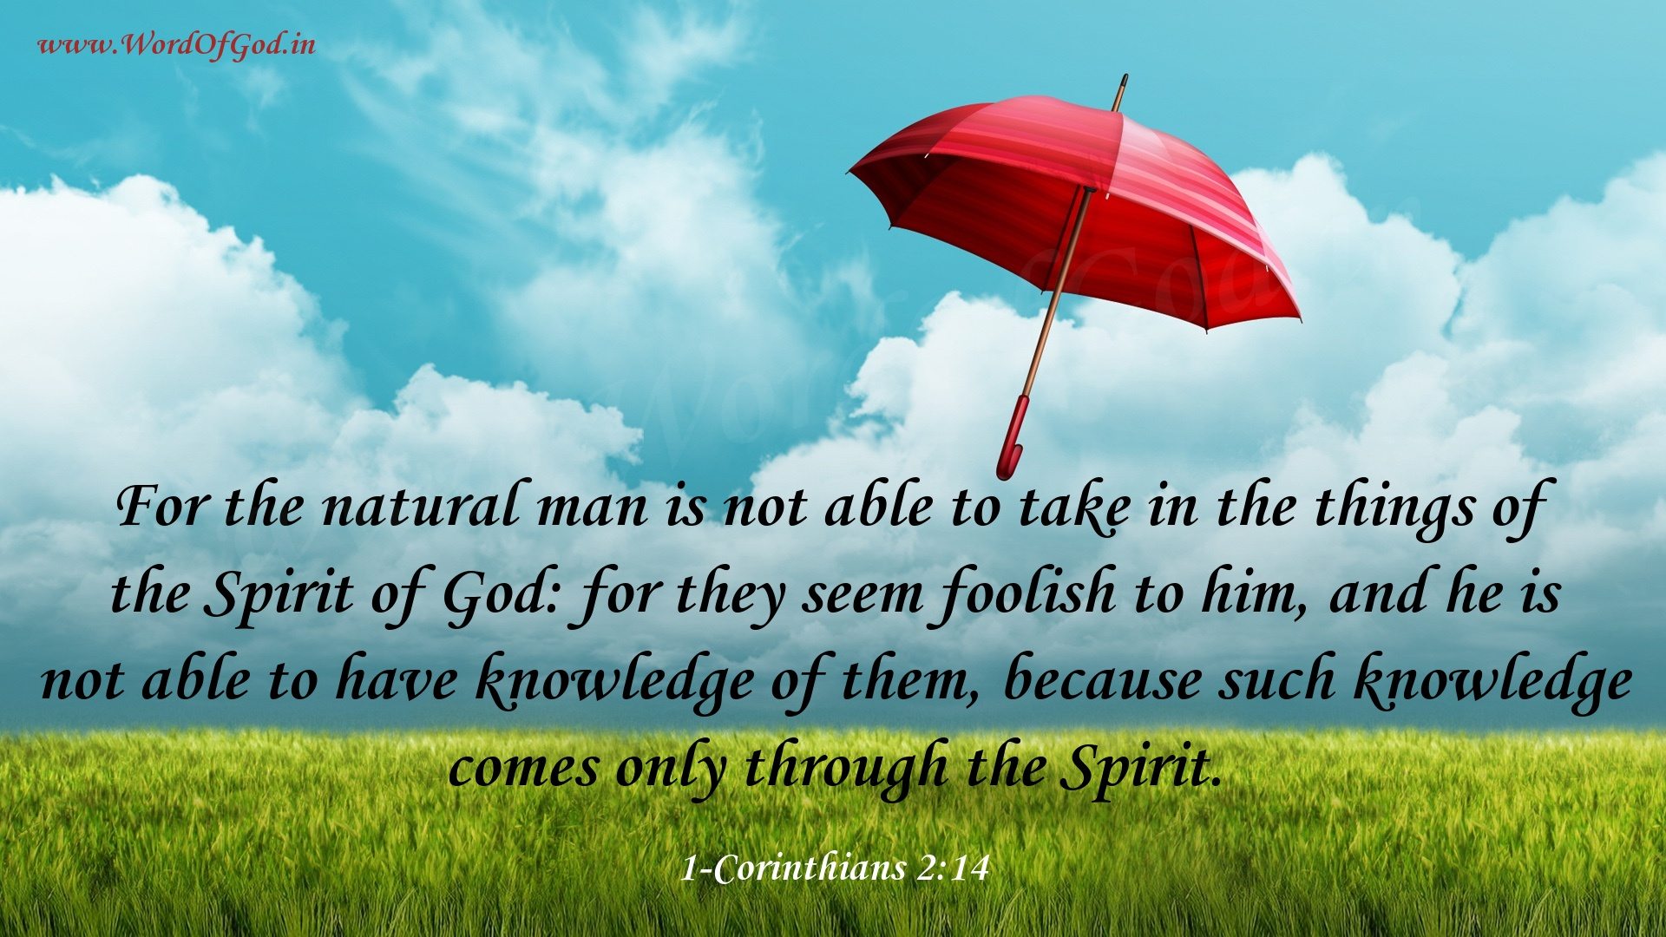
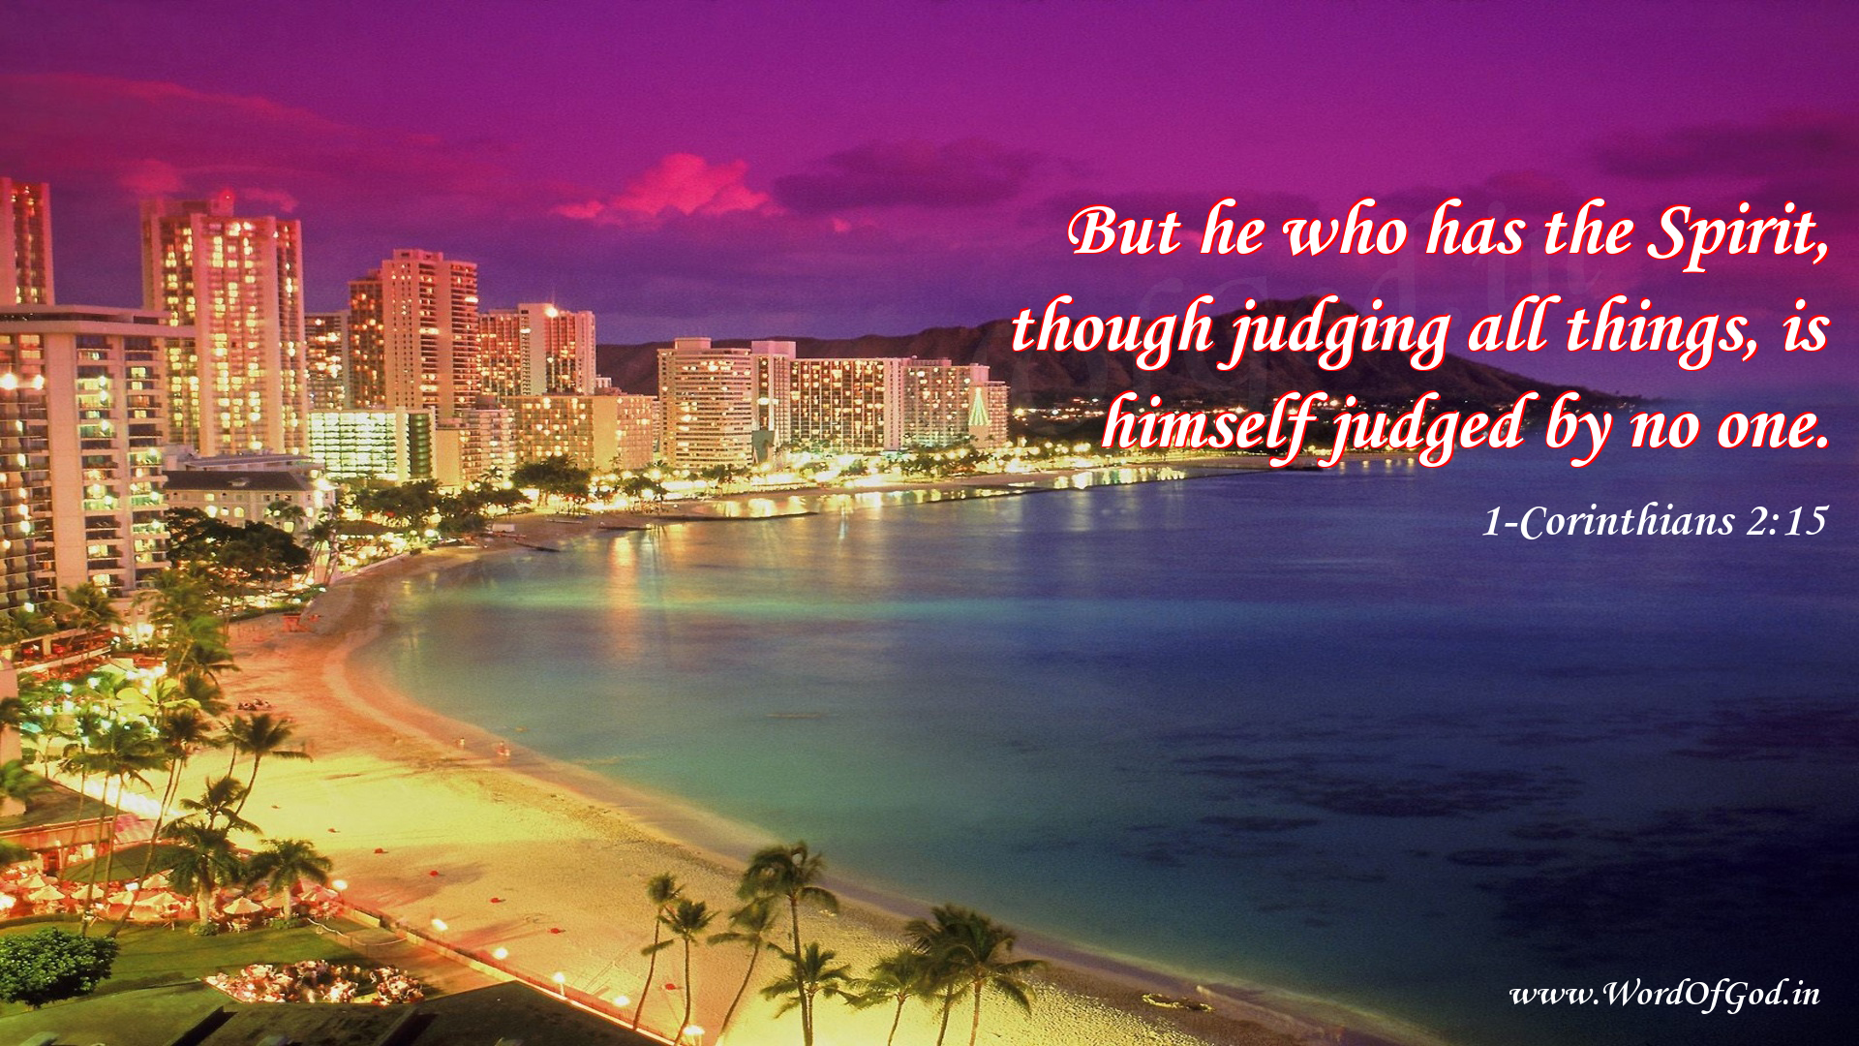
1 Cor. 2:14-15 (AMP)
¹⁴ But the natural [unbelieving] man does not accept the things [the teachings and revelations] of the Spirit of God, for they are foolishness [absurd and illogical] to him; and he is incapable of understanding them, because they are spiritually discerned and appreciated, [and he is unqualified to judge spiritual matters]. ¹⁵ But the spiritual man [the spiritually mature Christian] judges all things [questions, examines and applies what the Holy Spirit reveals], yet is himself judged by no one [the unbeliever cannot judge and understand the believer’s spiritual nature].

Slide 18
1 Cor. 2:16 (AMP)
¹⁶ For who has known the mind and purposes of the Lord, so as to instruct Him? But we have the mind of Christ [to be guided by His thoughts and purposes].

Slide 19
1 Cor. 3:1-3 (AMP)
3 However, brothers and sisters, I could not talk to you as to spiritual people, but [only] as to ^{[a]}worldly people [dominated by human nature], mere infants [in the new life] in Christ! ² I fed you with milk, not solid food; for you were not yet able to receive it. Even now you are still not ready. ³ You are still ^{[b]}worldly [controlled by ordinary impulses, the sinful capacity]. For as long as there is jealousy and strife and discord among you, are you not ^{[c]}unspiritual, and are you not walking like ordinary men [unchanged by faith]?

Slide 20
Rom. 8:1-4 (AMP)
8 Therefore there is now no condemnation [no guilty verdict, no punishment] for those who are in Christ Jesus [who believe in Him as personal Lord and Savior]. ² For the law of the Spirit of life [which is] in Christ Jesus [the law of our new being] has set you free from the law of sin and of death. ³ For what the Law could not do [that is, overcome sin and remove its penalty, its power] being weakened by the flesh [man’s nature without the Holy Spirit], God did: He sent His own Son in the likeness of sinful man as an offering for sin. And He condemned sin in the flesh [subdued it and overcame it in the person of His own Son], ⁴ so that the [righteous and just] requirement of the Law might be fulfilled in us who do not live our lives in the ways of the flesh [guided by worldliness and our sinful nature], but [live our lives] in the ways of the Spirit [guided by His power].

Slide 21
Rom. 8:5-8 (AMP)
⁵ For those who are living according to the flesh set their minds on the things of the flesh [which gratify the body], but those who are living according to the Spirit, [set their minds on] the things of the Spirit [His will and purpose]. ⁶ Now the mind of the flesh is death [both now and forever—because it pursues sin]; but the mind of the Spirit is life and peace [the spiritual well-being that comes from walking with God—both now and forever]; ⁷ the mind of the flesh [with its sinful pursuits] is actively hostile to God. It does not submit itself to God’s law, since it cannot, ⁸ and those who are in the flesh [living a life that caters to sinful appetites and impulses] cannot please God.

Slide 22
Rom. 8:9-13 (AMP)
⁹ However, you are not [living] in the flesh [controlled by the sinful nature] but in the Spirit, if in fact the Spirit of God lives in you [directing and guiding you]. But if anyone does not have the Spirit of Christ, he does not belong to Him [and is not a child of God]. ¹⁰ If Christ lives in you, though your [natural] body is dead because of sin, your spirit is alive because of righteousness [which He provides]. ¹¹ And if the Spirit of Him who raised Jesus from the dead lives in you, He who raised Christ Jesus from the dead will also give life to your mortal bodies through His Spirit, who lives in you. ¹² So then, [a]brothers and sisters, we have an obligation, but not to our flesh [our human nature, our worldliness, our sinful capacity], to live according to the [impulses of the] flesh [our nature without the Holy Spirit]— ¹³ for if you are living according to the [impulses of the] flesh, you are going to die. But if [you are living] by the [power of the Holy] Spirit you are habitually putting to death the sinful deeds of the body, you will [really] live forever.

Slide 23
Rom. 8:14-17 (AMP)
¹⁴ For all who are allowing themselves to be led by the Spirit of God are sons of God. ¹⁵ For you have not received a spirit of slavery leading again to fear [of God’s judgment], but you have received the Spirit of adoption as sons [the Spirit producing sonship] by which we [joyfully] cry, “^{[b]}Abba! Father!” ¹⁶ The Spirit Himself testifies and confirms together with our spirit [assuring us] that we [believers] are children of God. ¹⁷ And if [we are His] children, [then we are His] heirs also: heirs of God and fellow heirs with Christ [sharing His spiritual blessing and inheritance], if indeed we share in His suffering so that we may also share in His glory.

Slide 24
Rom. 8:24-28 (AMP)
²⁴ For in this hope we were saved [by faith]. But hope [the object of] which is seen is not hope. For who hopes for what he already sees? ²⁵ But if we hope for what we do not see, we wait eagerly for it with patience and composure.
Our Victory in Christ
²⁶ In the same way the Spirit [comes to us and] helps us in our weakness. We do not know what prayer to offer or how to offer it as we should, but the Spirit Himself [knows our need and at the right time] intercedes on our behalf with sighs and groanings too deep for words. ²⁷ And He who searches the hearts knows what the mind of the Spirit is, because the Spirit intercedes [before God] on behalf of ^{[a]}God’s people in accordance with God’s will.
²⁸ And we know [with great confidence] that God [who is deeply concerned about us] causes all things to work together [as a plan] for good for those who love God, to those who are called according to His plan and purpose.

Slide 25

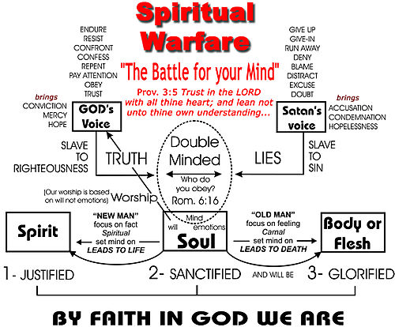
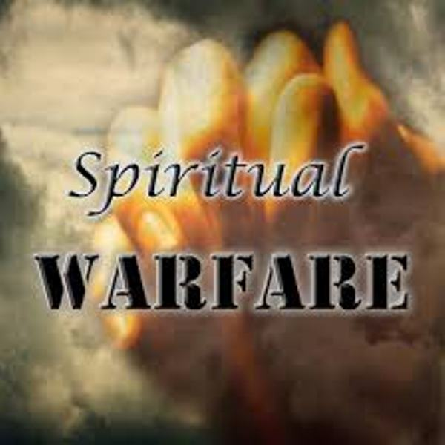
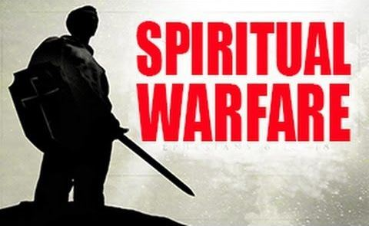
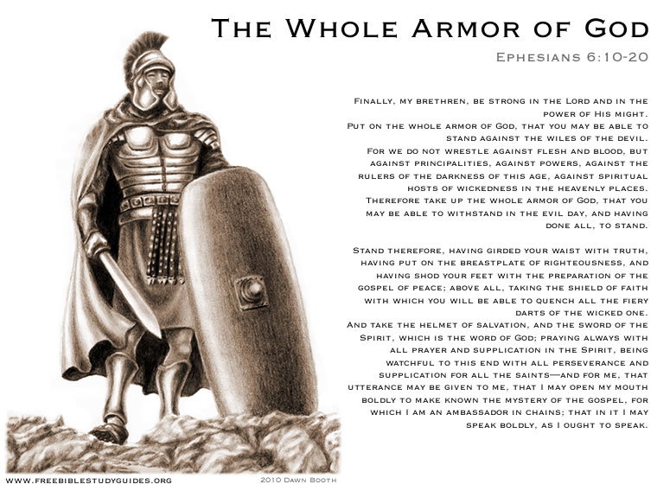


Slide 26
Satan / Lucifer
Rev. 12:9 (KJV)
⁹ And the great dragon was cast out, that old serpent, called the Devil, and Satan, which deceiveth the whole world: he was cast out into the earth, and his angels were cast out with him.

Slide 27
The Temptation of Jesus
Matt. 4:1-6 (AMP)
4 Then Jesus was led by the [Holy] Spirit into the wilderness to be tempted by the devil. ² After He had gone without food for forty days and forty nights, He became hungry. ³ And the tempter came and said to Him, “If You are the Son of God, command that these stones become bread.” ⁴ But Jesus replied, “It is written and forever remains written, ‘Man shall not live by bread alone, but by every word that comes out of the mouth of God.’”
⁵ Then the devil took Him into the holy city [Jerusalem] and placed Him on the pinnacle (highest point) of the temple. ⁶ And he said [mockingly] to Him, “If You are the Son of God, throw Yourself down; for it is written,
‘He will command His angels concerning You [to serve, care for, protect and watch over You]’; and ‘They will lift you up on their hands, So that You will not strike Your foot against a stone.’”

Slide 28
Matt. 4:7-11 (AMP)
⁷ Jesus said to him, “On the other hand, it is written and forever remains written, ‘You shall not test the Lord your God.’”
⁸ Again, the devil took Him up on a very high mountain and showed Him all the kingdoms of the world and the glory [splendor, magnificence, and excellence] of them; ⁹ and he said to Him, “All these things I will give You, if You fall down and worship me.” ¹⁰ Then Jesus said to him, “Go away, Satan! For it is written and forever remains written, ‘You shall worship the Lord your God, and serve Him only.’” ¹¹ Then the devil left Him; and angels came and ministered to Him [bringing Him food and serving Him].

Slide 29
Eph. 6:11-17 (AMP)
¹¹ Put on the full armor of God [for His precepts are like the splendid armor of a heavily-armed soldier], so that you may be able to [successfully] stand up against all the schemes and the strategies and the deceits of the devil. ¹² For our struggle is not against flesh and blood [contending only with physical opponents], but against the rulers, against the powers, against the world forces of this [present] darkness, against the spiritual forces of wickedness in the heavenly (supernatural) places. ¹³ Therefore, put on the complete armor of God, so that you will be able to [successfully] resist and stand your ground in the evil day [of danger], and having done everything [that the crisis demands], to stand firm [in your place, fully prepared, immovable, victorious]. ¹⁴ So stand firm and hold your ground, having ^{[a]}tightened the wide band of truth (personal integrity, moral courage) around your waist and having put on the breastplate of righteousness (an upright heart), ¹⁵ and having ^{[b]}strapped on your feet the gospel of peace in preparation [to face the enemy with firm-footed stability and the readiness produced by the good news]. ¹⁶ Above all, lift up the [protective] ^{[c]}shield of faith with which you can extinguish all the flaming arrows of the evil one. ¹⁷ And take the helmet of salvation, and the sword of the Spirit, which is the Word of God.

Slide 30
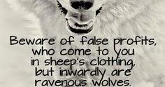
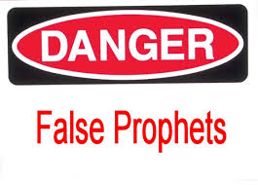
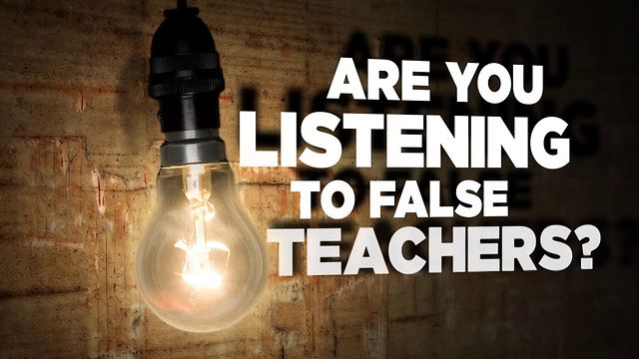

False Prophets/Teachers

Slide 31
John 8:44
⁴⁴ You are of your father the devil, and it is your will to practice the desires [which are characteristic] of your father. He was a murderer from the beginning, and does not stand in the truth because there is no truth in him. When he lies, he speaks what is natural to him, for he is a liar and the father of lies and half-truths.

Slide 32
Matthew 24:24 (AMP)
24 For false Christs and false prophets will appear and they will provide great signs and wonders, so as to deceive, if possible, even the elect (God’s chosen ones).
2 Peter 2:1 (AMP)
The Rise of False Prophets
2 But [in those days] false prophets arose among the people, just as there will be false teachers among you, who will subtly introduce destructive heresies, even denying the Master who bought them, bringing swift destruction on themselves.

Slide 33
1 John 4:1 (AMP)
4 Beloved, do not believe every spirit [speaking through a self-proclaimed prophet]; instead test the spirits to see whether they are from God, because many false prophets and teachers have gone out into the world.

Slide 34

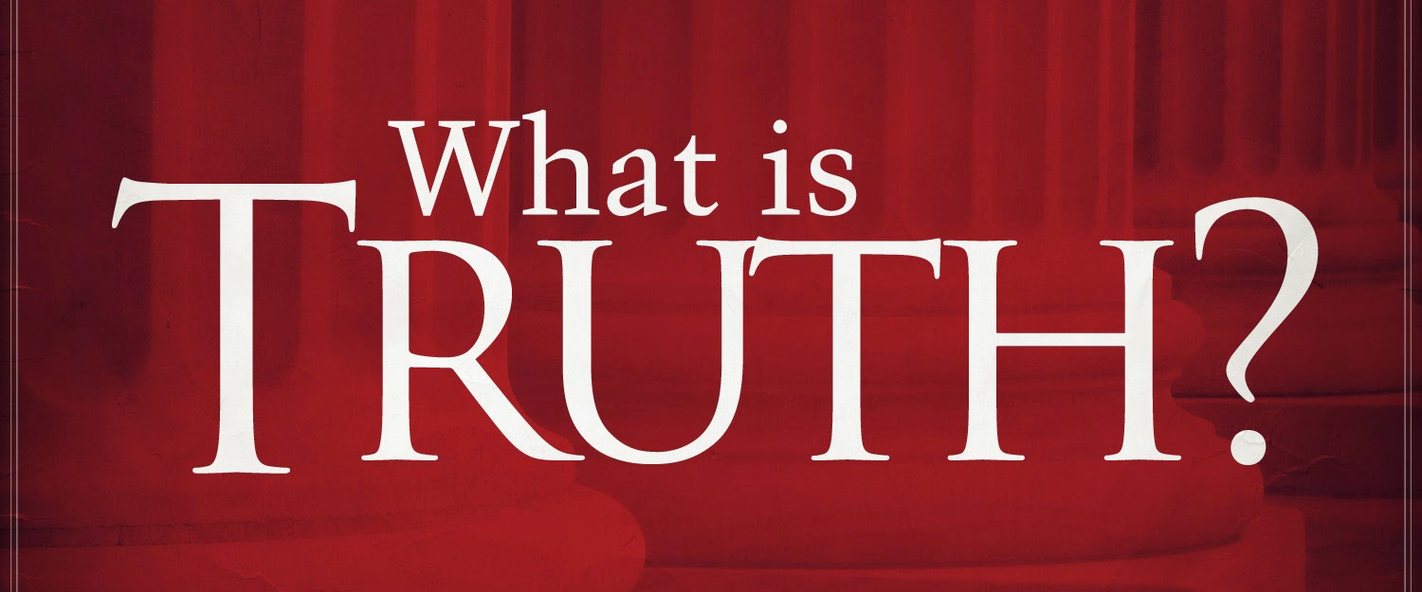

What is Truth?
Truth is the fundamental principles and precepts that God wants us to live by.

Slide 35
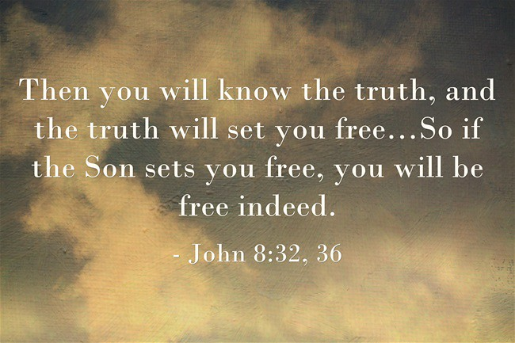

John 8:32 (AMP)
³² And you will know the truth [regarding salvation], and the truth will set you free [from the penalty of sin].”

Slide 36

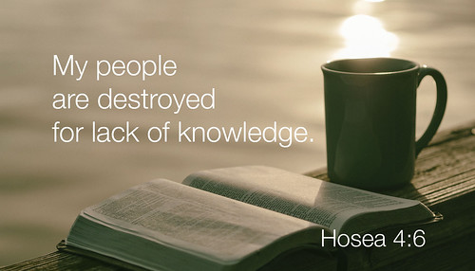
Hosea 4:6 (KJV)
⁶ My people are destroyed for lack of knowledge: because thou hast rejected knowledge, I will also reject thee, that thou shalt be no priest to me: seeing thou hast forgotten the law of thy God, I will also forget thy children.

Slide 37
Principle
A fundamental truth or proposition that serves as the foundation for a system of belief or behavior.

Slide 38
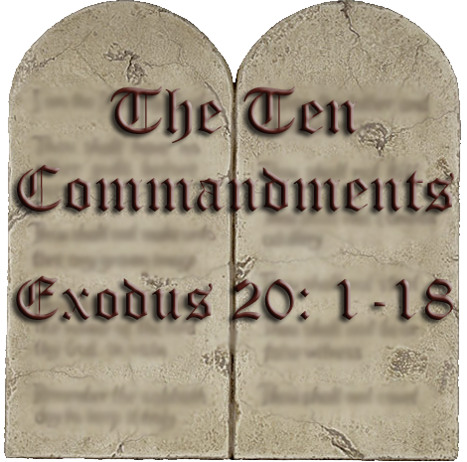
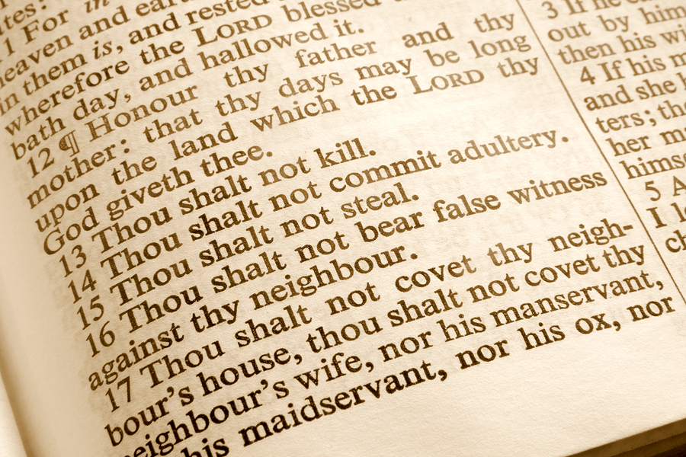
Precepts
The definition of a precept is a guiding principle or rule that is used to control, influence or regulate conduct. An example of a precept is a commandment found in the Ten Commandments

Slide 39
Deut. 6:4-7 (AMP)
⁴ “Hear, O Israel! The Lord is our God, the Lord is one [the only God]! ⁵ You shall love the Lord your God with all your heart and mind and with all your soul and with all your strength [your entire being]. ⁶ These words, which I am commanding you today, shall be [written] on your heart and mind. ⁷ You shall teach them diligently to your ^{[b]}children [impressing God’s precepts on their minds and penetrating their hearts with His truths] and shall speak of them when you sit in your house and when you walk on the road and when you lie down and when you get up.

Slide 40
Precepts
Psalms 119:4, 15, 27, 40 (AMP)
⁴ You have ordained Your precepts, That we should follow them with [careful] diligence.
¹⁵ I will meditate on Your precepts And [thoughtfully] regard Your ways [the path of life established by Your precepts].
²⁷ Make me understand the way of Your precepts, So that I will meditate (focus my thoughts) on Your wonderful works.
⁴⁰ I long for Your precepts; Renew me through Your righteousness.

Slide 41
Precepts
Psalms 119:45, 56, 63, 69 (AMP)
⁴⁵ And I will walk at liberty, For I seek and deeply long for Your precepts.
⁵⁶ This has become mine [as the gift of Your grace], That I observe Your precepts [accepting them with loving obedience].
⁶³ I am a companion of all who [reverently] fear You, And of those who keep and honor Your precepts.
⁶⁹ The arrogant have forged a lie against me, But I will keep Your precepts with all my heart.

Slide 42
Precepts
Isaiah 28:10-13 (AMP)
¹⁰ “For He says, ‘Precept upon precept, precept upon precept, Rule upon rule, rule upon rule, Here a little, there a little.’” ¹¹ Indeed, the Lord will teach this people [in a more humiliating way] By [men with] stammering lips and a foreign tongue, ¹² He who said to them, “This is the place of quiet, give rest to the weary,” And, “This is the resting place,” yet they would not listen. ¹³ Therefore the word of the Lord to them will be [merely monotonous repetitions]: “Precept upon precept, precept upon precept, Rule upon rule, rule upon rule, Here a little, there a little.” That they may go and stumble backward, and be broken, ensnared, and taken captive.

Slide 43
Rom. 10:1-3 (KJV)
10 Brethren, my heart's desire and prayer to God for Israel is, that they might be saved.
² For I bear them record that they have a zeal of God, but not according to knowledge.
³ For they being ignorant of God's righteousness, and going about to establish their own righteousness, have not submitted themselves unto the righteousness of God.

Slide 44
Spiritual Blindness
Isaiah 29:13 (AMP)
¹³ Then the Lord said,
“Because this nation approaches [Me only] with their words And honors Me [only] with their lip service, But they remove their hearts far from Me, And their reverence for Me is a tradition that is learned by rote [without any regard for its meaning],

Slide 45
Spiritual Blindness
Matt. 23:16-19 (AMP)
¹⁶ “Woe to you, blind guides, who say, ‘Whoever swears [an oath] by the sanctuary of the temple, that is nothing (non-binding); but whoever swears [an oath] by the gold of the temple is obligated [as a debtor to fulfill his vow and keep his promise].’ ¹⁷ You fools and blind men! Which is more important, the gold or the sanctuary of the temple that sanctified the gold? ¹⁸ And [you scribes and Pharisees say], ‘Whoever swears [an oath] by the altar, that is nothing (non-binding), but whoever swears [an oath] by the offering on it, he is obligated [as a debtor to fulfill his vow and keep his promise].’ ¹⁹ You [spiritually] blind men, which is more important, the offering, or the altar that sanctifies the offering?

Slide 46
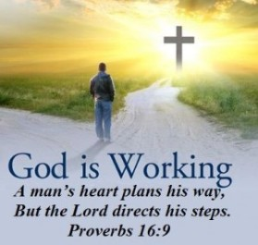
Spiritual Blindness
Matt. 23:24 (AMP)
²⁴ You [spiritually] blind guides, who strain out a gnat [consuming yourselves with miniscule matters] and swallow a camel [ignoring and violating God’s precepts]!

Slide 47
Deut. 4:1-6 (AMP)
Israel Urged to Obey God’s Law
4 “Now, O Israel, listen and pay attention to the statutes and the judgments (God’s legal decisions) which I am teaching you to do, so that you may live and go in and take possession of the land which the Lord, the God of your fathers, is giving you. ² You shall not add to the word which I am commanding you, nor take away from it, so that you may keep the commandments of the Lord your God which I am commanding you. ³ Your eyes have seen what the Lord did at Baal-peor; for all the men who followed [and participated in the worship of] Baal of Peor, the Lord your God destroyed them from among you, ⁴ but you who held tightly to the Lord your God are alive today, every one of you.
⁵ “Look, I have taught you statutes and judgments just as the Lord my God has commanded me, so that you may do them in the land which you are entering to possess. ⁶ So keep and do them, for that is your wisdom and your understanding in the sight of the peoples who will hear all these statutes and say, ‘Surely this great nation is a wise and understanding people.’

Slide 48
Deut. 4:7-10 (AMP)
⁷ For what great nation is there that has a god so near to it as the Lord our God [is to us] whenever we call on Him? ⁸ Or what great nation has statutes and judgments so righteous (upright, just) as this whole law which I am ^{[a]}placing before you today?
⁹ “Only pay attention and watch yourselves closely so that you do not forget the things which your eyes have seen and they do not depart from your heart all the days of your life. Make them known to your children and your grandchildren [impressing these things on their mind and penetrating their heart with these truths]— ¹⁰ especially the day you stood before the Lord your God at Horeb (Mount Sinai), when the Lord said to me, ‘Assemble the people to Me and I will let them hear My words, so that they may learn to fear Me [with awe-filled reverence and profound respect] all the days they live on the land, and so that they may teach their children.’

Slide 49
Spiritual Blindness
Matt. 15:12-14 (KJV)
¹² Then the disciples came and said to Jesus, “Do You know that the Pharisees were offended when they heard you say this?” ¹³ He answered, “Every plant which My heavenly Father did not plant will be torn up by the roots. ¹⁴ Leave them alone; they are blind guides ^{[a]}[leading blind followers]. If a blind man leads a blind man, both will fall into a pit.”

Slide 50
Message to the Church in Ephesus
Rev. 2:2-3 (AMP)
² ‘I know ^{[a]}your deeds and your toil, and your patient endurance, and that you cannot tolerate those who are evil, and have tested and critically appraised those who call themselves apostles (special messengers, personally chosen representatives, of Christ), and [in fact] are not, and have found them to be liars and impostors; ³ and [I know that] you [who believe] are enduring patiently and are bearing up for My name’s sake, and that you have not grown weary [of being faithful to the truth].

Slide 51
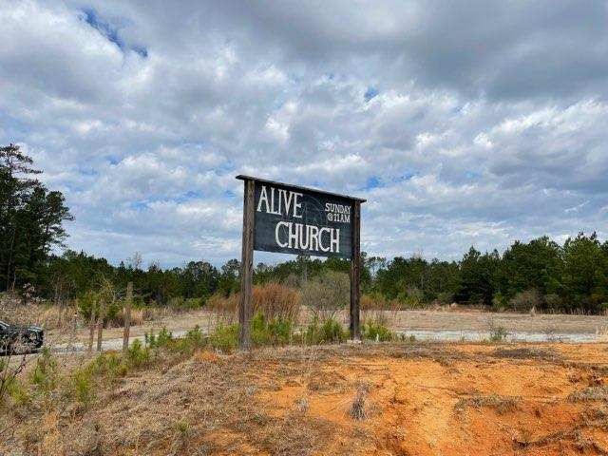
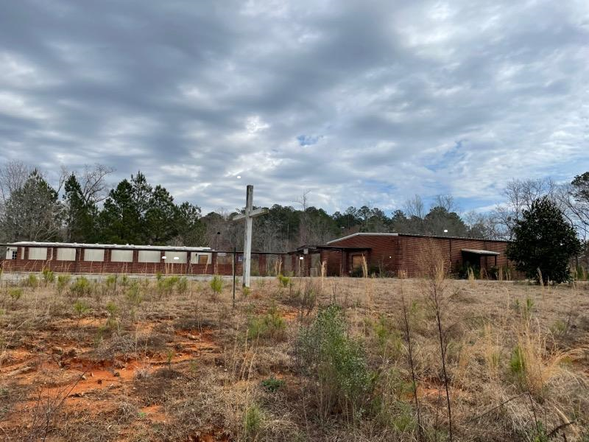
The Alive Church – Looking Dead – Macon, GA

Slide 52
Message to the Church in Laodicea
Rev. 3:14-22 (AMP)
14 “To the angel (divine messenger) of the church in Laodicea write:
These are the words of the Amen, the trusted and faithful and true Witness, the Beginning and Origin of God’s creation:
15 ‘I know your deeds, that you are neither cold (invigorating, refreshing) nor hot (healing, therapeutic); I wish that you were cold or hot. 16 So because you are lukewarm (spiritually useless), and neither hot nor cold, I will vomit you out of My mouth [rejecting you with disgust]. 17 Because you say, “I am rich, and have prospered and grown wealthy, and have need of nothing,” and you do not know that you are wretched and miserable and poor and blind and naked [without hope and in great need], 18 I counsel you to buy from Me gold that has been heated red hot and refined by fire so that you may become truly rich; and white clothes [representing righteousness] to clothe yourself so that the shame of your nakedness will not be seen; and healing salve to put on your eyes so that you may see. 19 Those whom I [dearly and tenderly] love, I rebuke and discipline [showing them their faults and instructing them]; so be enthusiastic and repent [change your inner self—your old way of thinking, your sinful behavior—seek God’s will]. 20 Behold, I stand at the door [of the church] and continually knock. If anyone hears My voice and opens the door, I will come in and eat with him (restore him), and he with Me. 21 He who overcomes [the world through believing that Jesus is the Son of God], I will grant to him [the privilege] to sit beside Me on My throne, as I also overcame and sat down beside My Father on His throne. 22 He who has an ear, let him hear and heed what the Spirit says to the churches.’ ”

Slide 53

John 4:24 (AMP)
²⁴ God is spirit [the Source of life, yet invisible to mankind], and those who worship Him must worship in spirit and truth.”

Slide 54
Message to the Church in Philadelphia
Rev. 3:7-13 (AMP)
7 “And to the angel (divine messenger) of the church in Philadelphia write:
These are the words of the Holy One, the True One, He who has the key [to the house] of David, He who opens and no one will [be able to] shut, and He who shuts and no one opens:
8 ‘I know your deeds. See, I have set before you an open door which no one is able to shut, for you have a little power, and have kept My word, and have not renounced or denied My name. 9 Take note, I will make those of the synagogue of Satan, who say that they are Jews and are not, but lie—I will make them come and bow down at your feet and make them know [without any doubt] that I have loved you. 10 Because you have kept the word of My endurance [My command to persevere], I will keep you [safe] from the hour of trial, that hour which is about to come on the whole [inhabited] world, to test those who live on the earth. 11 I am coming quickly. Hold tight what you have, so that no one will take your crown [by leading you to renounce the faith]. 12 He who overcomes [the world through believing that Jesus is the Son of God], I will make him a pillar in the temple of My God; he will most certainly never be put out of it, and I will write on him the name of My God, and the name of the city of My God, the new Jerusalem, which descends out of heaven from My God, and My [own] new name. 13 He who has an ear, let him hear and heed what the Spirit says to the churches.’

Slide 55
Message to the Church in Sardis
Rev. 3:1-6 (AMP)
1 “To the angel (divine messenger) of the church in Sardis write:
These are the words of Him who has the seven Spirits of God and the seven stars: ‘I know your deeds; you have a name (reputation) that you are alive, but [in reality] you are dead. 2 Wake up, and strengthen and reaffirm what remains [of your faithful commitment to Me], which is about to die; for I have not found [any of] your deeds completed in the sight of My God or meeting His requirements. 3 So remember and take to heart the lessons you have received and heard. Keep and obey them, and repent [change your sinful way of thinking, and demonstrate your repentance with new behavior that proves a conscious decision to turn away from sin]. So then, if you do not wake up, I will come like a thief, and you will not know at what hour I will come to you. 4 But you [still] have a few people in Sardis who have not soiled their clothes [that is, contaminated their character and personal integrity with sin]; and they will walk with Me [dressed] in white, because they are worthy (righteous). 5 He who overcomes [the world through believing that Jesus is the Son of God] will accordingly be dressed in white clothing; and I will never blot out his name from the Book of Life, and I will confess and openly acknowledge his name before My Father and before His angels [saying that he is one of Mine]. 6 He who has an ear, let him hear and heed what the Spirit says to the churches.’

Slide 56
Message to the Church in Thyatira
Rev. 2:18-29 (AMP)
18 “And to the angel (divine messenger) of the church in Thyatira write:
These are the words of the Son of God, who has eyes [that flash] like a flame of fire [in righteous judgment], and whose feet are like burnished [white-hot] bronze:
19 ‘I know your deeds, your love and faith and service and patient endurance, and that your last deeds are more numerous and greater than the first. 20 But I have this [charge] against you, that you tolerate the woman Jezebel, who calls herself a prophetess [claiming to be inspired], and she teaches and misleads My bond-servants so that they commit [acts of sexual] immorality and eat food sacrificed to idols. 21 I gave her time to repent [to change her inner self and her sinful way of thinking], but she has no desire to repent of her immorality and refuses to do so. 22 Listen carefully, I will throw her on a bed of sickness, and those who commit adultery with her [I will bring] into great anguish, unless they repent of her deeds. 23 And I will kill her children (followers) with pestilence [thoroughly annihilating them], and all the churches will know [without any doubt] that I am He who searches the minds and hearts [the innermost thoughts, purposes]; and I will give to each one of you [a reward or punishment] according to your deeds. 24 But to the rest of you in Thyatira, who do not hold this teaching, who have not explored and known the depths of Satan, as they call them—I place no other burden on you, 25 except to hold tightly to what you have until I come. 26 And he who overcomes [the world through believing that Jesus is the Son of God] and he who keeps My deeds [doing things that please Me] until the [very] end, to him I will give authority and power over the nations; 27 and he shall shepherd and rule them with a rod of iron, as the earthen pots are broken in pieces, as I also have received authority [and power to rule them] from My Father; 28 and I will give him the Morning Star. 29 He who has an ear, let him hear and heed what the Spirit says to the churches.’

Slide 57
Message to the Church in Ephesus
Rev. 2:1-7 (AMP)
1 “To the angel (divine messenger) of the church in Ephesus write:
These are the words of the One who holds [firmly] the seven stars [which are the angels or messengers of the seven churches] in His right hand, the One who walks among the seven golden lampstands (the seven churches):
2 ‘I know your deeds and your toil, and your patient endurance, and that you cannot tolerate those who are evil, and have tested and critically appraised those who call themselves apostles (special messengers, personally chosen representatives, of Christ), and [in fact] are not, and have found them to be liars and impostors; 3 and [I know that] you [who believe] are enduring patiently and are bearing up for My name’s sake, and that you have not grown weary [of being faithful to the truth]. 4 But I have this [charge] against you, that you have left your first love [you have lost the depth of love that you first had for Me]. 5 So remember the heights from which you have fallen, and repent [change your inner self—your old way of thinking, your sinful behavior—seek God’s will] and do the works you did at first [when you first knew Me]; otherwise, I will visit you and remove your lampstand (the church, its impact) from its place—unless you repent. 6 Yet you have this [to your credit], that you hate the works and corrupt teachings of the Nicolaitans [that mislead and delude the people], which I also hate. 7 He who has an ear, let him hear and heed what the Spirit says to the churches. To him who overcomes [the world through believing that Jesus is the Son of God], I will grant [the privilege] to eat [the fruit] from the tree of life, which is in the Paradise of God.’

Slide 58
Message to the Church in Smyrna
Rev. 2:8-11 (AMP)
8 “And to the angel (divine messenger) of the church in Smyrna write:
These are the words of the First and the Last [absolute Deity, the Son of God] who died and came to life [again]:
9 ‘I know your suffering and your poverty (but you are rich), and how you are blasphemed and slandered by those who say they are Jews and are not, but are a synagogue of Satan [they are Jews only by blood, and do not believe and truly honor the God whom they claim to worship]. 10 Fear nothing that you are about to suffer. Be aware that the devil is about to throw some of you into prison, that you may be tested [in your faith], and for ten days you will have tribulation. Be faithful to the point of death [if you must die for your faith], and I will give you the crown [consisting] of life. 11 He who has an ear, let him hear and heed what the Spirit says to the churches. He who overcomes [the world through believing that Jesus is the Son of God] will not be hurt by the second death (the lake of fire).’

Slide 59
Message to the Church in Pergamum
Rev. 2:12-17 (AMP)
12 “And to the angel (divine messenger) of the church in Pergamum write:
These are the words of Him who has and wields the sharp two-edged sword [in judgment]:
13 ‘I know where you dwell, [a place] where Satan sits enthroned. Yet you are holding fast to My name, and you did not deny My faith even in the days of Antipas, My witness, My faithful one, who was killed (martyred) among you, where Satan dwells. 14 But I have a few things against you, because you have there some [among you] who are holding to the [corrupt] teaching of Balaam, who taught Balak to put a stumbling block before the sons of Israel, [enticing them] to eat things that had been sacrificed to idols and to commit [acts of sexual] immorality. 15 You also have some who in the same way are holding to the teaching of the Nicolaitans. 16 Therefore repent [change your inner self—your old way of thinking, your sinful behavior—seek God’s will]; or else I am coming to you quickly, and I will make war and fight against them with the sword of My mouth [in judgment]. 17 He who has an ear, let him hear and heed what the Spirit says to the churches. To him who overcomes [the world through believing that Jesus is the Son of God], to him I will give [the privilege of eating] some of the hidden manna, and I will give him a white stone with a new name engraved on the stone which no one knows except the one who receives it.’

Slide 60
