Slide 1



HOW TO STUDY the BIBLE

Slide 2
Why?
Study the Bible
Command
Consciousness
Contend

Slide 3
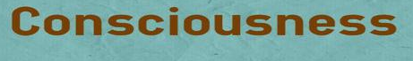
Hosea 4:6
Romans 10:1-3
2 Timothy 3:14-17

Slide 4
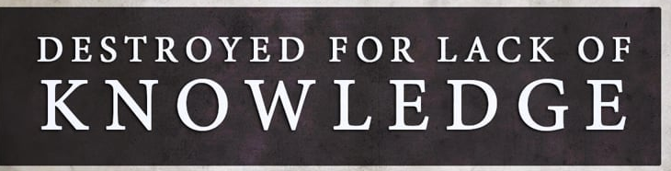
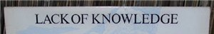
Hosea 4:6 (KJV)
“My people are destroyed for lack of knowledge: because thou hast rejected knowledge, I will also reject thee, that thou shalt be no priest to me: seeing thou hast forgotten the law of thy God, I will also forget thy children.”

Slide 5


Romans 10:1 – 3 (KJV)
Brethren, my heart’s desire and prayer to God for Israel is, that they might be saved. For I bear them record that they have a zeal of God, but not according to knowledge. For they being ignorant of God’s righteousness, and going about to establish their own righteousness, have not submitted themselves unto the righteousness of God.

Slide 6
2 Tim. 3:14-17 (KJV)
But continue thou in the things which thou hast learned and hast been assured of, knowing of whom thou hast learned them; And that from a child thou hast known the holy scriptures, which are able to make thee wise unto salvation through faith which is in Christ Jesus. All scripture is given by inspiration of God, and is profitable for doctrine, for reproof, for correction, for instruction in righteousness: That the man of God may be perfect, thoroughly furnished unto all good works.

Slide 7
2 Tim. 3:14-17 (MSG)
But don’t let it faze you. Stick with what you learned and believed, sure of the integrity of your teachers—why, you took in the sacred Scriptures with your mother’s milk! There’s nothing like the written Word of God for showing you the way to salvation through faith in Christ Jesus. Every part of Scripture is God-breathed and useful one way or another—showing us truth, exposing our rebellion, correcting our mistakes, training us to live God’s way, through the Word we are put together and shaped up for the tasks God has for us.

Slide 8
HOW?
To Study the Bible
Many methods of Bible Study exist:
A Theme
A book of the Bible
A passage of the Bible
A Bible word
A Doctrine
A Person
A Topic

Slide 9
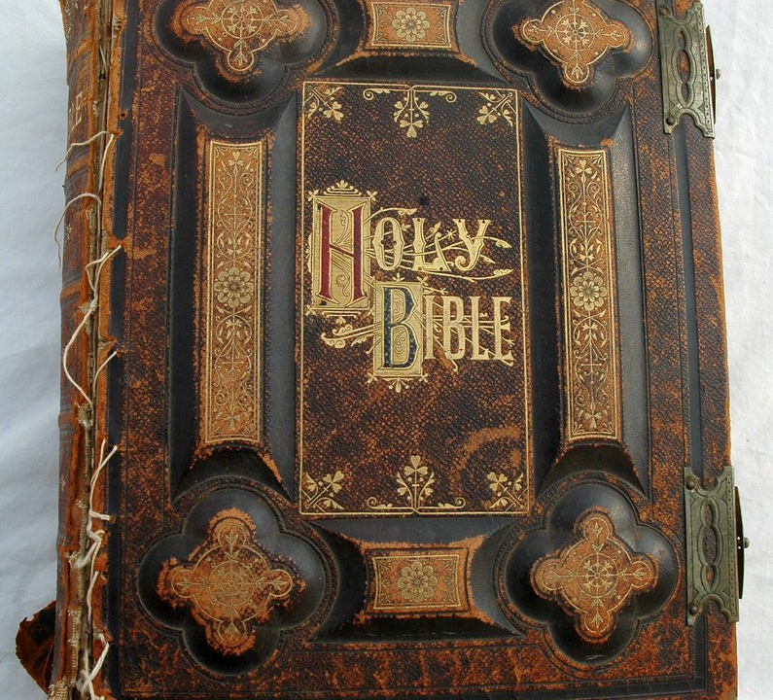
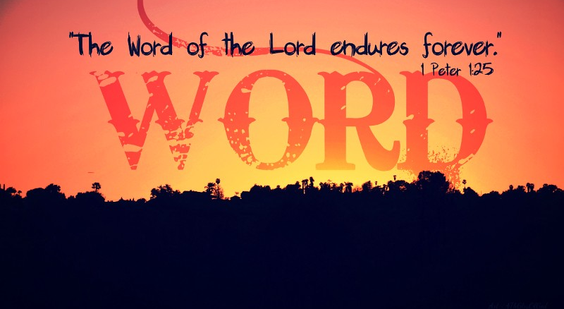
The Basics
Learn the fundamental basis of the Bible based on your own study habits.

Slide 10


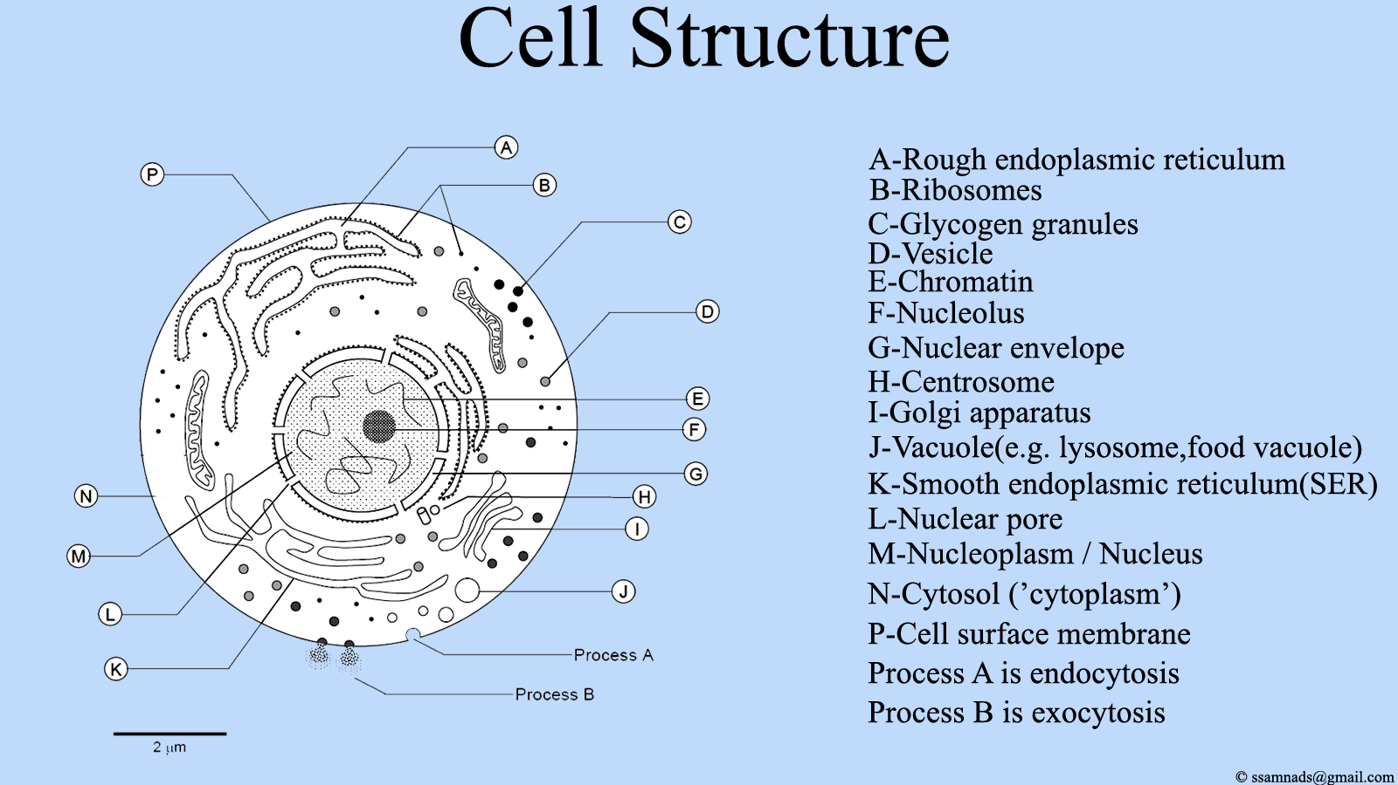

How to Study the Bible
The Believer Should:
1st Learn the BASICS (facts)
2nd Learn the STRUCTURE (interpretation)
3rd Learn the PRINCIPLES (foundational truths)

Slide 11


Studying a Person/Character
Choose a Bible character and discover what God teaches you through this person’s life.
Gather basic information about the character:
Genealogy: what shaped the person’s formative years?
Geography: where was the person born?
Significant events in the person’s life
How the person responded to events
What other characters were this person’s contemporaries
Statements the character made and what others said about this person
What impact the person had on others
The person’s strengths and weaknesses
Evidence of the person’s devotion to the Lord
Establish a lifeline for the Bible character and document with Scripture
Write biblical principles you learn from the character’s life.
Apply the teaching to your life. What strengths or weaknesses do you share with the person?

Slide 12





