Slide 1
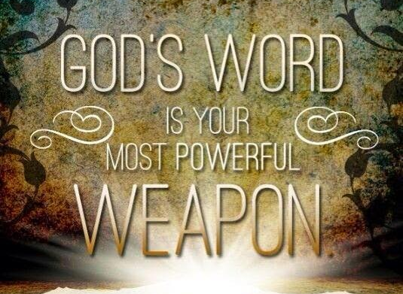
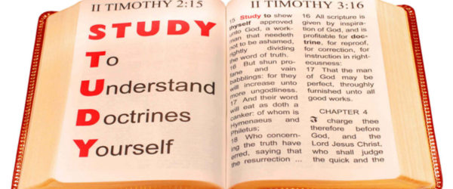
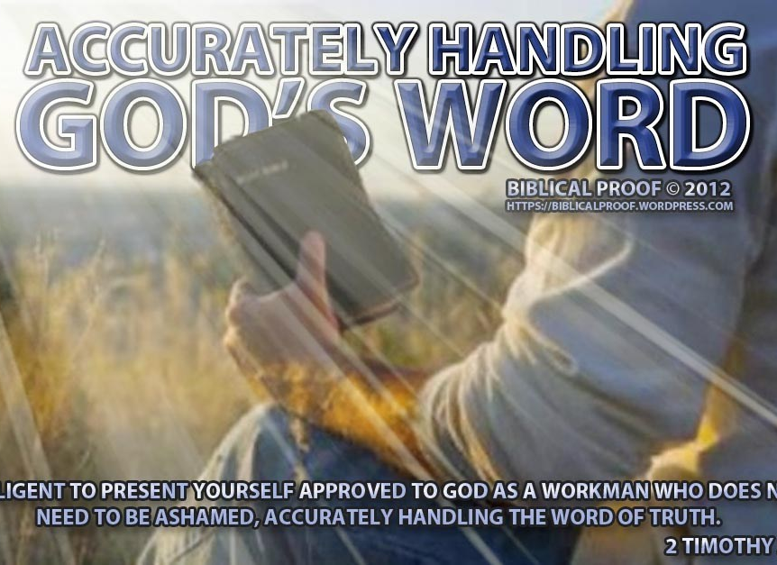
HOW TO STUDY the BIBLE

Slide 2
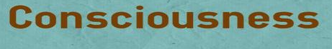
Hosea 4:1-6
Romans 1:28-32
Romans 10:1-3
2 Timothy 3:14-17

Slide 3
KNOWLEDGE
The Greek word GINOSKO signified to be taken in knowledge, to come to know, recognize, understand, or to understand completely, it frequently means to know in the sense of realizing.

Slide 4
GINOSKO
In the New Testament, Ginosko frequently indicates a relation between the person knowing and the object known; in this respect what is known is of value or importance to the one who knows. Knowing suggests approval and bears the meaning to be approved.

Slide 5
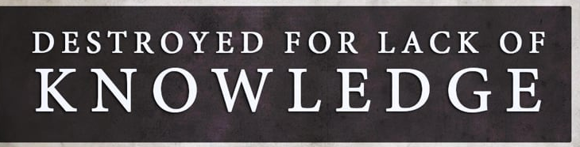
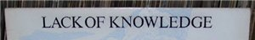
Hosea 4:1-6 (NIV)
Hear the word of the Lord, you Israelites, because the Lord has a charge to bring against you who live in the land: There is no faithfulness, no love, no acknowledgement of God in the land. There is only cursing, lying and murder, stealing and adultery; they break all bounds, and bloodshed follows bloodshed. Because of this the land dries up, and all who live in it waste away; the beasts of the field, the birds in the sky and the fish in the sea are swept away. But let no one bring a charge, let no one accuse another, for your people are like those who bring charges against a priest. You stumble day and night, and the prophets stumble with you. So I will destroy your mother—my people are destroyed from lack of knowledge. “Because you have rejected knowledge, I also reject you as my priests; because you have ignored the law of your God, I also will ignore your children.

Slide 6
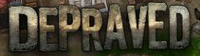

1 Corinthians 2:14 (KJV)
Romans 1: 28-32 (NIV)
Furthermore, just as they did not think it worthwhile to retain the knowledge of God, so God gave them over to a depraved mind, so that they do what ought not to be done. They have become filled with every kind of wickedness, evil, greed and depravity. They are full of envy, murder, strife, deceit and malice. They are gossips, slanderers, God-haters, insolent, arrogant and boastful; they invent ways of doing evil; they disobey their parents; they have no understanding, no fidelity, no love, no mercy. Although they know God’s righteous decree that those who do such things deserve death, they not only continue to do these very things but also approve of those who practice them.

Slide 7


Romans 10:1 – 3 (KJV)
Brethren, my heart’s desire and prayer to God for Israel is, that they might be saved. For I bear them record that they have a zeal of God, but not according to knowledge. For they being ignorant of God’s righteousness, and going about to establish their own righteousness, have not submitted themselves unto the righteousness of God.
Romans 10:1 – 3 (NIV)
Brothers and sisters, my heart’s desire and prayer to God for the Israelites is that they may be saved. For I can testify about them that they are zealous for God, but their zeal is not based on knowledge. Since they did not know the righteousness of God and sought to establish their own, they did not submit to God’s righteousness.

Slide 8
REJECTION OF KNOWLEDGE
Causes Destruction
Rejection of Religious Leadership
Generational Repercussions
Depraved or Reprobate Mind
Defilement
Death

Slide 9
Quality of Knowledge = Quality of Development
John 8:31-32 (KJV)
Then said Jesus to those Jews which believed on him, If ye continue in my word, then are ye my disciples indeed; And ye shall know the truth, and the truth shall make you free.
2 Peter 3:17-18 (KJV)
Ye, therefore, beloved, seeing ye know these things before, beware lest ye also, being led away with the error of the wicked, fall from your own stedfastness. But grow in grace, and in the knowledge of our Lord and Saviour Jesus Christ. To him be glory both now and for ever. Amen.

Slide 10
2 Tim. 3:14-17 (MSG)
But don’t let it faze you. Stick with what you learned and believed, sure of the integrity of your teachers—why, you took in the sacred Scriptures with your mother’s milk! There’s nothing like the written Word of God for showing you the way to salvation through faith in Christ Jesus. Every part of Scripture is God-breathed and useful one way or another—showing us truth, exposing our rebellion, correcting our mistakes, training us to live God’s way, through the Word we are put together and shaped up for the tasks God has for us.

Slide 11
HOW?
To Study the Bible
Many methods of Bible Study exist:
Basics of the Bible
A Theme
A book of the Bible
A passage of the Bible
A Bible word
A Doctrine
A Person
A Topic

Slide 12
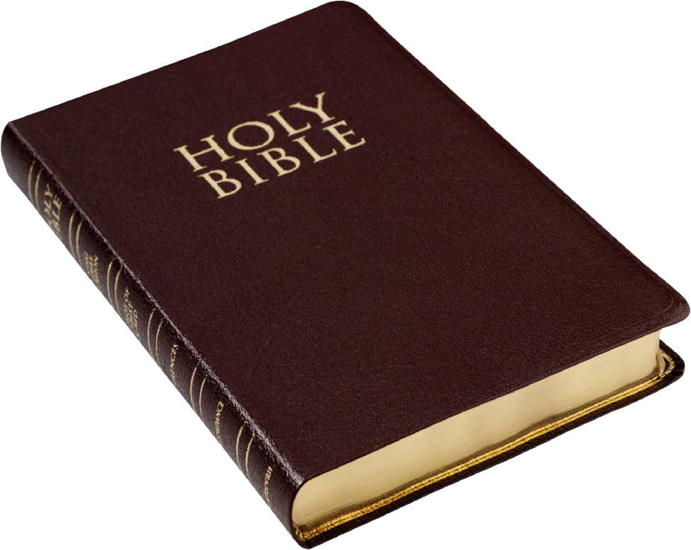

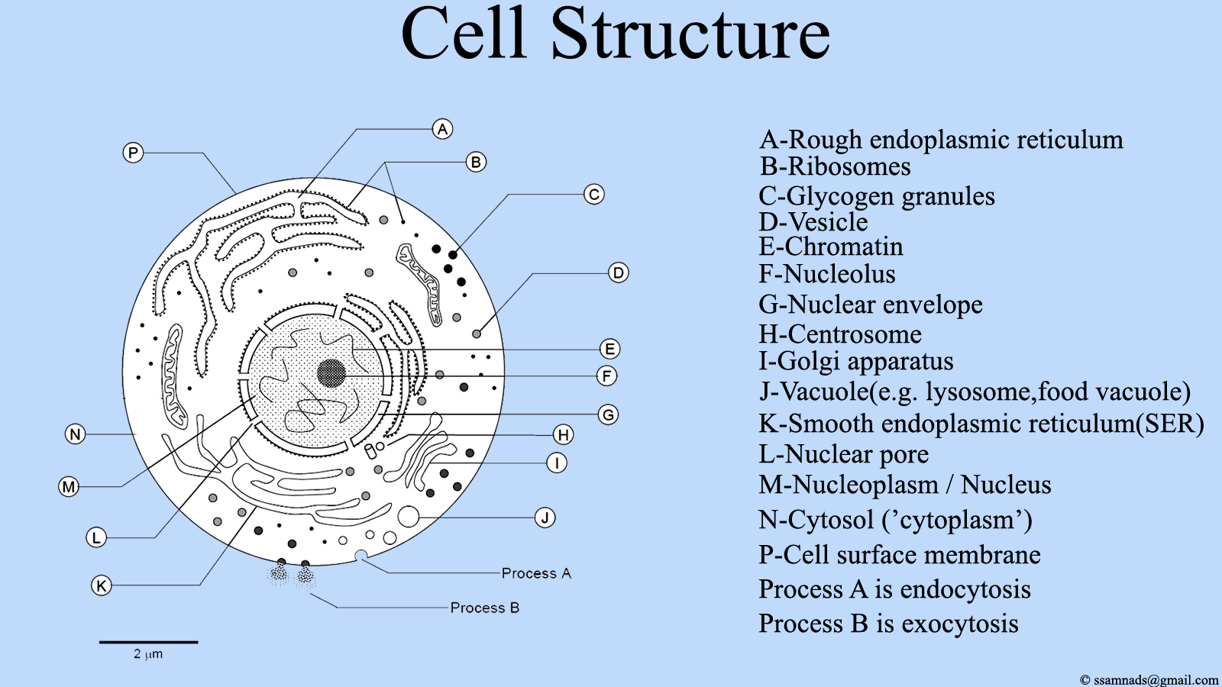

How to Study the Bible
The Believer Should:
1st Learn the BASICS (facts)
2nd Learn the STRUCTURE (interpretation)
3rd Learn the PRINCIPLES (foundational truths)

Slide 13
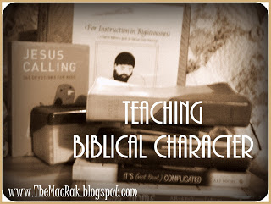

Studying a Person/Character
Choose a Bible character and discover what God teaches you through this person’s life.
Gather basic information about the character:
Genealogy: what shaped the person’s formative years?
Geography: where was the person born?
Significant events in the person’s life
How the person responded to events
What other characters were this person’s contemporaries
Statements the character made and what others said about this person
What impact the person had on others
The person’s strengths and weaknesses
Evidence of the person’s devotion to the Lord
Establish a lifeline for the Bible character and document with Scripture
Write biblical principles you learn from the character’s life.
Apply the teaching to your life. What strengths or weaknesses do you share with the person?

Slide 14
Abraham
Genealogy: what shaped the person’s formative years?
Genealogy is an account of the descent of a person, family or group from an ancestor. Biblical genealogy is important because it reveals how God has worked in the life of a people. We can learn lessons about the character we are studying by knowing how that character’s perspective is shaped based upon how the person understood God as he interacted with the ancestors. Moreover, it evidences the historical walk with God and the people he guides.
Abraham can be traced to Noah (Genesis 10:1)
He’s in the lineage of Shem (Genesis 11:10-27)
Interesting Fact – The name Shem is Hebrew – the Arabic is pronounced Sem. Adding the suffix itc brings specific reference to the biblical character as it relates to the lineage or the tribe Hence, Shemite, Semic or Shemtic/Semitic makes reference to those who are in the lineage of Shem

Slide 15
Abraham
Geography: where was the person born?
Abraham, who is first introduced to us as Abram in the Bible (Genesis 11:27), was a native of Ur in Mesopotamia. Ur – the Moon City is a city of the Chaldea. It was the center of political power and it stood near the mouth of the Euphrates River on the western bank.

Slide 16
Abraham
Significant events in the person’s life
He is married to his half sister Sarai (Genesis 11:29-30) and she is barren.
Abram, Sarai his wife, his father, Terah, and his nephew, Lot leaves their home place, Ur (Genesis 11:31)
God speaks to him in a dream (Genesis 12:1-3)
Abram responds yes to God (Genesis 12:4-10)
He engages the Egyptian Pharoah (Genesis 12:11-20)
Significant Circumstances
The name Abram means Exalted Father
His name is changed to Abraham which means Father of Many Nations
Names are significant in the Bible as it relates to the character
Abraham’s Expression of Faith
God’s Use of Covenant

Slide 17
Courses We Offer
Introduction to the Bible is a study of basic facts about the Bible
Women of the Bible – is a course on the development of character
The Gospel of John is a course about the book of John in the Bible

Slide 18
Announcements
Community Cleanup – Saturday, March 27, 2021 – Everyone is encouraged to clean up your property
Community Feeding – 12 NOON – 2 PM – Drive-up @ BRW
Palm Sunday Service is Sunday at 7:30AM
Holy Week Mid-day Services – Monday – Friday @ 12 Noon
Resurrection Service – 1st Sunday April @ 10am Drive-up

