Slide 1
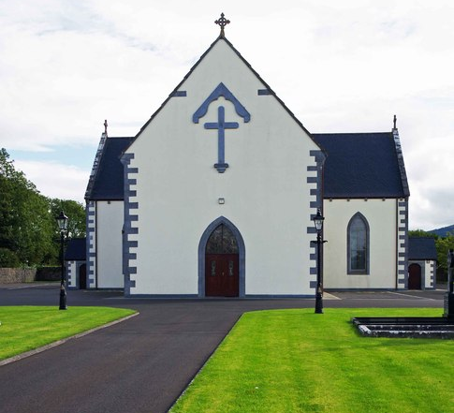
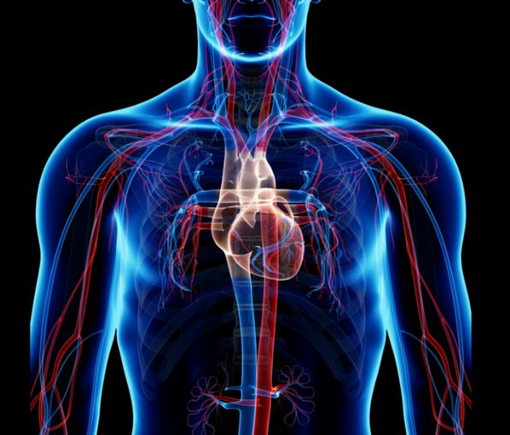
The Function of the Body
October 27, 2021

Slide 2
The Body
1 Cor. 12:27 (NIV)
Now you are the body of Christ, and each one of you is a part of it.
Ephesians 1:13 (NIV)
And you also were included in Christ when you heard the message of truth, the gospel of your salvation. When you believed, you were marked in him with a seal, the promised Holy Spirit …
Ephesians 2:22 (NIV)
And in him you too are being built together to become a dwelling in which God lives by his Spirit.

Slide 3
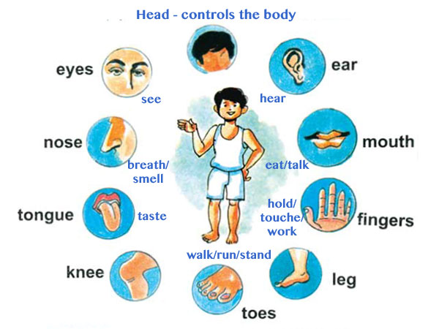
Christ is the Head
Colossians 1:17-18 (NIV)
He is before all things, and in him all things hold together. And he is the head of the body, the church; he is the beginning and the firstborn from among the dead, so that in everything he might have the supremacy.

Slide 4

The Submission
1 Cor. 12:25-26 (NIV)
… so that there should be no division in the body, but that its parts should have equal concern for each other. If one part suffers, every part suffers with it; if one part is honored, every part rejoices with it.

Slide 5

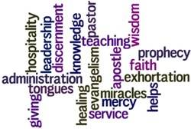
Parts of the Body
1 Cor. 12:1-26 (NIV)

Slide 6
Healthy Church
Worship | Discipleship | Fellowship | Evangelism | Mission
Hospitality | Knowledge | Wisdom (Spiritual Counseling) | Faith | Faith
Faith | Faith | Faith | Prophecy/Preaching | Healing
Prophecy/Preaching | Teaching | Healing | Speaking in Tongues | Ministering
Interpretation of tongues |  | Miracles | Evangelist
Unknown Tongues |  | Discerning the spirit
Ministering |  | Exhortation

Slide 7
The Call
Ephesians 4:1-7 (AMP)
So I, the prisoner for the Lord, appeal to you to live a life worthy of the calling to which you have been called [that is, to live a life that exhibits godly character, moral courage, personal integrity, and mature behavior—a life that expresses gratitude to God for your salvation], with all humility [forsaking self-righteousness], and gentleness [maintaining self-control], with patience, bearing with one another in [unselfish] love. Make every effort to keep the oneness of the Spirit in the bond of peace [each individual working together to make the whole successful]. There is one body [of believers] and one Spirit—just as you were called to one hope when called [to salvation]—one Lord, one faith, one baptism, one God and Father of us all who is [sovereign] over all and [working] through all and [living] in all. Yet grace [God’s undeserved favor] was given to each one of us [not indiscriminately, but in different ways] in proportion to the measure of Christ’s [rich and abundant] gift.

Slide 8
The Service
Ephesians 4:11-16 (NIV)
So Christ himself gave the apostles, the prophets, the evangelists, the pastors and teachers, to equip his people for works of service, so that the body of Christ may be built up until we all reach unity in the faith and in the knowledge of the Son of God and become mature, attaining to the whole measure of the fullness of Christ. Then we will no longer be infants, tossed back and forth by the waves, and blown here and there by every wind of teaching and by the cunning and craftiness of people in their deceitful scheming. Instead, speaking the truth in love, we will grow to become in every respect the mature body of him who is the head, that is, Christ. From him the whole body, joined and held together by every supporting ligament, grows and builds itself up in love, as each part does its work.

Slide 9
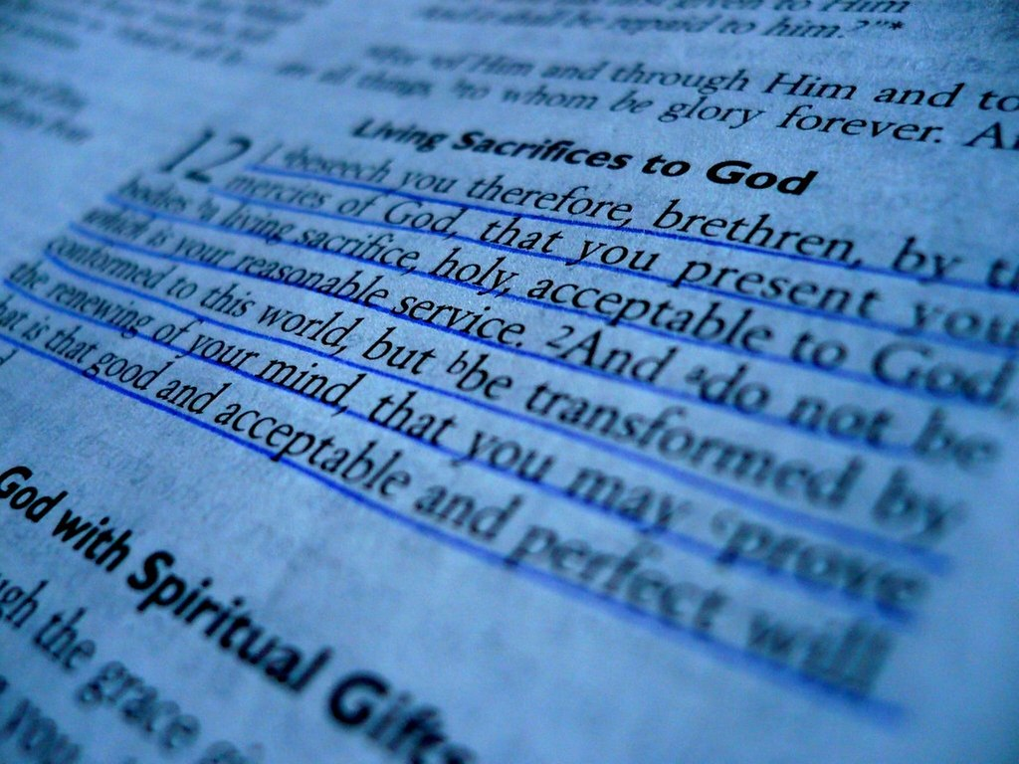
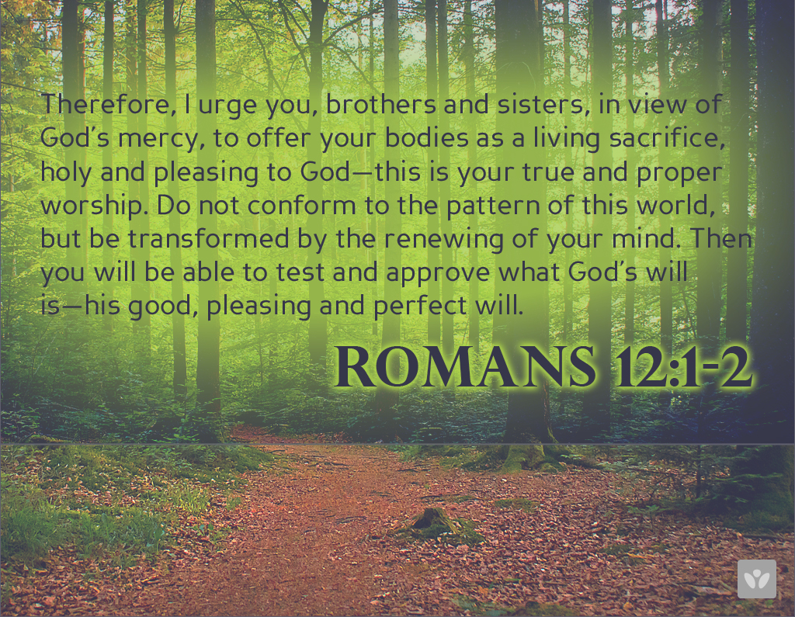
Romans 12:1-2 (NIV)
Therefore, I urge you, brothers and sisters, in view of God’s mercy, to offer your bodies as a living sacrifice, holy and pleasing to God—this is your true and proper worship. Do not conform to the pattern of this world, but be transformed by the renewing of your mind. Then you will be able to test and approve what God’s will is—his good, pleasing and perfect will.

Slide 10
God/Shephard
Undershephard
Pastor
God gives him the vision
MISSION
EVANGELISM
W O R S H I P
FELLOWSHIP
DISCIPLESHIP

Slide 11


Worship Ministries
Worship Services
Deacons/Jr. Deacons
Deaconess/Jr. Deaconess
Mothers
Sr. Ushers/Jr. Ushers
Courtesy Guild
Cultural
Music Ministry

Slide 12


Fellowship Ministries
Klan Elders
Youth Ministry
Family Ministry
Elisha Ministry

Slide 13

Evangelism
Radio
TV
Tape/CD/DVD
Revival
Street Evangelism
Evangelism Task Force
Prison
Canvassing
Crusade
Home Outreach
Targeted Evangelism
Discipler

Slide 14


Mission Ministries
Missionary
Mission in Action (MIA)
Shelter (Homeless)
Scholarship/Contributions
MANNA
Toys for Tots
Bus Ministry
Tutorial
Haiti (Food/Shelter)
Springfield Family Support
Substance Abuse
Health Ministry
Prison Ministry
Imani Ministry
Senior boxes
Angel Tree

Slide 15


Discipleship Ministries
__a. Church School
__b. New Membership
__c. Equipping Hour
__Wed. (11 AM)
__Wed. (6:30 PM)
__Sat. (8:30 AM)
__d. Backyard Bible Study
__e. SBC Bible Institute
__f. Lectures
__g. Mini Congress
__h. Vacation Bible School
__i. National Convention
__j. National Congress
__k. State Convention
__l. State Congress
__m. 4th Shiloh Assoc.
__n. District Congress
__o. District Convention
__p. Media Ministry
__Library
__Internet
__q. Teacher’s Training
__r. Community Bible Study

