Slide 1
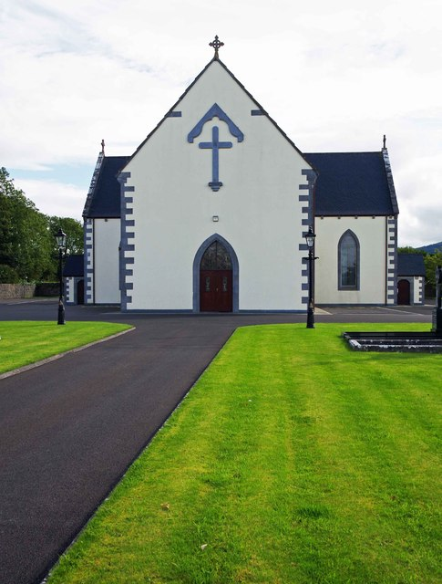

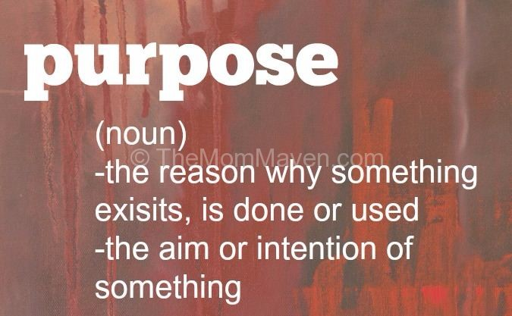

The Church Purpose
Matthew 28:18-20
Acts 2
October 20, 2021

Slide 2

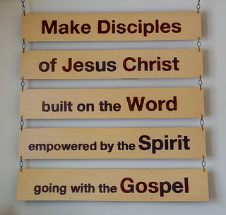
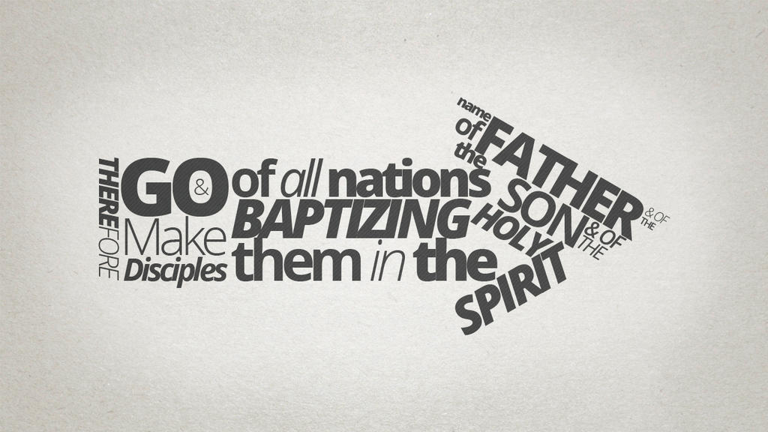

Slide 3
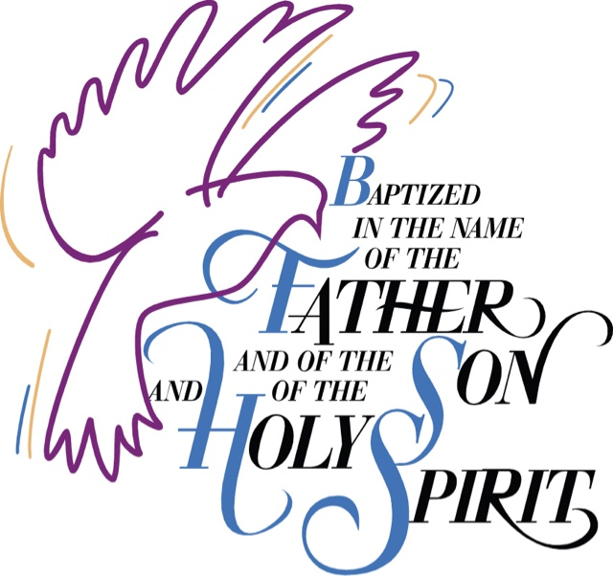
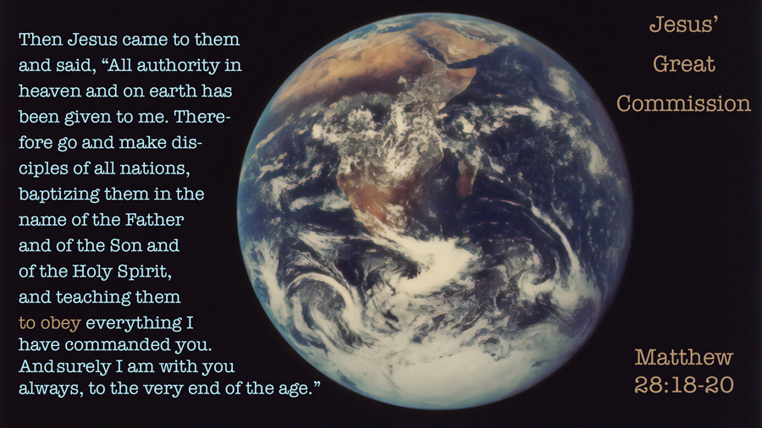
The Great Commission

Slide 4
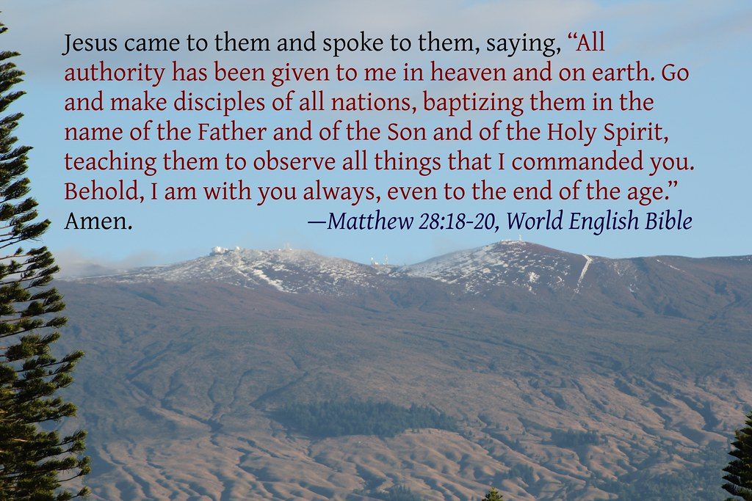
Matthew 28:18-20 (AMP)
Jesus came up and said to them, “All authority (all power of absolute rule) in heaven and on earth has been given to Me. Go therefore and make disciples of all nations [help the people to learn of Me, believe in Me, and obey My words], baptizing them in the name of the Father and of the Son and of the Holy Spirit, teaching them to observe everything that I have commanded you; and lo, I am with you always [remaining with you perpetually—regardless of circumstance, and on every occasion], even to the end of the age.”

Slide 5
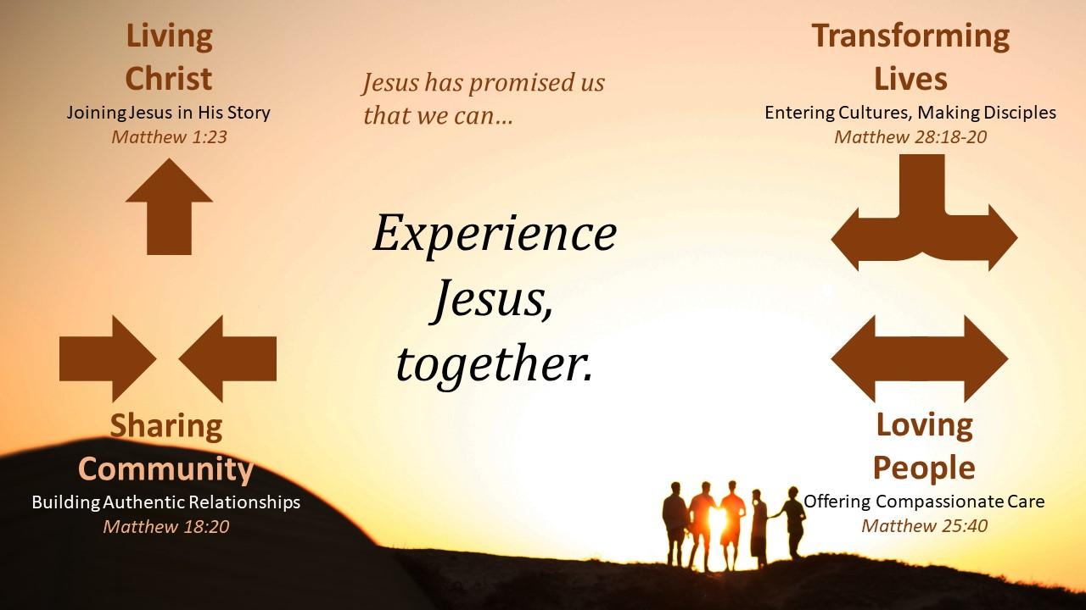

Slide 6
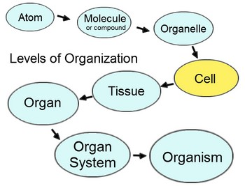
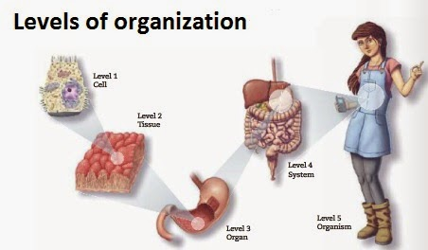
Simple Definition of an Organism
An organism is an individual form of life that is capable of growing and reproducing, and have one or more cells. Animals, plants and bacterium are all organisms. … Inside the body, organelles or organs work together to sustain life. Organisms can also respond to stimuli, grow and reproduce.

Slide 7
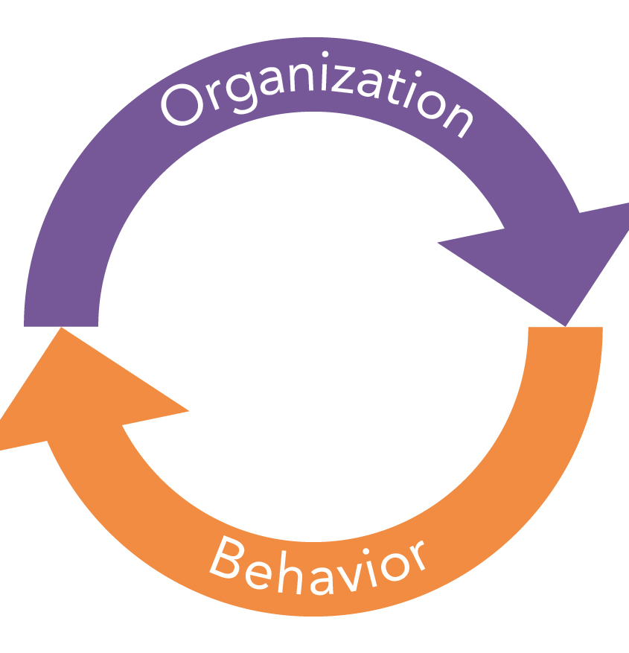
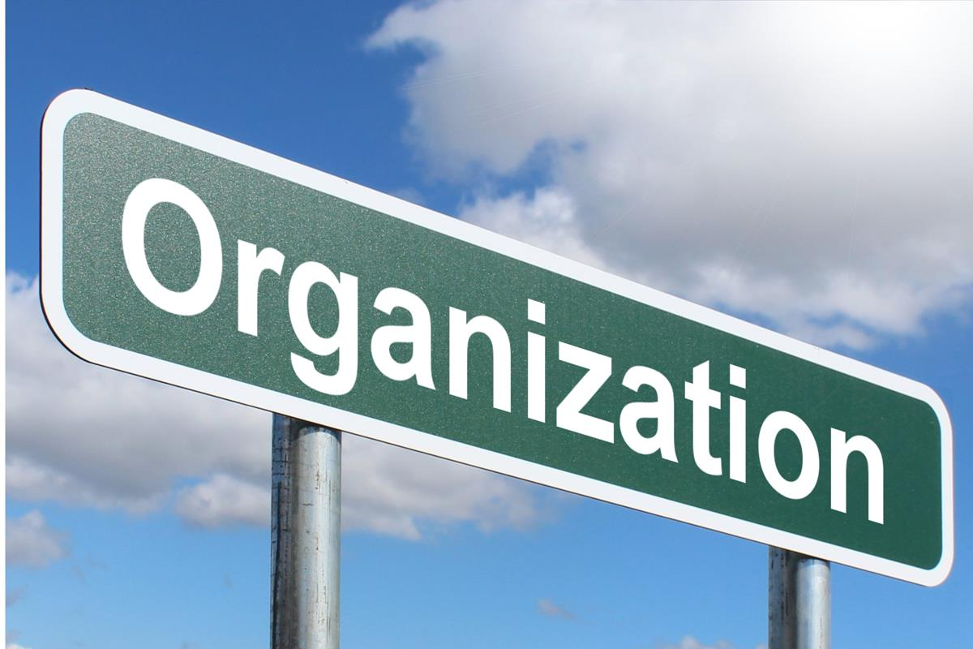
Simple Definition of an Organization
An organization is an entity – such as a company, an institution, or an association – comprising one or more people and having a particular purpose.

Slide 8

Acts 2:41 (NIV)
Church Beginning
Those who accepted his message were baptized, and about three thousand were added to their number that day.

Slide 9
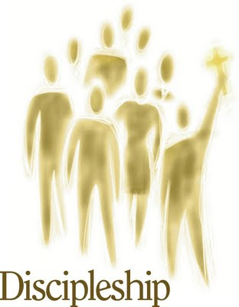
Acts 2:42 (NIV)
Teaching
They devoted themselves to the apostles’ teaching and to fellowship, to the breaking of bread and to prayer.

Slide 10


Acts 2:44 (NIV)
Fellowship
All the believers were together and had everything in common.

Slide 11


Acts 2:45 (NIV)
Mission
They sold property and possessions to give to anyone who had need.

Slide 12

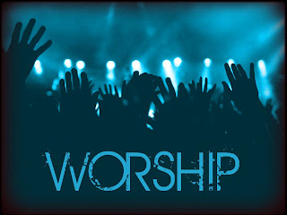
Acts 2:47 (NIV)
Worship and Evangelism
… praising God and enjoying the favor of all the people. And the Lord added to their number daily those who were being saved.

Slide 13
1 Corinthians 12:3-6 (NIV)
Therefore I want you to know that no one who is speaking by the Spirit of God says, “Jesus be cursed,” and no one can say, “Jesus is Lord,” except by the Holy Spirit. There are different kinds of gifts, but the same Spirit distributes them. There are different kinds of service, but the same Lord. There are different kinds of working, but in all of them and in everyone it is the same God at work.

