Slide 1


What the Bible Says About the Human Body

Slide 2
C ₈ R ₂₄
Creation
Revelation
Responsibility
Redemption
Cuisine
Restraint
Reapportion
Resist
Cleanliness
Rinsing
Refine
Recycle
Cardio
Running
Reaching
Rate
Core
Resilience
Redefined
Revive
Cutting
Restructuring
Repetition
Recondition
Consciousness
Reading
Researching
Ruminating
Convalescence
Relaxing
Renewing
Resting

Slide 3
Calisthenics
Cardio
Core
Cutting
1 Timothy 4:8 (NIV)
. . . Exercise daily in God—no spiritual flabbiness, please! Workouts in the gymnasium are useful, but a disciplined life in God is far more so, making you fit both today and forever.

Slide 4
Mark 8:36 (KJV)
For what shall it profit a man, if he shall gain the whole world, and lose his own soul.
Matthew 10:37 (KJV)
He that loveth father or mother more than me is not worthy of me: and he that loveth son or daughter more than me is not worthy of me.

Slide 5

Cardio
Running
Reaching
Rate

Slide 6
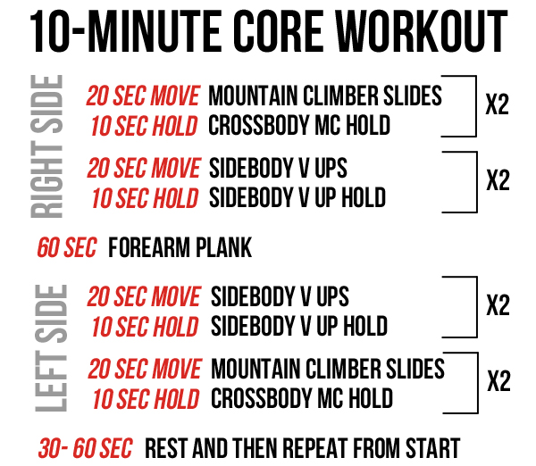
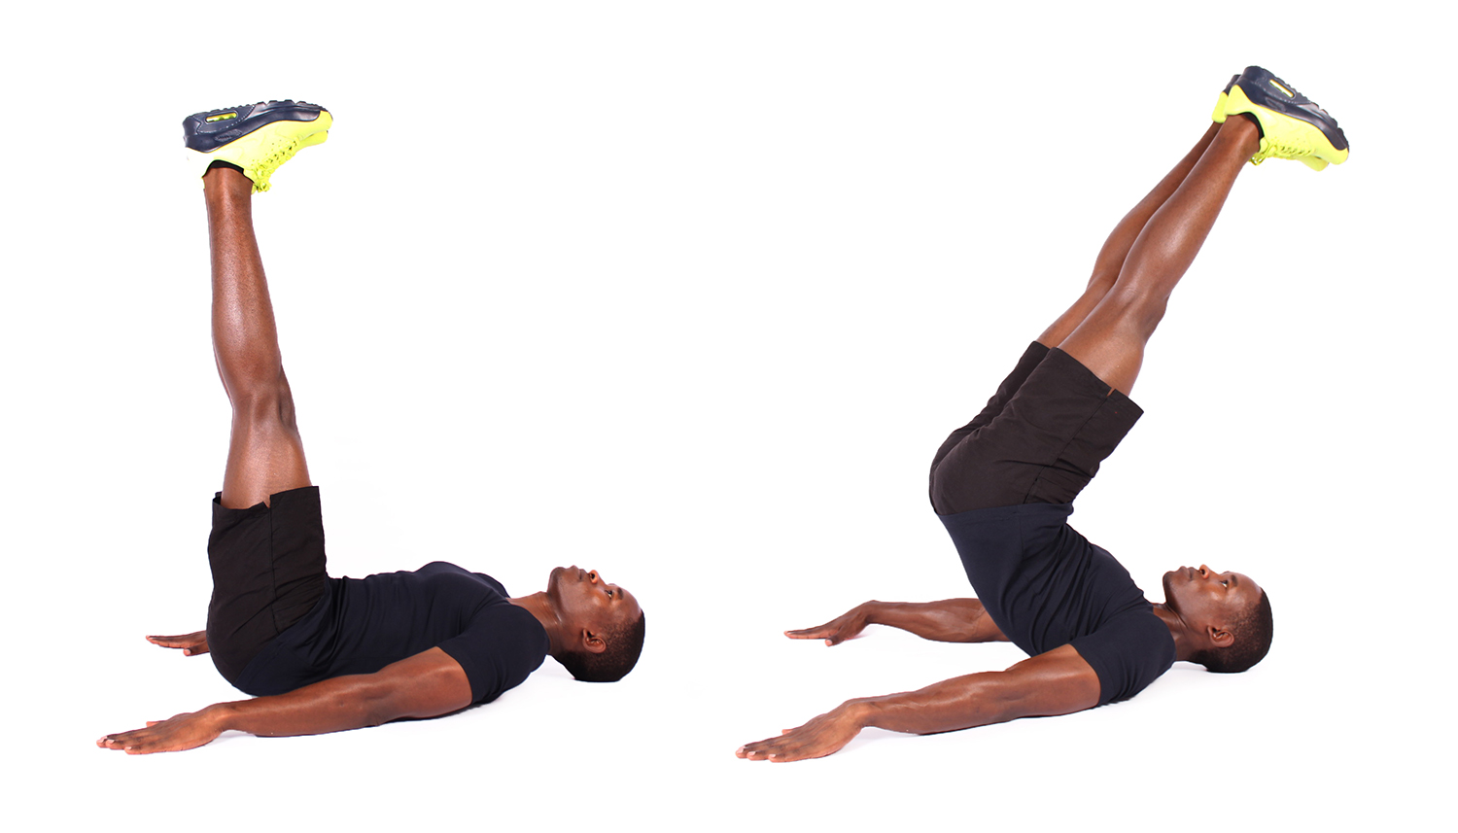
Core
Resilience
Redefined
Revive

Slide 7

Cutting
Restructuring
Repetition
Recondition

Slide 8

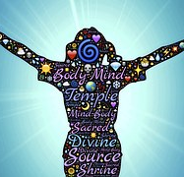
Consciousness
Reading
Researching
Ruminating
This Photo by Unknown Author is licensed under CC BY-SA-NC

Slide 9
Convalescence
Relaxing
Renewing
Resting
The four aspects of body image:
The way you see yourself (Perceptual) ...
The way you feel about the way you look (Affective) ...
The thoughts and beliefs you feel about your body (Cognitive) ...
The things you do in relation to the way you look (Behavioral)

