Slide 1

LESSON 1
Growing in Grace
What Spiritual Growth Is (and Isn’t)
Worksheet walkthrough · follow along on page 1
1
Notes:
Hand out the worksheet. Tell them page 1 fills in as we go and page 2 is for after the video. If you are showing the video first, run it start to finish, then work these slides.

Slide 2
THE BIG IDEA
Spiritual growth is God changing
who we are from the inside out,
slow on purpose, and far easier
to see in a year than in a week.
2
Notes:
This is the sentence in the ruled box at the top of their page. Read it once and move on.

Slide 3
PAGE ONE
Follow Along
3
Notes:
Nine blanks. Give them a beat to write before you advance to the answer.

Slide 4
1
The ledger can count what we _________. It cannot see what we are ____________.
4

Slide 5
1
The ledger can count what we do. It cannot see what we are becoming.
5
Notes:
Two men read the same chapter on the same morning — one wants to hear from God, one will feel guilty if he skips it. The ledger records both the same way. God does not.

Slide 6
2
Peter’s command in 2 Peter 3:18 uses a word for _________ things, which grow at a pace they do not set for themselves.
6

Slide 7
2
Peter’s command in 2 Peter 3:18 uses a word for living things, which grow at a pace they do not set for themselves.
7
Notes:
A seed. A child between one school year and the next. No farmer has ever gotten a field to hurry.

Slide 8
3
Peter puts grow in the _______________ — it is a command, and two chapters earlier he asks for every effort.
8

Slide 9
3
Peter puts grow in the imperative — it is a command, and two chapters earlier he asks for every effort.
9
Notes:
Guard the balance here. 2 Peter 1:5 — make every effort. Effort and growth are never competitors.

Slide 10
4
In 2 Corinthians 3:18, are being transformed is ___________, which means God is the one doing the work.
10

Slide 11
4
In 2 Corinthians 3:18, are being transformed is passive, which means God is the one doing the work.
11
Notes:
Our part of the sentence is the looking. The transforming is done to us while we look.

Slide 12
5
From _________ to _________ — whatever God is doing, he is doing it in installments.
12

Slide 13
5
From glory to glory — whatever God is doing, he is doing it in installments.
13
Notes:
Stages are built into the phrase. One measure at a time.

Slide 14
6
In Jesus’ parable the farmer scatters the seed and then _________, and the soil produces the crop by itself.
14

Slide 15
6
In Jesus’ parable the farmer scatters the seed and then sleeps, and the soil produces the crop by itself.
15
Notes:
Mark 4:26–27. He works at the two ends of the season and goes to bed in between.

Slide 16
7
The five words Jesus adds: although he ___________ _________ _________.
16

Slide 17
7
The five words Jesus adds: although he doesn’t know how.
17
Notes:
The man is not being scolded for his ignorance. That is simply the arrangement.

Slide 18
8
Paul planted and Apollos watered, but _________ gave the growth.
18

Slide 19
8
Paul planted and Apollos watered, but God gave the growth.
19
Notes:
1 Corinthians 3:6. Two men worked hard. Neither one of them grew anything.

Slide 20
9
Hebrews says solid food is for those whose senses have been ___________ to distinguish between good and evil.
20

Slide 21
9
Hebrews says solid food is for those whose senses have been trained to distinguish between good and evil.
21
Notes:
Hebrews 5:14. Trained by use. A man can learn a great deal in twelve months and come out the same man with a larger vocabulary.

Slide 22
PAGE ONE
Three Things That Get
Mistaken for Growth
22
Notes:
The three-column block. Let them try to name all three before you reveal.

Slide 23
One: ___________. Two: _________________. Three: _______________________.
23

Slide 24
One: feeling. Two: information. Three: fewer struggles.
24
Notes:
Feeling is real, and feeling changes with the week. Information can leave a man unchanged. And the third reads the evidence backward — a sharpened conscience finds more to be sorry about, not less.

Slide 25
It reads like failure.
Most of the time it is evidence
that the conscience is
doing its work.
25
Notes:
Slow down. Somebody in the room has been quietly concluding the opposite for months.

Slide 26
PAGE ONE
Who Does What
26
Notes:
Bottom table. Have them fill in the missing half of each row, then reveal.

Slide 27
Fill in the missing half
1 2 Corinthians 3:18 — looking / ?
2 Mark 4:26–29 — ? / the seed sprouts and grows
3 1 Corinthians 3:6 — planting, watering / ?
4 Ephesians 4:16 — ? / from him the whole body grows
27
Notes:
Give them two minutes. Answers on the next slide.

Slide 28
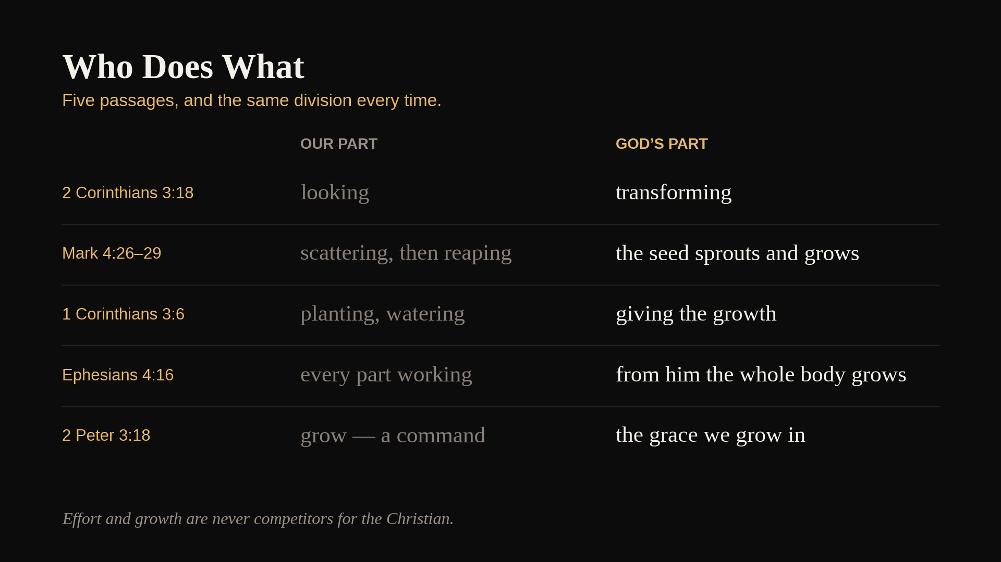
Notes:
The answers, plus 2 Peter 3:18 as a fifth row. Once they are stacked the pattern is hard to miss.

Slide 29
PAGE TWO
Nobody Grows Alone
29
Notes:
Tell them plainly: this one is not in the workbook. It came out of the video.

Slide 30
speaking the truth in love, let us grow in every way into him who is the head — Christ. From him the whole body … promotes the growth of the body for building up itself in love by the proper working of each individual part.
Ephesians 4:15–16
30
Notes:
Same verb Peter used. But look at who is doing it: let us grow. The whole body. Every supporting ligament. Each individual part.

Slide 31
WRITE
Name one person who would notice
a change in you before you noticed it
yourself. What would you have
to let them see?
31
Notes:
Two ruled lines on their page. Three quiet minutes, then take two or three answers if the room is willing. Do not push.

Slide 32
We are poor witnesses
in our own case, and God knew that
when he put us in a body.
32
Notes:
Point at the room when you say it. The person most likely to see change in us is sitting in it.

Slide 33
PAGE TWO
Better Questions
33
Notes:
The ledger is the wrong instrument. Put it down and answer these instead.

Slide 34
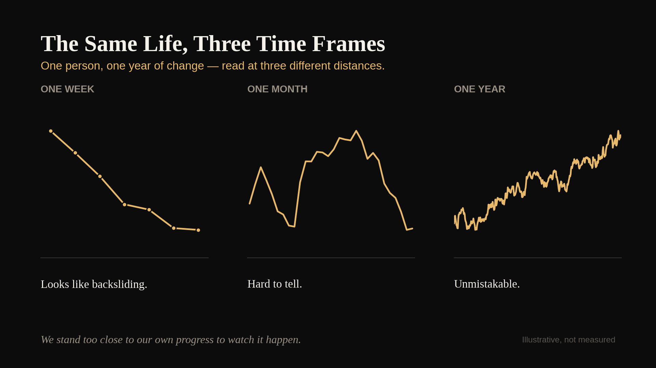
Notes:
Why the ledger fails: same life under all three panels. We stand too close to our own progress to watch it happen.

Slide 35
ONE
How long does it take you
to come back now,
compared to a year ago?
35
Notes:
Let it sit. Do not fill the silence.

Slide 36
TWO
What do you do with a sin
you used to defend?
36
Notes:
Nobody has to answer out loud. The writing is the work.

Slide 37
THREE
Who are you at home
on a day that has gone badly?
37
Notes:
This is usually the one that lands hardest.

Slide 38
FOUR
What would the people who see you
at Christmas say about you
if nobody asked them to be kind?
38
Notes:
Then open it up: if someone asked you for evidence that God has been at work in you over the past year, what would you point to? Why is that hard to say out loud?

Slide 39
Grace is the ground we grow on,
and it was put under us
before any of this started.
None of us is on trial for the pace.
39
Notes:
Peter's little preposition — we grow IN the grace and knowledge of our Lord. If anyone came in afraid they are behind, that fear is not coming from this verse.

Slide 40
PAGE TWO
Three Things
Before Sunday
40
Notes:
Checkboxes at the bottom of their page.

Slide 41
This Week
1 Write 2 Peter 3:18 on a card. Put it where you will see it first thing in the morning.
2 Keep one line a day for seven days. One thing you would not have done a year ago.
3 Read Titus 2:11–14 and Romans 6:1–4 before we meet.
41
Notes:
Say the blank-day instruction out loud: some days the line will be blank. Leave it blank and keep the card up. That permission is the point.

Slide 42
keeping our eyes on Jesus, the source and perfecter of our faith
Hebrews 12:2
42
Notes:
End here. He began this work and he will bring it to its end. Nothing in these thirteen weeks depends on our being able to see the progress.

Slide 43
LESSON 2
Next Week
The Role of Grace in Change
Titus 2:11–14 · Romans 6:1–4
43
Notes:
This week called grace the ground we grow on. Next week asks what grace does once we are standing on it — and Paul answers with a burial.

