Slide 1


Slide 2

LESSON 2
Growing in Grace
The Role of Grace in Change
Titus 2:11–14 · Romans 5:20 · Romans 6:1–14 · Titus 3:2–5
1
Notes:
Welcome. Hand out the worksheet before you start. Tell them the video runs about thirteen minutes and the blanks track it in order.

Slide 3
THE BIG IDEA
Grace pardons, and then grace raises.
One appearing does both of them,
and nothing has to be added to grace
to get obedience out of it.
2
Notes:
Read it aloud once and leave it. The hour unpacks it.

Slide 4
OPENING
Think of a time someone paid for something on your behalf — a debt, a repair, a mistake at work. What did being covered like that do to you afterward?
When people say that a Christian is “living under grace,” what do they usually seem to mean by it?
3
Notes:
5–7 minutes. The second question is the one that matters. Listen for whether grace sounds like permission or like power.

Slide 5
ONE
The One That
Hasn’t Moved
4
Notes:
Start where the room actually lives. Do not rush this — the whole lesson answers it.

Slide 6
Most of us have one.
Nobody in the congregation
would ever guess.
5
Notes:
Say it plainly and let it sit. You are naming something people carry privately.

Slide 7
There are two doors out of that room,
and most of us have tried both.
6
Notes:
Name both doors before you evaluate either. Worksheet: the three-column block.

Slide 8
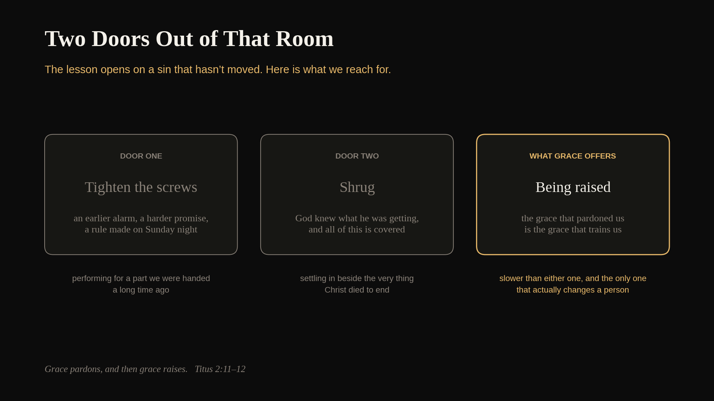
7
Notes:
Walk the three panels left to right. Ask which door the room reaches for first. The third panel is the lesson.

Slide 9
And so we settle in beside it,
and after a while we start
calling the settling maturity.
8
Notes:
This is the shrug, described honestly. Somebody in the room has done exactly this.

Slide 10
TWO
Something Appeared
9
Notes:
Titus tells us what grace is. The whole thing depends on one verb.

Slide 11
For the grace of God has appeared, bringing salvation for all people,
Titus 2:11
10
Notes:
Have someone read it. Then ask them to find the verb.

Slide 12
appeared
Titus 2:11
11
Notes:
A word for something breaking into view. Grace showed up — it has a date and a face. Worksheet blank 2.

Slide 13
We talk about grace as if it were
a mood God has been in all along.
Paul talks about it like an event.
12
Notes:
The correction that opens the lesson. Grace is an event, not a temperament.

Slide 14
instructing us to deny godlessness and worldly lusts and to live in a sensible, righteous, and godly way in the present age,
Titus 2:12
13
Notes:
This is the clause we read past. Worksheet blank 3.

Slide 15
instructing us
Titus 2:12
14
Notes:
The ordinary word a household used for raising a child — teaching, correction, and the long work of turning somebody into an adult. Hebrews uses it of how God disciplines a son.

Slide 16
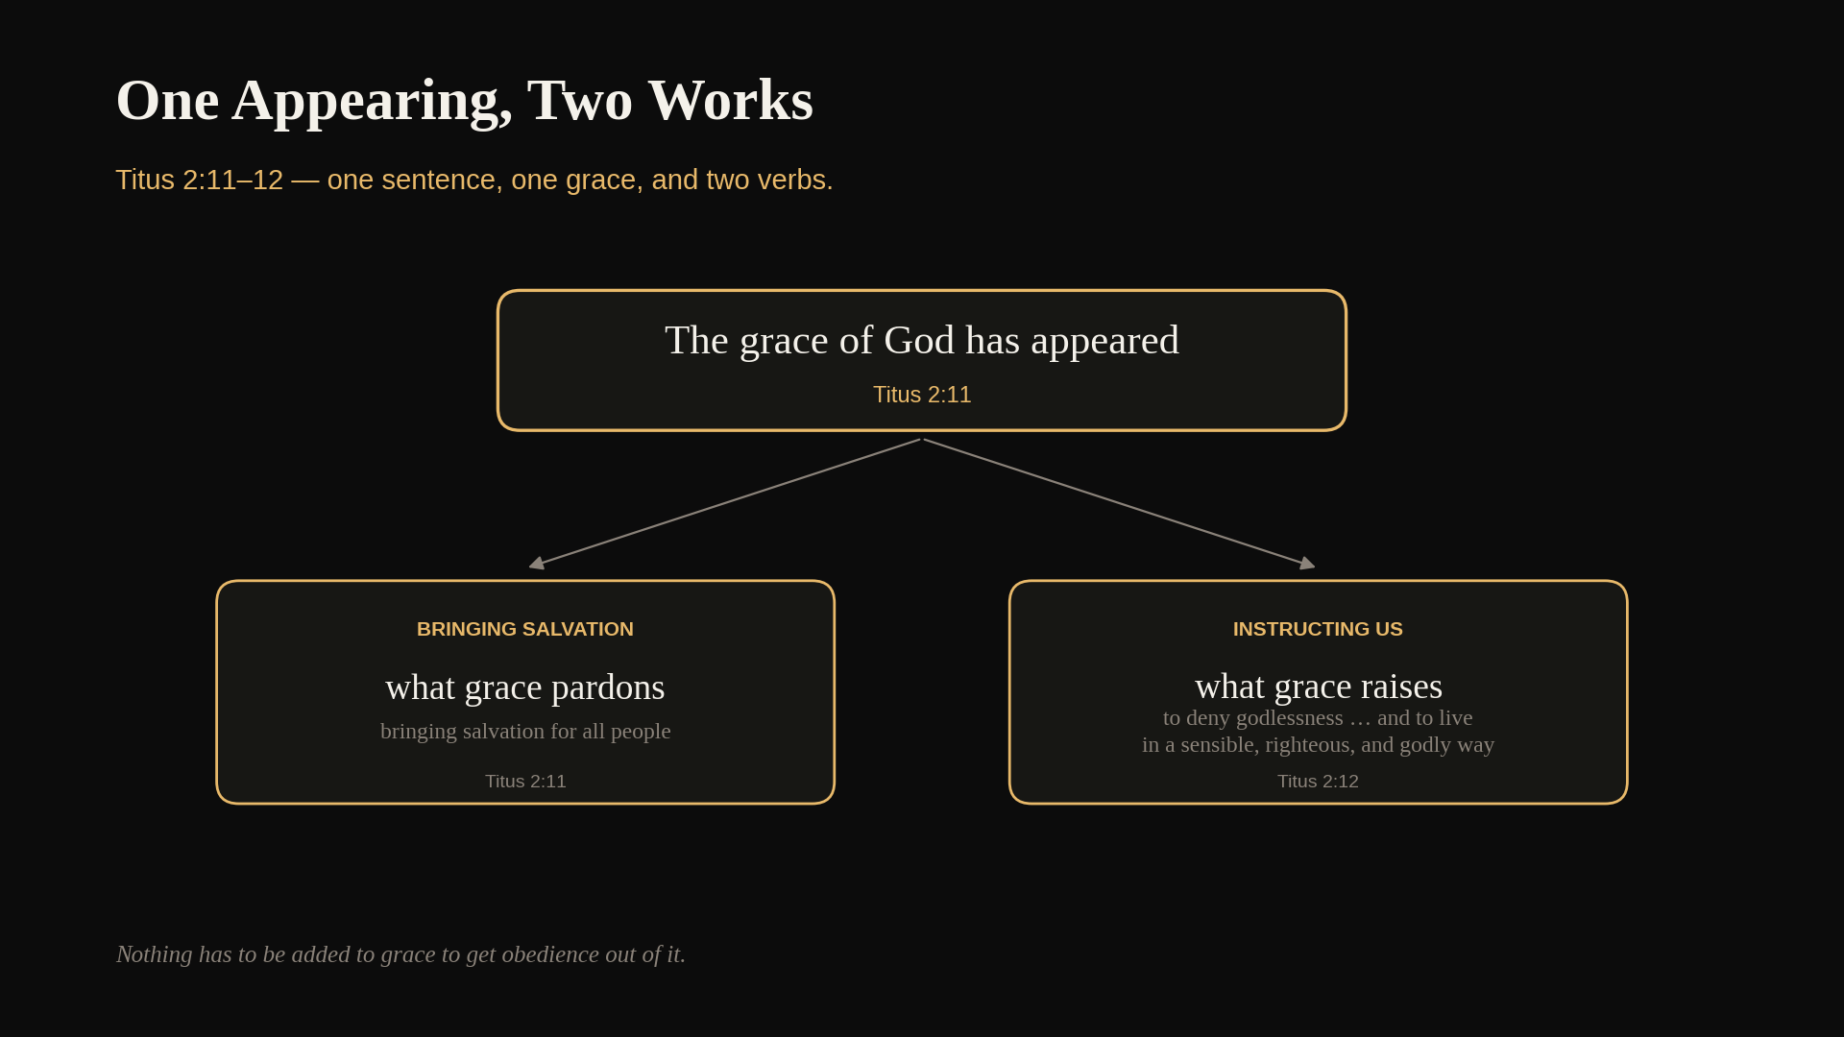
15
Notes:
One appearing, two works. Both boxes carry the same weight on purpose: pardoning and training are one thing, not two.

Slide 17
Grace pardons,
and then grace raises.
16
Notes:
The sentence to leave with them. Worksheet blank 4.

Slide 18
DISCUSS
Read Titus 2:11–12 out loud. Paul puts saving and instructing in one sentence about one grace. What changes if we hear those as two separate things God does?
17
Notes:
4–5 minutes. Listen for anyone who has been treating grace as the door and effort as the hallway.

Slide 19
THREE
What Grace
Is Aiming At
18
Notes:
Paul does not leave the training open-ended. He gives it a horizon.

Slide 20
while we wait for the blessed hope, the appearing of the glory of our great God and Savior, Jesus Christ,
Titus 2:13
19
Notes:
Appeared, and now appearing. One behind us and one ahead.

Slide 21
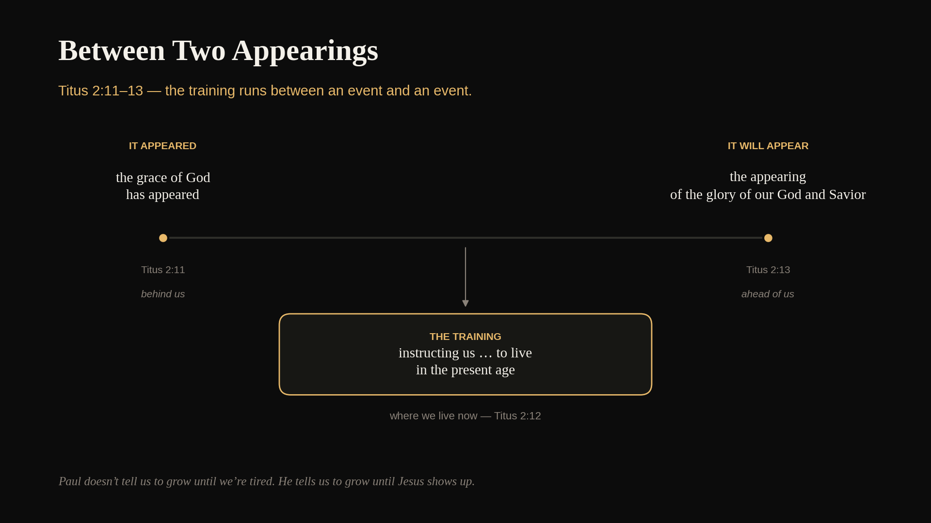
20
Notes:
We live in the middle. Worksheet blank 5. Ask what it does to a slow year to know it has an end somebody else set.

Slide 22
He doesn’t tell us to grow
until we’re tired. He tells us
to grow until Jesus shows up.
21
Notes:
The pastoral payload of this section. Say it slowly.

Slide 23
He gave himself for us to redeem us from all lawlessness and to cleanse for himself a people for his own possession, eager to do good works,
Titus 2:14
22
Notes:
What it cost and what it was for. Worksheet blank 6.

Slide 24
A people for his own possession.
He bought us.
23
Notes:
Hold this — the next section is a man who heard the same doctrine and drew the wrong conclusion.

Slide 25
FOUR
The Question
Somebody Actually Asked
24
Notes:
Turn to Romans. Paul quotes an objection he has actually heard.

Slide 26
But where sin multiplied, grace multiplied even more
Romans 5:20
25
Notes:
The sentence that got him in trouble.

Slide 27
What should we say then? Should we continue in sin so that grace may multiply?
Romans 6:1
26
Notes:
Somebody did the arithmetic. Worksheet blank 7.

Slide 28
If grace is only the eraser
that wipes the board, a fuller board
just means a busier eraser.
27
Notes:
The logic is airtight if grace is nothing but pardon. That is the point.

Slide 29
Absolutely not! How can we who died to sin still live in it?
Romans 6:2
28
Notes:
Watch what Paul does not do: he never reaches for a rule.

Slide 30
He answers
with an obituary.
29
Notes:
Let this land before you move on.

Slide 31
DISCUSS
Romans 6:1 is a question somebody actually asked. What would you have expected Paul to say back? Why do you think he answers with something that already happened rather than with a rule?
30
Notes:
4–5 minutes. Push on the second half — this is the hinge of the lesson.

Slide 32
FIVE
Buried
31
Notes:
The extended illustration. Read the text before you tell the story.

Slide 33
Therefore we were buried with him by baptism into death, in order that, just as Christ was raised from the dead by the glory of the Father, so we too may walk in newness of life,
Romans 6:3–4
32
Notes:
Worksheet blank 8.

Slide 34
Nobody hands a bill
to a dead man.
33
Notes:
Work the graveside. The ending is final — nobody negotiates with him, nobody waits to see if he changes his mind.

Slide 35
Something that had a claim on us
went into the ground.
What came up out of the water
was you, with a new life to walk in.
34
Notes:
Turn to second person here. This is the one place in the lesson where it belongs.

Slide 36
So, you too consider yourselves dead to sin and alive to God in Christ Jesus,
Romans 6:11
35
Notes:
Consider is a counting word — reckon it true before you feel it.

Slide 37
For sin will not rule over you, because you are not under the law but under grace,
Romans 6:14
36
Notes:
Rule is a word for what a king does. Worksheet blank 9.

Slide 38
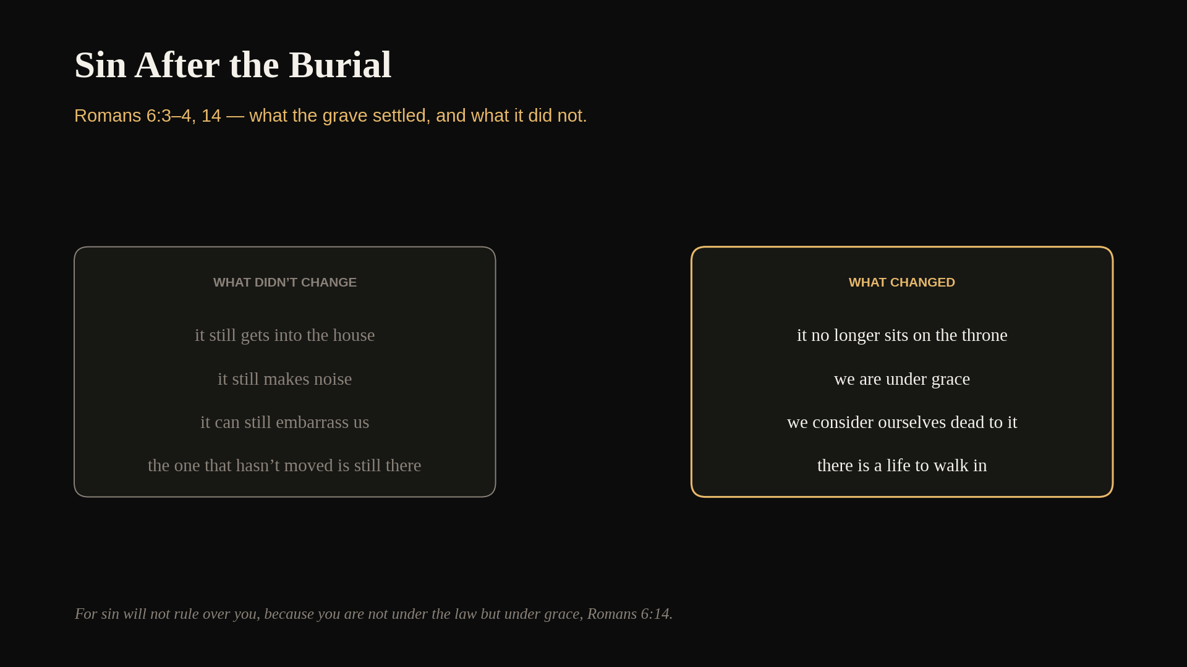
37
Notes:
Work both columns. Sin still shows up; what it lost is the throne. Worksheet: the fill-in table.

Slide 39
DISCUSS
Read Romans 6:3–4 slowly. What ended in that burial, and what began? Where does our own effort show up in Paul’s sentence?
38
Notes:
5 minutes. If nobody sees it: our effort is not in the sentence at all.

Slide 40
BONUS
The Grace You Hand
Somebody Else
39
Notes:
Tell them plainly this is not in the workbook. The lesson has been entirely interior until now.

Slide 41
For we too were once foolish, disobedient, deceived, enslaved by various passions and pleasures, living in malice and envy, hateful, detesting one another,
Titus 3:3
40
Notes:
Watch the pronoun. We too. Paul is describing the people in the pews.

Slide 42
But when the kindness of God our Savior and his love for mankind appeared, he saved us — not by works of righteousness that we had done, but according to his mercy,
Titus 3:4–5
41
Notes:
The same appearing verb, aimed now at how we treat each other.

Slide 43
We’re usually hardest on the sin
in somebody else that we quietly
quit fighting in ourselves.
42
Notes:
The most uncomfortable sentence in the hour. Let the room sit with it.

Slide 44
DISCUSS
Most of us have something that hasn’t moved in a long time. What does the tightening-the-screws door cost a person over a year? What does the shrugging door cost?
43
Notes:
5 minutes. If the room is willing, this is the most useful conversation of the lesson.

Slide 45
CLOSE
Back to the Room
44
Notes:
Bring it home.

Slide 46
God has done something to us
that we did not do to ourselves,
and he is not finished.
45
Notes:
Gather the two letters into one claim.

Slide 47
DISCUSS
Romans 6:11 asks us to consider something true that we may not feel is true. How is that different from pretending? What would it look like on a bad morning?
46
Notes:
Close the discussion here. Do not force answers — some of this is between them and God.

Slide 48
Two Things Before Sunday
1 Write Romans 6:4 out in full, with the date you were baptized at the top.
2 Read Galatians 5:16–25 and Romans 8:9–14 before we meet.
47
Notes:
Say the date instruction out loud — if they cannot remember the date, the month will do.

Slide 49
because we know that Christ, having been raised from the dead, will not die again. Death no longer rules over him,
Romans 6:9
48
Notes:
End here. Sin will not rule over you; death no longer rules over him. Same word, on purpose.

Slide 50
He’s out of the grave,
and he took you with him.
49
Notes:
The last thing they hear. Then stop.

Slide 51
LESSON 3
Next Week
The Spirit Who Does the Growing
Galatians 5:16–25 · Romans 8:9–14
50
Notes:
This week said grace does the raising. Next week names the One doing it.

