Slide 1
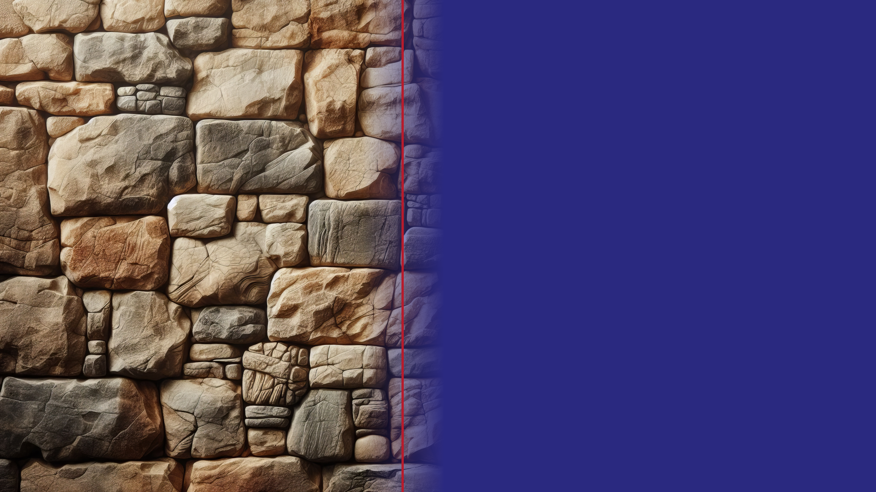

SUNDAY LECTURE HALL · WEEK ONE
Seeing Each Other
Through God’s Eyes
How the Called Out Came Together

Slide 2

HERE’S THE PLAN
Today’s Class
Welcome & Opening Prayer
1
5 min
Watch the Teaching Video
2
15 min
Small Groups — Work the Worksheet
3
20 min
Review & Close Together
4
20 min

Slide 3

Watch the Teaching Video
Lesson 1 — “Seeing Each Other Through God’s Eyes” · about 15 minutes

Slide 4
NOW IT’S YOUR TURN
In Your Small Groups
ABOUT 20 MIN
Gather
Break into your groups and pick someone to read aloud.
Work the worksheet
Move through the fill-in-the-blanks together, then the discussion questions.
Talk it out
Don’t rush to the “right” answer. Let everyone weigh in and jot a few notes.
Be ready to share
We’ll come back together for the last 20 minutes.

Slide 5
LET’S GO OVER IT TOGETHER
Reviewing the
Worksheet

Slide 6
FILL IN THE BLANK · 1 OF 5
“Every person in the church sees every other person through some set of eyes. There is no neutral looking.”

Slide 7
FILL IN THE BLANK · 2 OF 5
Paul writes, “From now on, then, we do not know anyone from a worldly perspective.” (2 Corinthians 5:16)

Slide 8
FILL IN THE BLANK · 3 OF 5
The four categories the church is tempted to import: status, appearance, usefulness, and grievance.

Slide 9
FILL IN THE BLANK · 4 OF 5
“The flesh sees the outside. The Spirit sees the person.”

Slide 10
FILL IN THE BLANK · 5 OF 5
“If anyone is in Christ, he is a new creation.” (2 Corinthians 5:17)

Slide 11
TALK IT THROUGH
Discussion
Surface to the heart — seven questions.

Slide 12
1. WARM-UP
The lesson says there is “no neutral looking.” Before this video, which “eyes” do you most naturally use to size people up?

Slide 13
2. THE TEXT
What is the “before” and the “after” Paul describes when he says “from now on”? What changed?
Read together: 2 Corinthians 5:14–17 · CSB

Slide 14
3. GOING DEEPER
Paul once viewed even Christ “from a worldly perspective” and missed him. Why does it matter that the flesh’s categories could blind Saul of Tarsus to the Son of God himself?

Slide 15
4. THE FOUR CATEGORIES
Status, appearance, usefulness, grievance. Which one is most quietly at work in a typical congregation — and why is it so hard to notice in ourselves?

Slide 16
5. NOTICING VS. JUDGING
What is the difference between simply noticing something about a person and rendering a verdict on them? Where does that line get crossed?
Read together: 1 Samuel 16:7 · CSB

Slide 17
6. NEW CREATION
How would it change the way you treat a brother or sister to believe their identity is already settled “in Christ” — even when old failures are still in view?
Read together: 2 Corinthians 5:17 · CSB

Slide 18
7. BRINGING IT HOME
“Are you willing to see your brother for what he cost God, instead of for how he makes you feel?” Think of one person you find hard to see clearly. Which category is doing the work — and what is one concrete way to begin seeing them as God does this week?

Slide 19
BEFORE YOU GO
Pray for those eyes.
Then act like a person
who has them.
Next week:
Genuine Care for One Another

