Slide 1

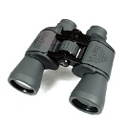
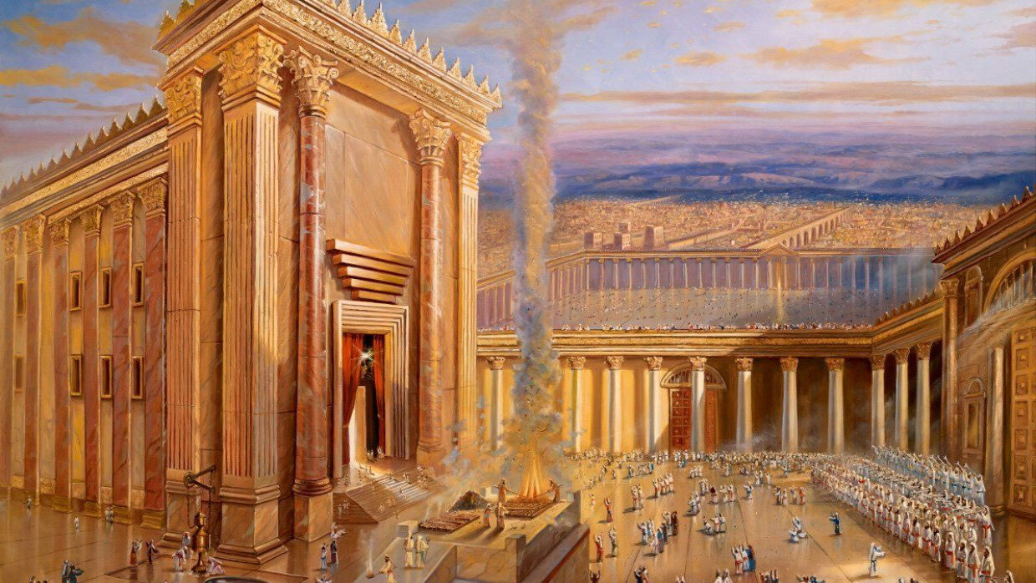
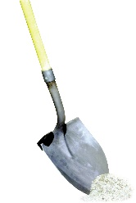
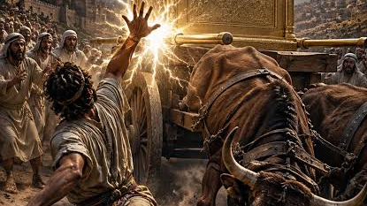

Notes & Quotes
“We show how little we think of Christ by speaking endless negativity about his bride.”
Life Group Growth Guides
1 Corinthians 3:16,17
PASSAGE FOR STUDY
Describe your “church experience” growing up. Good, Bad, Indifferent?
How would you describe your “evolution” of thinking about the importance of the Church?
From your observations, what would you say the opinion of the world is of the Church?
1. The local church is a dwelling place of the Holy Spirit.
2. The local church is the Apple of God’s Eye.
3. The Destroyer of the Church will Himself be destroyed.
1 Corinthians 3:16,17
Opener
THIS WEEK’S TAKE HOME TRUTH
Read 1 Corinthians 3:16,17 and 6:19,20.
Compare and Contrast these two passages. What is the context of both passages? Why might these two passages be confused as having similar applications?
Read 1 Corinthians 3:16,17. In the message, it was noted that Paul uses the word for “temple” that refers to the actual sanctuary, the place of the deity’s dwelling. Why is this significant? How is our local church like the holy of holies? Explain.
The Church-Wrecker God will Wreck
First
Look
_______________________________________________________________________________________________________________________
If anyone destroys God’s temple, God will destroy that person;
for God’s temple is sacred, and you together are that temple.
Read 1 Corinthians 3:17. What is warning about “destroying” the local church? How do individuals “destroy” the church?
Read 1 Corinthians 11:28,29. What is the context of this passage? How might sharing the Lord’s Table result in division? What was the price for division in the local church in Corinth? What is the warning for us today?
*Christ’s vision and concern for His body boggles, stretches, and defies human explanation. Divide up and have the group look up the following verses . . . Ephesians 5:25-27, 29,30; Ephesians 1:22,23; Colossians 1:18,24; Revelation 9:7. What is the relationship between Christ and the Church in each passage? What do these reveal about Christ’s view/value of His Church? How might we align our view with Christ’ view of the Church?
Digging
Deeper
1 Corinthians 3:17
*Prayer Time . . . Take a few minutes and pray for our church. Pray for vision, wisdom, effectiveness and unity. Pray that God might ignite a new fire in the Tabernacle.
Life Change
October 11th 2026

