Slide 1
Prioritizing Discipleship
A Long Journey in the Same Direction…

Slide 2
If you make disciples you will always get the church.
But if you make a church, you rarely get disciples.
Mike Breen, Building a Discipling Culture

Slide 3
Disclaimers
I’m still on the journey
This is material gleaned from others
Becoming a disciple-reproducing church is challenging
Much of what we do as the church counters this value

Slide 4
All authority in heaven and on earth has been given to me.
Therefore go and make disciples of all nations, baptizing them in the name of the Father and of the Son and of the Holy Spirit, and teaching them to obey everything I have commanded you.
And surely I am with you always, to the very end of the age.
Matthew 28:18-20

Slide 5
“But you will receive power when the Holy Spirit comes on you, and you will be my witnesses in Jerusalem, and in all Judea and Samaria, and to the ends of the earth.”
Acts 1:8

Slide 6
Challenges to Confront
Church Culture & Expectations
  What do we measure?
  What makes us comfortable?
    Congregation
    Clergy
  What gives us value?
    Pastors
  How do we change?

Slide 7
What is a Disciple?

Slide 8
What is a Disciple?
Standard Church Assumption
Someone who is faithful in attending church, faithful in giving, and who serves in one of the church’s ministries.

Slide 9
What is a Disciple?
“Someone who is changed by Jesus, is following Jesus, and is committed to the mission of Jesus.”
- 3DM

Slide 10
What is a Disciple?
Someone who is being formed into Christ for the benefit of others.
- Robert Mulholland

Slide 11
What is a Disciple?
“Someone who has decided to be with another person, under appropriate conditions, in order to become capable of doing what that person does or to become what that person is.”
- Dallas Willard (Divine Conspiracy)

Slide 12
What is a Disciple?
“The effort to create some space in your life in which God can act.”
- Henri Nouwen, “From Solitude to Community to Ministry”

Slide 13
What is a Disciple?
“We are all being formed into disciples of one thing or another. What’s forming you?”
- Alan Hirsch

Slide 14
In order to be a Disciple-Making Church we must have a clear definition:
“What is a Disciple?”
What is it that we are growing?
Multiplying?

Slide 15
Worship
(Up)
“Love the Lord with all your heart, soul, mind, and strength”
- Mark 12:30
The Church:
A 3D Economy
(Oikos) of Love
Community
(In)
“Love each other as I have loved you.”
- John 13:34
Mission
(Out)
“Love your neighbor as yourself.”
- Mark 12:31

Slide 16
Worship
(Up)
“Love the Lord with all your heart, soul, mind, and strength”
- Mark 12:30
When all three
intersect, the Kingdom
becomes visible,
tangible, and
powerful. . .
Community
(In)
“Love each other as I have loved you.”
- John 13:34
Power
Mission
(Out)
“Love your neighbor as yourself.”
- Mark 12:31

Slide 17
Worship
(Up)
“Love the Lord with all your heart, soul, mind, and strength”
- Mark 12:30
When all three
intersect, the Kingdom
becomes visible,
tangible, and
powerful. . .
But it will
also bring
tension
to the church.
Community
(In)
“Love each other as I have loved you.”
- John 13:34
Tension
Mission
(Out)
“Love your neighbor as yourself.”
- Mark 12:31

Slide 18
Worship
(Up)
“Love the Lord with all your heart, soul, mind, and strength”
- Mark 12:30
If we are not intentionally engaging all three dimensions, one or more of the three will always be neglected.
Community
(In)
“Love each other as I have loved you.”
- John 13:34
Mission
(Out)
“Love your neighbor as yourself.”
- Mark 12:31

Slide 19
Worship
(Up)
“Love the Lord with all your heart, soul, mind, and strength”
- Mark 12:30
Community
(In)
“Love each other as I have loved you.”
- John 13:34
Mission
(Out)
“Love your neighbor as yourself.”
- Mark 12:31

Slide 20
Worship
(Up)
“Love the Lord with all your heart, soul, mind, and strength”
- Mark 12:30
Mission
(Out)
“Love your neighbor as yourself.”
- Mark 12:31
Community
(In)
“Love each other as I have loved you.”
- John 13:34

Slide 21
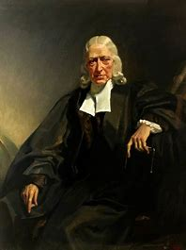
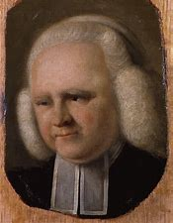
“My brother Wesley acted wisely—the souls that were awakened under his ministry he joined in class, and thus preserved the fruits of his labor. This I neglected, and my people are a rope of sand.”
Evangelist
George Whitefield
1714-1770

Slide 22
The Church:
A 3D Disciple-Making
Community
Shared Devotion
(Up)
“Love the Lord with all your heart, soul, mind, and strength”
- Mark 12:30
Mutual Care
(In)
“Love each other as I have loved you.”
- John 13:34
Shared
Mission
(Out)
“Love your neighbor as yourself.”
- Mark 12:31

Slide 23
Every person longs to
touch God (Up),
belong to a loving family (In), and make
a difference in the world. (Out)
Shared Devotion
(Up)
“Love the Lord with all your heart, soul, mind, and strength”
- Mark 12:30
Mutual Care
(In)
“Love each other as I have loved you.”
- John 13:34
Shared
Mission
(Out)
“Love your neighbor as yourself.”
- Mark 12:31

Slide 24
Every person longs to
touch God (Up),
belong to a loving family (In), and make
a difference in the world. (Out)
The gospel, as lived out through the historical/biblical
church provides the most comprehensive answer to this
human longing.
Shared Devotion
(Up)
“Love the Lord with all your heart, soul, mind, and strength”
- Mark 12:30
Mutual Care
(In)
“Love each other as I have loved you.”
- John 13:34
Shared
Mission
(Out)
“Love your neighbor as yourself.”
- Mark 12:31

Slide 25
“I want the whole Christ for my Savior, the whole Bible for my book, the whole Church for my fellowship,
and the
whole world
for my
mission
field.”
John Wesley
Shared Devotion
(Up)
“Love the Lord with all your heart, soul, mind, and strength”
- Mark 12:30
Mutual Care
(In)
“Love each other as I have loved you.”
- John 13:34
Shared
Mission
(Out)
“Love your neighbor as yourself.”
- Mark 12:31

Slide 26
Questions
How might this description of the church and the 3D life of love bring new perspective or clarity to your understanding and vision for discipleship?
2. Using the 3D model, draw a picture of your own life. Then draw a picture of your local church.

Slide 27
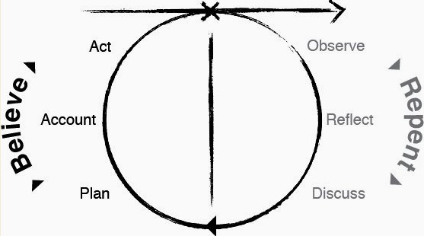
The Learning Circle – Trust the Holy Spirit

Slide 28
The Rhythmic Pattern of a Life in Christ

Slide 29
Human Wholeness is
the freedom to give and receive love from God and from others.

Slide 30
God
Me

Slide 31
God
The arc that flows from God
to me represents . . .
All that He is.
All that He has done.
All that He has promised.
Me

Slide 32
God
The arc that flows from God
to me represents . . .
All that He is.
All that He has done.
All that He has promised.
(fully revealed
in Jesus)
Me

Slide 33
God
The arc that flows from me back to God represents my loving and joyful obedience in response to His love for me.
Me

Slide 34
God
I joyfully obey all that He commands
  With all that I am
  All that I possess
  All that I can do
Me

Slide 35
Respond
God
Rest
Me

Slide 36
Obey
- All that He commands
God
Trust
In all that He is
All that He has done
All that He has promised
Me

Slide 37
Obey
- All that He commands
God
Trust
In all that He is
All that He has done
All that He has promised
Faith =
Trust and
Obedience
Me

Slide 38
God
“You shall have no other gods before me,
etc., etc.”
Exodus 20:3-17
Me

Slide 39
God
“I am the Lord your God who brought you out of Egypt, out of the land of slavery.”
Exodus 20:2
“You shall have no other gods before me,
etc., etc.”
Exodus 20:3-17
Me

Slide 40
God
“Therefore I urge you brothers, in view of God’s mercy . . .”
Romans 12:1
Me

Slide 41
God
“. . . To offer your bodies as living sacrifices, holy and acceptable to the Lord.”
Romans 12:1
“Therefore I urge you brothers, in view of God’s mercy . . .”
Me

Slide 42
One Another
“Love one another . . .
John 13:34
Me

Slide 43
One Another
“Love one another . . .
. . . as I have loved you.”
John 13:34
Me

Slide 44
One Another
“Accept one another, then . . .
Romans 15:7
Me

Slide 45
One Another
“just as Christ accepted you.”
Romans 15:7
“Accept one another, then . . .
Me

Slide 46
One Another
“Be kind and compassionate to one another, forgiving one another . . .”
Ephesians 4:32
Me

Slide 47
One Another
“Be kind and compassionate to one another, forgiving one another . . .”
“just as in Christ, God forgave you.”
Ephesians 4:32
Me

Slide 48
One Another
“Be kind and compassionate to one another, forgiving one another . . .”
“just as in Christ, God forgave you.”
Ephesians 4:32
God issues no command
that He has not already
done for us in
Christ Jesus.
Me

Slide 49
God
“We love. . .
…because he first loved us.”
I John 4:19
The defining rhythm
of the God-life
Me

Slide 50
God
“We love . . .
The only healthy and
sustainable motive
for mission
…because he first loved us.”
I John 4:19
Me

Slide 51
God
Some people see discipleship as only this.
Me

Slide 52
Do more.
Pray more.
Read the Bible more.
Give more.
Serve more.
Be more committed.
Be more missional.
God
Some people see discipleship as only this.
Me

Slide 53
Do more.
Pray more.
Read the Bible more.
Give more.
Serve more.
Be more committed.
Be more missional.
God
We become like the older brother.
Me

Slide 54
God
While more people today see the Christian life like this. . .
Me

Slide 55
God
God loves you just as you are. There is nothing you can do to make Him love you more.
While more people today see the Christian life like this. . .
Me

Slide 56
God
“Love so amazing, so Divine . . .
Me

Slide 57
God
. . .demands
my soul, my
life, my all”
“Love so amazing, so Divine . . .
Me

Slide 58
God
“His love is made complete in us.”
I John 4:12
Obey
Trust
Me

Slide 59
God
Breathe in
Breathe out
Me

Slide 60
God
“Where have you walked
in love today?”
- Ignatius
Me

Slide 61
God
“Where have you failed
to walk in love?”
- Ignatius
Me

Slide 62
God
What hinders your willingness or freedom to rest in God’s sovereign
love?
Me

Slide 63
God
What hinders your desire and freedom
to
fully obey?
Me

Slide 64
God
“From Solitude to Community to Ministry”
Henri Nouwen
How do we help people cultivate this kind of life?
Me

Slide 65
The Empowerment Factor –
Larry Walkemeyer
“For much of my ministry I majored in organizational and platform leadership and minored in discipleship. I was mistaken” (p49)
If we want to be truly empowered we must learn to love sitting in the back with the servants. Mark 10:45 (p60)
EMPOWERED – our current level of Spirit-fullness
EMPOWERING – our current level of empowering those in our circle of relationships

Slide 66
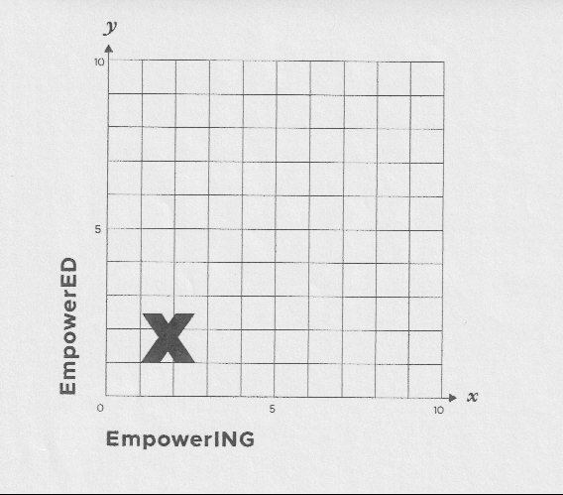
The Empowerment Factor - PMC
Larry Walkemeyer
PMC
Personal Multiplication
Capacity

Slide 67
Discovery Bible Study
Trusting the Word and the Spirit

Slide 68
Discovery Bible Study
Trusting the Word and the Spirit
Connection Questions
What are you thankful for this week?
What is causing you stress or worry?
How can this group help you this week?

Slide 69
Discovery Bible Study
Trusting the Word and the Spirit
Understanding the Scripture
Read the Passage, Reread it, and have someone retell it in their own words.

Slide 70
Discovery Bible Study
Trusting the Word and the Spirit
Understanding the Scripture
Read the Passage, Reread it, and have someone retell it in their own words.
What does this passage teach us about God or Jesus?

Slide 71
Discovery Bible Study
Trusting the Word and the Spirit
Understanding the Scripture
Read the Passage, Reread it, and have someone retell it in their own words.
What does this passage teach us about God or Jesus?
What does this passage teach us about humanity or ourselves?

Slide 72
Discovery Bible Study
Trusting the Word and the Spirit
Application Questions
If this passage is true, how will you change your life this week?

Slide 73
Discovery Bible Study
Trusting the Word and the Spirit
Application Questions
If this passage is true, how will you change your life this week?
Write down a specific “I will” statement based on what we’ve read?

Slide 74
Discovery Bible Study
Trusting the Word and the Spirit
Application Questions
If this passage is true, how will you change your life this week?
Write down a specific “I will” statement based on what we’ve read?
Who will you share this story or lesson with this week?

Slide 75
Discovery Bible Study – Group Guidelines
Brief answers (sentences – not paragraphs
Focus only on this text – don’t cross reference
Focus only on the observations of the group
Allow for silence
The facilitator should only facilitate – not teach

Slide 76
Discovery Bible Study – Facilitator Guidelines
Stay on schedule – complete all sections, but not necessarily all questions
Prepare before by studying passage, looking for main idea, and think of some examples, stories or applications from your own life.

Slide 77
Discovery Bible Study – Facilitator Guidelines
Respond to questions by asking group, “What in the passage helps us answer that question?”
Respond to distracting comments by asking, “Where is that found in this passage?”
Respond to strange questions by asking, “, Help us understand what you are thinking.”

Slide 78
Discipleship Systems
Trust the Holy Spirit
Know our Context
Identify our Essentials
  The non-negotiables in your discipleship plan
  Scripture-centered, Relationship-based, Reproducible
Honestly assess our priorities and challenges
Pray for Spirit-filled disciple-makers

Slide 79
Discipleship Cohorts – Keeping it Real
Monthly revisiting our Discipleship Systems
Review/Revise our Definition of a Disciple
Reflecting our our Context - what is uniquely us
Review our Essentials – what are we measuring?
Invite the Spirit to speak truth into our priorities

