Slide 1

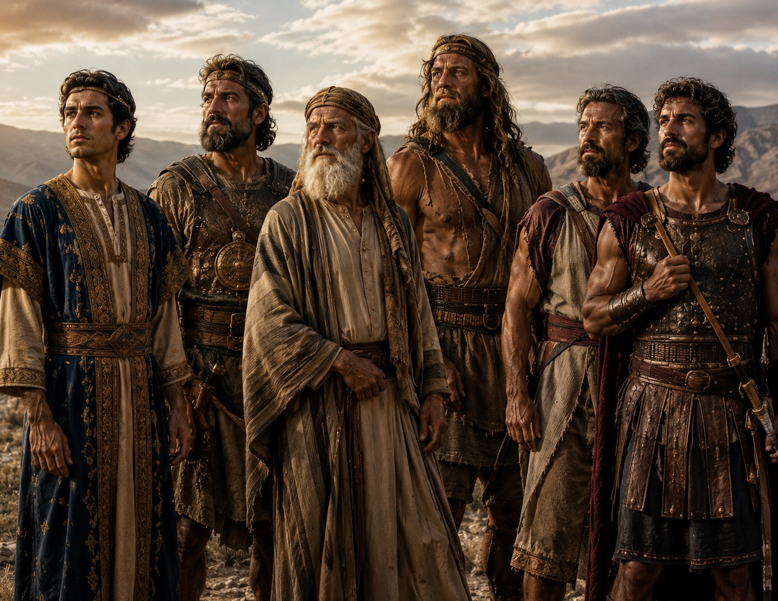
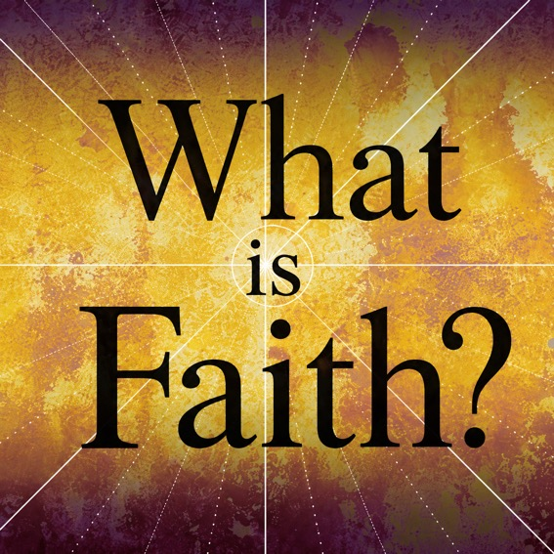
A Study in
Hebrews 11
Notes:
Aligns with John 1:1-5, 14
1 In the beginning was the Word, and the Word was with God, and the Word was God. 2 He was with God in the beginning. 3 Through him all things were made; without him nothing was made that has been made. 4 In him was life, and that life was the light of all mankind. 5 The light shines in the darkness, and the darkness has not overcome[fn] it. The Word became flesh and made his dwelling among us. We have seen his glory, the glory of the one and only Son, who came from the Father, full of grace and truth.

Slide 2
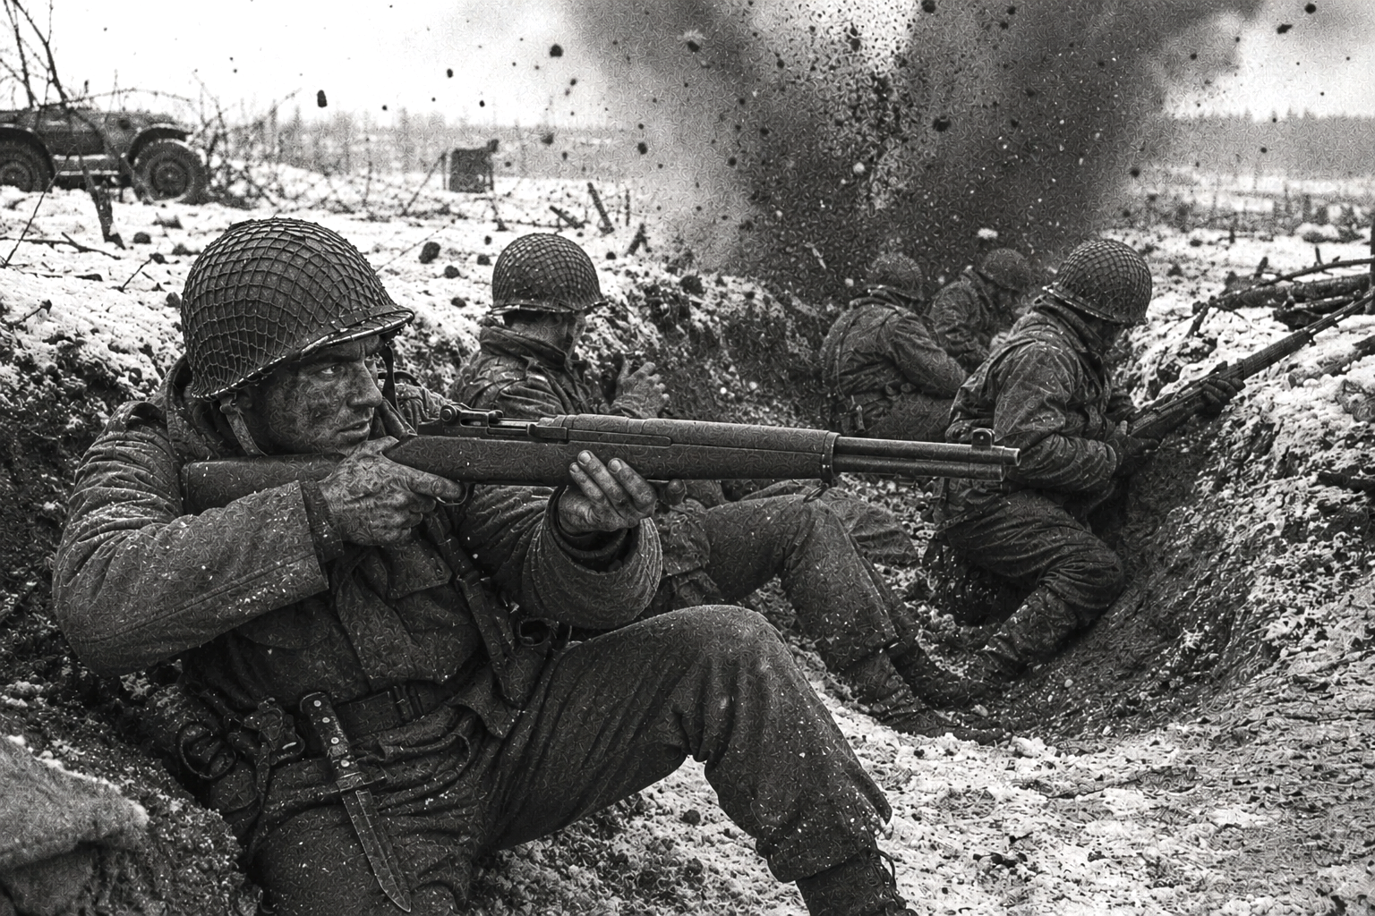
Notes:
Aligns with John 1:1-5, 14
1 In the beginning was the Word, and the Word was with God, and the Word was God. 2 He was with God in the beginning. 3 Through him all things were made; without him nothing was made that has been made. 4 In him was life, and that life was the light of all mankind. 5 The light shines in the darkness, and the darkness has not overcome[fn] it. The Word became flesh and made his dwelling among us. We have seen his glory, the glory of the one and only Son, who came from the Father, full of grace and truth.

Slide 3
Hebrews 11:1
Ang pananampalataya ay ang katunayan ng mga bagay na inaasahan, ang katibayan ng mga bagay na hindi nakikita
Faith / Pananampalataya – pistis – paniniwala sa katotohanan ng anumang bagay, paniniwala na may nangingibabaw na ideya ng tiwala (o kumpiyansa)
Substance / Sangkap – hypostasis – pundasyon, substructure, katatagan, kasiguruhan
Evidence / Ebidensya– elegchos – patunay, paniniwala, na kung saan ang isang bagay ay napatunayan o nasubok
Notes:
Aligns with John 1:1-5, 14
1 In the beginning was the Word, and the Word was with God, and the Word was God. 2 He was with God in the beginning. 3 Through him all things were made; without him nothing was made that has been made. 4 In him was life, and that life was the light of all mankind. 5 The light shines in the darkness, and the darkness has not overcome[fn] it. The Word became flesh and made his dwelling among us. We have seen his glory, the glory of the one and only Son, who came from the Father, full of grace and truth.

Slide 4
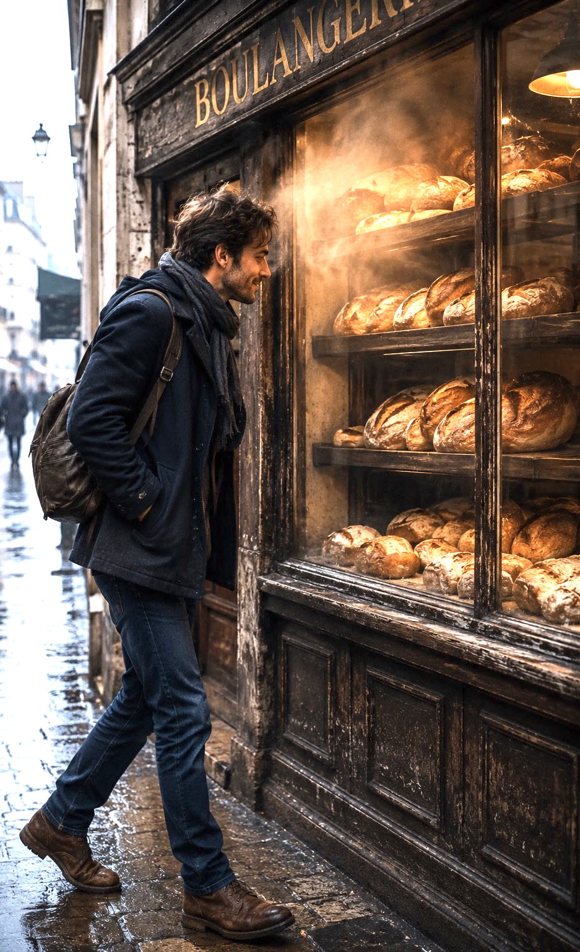
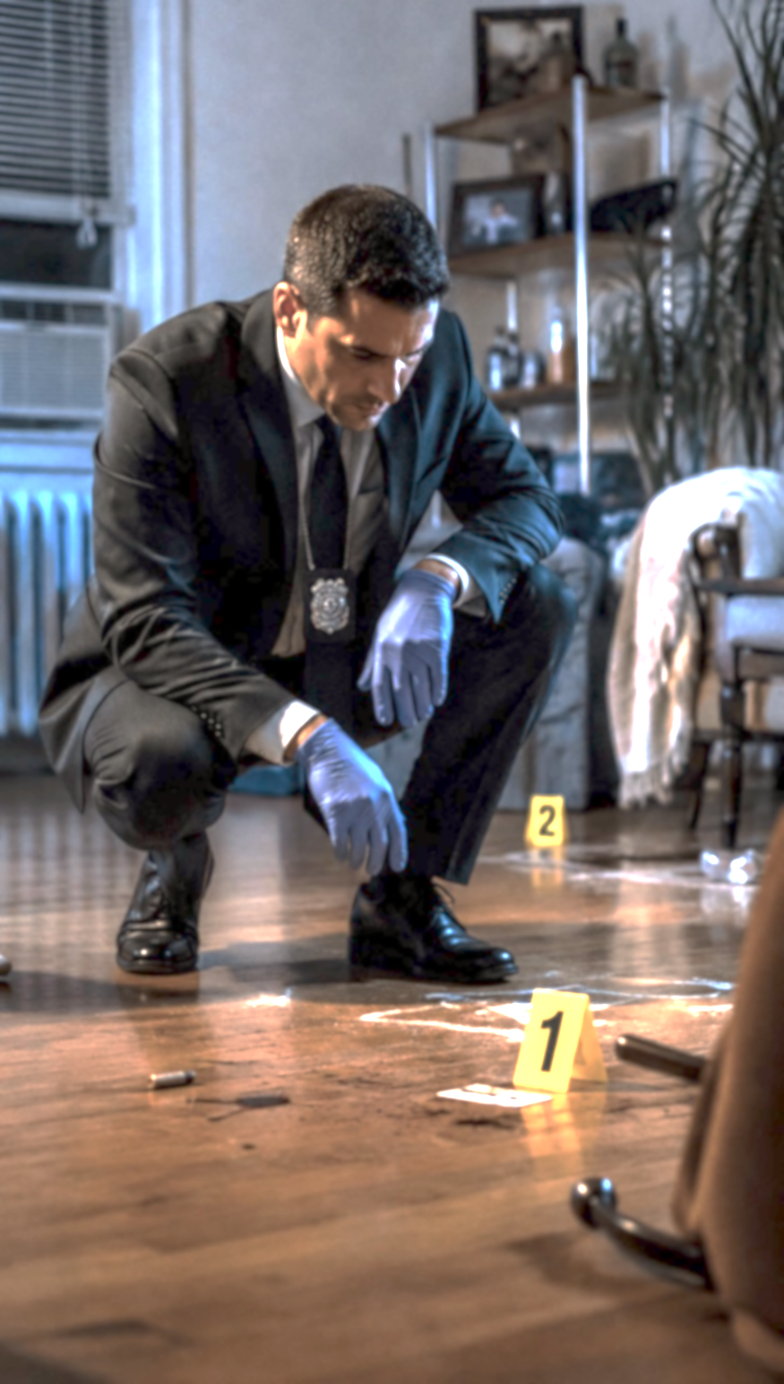
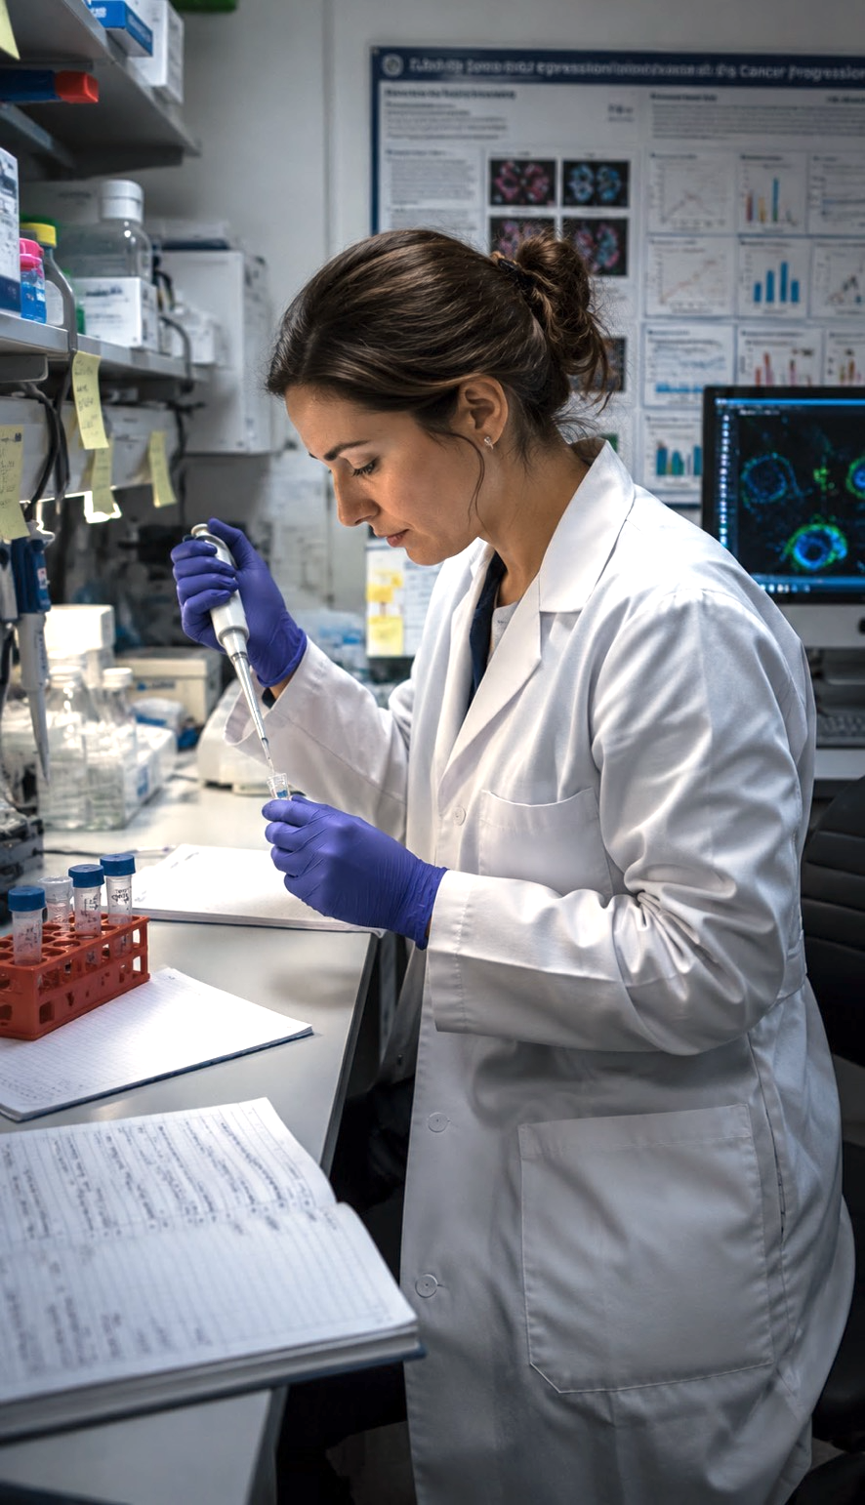
Notes:
Aligns with John 1:1-5, 14
1 In the beginning was the Word, and the Word was with God, and the Word was God. 2 He was with God in the beginning. 3 Through him all things were made; without him nothing was made that has been made. 4 In him was life, and that life was the light of all mankind. 5 The light shines in the darkness, and the darkness has not overcome[fn] it. The Word became flesh and made his dwelling among us. We have seen his glory, the glory of the one and only Son, who came from the Father, full of grace and truth.

Slide 5
Seeing what is unseen
1 Corinthians 2:14
Ang taong walang Espiritu ay hindi tumatanggap ng mga bagay na nagmumula sa Espiritu ng Diyos. Itinuturing niya ang mga ito na kamangmangan. Hindi niya nauunawaan ang mga ito dahil ang mga ito ay nauunawaan lamang sa pamamagitan ng Espiritu.
Hebrews 11:3
Sa pananampalataya ay nauunawaan natin na ang sansinukob ay nilikha sa utos ng Diyos, kaya't ang nakikita ay hindi ginawa mula sa mga bagay na nakikita.
Notes:
Aligns with John 1:1-5, 14
1 In the beginning was the Word, and the Word was with God, and the Word was God. 2 He was with God in the beginning. 3 Through him all things were made; without him nothing was made that has been made. 4 In him was life, and that life was the light of all mankind. 5 The light shines in the darkness, and the darkness has not overcome[fn] it. The Word became flesh and made his dwelling among us. We have seen his glory, the glory of the one and only Son, who came from the Father, full of grace and truth.

Slide 6
Seeing what is unseen
Hebrews 11:6
And without faith, it is impossible to please Him, for he who comes to God must believe that He is, and He is a rewarder of those who seek Him.
Hebreo 11:6
At kung walang pananampalataya, imposibleng mapalugdan Siya; sapagkat ang lumalapit sa Diyos ay dapat maniwala na Siya ay may Diyos, at Siya ang tagapagbigay-gantimpala sa mga humahanap sa Kanya.
Notes:
Aligns with John 1:1-5, 14
1 In the beginning was the Word, and the Word was with God, and the Word was God. 2 He was with God in the beginning. 3 Through him all things were made; without him nothing was made that has been made. 4 In him was life, and that life was the light of all mankind. 5 The light shines in the darkness, and the darkness has not overcome[fn] it. The Word became flesh and made his dwelling among us. We have seen his glory, the glory of the one and only Son, who came from the Father, full of grace and truth.

Slide 7
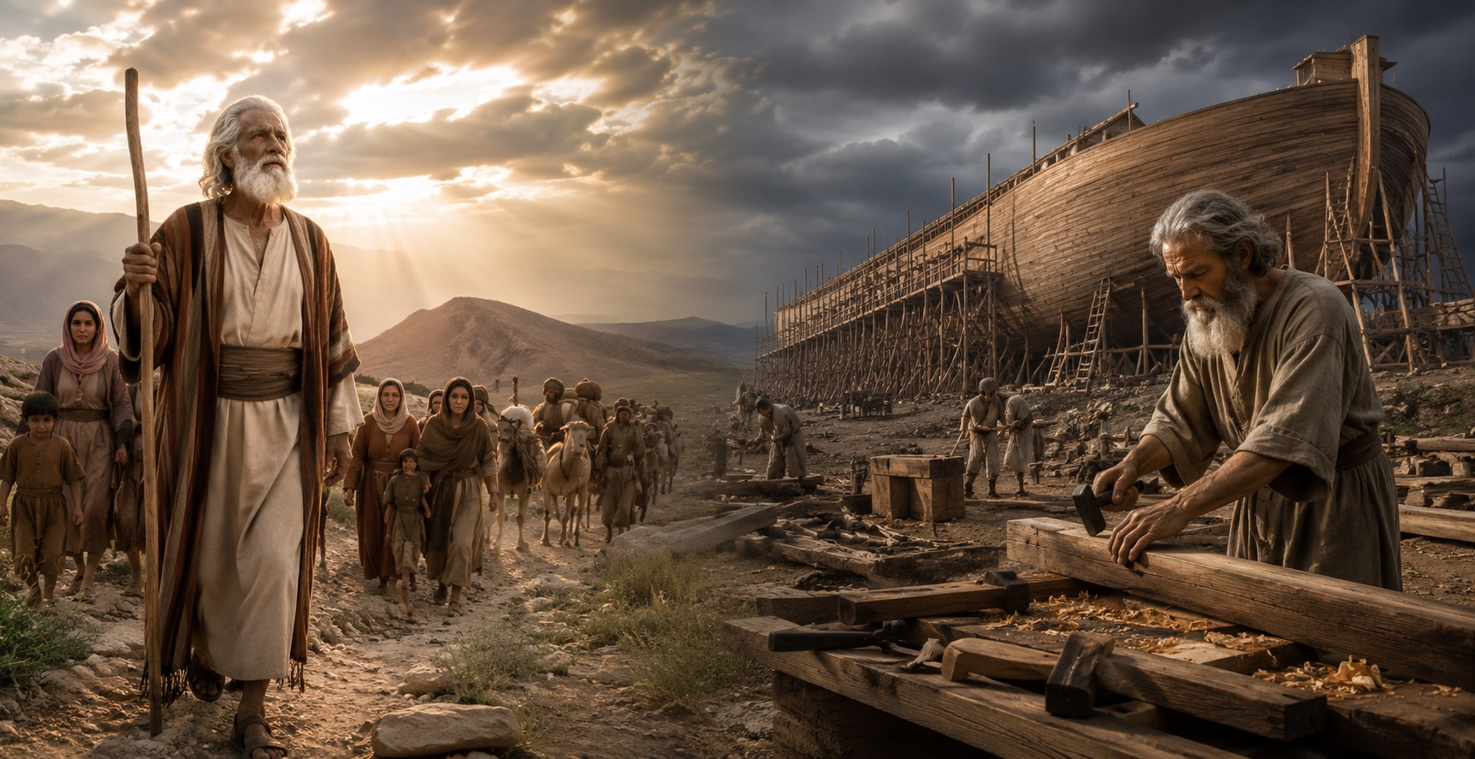

Slide 8

1 Corinthians 12:7-9, 27
Isang espirituwal na kaloob ang ibinibigay sa bawat isa sa atin upang tayo ay magtulungan. Sa isang tao, ang Espiritu ay nagbibigay ng kakayahang magbigay ng matalinong payo; sa isa naman, ang Espiritu ring iyon ay nagbibigay ng mensahe ng espesyal na kaalaman. Sa isa naman, ang Espiritu ring iyon ay nagbibigay ng dakilang pananampalataya, at sa iba naman, ang Espiritu ring iyon ay nagbibigay ng kaloob ng pagpapagaling…. Kayo ngang lahat ay katawan ni Cristo, at ang bawat isa sa inyo ay bahagi nito.
Notes:
Aligns with John 1:1-5, 14
1 In the beginning was the Word, and the Word was with God, and the Word was God. 2 He was with God in the beginning. 3 Through him all things were made; without him nothing was made that has been made. 4 In him was life, and that life was the light of all mankind. 5 The light shines in the darkness, and the darkness has not overcome[fn] it. The Word became flesh and made his dwelling among us. We have seen his glory, the glory of the one and only Son, who came from the Father, full of grace and truth.

Slide 9
Buod
Ang pananampalataya ay isang supernatural na regalo mula sa Diyos na nagpapahintulot sa atin na makita ang realidad ng Diyos nang higit pa sa ating limang pandama.
Kung walang pananampalataya, bulag tayo sa katotohanan ng Diyos at hindi Siya kailanman mapalulugdan.
Notes:
Aligns with John 1:1-5, 14
1 In the beginning was the Word, and the Word was with God, and the Word was God. 2 He was with God in the beginning. 3 Through him all things were made; without him nothing was made that has been made. 4 In him was life, and that life was the light of all mankind. 5 The light shines in the darkness, and the darkness has not overcome[fn] it. The Word became flesh and made his dwelling among us. We have seen his glory, the glory of the one and only Son, who came from the Father, full of grace and truth.

Slide 10
Buod
Ang pananampalataya ay isang supernatural na regalo mula sa Diyos na nagpapahintulot sa atin na makita ang realidad ng Diyos nang higit pa sa ating limang pandama.
Kung walang pananampalataya, bulag tayo sa katotohanan ng Diyos at hindi Siya kailanman mapalulugdan.
Notes:
Aligns with John 1:1-5, 14
1 In the beginning was the Word, and the Word was with God, and the Word was God. 2 He was with God in the beginning. 3 Through him all things were made; without him nothing was made that has been made. 4 In him was life, and that life was the light of all mankind. 5 The light shines in the darkness, and the darkness has not overcome[fn] it. The Word became flesh and made his dwelling among us. We have seen his glory, the glory of the one and only Son, who came from the Father, full of grace and truth.

