Slide 1

Session 1
Passion and Prayer

Slide 2

Nehemiah 2:19-20a
But when Sanballat the Horonite, Tobiah the Ammonite official and Geshem the Arab heard about it, they mocked and ridiculed us. “What is this you are doing?” they asked. “Are you rebelling against the king?” I answered them by saying, “The God of heaven will give us success; therefore we his servants will arise and build
“Ngunit nang mabalitaan ito nina Sanballat na Horonita, Tobias na opisyal na Ammonita, at Geshem na Arabo, kami ay kanilang kinutya at nilait. ‘Ano itong ginagawa ninyo?’ tanong nila. ‘Naghihimagsik ba kayo laban sa hari?’ Sinagot ko sila sa pagsasabing, ‘Ang Diyos ng langit ang magbibigay sa amin ng tagumpay; kaya kaming Kanyang mga lingkod ay babangon at magtatayo…’”
Notes:
Aligns with John 1:1-5, 14
1 In the beginning was the Word, and the Word was with God, and the Word was God. 2 He was with God in the beginning. 3 Through him all things were made; without him nothing was made that has been made. 4 In him was life, and that life was the light of all mankind. 5 The light shines in the darkness, and the darkness has not overcome[fn] it. The Word became flesh and made his dwelling among us. We have seen his glory, the glory of the one and only Son, who came from the Father, full of grace and truth.

Slide 3
Our calling
Rebuild broken lives, build disciples
Defend our people
Rest in Christ
Notes:
Aligns with John 1:1-5, 14
1 In the beginning was the Word, and the Word was with God, and the Word was God. 2 He was with God in the beginning. 3 Through him all things were made; without him nothing was made that has been made. 4 In him was life, and that life was the light of all mankind. 5 The light shines in the darkness, and the darkness has not overcome[fn] it. The Word became flesh and made his dwelling among us. We have seen his glory, the glory of the one and only Son, who came from the Father, full of grace and truth.

Slide 4
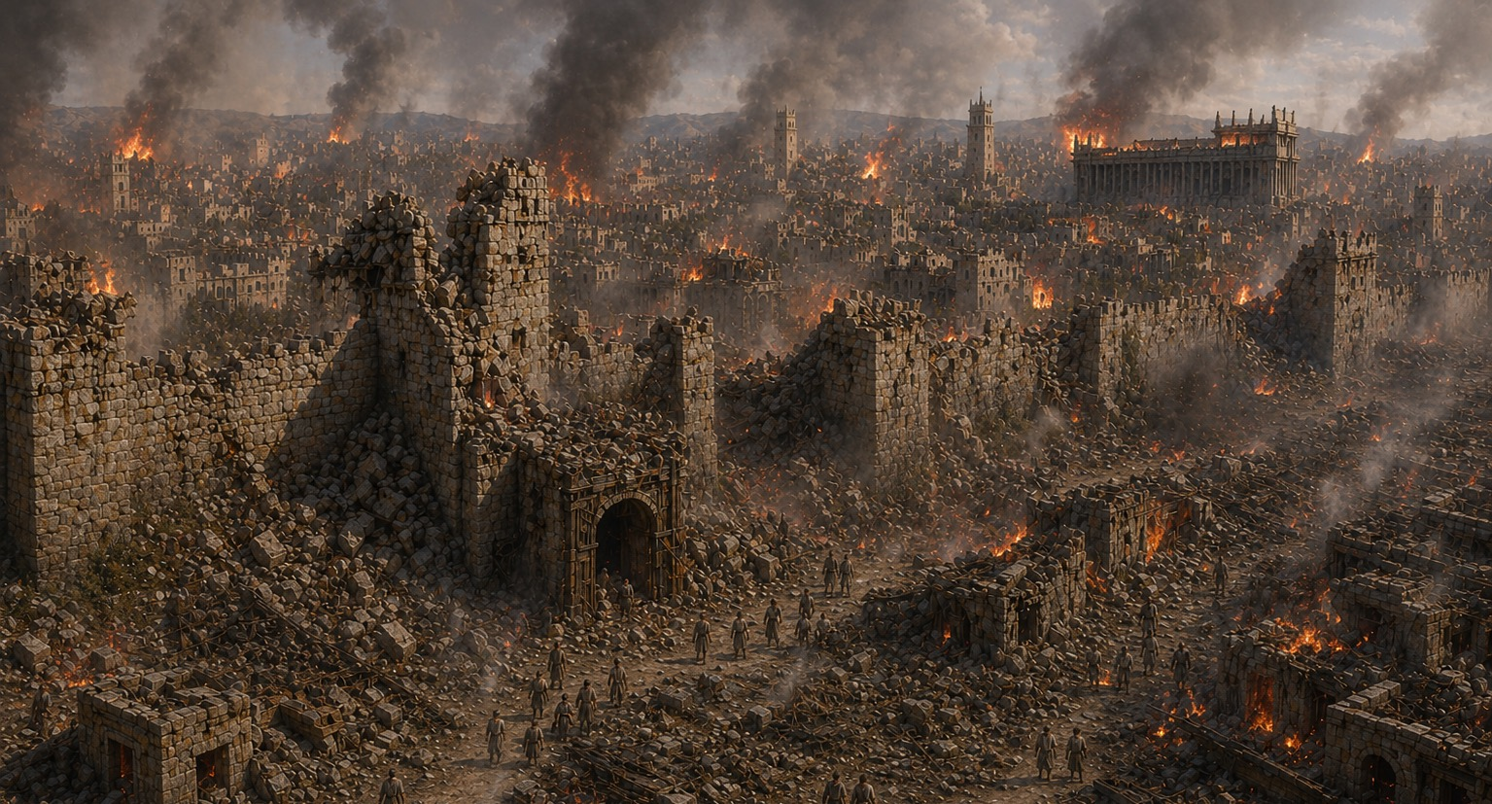
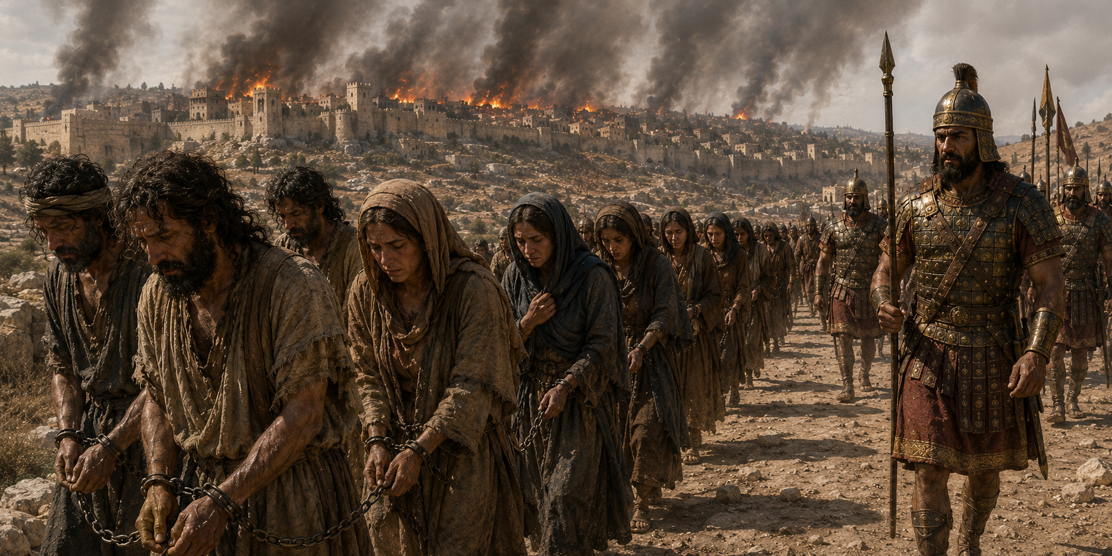
Notes:
Aligns with John 1:1-5, 14
1 In the beginning was the Word, and the Word was with God, and the Word was God. 2 He was with God in the beginning. 3 Through him all things were made; without him nothing was made that has been made. 4 In him was life, and that life was the light of all mankind. 5 The light shines in the darkness, and the darkness has not overcome[fn] it. The Word became flesh and made his dwelling among us. We have seen his glory, the glory of the one and only Son, who came from the Father, full of grace and truth.

Slide 5
Nehemiah 1:3
And they said to me, “The remnant there in the province who survived the captivity are in great distress and disgrace, and the wall of Jerusalem is broken down and its gates have been burned with fire.”
At sinabi nila sa akin, “Ang nalabi roon sa lalawigan na nakaligtas sa pagkabihag ay nasa matinding paghihirap at kahihiyan, at ang pader ng Jerusalem ay wasak at ang mga pintuan nito ay sinunog ng apoy.”
Notes:
Aligns with John 1:1-5, 14
1 In the beginning was the Word, and the Word was with God, and the Word was God. 2 He was with God in the beginning. 3 Through him all things were made; without him nothing was made that has been made. 4 In him was life, and that life was the light of all mankind. 5 The light shines in the darkness, and the darkness has not overcome[fn] it. The Word became flesh and made his dwelling among us. We have seen his glory, the glory of the one and only Son, who came from the Father, full of grace and truth.

Slide 6
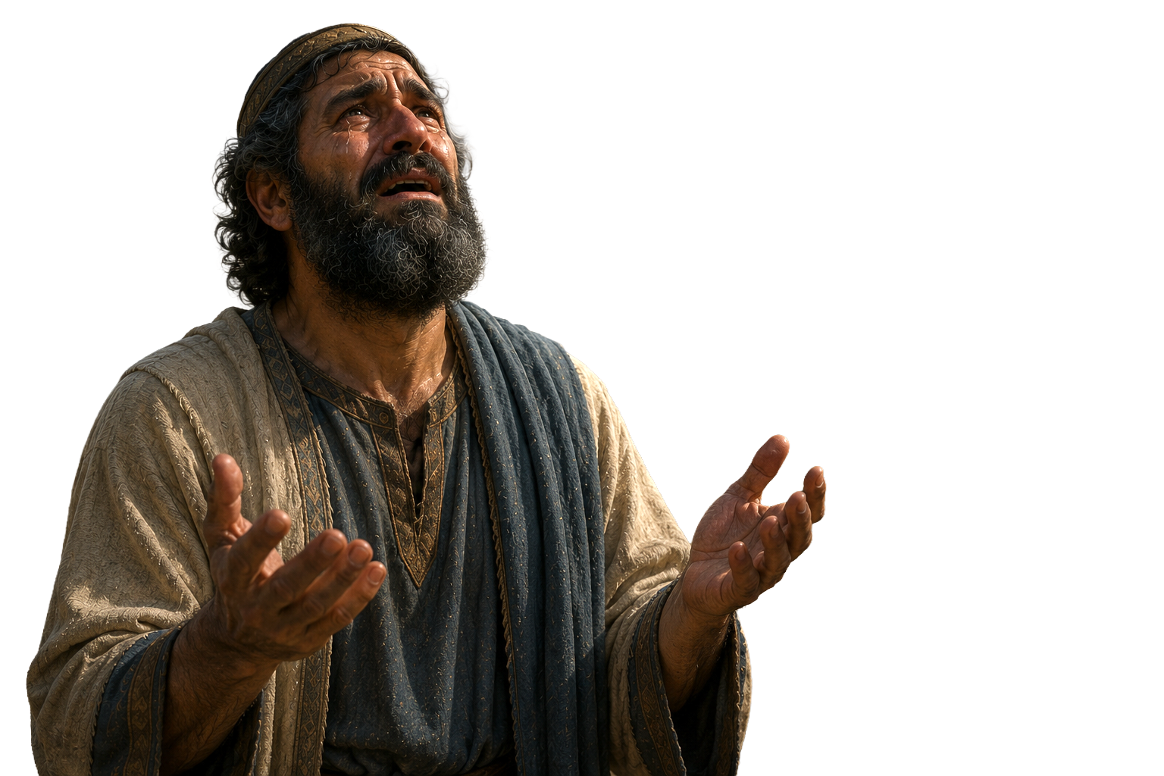
Nehemiah 1:4
Nang marinig ko ang mga salitang ito, umupo ako at umiyak at nagluksa ng ilang araw; nag-aayuno at nananalangin ako sa harap ng Diyos ng langit.
Now when I heard these words, I sat down and wept and mourned for days; and I was fasting and praying before the God of heaven.
Notes:
Aligns with John 1:1-5, 14
1 In the beginning was the Word, and the Word was with God, and the Word was God. 2 He was with God in the beginning. 3 Through him all things were made; without him nothing was made that has been made. 4 In him was life, and that life was the light of all mankind. 5 The light shines in the darkness, and the darkness has not overcome[fn] it. The Word became flesh and made his dwelling among us. We have seen his glory, the glory of the one and only Son, who came from the Father, full of grace and truth.

Slide 7

God is great and awesome
God keeps His promises
God is Truth
God is Just
God is Love
Nehemiah’s prayer
Notes:
Aligns with John 1:1-5, 14
1 In the beginning was the Word, and the Word was with God, and the Word was God. 2 He was with God in the beginning. 3 Through him all things were made; without him nothing was made that has been made. 4 In him was life, and that life was the light of all mankind. 5 The light shines in the darkness, and the darkness has not overcome[fn] it. The Word became flesh and made his dwelling among us. We have seen his glory, the glory of the one and only Son, who came from the Father, full of grace and truth.

Slide 8
Nehemiah’s prayer
Begins with the character of God
Nagsisimula sa katangian ng Diyos
Addresses the root problem: sin
Tinutugunan ang ugat ng problema: kasalanan
Prays the promises of God
Ipinapanalangin ang mga pangako ng Diyos
Pray that the Lord be glorified in the work
Ipinapanalangin na ang Diyos ay maluwalhati sa gawain
Notes:
Aligns with John 1:1-5, 14
1 In the beginning was the Word, and the Word was with God, and the Word was God. 2 He was with God in the beginning. 3 Through him all things were made; without him nothing was made that has been made. 4 In him was life, and that life was the light of all mankind. 5 The light shines in the darkness, and the darkness has not overcome[fn] it. The Word became flesh and made his dwelling among us. We have seen his glory, the glory of the one and only Son, who came from the Father, full of grace and truth.

Slide 9
Session 2
Edifying

Slide 10
Preparing for the call
Ensure the work is grounded in the Lord’s approval and provision
Before setting off to work, study the situation
Establish a faithful vision with a clear objectives:
  Glorify God
  Make Disciple
      Tyeken na ang gawain ay nakabatay sa pagsang-ayon at pagkakaloob ng Panginoon
      Bago umalis upang magtrabaho, pag-aralan ang sitwasyon.
      Magtatag ng isang tapat na bisyon g na may malinaw na mga layunin:
                ・Luwalhatiin ang Diyos
                ・Gumawa ng mga alagad
Notes:
Aligns with John 1:1-5, 14
1 In the beginning was the Word, and the Word was with God, and the Word was God. 2 He was with God in the beginning. 3 Through him all things were made; without him nothing was made that has been made. 4 In him was life, and that life was the light of all mankind. 5 The light shines in the darkness, and the darkness has not overcome[fn] it. The Word became flesh and made his dwelling among us. We have seen his glory, the glory of the one and only Son, who came from the Father, full of grace and truth.

Slide 11
1 Thessalonians 5:11a
Edify – Oikedomeo
Therefore encourage one another and build each other up…
To build a house, erect a building, build up from a foundation, restore by rebuilding
Magpatayo ng bahay, magtayo ng gusali, magtayo pataas mula sa pundasyon
Notes:
Aligns with John 1:1-5, 14
1 In the beginning was the Word, and the Word was with God, and the Word was God. 2 He was with God in the beginning. 3 Through him all things were made; without him nothing was made that has been made. 4 In him was life, and that life was the light of all mankind. 5 The light shines in the darkness, and the darkness has not overcome[fn] it. The Word became flesh and made his dwelling among us. We have seen his glory, the glory of the one and only Son, who came from the Father, full of grace and truth.

Slide 12
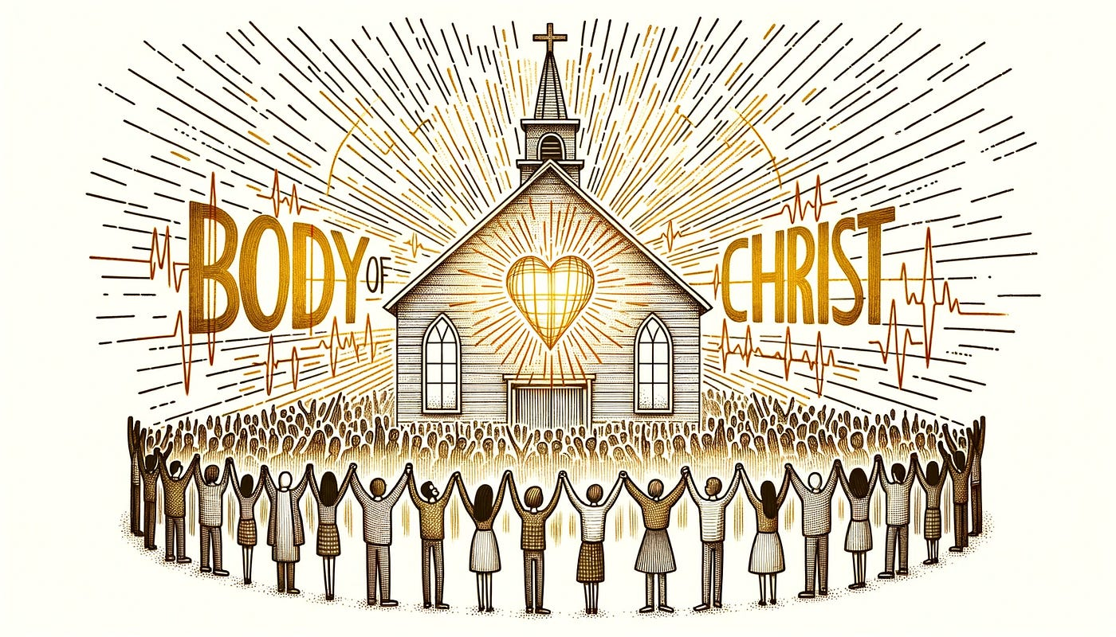
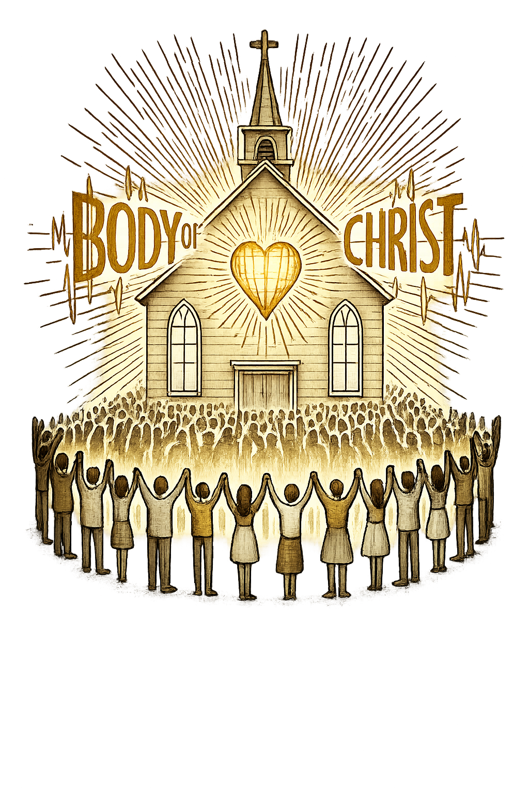
Ephesians 4:11-13
And it was He who gave some to be apostles, some to be prophets, some to be evangelists, and some to be pastors and teachers, to equip the saints for works of ministry and to build up the body of Christ, until we all reach unity in the faith and in the knowledge of the Son of God, as we mature to the full measure of the stature of Christ.
Spiritual gifts equip you to fulfill your God-appointed role in the body of Christ

Slide 13
Gifts of the Spirit
Regularly used
Situational
Absent
Serving
Administration
Faith
Encouragement
Giving
Leadership
Showing mercy
Prayer language
Teacher
Evangelist
Pastor
Apostles
Prophets
Word of Knowledge
Word of Wisdom
Discerning spirits
Miracles
Prophecy
Prophetic tongue
Interpretation of tongues
Foreign Tongues
Very Situational

Slide 14
God has given us:
Kapangyarihan: Kumpiyansa, kahusayang moral, kakayahang gumawa ng mga sobrenatural na Gawain
Agape: Walang kondisyong pag-ibig na siyang pinagmumulan ng ating pagmamahal maging sa ating mga kaaway
Maayos na pag-iisip: Kapanatagan na nakabatay sa pagtitiwala sa pagtawag at pagbibigay-kakayahan ng Diyos.
Power: Confidence, moral excellence, ability to do supernatural acts
Agape: Unconditional love that is the source of our love for even our enemies
Sound mind: Calmness based on trust in God’s calling and equipping
Notes:
Aligns with John 1:1-5, 14
1 In the beginning was the Word, and the Word was with God, and the Word was God. 2 He was with God in the beginning. 3 Through him all things were made; without him nothing was made that has been made. 4 In him was life, and that life was the light of all mankind. 5 The light shines in the darkness, and the darkness has not overcome[fn] it. The Word became flesh and made his dwelling among us. We have seen his glory, the glory of the one and only Son, who came from the Father, full of grace and truth.

Slide 15
Ensure your work is grounded in the Lord’s authority and provision
Get to know the work and the people to which you are called
We are called to build disciples of Christ who are operating in their gifts
God has given us a bold heart and mind to testify of Christ
Summary
Kingdom Builders 2
Notes:
Aligns with John 1:1-5, 14
1 In the beginning was the Word, and the Word was with God, and the Word was God. 2 He was with God in the beginning. 3 Through him all things were made; without him nothing was made that has been made. 4 In him was life, and that life was the light of all mankind. 5 The light shines in the darkness, and the darkness has not overcome[fn] it. The Word became flesh and made his dwelling among us. We have seen his glory, the glory of the one and only Son, who came from the Father, full of grace and truth.

Slide 16
Session 3
Guarding & Rest

Slide 17
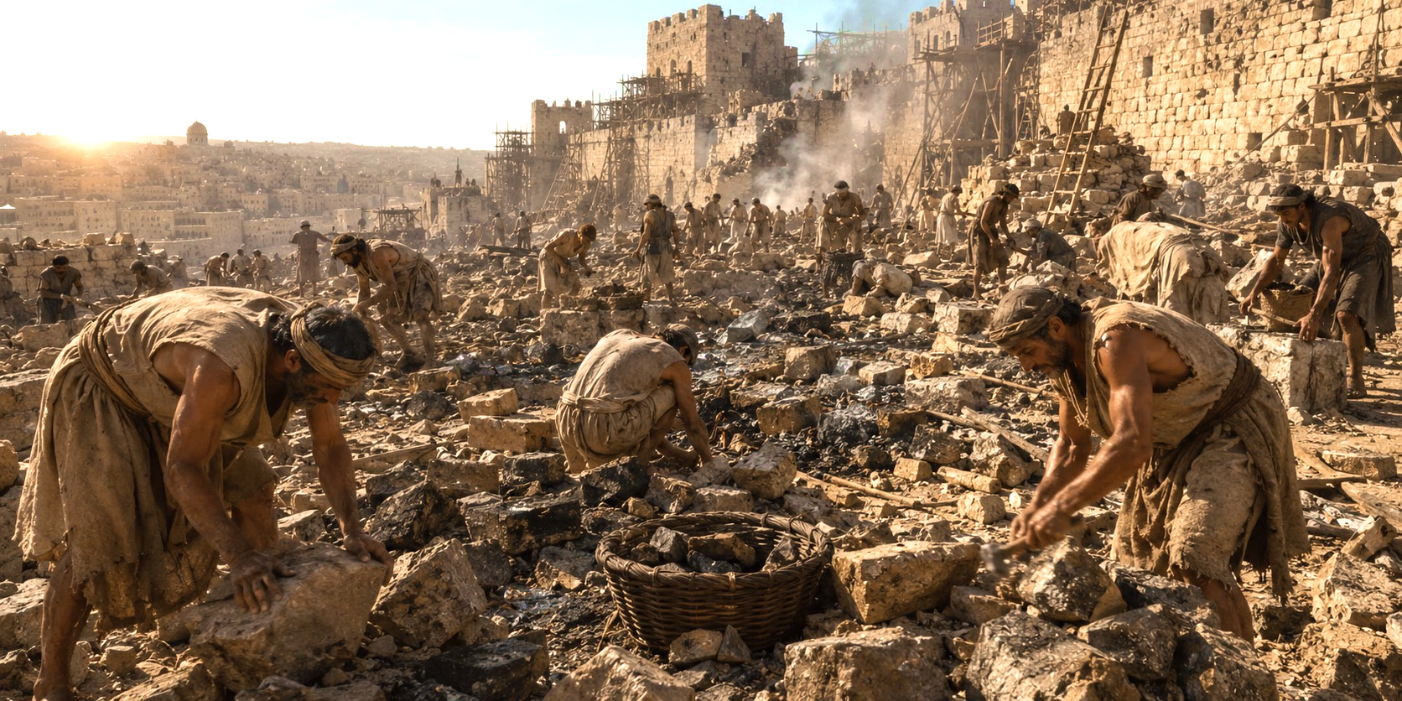
The Large Task
Notes:
Aligns with John 1:1-5, 14
1 In the beginning was the Word, and the Word was with God, and the Word was God. 2 He was with God in the beginning. 3 Through him all things were made; without him nothing was made that has been made. 4 In him was life, and that life was the light of all mankind. 5 The light shines in the darkness, and the darkness has not overcome[fn] it. The Word became flesh and made his dwelling among us. We have seen his glory, the glory of the one and only Son, who came from the Father, full of grace and truth.

Slide 18
Nehemiah 4:10-12
Then the people of Judah began to complain, “The workers are getting tired, and there is so much rubble to be moved. We will never be able to build the wall by ourselves.”
Meanwhile, our enemies were saying, “Before they know what’s happening, we will swoop down on them and kill them and end their work.”
The Jews who lived near the enemy came and told us again and again, “They will come from all directions and attack us!”
Notes:
Aligns with John 1:1-5, 14
1 In the beginning was the Word, and the Word was with God, and the Word was God. 2 He was with God in the beginning. 3 Through him all things were made; without him nothing was made that has been made. 4 In him was life, and that life was the light of all mankind. 5 The light shines in the darkness, and the darkness has not overcome[fn] it. The Word became flesh and made his dwelling among us. We have seen his glory, the glory of the one and only Son, who came from the Father, full of grace and truth.

Slide 19

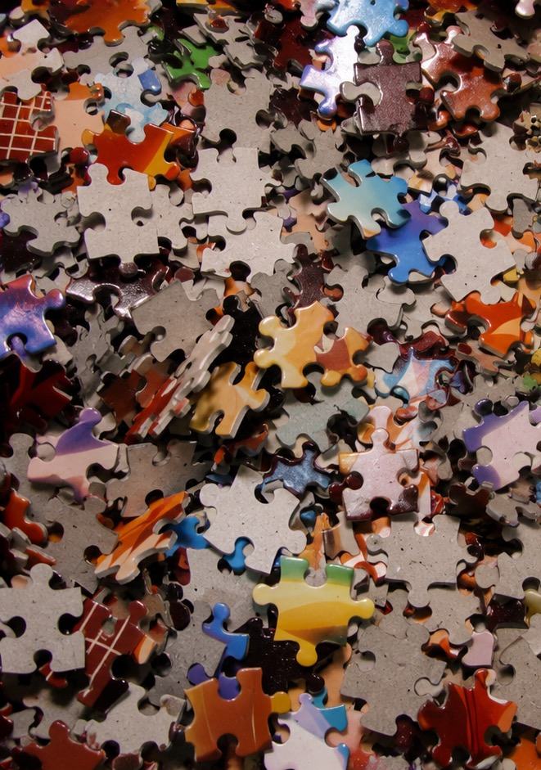
Notes:
Aligns with John 1:1-5, 14
1 In the beginning was the Word, and the Word was with God, and the Word was God. 2 He was with God in the beginning. 3 Through him all things were made; without him nothing was made that has been made. 4 In him was life, and that life was the light of all mankind. 5 The light shines in the darkness, and the darkness has not overcome[fn] it. The Word became flesh and made his dwelling among us. We have seen his glory, the glory of the one and only Son, who came from the Father, full of grace and truth.

Slide 20
Pastor Alan Redpath
“There is no winning without warfare; there is no opportunity without opposition; there is no victory without vigilance. For whenever the people of God say, ‘Let us arise and build,’ Satan says, ‘Let me arise and oppose.’”
“Walang pagtatagumpay nang walang pakikidigma; walang oportunidad nang walang pagsalungat; walang tagumpay nang walang pagbabantay. Sapagkat sa tuwing sinasabi ng mga tao ng Diyos, ‘Tayo’y bumangon at magtayo,’ sinasabi ni Satanas, ‘Hayaan ninyo akong bumangon at sumalungat.’”
Notes:
Aligns with John 1:1-5, 14
1 In the beginning was the Word, and the Word was with God, and the Word was God. 2 He was with God in the beginning. 3 Through him all things were made; without him nothing was made that has been made. 4 In him was life, and that life was the light of all mankind. 5 The light shines in the darkness, and the darkness has not overcome[fn] it. The Word became flesh and made his dwelling among us. We have seen his glory, the glory of the one and only Son, who came from the Father, full of grace and truth.

Slide 21
https://www.youtube.com/watch?v=23JW-FdeTDo

Slide 22
https://www.youtube.com/watch?v=6EmP-_GPEmI

Slide 23
Armed and Equipped
    Being equipped and employed for works of service…they are operating in their gifts
Unified in the faith because they are growing in the knowledge of Christ and are confident in what they believe
          Dahil sila ay nasasangkapan at ginagamit para sa mga gawain ng paglilingkod… ginagamit nila ang kanilang mga kaloob.
Nagkakaisa sa pananampalataya dahil sila ay lumalago sa kaalaman tungkol kay Cristo at may pagtitiwala sa kanilang pinaniniwalaan.
Notes:
Aligns with John 1:1-5, 14
1 In the beginning was the Word, and the Word was with God, and the Word was God. 2 He was with God in the beginning. 3 Through him all things were made; without him nothing was made that has been made. 4 In him was life, and that life was the light of all mankind. 5 The light shines in the darkness, and the darkness has not overcome[fn] it. The Word became flesh and made his dwelling among us. We have seen his glory, the glory of the one and only Son, who came from the Father, full of grace and truth.

Slide 24
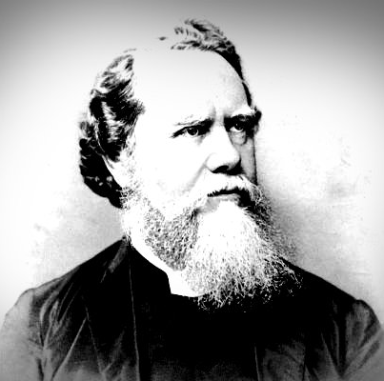
Hudson Taylor
"I have striven in vain to rest in Him. I'll strive no more. For has He not promised to abide with me—never to leave me, never to fail me?"
"God, even my God, was a living bright Reality, and all I had to do was joyful service."
Notes:
Aligns with John 1:1-5, 14
1 In the beginning was the Word, and the Word was with God, and the Word was God. 2 He was with God in the beginning. 3 Through him all things were made; without him nothing was made that has been made. 4 In him was life, and that life was the light of all mankind. 5 The light shines in the darkness, and the darkness has not overcome[fn] it. The Word became flesh and made his dwelling among us. We have seen his glory, the glory of the one and only Son, who came from the Father, full of grace and truth.

Slide 25
Summary Kingdom Builders 3
Christian ministry may seem overwhelming
There is much work to do and often opposition to it
Focus on making disciples who operate in their gifts and stand against false teaching
Rest outside the work, in the work, and always in Christ
Maaaring mukhang napakabigat ng ministeryong Kristiyano
Maraming gawaing kailangang gawin at madalas ay may pagtutol dito
Magpokus sa paggawa ng mga alagad na ginagamit ang kanilang mga kaloob at naninindigan laban sa maling katuruan
Magpahinga sa labas ng gawain, sa gitna ng gawain, at laging kay Cristo
Notes:
Aligns with John 1:1-5, 14
1 In the beginning was the Word, and the Word was with God, and the Word was God. 2 He was with God in the beginning. 3 Through him all things were made; without him nothing was made that has been made. 4 In him was life, and that life was the light of all mankind. 5 The light shines in the darkness, and the darkness has not overcome[fn] it. The Word became flesh and made his dwelling among us. We have seen his glory, the glory of the one and only Son, who came from the Father, full of grace and truth.

