Slide 1
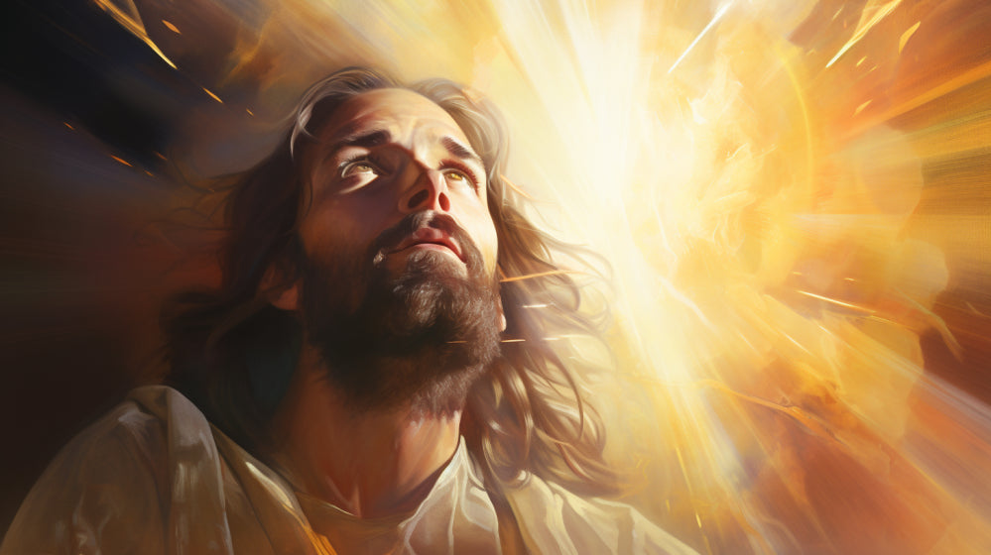

Who is God?
Pastor Jesse Hall
17 May 2026
Notes:
Objective 1: Anchor your worldview in the reality of who God is and your relationship with him and all of creation.
Fact: We are heirs to all he’s created…we are his offspring. How great is his love (1 John 3:1-3).
Why we believe what we believe.

Slide 2
Gen 3:1-6
“Indeed has God said…”
“You certainly will not die!
For God knows that on the day you eat from it
your eyes will be opened, and you will become like God
“When the woman saw that the tree was good for food, and that it was a delight to the eyes…
Causes us to doubt/question God’s Word
Contradicts God’s Word – calls God a liar.
Attacks God’s character; sows mistrust
Activates the God complex in Eve
Appeals to the senses
Notes:
Objective 1: Anchor your worldview in the reality of who God is and your relationship with him and all of creation.
Fact: We are heirs to all he’s created…we are his offspring. How great is his love (1 John 3:1-3).
Why we believe what we believe.

Slide 3
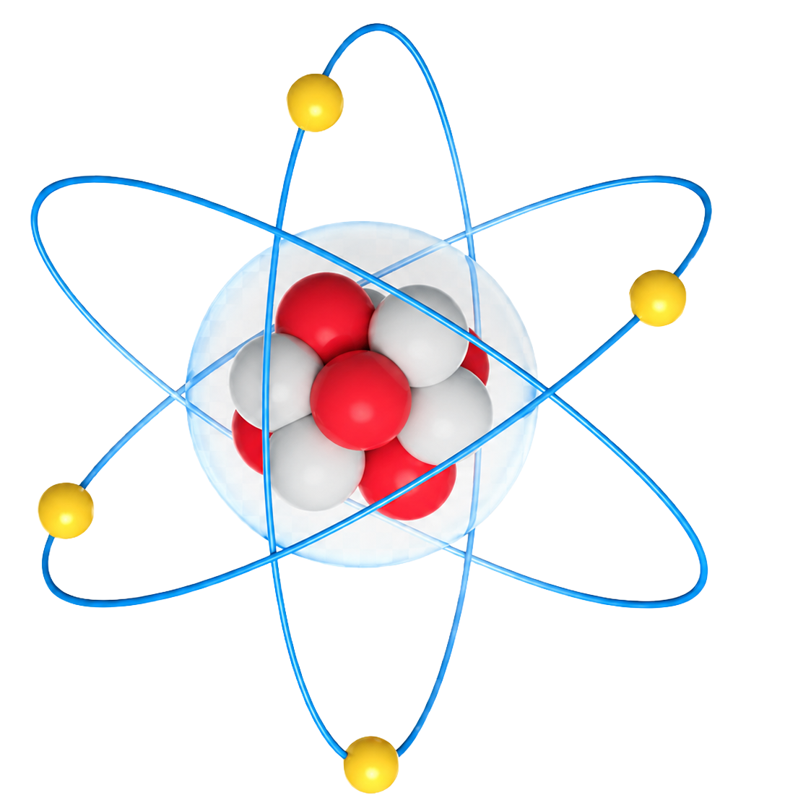

Croutons
Futons
Fig Newtons
1 X 10^⁸⁰
100000000000000000000000000000000000000000000000000000000000000000000000000000000
Electrons
Neutrons
Nuclear Strong Force
Protons
Notes:
Objective 1: Anchor your worldview in the reality of who God is and your relationship with him and all of creation.
Fact: We are heirs to all he’s created…we are his offspring. How great is his love (1 John 3:1-3).
Why we believe what we believe.

Slide 4
https://www.youtube.com/watch?v=NrI57COWVF4

Slide 5
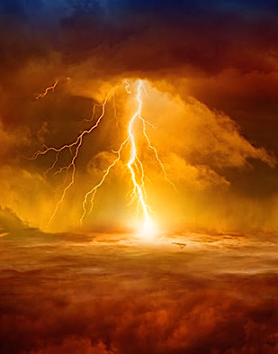
The Mighty God
Hebrews 12:29
Our God is a consuming fire
Psalm 97:5
The mountains melt like wax at the presence of the Lord
Nahum 1:5
The mountains quake before him, and the hills melt; the earth trembles, and its people are destroyed

Slide 6
https://www.youtube.com/watch?v=l9vn5UvsHvM

Slide 7
Fate of the unrighteous
Romans 3:1-12, 23
As it is written: “There is no one righteous, not even one; there is no one who understands; there is no one who seeks God. All have turned away…for ALL HAVE SINNED and fall short of the glory of God
Hebrews 9:27
And as it is appointed for men to die once, but after this the judgment
Notes:
Graphic source: http://commonsenseatheism.com/wp-content/uploads/2010/03/hand-galaxy.png
Anthropic principle – coined by Cambridge Physicist Brandon Carter. Essentially states that all the constants in physics have one thing in common…they are precisely the values needed for a universe capable of producing life….refered to as a razor’s edge. (ibid, P. 126)
These include the amount of carbon and oxygen produced in stars (our sun particularly).
A slight variation in governing laws on earth or in the universe could wipe out life as we know it.
1a. Oxygen at 25 percent, earth would be aflame.
1b. Oxygen at 15 percent, humans would suffocate
2. Precise, constant levels of nitrogen, oxygen, carbon dioxide and ozone provide ensure health amounts of solar radiation reach Earth.
3. Higher CO2 would create deadly greenhouse effect, with temperatures beyond our tolerance. Lower CO2 would bring death to plants, which would lower oxygen levels and eventually suffocate humans.
4. Gravity – Imagine a ruler that goes all the way across the universe and is broken down in one inch increments. A one-inch adjustment in the force of gravity (remember, the ruler is the entire length of the universe) would increase that force a billion-fold. All human life would cease to exist, we would crush under the weight.
5. Produce carbon and other elements to sustain life (story about professior).
6a. If the centrifugal force of planetary movements did not precisely balance the gravitational forces, nothing could be held in orbit around the sun.
6b. Essentially, the sun’s gravitational pull would suck the planets into it, however, centripetal force based on the velocity of the planets rotation around the sun, keep them in orbit.
7. If the universe had expanded at a rate one millionth more slowly than it did, expansion would have stopped and the universe would have collapsed back on itself before any stars formed. If it expanded any faster, no galaxies would have formed.
8. The laws of physics can be described as a function of the velocity of light, which is defined at roughly 186,000 miles per second – this means light could travel around earth 7.5 times in one second! If there was even a slight variation in its velocity life as we know it would come to an end.
9. If Jupiter were not in its current orbit, the earth would be bombarded with space material. Jupiter acts as a shield, pulling in asteroids and comets that otherwise might strike the earth.
“Scientists are finding that the universe in which we live is like a diamond-studded Rolex watch, except the universe is even more precisely designed than the watch. In fact, the improbable and interdependent life-supporting conditions that exist on earth, likely exist nowhere in the universe. In fact, Earth is an “oasis” in a vast, hostile universe.” (Norm Geisler and Frank Turek

Slide 8
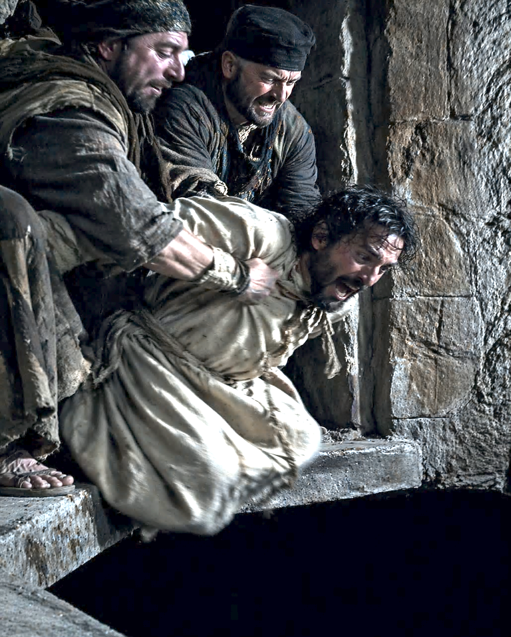
Fate of the unrighteous
Matthew 22:13
‘Tie (the unworthy man) hand and foot, and throw him outside, into the darkness, where there will be weeping and gnashing of teeth.’
Matthew 13:41-42
The Son of Man will send out his angels, and they will weed out of his kingdom everything that causes sin and all who do evil. ⁴² They will throw them into the blazing furnace, where there will be weeping and gnashing of teeth.

Slide 9
Psalm 36:5 - Your love, Lord, reaches to the heavens, your faithfulness to the skies.
The
Love
of
God
Lamentations 3:22 - The Lord’s lovingkindness never ceases, and His compassion never fails. His mercies are new every morning; great is His faithfulness.
Nehemiah 9:17 - But you are a forgiving God, gracious and compassionate, slow to anger and abounding in love.

Slide 10
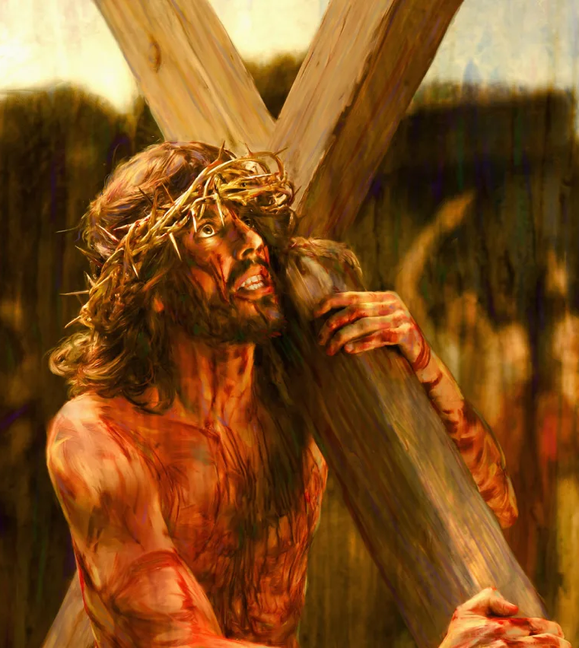
1 John 4:9-10
This is how God showed his love among us: He sent his one and only Son into the world that we might live through him. This is love: not that we loved God, but that he loved us and sent his Son as an atoning sacrifice for our sins.

Slide 11
God’s Holiness
Power
Righteousness
The infinite capacity to create, sustain, alter, or destroy reality
Love
Justice
Deep, pure affection that is ever giving
Administering divine moral law to correct or destroy evil
God’s love and justice are always in balance. Both are at work in everything God does; even when his righteous wrath falls on man, it is ultimately a work of justice and love.
Truth
The revelation of God’s will and character through his words and works

