Slide 1
1st session

Slide 2

End-times
interactive online teaching on Biblical End-times Prophecy
text document
'The Lord is not slow in keeping his promise, as some understand slowness. Instead he is patient with you, not wanting anyone to perish, but everyone to come to repentance.' 2 Peter 3:9 NIV
© 2021 Ed van Ouwerkerk. This presentation is available in English and in Dutch

Slide 3
content of
1st session
Why is teaching about the end times important
Which Bible books display yet unfulfilled future events
Daniel’s interpretation of Nebuchadnezzar’s dream
Daniel’s 70 year-weeks
What is the millennial kingdom
End-time positions
Post-tribulationisme
A-millennianism
Pan-millennialism
What is dispensationalism
What is covenant theology
What is replacement theology
Kingdom Now
Tumpets
The four major positions in eschatology

Slide 4
content of
2nd session
Prophetic calendar
Wars and invasions 1 (from 1948 – now)
Rapture, Jesus appearing for the church
Judgment Seat of Christ, also called BEMA seat
Wedding Feast of the Lamb
Second coming of Christ with the church
Flowchart of resurrections
Tribulation and great tribulation
Wars and invasions 2 (Ezekiel war)
Unholy trinity
Antichrist
False Prophet
The 144,000
The Two Witnesses
Wars and invasions 3 (Armageddon)
Millennial Kingdom
Reign with Christ in the Millennial Kingdom
Wars and invasions 4 (Revelation 20:7-10)
The Great White Throne judgment
The New Jerusalem
The ABC of salvation

Slide 5
Why is teaching about the end times important
About 27% of the content of the Bible is prophetic.
Many Old Testament prophesies are fulfilled in Jesus. But a large part of biblical prophecy is still hidden in the future. That is about 15% of the Bible.
Most churches in Europe fall short to teach about biblical prophecy. Then the church is left without knowledge and insight and isn't prepared for future events.
Now, in times of distress (current corona-virus pandemic/pandemonium, the global plague of locusts, and forest wildfires, etc.), it is time to be prepared and to persevere in sharing the hope that is in us, through Jesus, the perfecter of our faith.
In this corona-virus time, Exodus 12:22 is both historic as well prophetic as it says: “ . . . none of you shall go out of the door of your house . . .”

Slide 6
Last week of Jesus on earth
Jesus teaches two messages on dispensation (time-period):
Location: Mount of Olives, east of Jerusalem
Audience: Jews
Theme: “Goodbye Israel”
Scripture: Matthew 24-25, Mark 13, Luke 21
Message: Old Testament is fulfilled. I will come again to deal with Israel in the tribulation. Sermon is also called the Olivet Discourse
Location: Upper room, in Jerusalem
Audience: Christians
Theme: “Welcome church”
Scripture: John 13-17
Message: New Testament period starts. I will take you up to heaven during the tribulation and bring you back to earth for the Millennial Kingdom.

Slide 7
The old recipe renewed for our lifetime
Let’s do the same as the first churches in Europe did.
Look how early the apostle Paul taught on the topic of the Second Coming of Jesus, as we see in 1 Thessalonians, that was written in approximately 58 AD.
“They (the people who heard about God’s work through the church) tell how you (the church in Thessalonica) turned to God from idols, to serve the living and true God, and to wait for his Son from heaven, whom he (God) raised from the dead – Jesus, who rescues us from the coming wrath”
(1 Thessalonians 1:8-10 NIV).

Slide 8
Which Bible books display yet unfulfilled future events
In the Old Testament
Psalm 83 (partly fulfilled)
Daniel, chapter 2 (Nebuchadnezzar’s dream and the statue), chapter 7 (beasts-prophecy, Antichrist and judgment of the nations), chapter 9 (the 70 sevens), and chapter 12 (75-days time between tribulation and millennial kingdom)
Ezekiel, chapters 38-39 (the Ezekiel war)
Joel 3 (the nations judged)
In the New Testament
Jesus' own words in the Olivet Discourse (instructions on the Mount of Olives in the beginning of His passion week) as a “goodbye Israel”-message:
  Mark 13:1-13 (signs of the end times); parallel texts Matthew 24:4-35 and Luke 21:5-19
  Mark 13:14-31 (day and hour unknown, in the tribulation just before the second coming); parallel text in Matthew 24:36-51
  Matthew 25:1-13 (parable of the virgins, division of believing and unbelieving Jews at the 2nd coming)
  Matthew 25:31-46 (judgment of the nations at the second coming, sheep and goats separated, last judgment), also Luke 17:26-37
  Luke 21:20-36 (for the Jews, to flee during the second half of the tribulation)

Slide 9
In the New Testament
Jesus’ own words in the Upper Room Discourse (instructions in the Upper Room at the end of the Passion week) as a “welcome church”-message:
  John 13-17, especially John 14:1-3 (preparation of room for us in the Father’s House and the rapture)
Paul’s prophetic insights in:
  1 Thessalonians 4:13-18 (rapture), 2 Thessalonians 2:3 (rapture, as right translation of ‘apostasia’, NOT falling away)
  1 Corinthians 15:52 (rapture)
  2 Thessalonians 2:1-12 (the Day of the Lord = the tribulation and the second coming, the man of lawlessness)
  1 Corinthians 15:12-49 (resurrection bodies)
Jesus’ prophecy through John in Revelation:
  Chapter 1 is about the past
  Chapters 2 - 3 are about the present or the church history
    Chapters 4 - 5 are about the rapture
      Chapters 6 - 18 are about the 7-year tribulation, where the church in not mentioned
        Chapter 7 (the 144,000)
        Chapter 11 (two witnesses)
        Chapter 12 (the Jews’ 3.5 years in the wilderness)
        Chapter 13 (the Antichrist and False Prophet)
    Chapter 19 is about the second coming
    Chapter 20 is about the millennium
    Chapters 21-22 are about the new heavens and the new earth

Slide 10
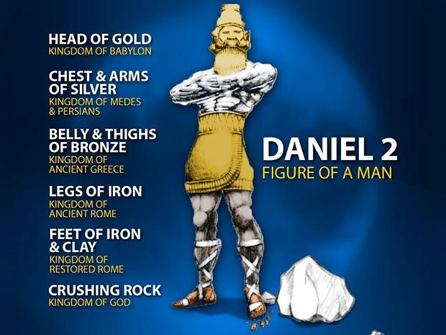
“This was the dream, and now we will interpret it to the king. Your Majesty, you are the king of kings. The God of heaven has given you dominion and power and might and glory; in your hands he has placed all mankind and the beasts of the field and the birds in the sky. Wherever they live, he has made you ruler over them all. You are that head of gold. “After you, another kingdom will arise, inferior to yours. Next, a third kingdom, one of bronze, will rule over the whole earth. Finally, there will be a fourth kingdom, strong as iron—for iron breaks and smashes everything—and as iron breaks things to pieces, so it will crush and break all the others. Just as you saw that the feet and toes were partly of baked clay and partly of iron, so this will be a divided kingdom; yet it will have some of the strength of iron in it, even as you saw iron mixed with clay. As the toes were partly iron and partly clay, so this kingdom will be partly strong and partly brittle. And just as you saw the iron mixed with baked clay, so the people will be a mixture and will not remain united, any more than iron mixes with clay. “In the time of those kings, the God of heaven will set up a kingdom that will never be destroyed, nor will it be left to another people. It will crush all those kingdoms and bring them to an end, but it will itself endure forever. This is the meaning of the vision of the rock cut out of a mountain, but not by human hands—a rock that broke the iron, the bronze, the clay, the silver and the gold to pieces. “The great God has shown the king what will take place in the future. The dream is true, and its interpretation is trustworthy.” Then King Nebuchadnezzar fell prostrate before Daniel and paid him honor and ordered that an offering and incense be presented to him. (Daniel 2:36-46 NIV)
Daniel’s interpretation of Nebuchadnezzar’s dream (ch. 2) & own vision (ch. 7)
beast
Read Daniel 2:36-45
and chapter 7
1
2
prophesies about
four kingdoms
fulfilled
3
4
kingdom of the
antichrist during the
(great) tribulation
millennial kingdom
of Jesus

Slide 11
Daniel’s 70 year-weeks
We read the words of the prophet Daniel: “Know and understand this: From the time the word goes out to restore and rebuild Jerusalem until the Anointed One, the ruler, comes, there will be seven ‘sevens,’ and sixty-two ‘sevens.’ (Daniel 9:25 NIV)
This means 7 + 62 = 69 year-weeks,
which is 69 x 7 = 483 years (of 360 days/year in the Jewish lunar calendar),
which is 476 years and 25 days (in our Gregorian calendar).
That time span is exactly the time between the day that the decree was given to Nehemiah
(445 BC*) to rebuild the walls of Jerusalem and the day of Jesus’ entrance in Jerusalem on Palm Sunday. Prophecy was fulfilled, which gives reason to believe that also the 70th year week prophecy (7-year tribulation) will be fulfilled.
* Some people take the date of the destruction of the temple (587 BC) as start to rebuild the Jerusalem walls, and arrive with the 69 year-weeks at the reign of successive Greek-Syrian Celeucid Empire kings Antiochus Epiphanes (175-96 BC) which would fulfill Daniel’s prophecy. They point to a “ruler”, not to the “Anointed One”. They use evidence taken from the book of the Maccabees. This position is taken by amillennialists, who argue that the symbolic Millennial Kingdom started at first Pentecost.

Slide 12
What is the millennial kingdom
The millennial kingdom in earthly state is the 1000-year reign of Jesus Christ on the earth. Most Christian scholars take this time span literally, however, some see it as allegorical or symbolic.
In Revelation 20:2-7, the millennial kingdom is six times said to be 1000 years in length.
The Bible tells us that, when Christ returns to the earth, He will establish Himself as king in Jerusalem, sitting on the throne of David
(2 Samuel 7:10–13, Luke 1:32–33).
Satan will not be able to disturb the reign of Jesus (Revelation 20:2).

Slide 13
Endtimes positions
pre-millennialism
post-millennialism
a-millennialism
pan-millennialism
millennial kingdom
tribulation
pre-tribulationism
mid-tribulationism
post-tribulationism
dispensationalism
covenant
(reformed/calvinist) theology
replacement theology
Israel

Slide 14
Post-tribulationism
Arguments against two second comings (rapture and second advent)*
They argue that there cannot be two second comings, what pre-trubulationists believe (rapture + second coming), because 2 Thessalonians 1:7 says: “This will happen when the Lord Jesus is revealed from heaven in blazing fire with his powerful angels”. This would mean that there is only one coming, which excludes a coming in the air prior to the second coming on earth. The word ‘when’ would exclude two times.
Another point they try to make is from 1 Thessalonians 4:17. It says: “After that, we who are still alive and are left will be caught up together with them in the clouds to meet the Lord in the air. And so, we will be with the Lord forever.” They argue that when people meet, they always need to return to the same location. They argue that after meeting in the air cannot mean to go elsewhere thereafter (in this case to heaven).
Arguments for post-tribulationism**
1 Thessalonians 3:4 speaks about suffering, although it is not sure that the suffering refers to the tribulation for the believers. 2 Thessalonians 1:5-12 speaks about judgment and suffering for the believers and those who oppress them (verses 5-6). It is not clear when this will take place. But it could be that this is an argument for the belief that Christians will go through the tribulation.
* Interview with pastor John Piper (post-tribulationist), called “What is the Rapture”, YouTube Dec 21, 2018
** Sermon by pastor John Piper (post-tribulationist), called “The Second Coming: Wrath and Rescue”, YouTube April 5, 2020

Slide 15
Amillennialism
Amillennialism is the name given to the belief that there will not be a literal 1,000-year reign of Christ. Amillennialists do not believe that there is no millennium at all. Instead, they believe that Christ is now sitting on the throne of David and that this present church age is the kingdom over which Christ reigns. In order for God to keep His promises to Israel and His covenant with David (2 Samuel 7:8-16, 23:5; Psalm 89:3-4), there must be a literal, physical kingdom on this earth. To doubt this is to call into question God’s desire and/or ability to keep His promises. Those who hold to amillennialism believe that a “spiritual” reading of unfulfilled prophecy is the normal reading of the texts.
The prophecies concerning Christ’s first coming were all fulfilled literally. The fact that fulfilled prophecy was fulfilled literally is the best reason of all for assuming that unfulfilled prophecy will also be literally fulfilled.

Slide 16
Pan-millennialism
Pan-millennialists believe that no one can know the future, but that everything will all pan out in the long run according to God's will and God's own timetable. Therefore, there is no need to study eschatology and to know the future.
This attitude is contrary to God’s teaching in which all Christians are taught about His prophetic plan of salvation, both for Israel and the church. Over and over again the New Testament says “I do not want you to be ignorant . . . “; Romans 11:25, 1 Corinthians 10:1, 1 Corinthians 15:34, Hebrews 5:2, 1 Peter 2:15, 2 Peter 3:16.

Slide 17
What is dispensationalism
In theology, a dispensation is the divine administration of a time period.
Dispensationalism is a theological system that recognizes these ages ordained by God to order the affairs of the world.
Dispensationalism has two primary distinctives:
A consistently literal interpretation of Scripture, especially Bible prophecy. In Revelation 20, dispensationalists interpret “a thousand years” as a literal period of 1,000 years (the dispensation of the Kingdom). We now live in the so-called time of the dispensation of grace. It began with the New Covenant of Christ's blood (Luke 22:20). This time is also called the "Age of Grace" or the "Church Age", which occurs between the 69th and 70th year-week of Daniel. *
A view of the uniqueness of Israel as separate from the Church in God’s parallel plan of redemption. **
* The church age is not part of Daniel’s prophecy, because that prophecy is only about Israel. The country Israel didn’t exist
from 70 AD until 1948. During this almost 2,000 year’s period God stopped the ‘clock’. The 70th year-week of Daniel can begin any time,
since Israel became a nation in 1948.
** Don’t confuse dispensationalism with the erroneous dual-covenant theology, which states that the Jews don’t need to be redeemed
by Jesus, because they were already made righteous through Old Testament covenants. That theology contradicts the entire New Testament.

Slide 18
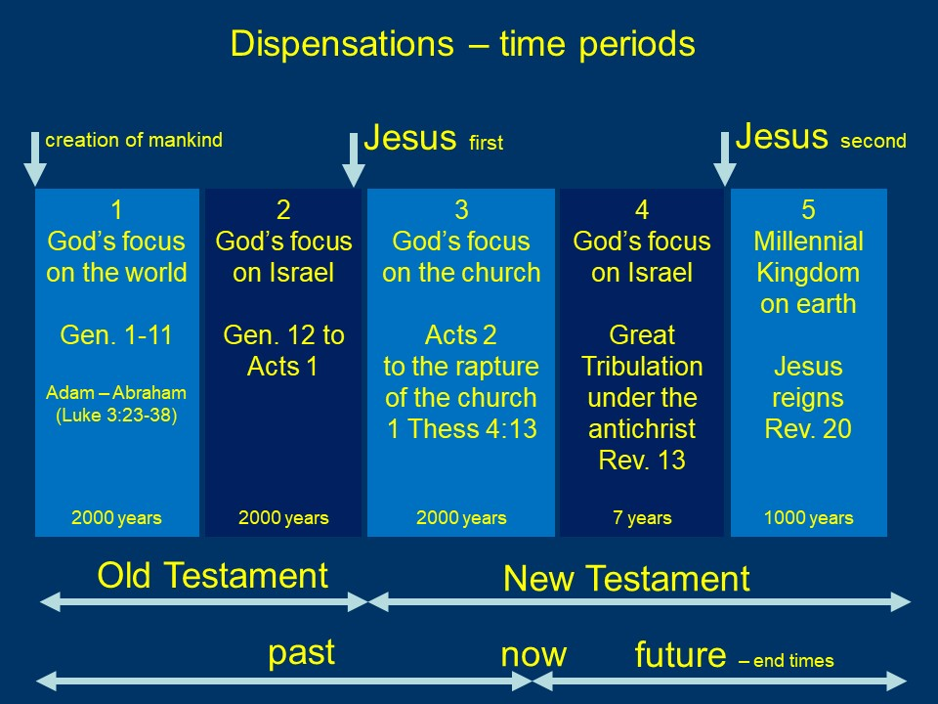

Slide 19
What is covenant theology
Covenant Theology, also called Reformed Theology, looks at the Scriptures through the grid of covenants. Covenant Theology defines two overriding covenants: the covenant of works (with Noah, Abraham, Moses, and David) and the covenant of grace (through Jesus, in which God writes His law upon our hearts and completely forgives our sins), because Christ came to fulfill the Law (Matthew 5:17).
The story of redemptive history is God unfolding the Covenant of Grace from its nascent stages (Genesis 3:15) through to its fruition in Christ.
Covenant Theology states that the Church doesn’t replace Israel; the Church is Israel and Israel is the Church (Galatians 6:16 ESV).
Reformed theologians regard Revelation 20:1-5 as a symbolic recapitulation of Christian church history.

Slide 20
What is replacement theology
Replacement theology is a belief system in which the Church has replaced Israel. That implies that God broke His covenant with the people and the land of Israel, because Israel rejected the Messiah Jesus. This theology is contrary to dispensationalism. The biblical vision on the relationship between Israel and the Church is illustrated in Romans chapter 11, in which we see that Israel will be saved, rather in a different manner than the Church.
The replacement theology was introduced in the early church, and it is still alive. The majority of the Roman Catholic Church and many liberal Protestant denominations adhere to this belief.

Slide 21
End-time related movement: Kingdom Now
Kingdom Now proponents believe that God lost control over the world to Satan when Adam and Eve sinned. Since then, the theology goes, God has been trying to reestablish control over the world by seeking a special group of believers.
The belief is that, since believers are indwelt by the same Holy Spirit that indwelt Jesus, we have all authority in heaven and on the earth; we have the power to believe for and speak into existence things that are not, and thus we can bring about the Kingdom Age.
Kingdom Now claims that Jesus cannot return until all His enemies have been put under the feet of the church.
Comments:
Kingdom Now theology focuses on New Testament revelation and lacks searching congruency with Old Testament revelation (Acts 17:11).
It is God who will usher in the Kingdom, not men (Daniel 2:44).
The kingdom cannot arrive in this age (dispensation), because the old and the new will
co-exist (Matthew 13:52)

Slide 22
Another end-time related movement: the New Apostolic Reformation (NAR)
The New Apostolic Reformation, or NAR, is a religious movement that emphasizes experience over Scripture, mysticism over doctrine, and modern-day “apostles” over the plain text of the Bible.
Of particular distinction in the New Apostolic Reformation are the role and power of spiritual leaders and miracle-workers, the reception of “new” revelations from God, an over-emphasis on spiritual warfare, and a pursuit of cultural and political control in society.
NAR teaches that new apostles and prophets hold leadership over evangelists, pastors, and teachers.

Slide 23
Trumpets
Some people get confused about the last trumpet in 1 Corinthians 15 and the seven trumpets in Revelation. The seven trumpets are blown in the first half of the tribulation. They (mid-tribulationists) think that the last trumpet (1 Cor. 15:52 and 1 Thess. 4:16) must be equal to the seventh trumpet (Rev. 11:15).
Pre-tribulationists are convinced that these trumpets are not the same. Why?
Understanding this has to do with chronology. The last trumpet is a sign of the end of the church age dispensation. Paul revealed this prophecy decennia before the prophecy of John in Revelation.
The seven trumpets blown by angels in Revelation sound in the next dispensation: the tribulation, mainly for the Jews. They all have to do with God’s wrath upon the disobedient.
Another sign of a trumpet announcing the rapture before the judgments begin, is Revelation 4:1, right after the last descriptions of the church were done. Then Jesus says, “Come up here”.

Slide 24
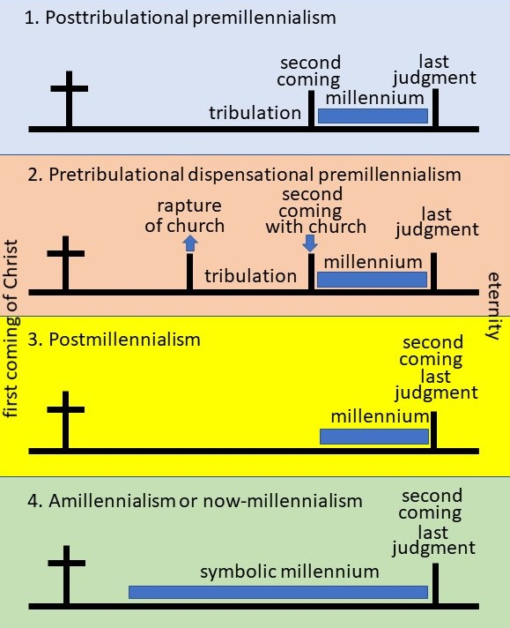
Four major positions in eschatology
They have in common at the same time:
The first coming of Jesus (cross)
A last judgment
They have in common at different times:
A millennium (one has another length)
The second coming/advent (one has
two second comings=one for the
church and one with the church)
Regarding the tribulation:
Two have a tribulation
Two have no tribulation
Regarding the rapture:
Only one (2) has a rapture

Slide 25
Comments on major positions
Regarding heaven:
Three positions don’t indicate any time for believers to spend in heaven with the Lord.
Only one position (2) reserves time in
heaven for the believers to enjoy:
  the rewards (crowns) obtaining judgment seat of Christ (James 1:12)
  dwell in the mansions that were prepared by Jesus (John 14:3)
  the presence at the wedding
  of the Lamb with His bride (the church)
Regarding the millennial kingdom:
Two positions (1 and 2) make sense
that there will be a millennial kingdom
with king Jesus present on earth

Slide 26
This is the end of the 1st session

Slide 27
End-times
2nd session
In the 1st session we covered the rough framework of eschatology.
Then we ended with this figure.

Slide 28
What to expect of this session?
Today we’ll try to cover all events, mentioned in the four positions figure, one-by-one.
Because dispensational pre-tribulationism includes most of the events, we chose to take that position as our guide today. I can endorse and defend that position with all of my heart.
This means that we don’t speak about the other positions today.
Mid-tribulationism, post-tribulationism, post-millenianism, amillennialism, pan-millennialismcovenant theology, and replacement theology will not be covered today. I am not the person to endorse those positions.

Slide 29
2nd session
Prophetic calendar
Wars and invasions 1 (from 1948 – now)
Rapture, Jesus appearing for the church
Judgment Seat of Christ, also called BEMA seat
Wedding Feast of the Lamb
Second coming of Christ with the church
Flowchart of resurrections
Tribulation and great tribulation
Wars and invasions 2 (Ezekiel war)
Unholy trinity
Antichrist
False Prophet
The 144,000
The Two Witnesses
Wars and invasions 3 (Armageddon)
Millennial Kingdom
Reign with Christ in the Millennial Kingdom
Wars and invasions 4 (Revelation 20:7-10)
The Great White Throne judgment
The New Jerusalem
The ABC of salvation

Slide 30
Prophetic calendar
 |  | Jewish feasts, Leviticus 23 | Christian counterparts | Fulfilment by Jesus
1 | spring | Passover; Pesach | Good Friday – Crucifixion – Burrial | fulfilled
2 |  | Unleavened bread; Chag ha Motzah
3 |  | First fruits; Yom ha Bikkurim | Resurrection day
4 |  | Weeks; Shavu’ot | Pentecost – Holy Spirit
5 | fall | Trumpets; Yom Teruah | Rapture - Second coming | Yet to be fulfilled
6 |  | Day of Atonement; Yom Kippur | Judgment (Israel saved)
7 |  | Tabernacles; Sukkoth | Millennium Reign - shelter

Slide 31
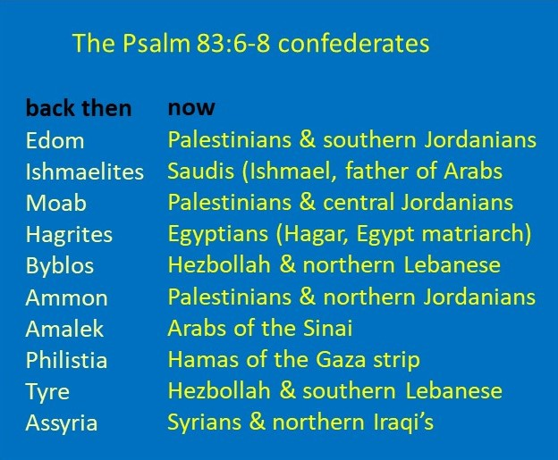
Wars and invasions 1 (1948-now)
text document
Psalm 83, written by Asaph.
This prophecy is also called the attack by ten powers forming a confederation. Many scholars say that this prophecy has been fulfilled in the last 72 years after the wars against Israel since its founding in 1948 by neighboring Arab countries, in which Israel has successfully defeated them. The chart gives an idea which countries were involved.
Gog and Magog are mentioned in Ezekiel and in Revelation. However, it is about different wars.

Slide 32
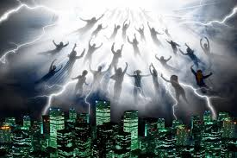
The rapture, Jesus appearing for the church
At the rapture Jesus will suddenly come (Isaiah 26:19) in the
air (in the clouds) and will not set foot on the earth. All
believers, both dead and alive, will receive their resurrection
bodies and meet the Lord in the air (1 Corinthians 15:51-54, 1 Thess. 4:13-18, 2 Thess. 2:3*). Jesus promised to prepare a place in heaven and come back to gather His church to come to the place where He is (John 14:1-3). On the other hand, at the second coming Jesus will set foot on the earth (Zech. 14:4) seven years later, after the tribulation.
* In the original text the word ‘apostasia’ is used, which is rapture, NOT falling away.
¹³Brothers and sisters, we do not want you to be uninformed about those who sleep in death, so that you do not grieve like the rest of mankind, who have no hope. ¹⁴For we believe that Jesus died and rose again, and so we believe that God will bring with Jesus those who have fallen asleep in him. ¹⁵According to the Lord’s word, we tell you that we who are still alive, who are left until the coming of the Lord, will certainly not precede those who have fallen asleep. ¹⁶For the Lord himself will come down from heaven, with a loud command, with the voice of the archangel and with the trumpet call of God, and the dead in Christ will rise first. ¹⁷After that, we who are still alive and are left will be caught up together with them in the clouds to meet the Lord in the air. And so we will be with the Lord forever. ¹⁸Therefore encourage one another with these words
(1 Thessalonians 4:13-18 NIV).
In Daniel 9:20-27 we see that the prophecy of the seventieth-seven period of the tribulation has to do with Israel and God's wrath. Why should the church be present on earth during that period? That would be inconsistent with God's promise "For God did not appoint us to suffer wrath but to receive salvation through our Lord Jesus Christ (1 Thess. 5:9)".

Slide 33
Judgment Seat of Christ, also called BEMA seat
For we will all stand before God’s judgment seat. . . . So then, each of us will give an account of himself to God (Rom. 14:10–12 ESV).
We must all appear before the judgment seat of Christ, so that each of us may receive what is due us for the things done while in the body, whether good or bad (2 Cor. 5:10).
The Bible speaks of believers receiving crowns (no punishment) as rewards for different things based on how faithfully they served Christ
(1 Corinthians 9:4-27; 2 Timothy 2:5)
Blessed is the man who perseveres under trial, because when he has stood the test, he will receive the crown of life that God has promised to those who love him (James 1:12).

Slide 34
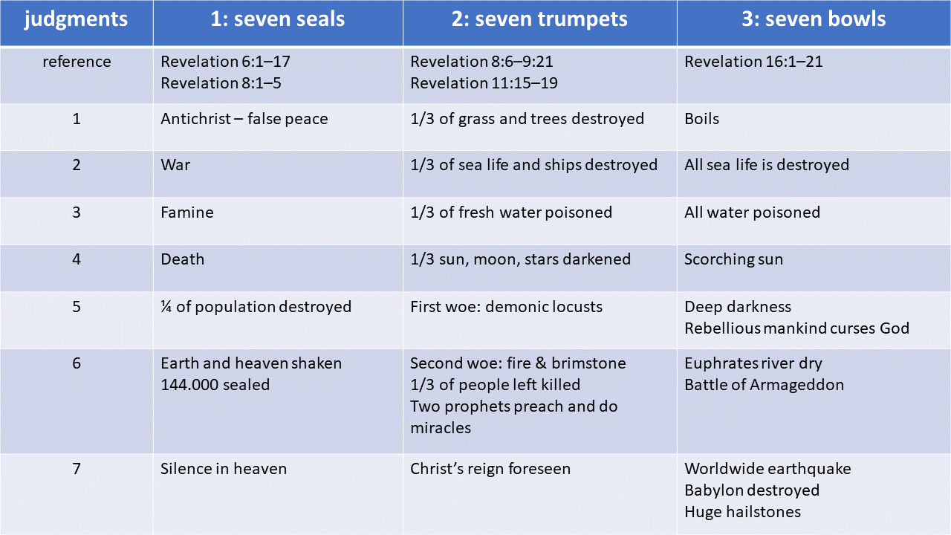
God’s wrath according to the book of Revelation

Slide 35
Wedding Feast of the Lamb
The marriage feast of the Lamb (Isaiah 26:20) takes place in heaven between the rapture and the second coming (during the tribulation on earth).
Partaking in the wedding feast will be not only the Church as the Bride of Christ, but others as well. The “others” include the Old Testament saints—they will not have been resurrected yet (Ezekiel 37:13-14, Daniel 12:1-2), but their souls/spirits will be in heaven.
The supper of the wedding may take place on earth or in heaven (not sure). As the angel told John to write, “Blessed are those who are invited to the marriage supper of the Lamb” (Revelation 19:9). The marriage supper of the Lamb is a glorious celebration for all who are in Christ! The supper will be held as soon as also those who came to Christ in the tribulation are invited and counted in.
After the wedding feast the bride is no longer called the Bride. She is called the “wife of the Lamb” (Revelation 21:9).

Slide 36
Second coming/advent of Christ (in position 2 with the church)
The second coming/advent of Jesus Christ is the hope of believers that God is in control of all things and is faithful to the promises and prophecies in His Word.
In His first coming
In His second coming
He came to earth as a baby in humble circumstances
He was the suffering servant
(Isaiah 53:3-12)
Jesus fulfilled many of the prophecies of the Messiah during His birth, life, ministry, death, and resurrection.
He will be the conquering King, coming with thousands of saints (Jude 14)
He will arrive (Zech. 12:3-9) on the Mount of Olives with the armies of heaven at His side (Zechariah 12:10-13; 14:4) and everybody will see Him (Matthew 24:30; Rev. 1:7).
With justice He judges the nations and wages war (Rev. 19:11-16)
Israel will be saved (Rom. 11:25-27, Matthew 23:37-39) and He will establish a new covenant with the Jews (Jeremiah 31:31-34)

Slide 37

A = resurrection of Jesus
Chart of resurrections
1 Crucifixion on
Good Friday
in dispensational pre-tribulationism
5
B = resurrection of NT saints
2 Resurrection on
Easter
C = resurrection of
OT saints and
Jews who accept
Jesus and martyrs
who don’t take the
mark of the Beast
3 Ascension
4 Rapture of
the church
Until here we know the story. This is the current age of grace in which we live. We all are preparing ourselves, waiting for Jesus’ promised second coming.
4
5 Jesus’ second
coming
3
tribulation
A
B
MK
C
Jesus
1
2
NT saint
Zoom in into
point C
OT saint
time
Jew and martyr

Slide 38
The Tribulation
This final seven-year period (of the seventy sevens) is known as the tribulation period—it is a time when God finishes judging Israel for its sin. And the world will severely suffer during that One-World government. Daniel 9:27 gives a few highlights of the seven-year tribulation period: “He, the Antichrist also called the Beast (Matthew 24:15), will confirm a covenant with Israel for one 'seven.' In the middle of the 'seven' he will put an end to sacrifice in the by then rebuilt temple. And on a wing of the temple, he will set up an “abomination that causes desolation”, an image of himself to be worshipped, until the end that is decreed is poured out on him.” During the second 3.5-year period (1260 days) of the
7-year tribulation, the remaining Jews will flee to the desert (Rev. 12:6). The devastation will be as never has been before.
How many people die during the Tribulation? At the seal judgments in Revelation 6:7-8, a quarter of the world's population dies. At the trumpet judgments in Revelation 9:15, a third of the surviving ones perish. That means that 47% of the world's population dies in the Tribulation.

Slide 39
Wars and invasions 2 (Ezekiel war)
Ezekiel 36 and 37 are prophesies that partly have been fulfilled 2600 years after Ezekiel prophesied: Israel became a state for the Jews in 1948. The prophetic resurrection of Old Testament saints (Ezekiel 37:13-14) is yet to be fulfilled.
The Ezekiel war prophesied in Ezekiel 38 and 39 is yet to be fulfilled.
It will be an invasion of Israel, led by Russia in alliance with Iran and Turkey, attacking Israel from the north. The war can begin any moment, probably during the first 3.5 years of the 7-year (great) tribulation. The prophecy says that God will fight for Israel and destroy the armies of all attacking powers.

Slide 40
Unholy trinity
A common tactic of Satan is to imitate or counterfeit the things of God in order to make himself appear to be like God. What is commonly referred to as the unholy trinity is described in Revelation 12 and 13. The unholy trinity will rule on earth in the 7-year tribulation period.
The Holy Trinity consists of God the Father, the Son Jesus Christ, and the Holy Spirit. Their counterparts in the unholy trinity are Satan/Devil, the Antichrist/Beast, and the False Prophet/Dragon. Satan is the anti-God, the Beast is the anti-Christ, and the False Prophet is the anti-Spirit.
The Holy Trinity is characterized by infinite truth, love, and goodness. The unholy trinity portrays the diametrically opposite traits of deception, hatred, and evil.

Slide 41
Antichrist, also called The Beast
In the epistles of John, the Antichrist is mentioned seven times.
In the end times/last hour, a man will arise to oppose Christ and His followers more than anyone else in history. Likely claiming to be the true Messiah, the Antichrist will seek world domination (one-world government, one-world religion, and one-world currency) and will attempt to destroy all followers of Jesus Christ and the nation of Israel.
He establishes a 7-year covenant with Israel and then breaks it half-way (Daniel 9). He allows Israel to build the third temple on the temple mount in Jerusalem and reinstall the animal sacrifices. But after 3.5 year He, as the global dictator-king, will set up a statue at the temple in Jerusalem, called the abomination of desolation, and will demand all people to worship Him and the speaking statue (Mark 13:14; Daniel 9:27).

Slide 42
False prophet
In the 7-year tribulation period, the false prophet (beast from the earth, Rev. 13:11-18) comes like a lamb, winsomely, with persuasive words that elicit sympathy and good will from others. He may be an extraordinary preacher or orator whose demonically empowered words will deceive the multitudes. He will not be hindered by the Holy Spirit, because all believers and the Holy Spirit will reside in heaven in that period. However, the Holy Spirit will be present on earth in another form.
The false prophet’s mission on earth is to force humanity to worship the Antichrist. His main thing is to force all people to receive a mark (666) on their forehead or right hand, that enables them to buy or sell (Rev. 13:16-18).
The life of the Antichrist and the False Prophet will be short. At Jesus’ second coming, they will be thrown in the lake of Fire (Rev. 19:20).

Slide 43
The 144,000
During the first half of the tribulation there will be 144,000 Jews who will evangelize the world, and millions will come to faith (Rev. 7:4-9). It is hard to imagine that in 3.5 years there will come 144,000 Jews to faith in Jesus during the hard times of the tribulation, while the Holy Spirit is not on the earth in the current form. But the bible prophesies it. All those Jews will evangelize the world.
The 144,000 Jews are a sort of “first fruits” (Revelation 14:4) of a redeemed Israel which has been previously prophesied (Zechariah 12:10; Romans 11:25–27).

Slide 44
The two witnesses
In Revelation 11:3–12 is a description of two individuals who will help accomplish God’s work during the tribulation: “I will appoint my two witnesses, and they will prophesy for 1,260 days (3.5 years of 360 days) in the first half of the tribulation, clothed in sackcloth”. Nowhere does the Bible identify these two witnesses by name, although people through the years have speculated, i.e. Moses and Elijah. The two witnesses will have miraculous powers to accompany their message, and no one will be able to stop them in their work. At the end of their ministry, when they have said all they need to say, the beast (Antichrist) will kill them and the wicked world will rejoice, allowing the bodies of these fallen prophets to lie in the street. Three and a half days later, however, God’s two witnesses will be resurrected and, in full view of their enemies, ascend to heaven.

Slide 45
Wars and invasions 3 (Armageddon)
The Armageddon war is the battle of the great day of the God Almighty is described in Revelation 16:12-16:
'The sixth angel poured out his bowl on the great river Euphrates, and its water was dried up to prepare the way for the kings from the East. Then I saw three impure spirits that looked like frogs; they came out of the mouth of the dragon, out of the mouth of the beast and out of the mouth of the false prophet. They are demonic spirits that perform signs, and they go out to the kings of the whole world, to gather them for the battle on the great day of God Almighty. “Look, I come like a thief! Blessed is the one who stays awake and remains clothed, so as not to go naked and be shamefully exposed.” Then they gathered the kings together to the place that in Hebrew is called Armageddon (Megiddo; in the valley of Josaphat, Joel 3:11-16).’ The armies gather in Megiddo, but the battle will be in Jerusalem.
This will happen at the end of the great tribulation. In this battle many nations will be involved.

Slide 46
Zoom in into point C, end of Tribulation, beginning of Millennial Kingdom
In Daniel 12:11-12 we read: “From the time that the daily sacrifice is abolished and the abomination that causes desolation is set up, there will be 1,290 days. Blessed is the one who waits for and reaches the end of the 1,335 days”.
7-year Tribulation
Millennial Kingdom
1260 days
A mid-point of tribulation
1290 days
B end of Armageddon war
and second coming of Jesus
1335 days
C
C end of cleaning up of
destroyed temple, acc. to
Dr. Arnold Fruchtenbaum
75 days
A
B
D
D beginning of Millennial Kingdom

Slide 47
What happens in those 75 days between the end of the tribulation and
the beginning of the Millennial Kingdom
Jesus’ second coming with the church (Isaiah 26:21; Rev. 19:11-14); all having received imperishable resurrection bodies 7 years earlier.
Victory of Jesus in the last days of the Armageddon battle (Rev. 19:15, 19).
Clean up of the destroyed third temple in Jerusalem.
The Antichrist and the False Prophet are thrown into the lake of fire (Rev. 19:20-21).
Satan is thrown into the bottomless pit, the Abyss, for a thousand years (Rev. 20:1-3, 7-10).
Jesus’ judgment of the nations (Luke 17:26-37; Rev. 20:4-15); dividing the “sheep” from the “goats”, in which the unbelieving goats are thrown into the lake of fire (Matthew 25:31-46). New sheep are those who accepted Jesus during the Tribulation, both Jews and gentiles, who didn’t accept the mark of the Beast nor worshipped his image. These new believers do not receive a resurrection body yet. Their bodies are still perishable (Rev. 20:5-6).
The resurrection of the OT saints, receiving imperishable resurrection bodies (Ezekiel 37:12-14, Daniel 7:27, Daniel 12:1-2, Rev. 20:4).
The wedding supper of the Lamb (Rev. 19:17); all believers are invited, including the bridesmaids who were prepared (parable of the virgins in Matthew 25:1-13).
Jesus and all saints enter the Millennial Kingdom, in which Jesus will sit on the thrown of David in Jerusalem.

Slide 48
The millennial kingdom
At the second coming of Jesus, Old Testament covenants will be fulfilled as Israel is re-gathered from the nations (Matthew 24:31), converted (Zechariah 12:10–14), and restored to the land under the rule of the Messiah, Jesus Christ. The Bible speaks of the conditions during the millennium as a perfect environment physically and spiritually. It will be a time of peace (Micah 4:2–4; Isaiah 32:17–18), joy (Isaiah 61:7, 10), and comfort (Isaiah 40:1–2). The Bible also tells us that only believers, including the O.T. believers will enter the millennial kingdom, having resurrected bodies. Because of this, it will be a time of obedience (Jeremiah 31:33), holiness (Isaiah 35:8), truth (Isaiah 65:16), and the knowledge of God (Isaiah 11:9, Habakkuk 2:14). Christ will rule as king (Isaiah 9:3–7; 11:1–10).
Satan will not be able to disturb the reign of Jesus (Revelation 20:2-3) during the millennial kingdom, because he will be thrown in the Abyss.
Some people believe that the Millennial Kingdom will take place in heaven. That cannot be true, because Isaiah 9:7 says that Jesus will reign on David’s throne, which is in Jerusalem (Zechariah 14:8-9). Maybe they mean the eternal state of the kingdom after the new heavens and new earth are ushered in.

Slide 49
Reign with Christ in the Millennial Kingdom
Who will reign with Christ during the Millennial Kingdom?
All believers that were raptured before the Tribulation and who returned with Christ at His second coming, including the Jews that believed in Jesus before the rapture: the church (Luke 22:28-30; 2 Timothy 2:11-12; Revelation 5:9-10)
The Old Testament resurrected saints (Ezekiel 37:13-14, Daniel 12:1-2)
The martyrs of the Tribulation; those who came to Jesus according to Revelation 20:4 “Those who had been beheaded because of their testimony about Jesus and because of the word of God. They had not worshipped the beast or its image and had not received its mark on their foreheads or their hands. They came to life and reigned with Christ a thousand years.”
Over whom will these three groups reign with Christ during the millennial?
All people who enter the Millennium Kingdom are believers. The NT and OT saints have received a resurrection body. But those who survived the tribulation (martyrs) have no resurrection body yet. They will reproduce. So their offspring, if they do not give their lives to Christ, are the people over whom will be reigned. And those will be recruited by Satan at the end of the millennium to rebel against the King. And they will be judged in the final judgment.

Slide 50
Wars and invasions 4 (Revelation 20:7-10)
'When the thousand years are over, Satan will be released from his prison and will go out to deceive the nations in the four corners of the earth—Gog and Magog—and to gather them for battle. In number they are like the sand on the seashore. They marched across the breadth of the earth and surrounded the camp of God’s people, the city he loves. But fire came down from heaven and devoured them. And the devil, who deceived them, was thrown into the lake of burning sulfur, where the beast and the false prophet had been thrown. They will be tormented day and night for ever and ever. ' Revelation 20:7-10

Slide 51
The great white throne judgment
At the end of the thousand years of Jesus’ reign, Satan will be released for a short time and defeated again and cast into the lake of fire (Revelation 20:7-10) for eternity.
Christ then judges all unbelievers, “the goats” (Revelation 20:10-15), casting them all into the lake of fire. Christ will then usher in a new heaven and new earth (Isaiah 65:17-25) for the believers, “the sheep” (Revelation 21:1-8); there will be no more sin, sorrow, nor death.

Slide 52
The New Jerusalem
And the New Jerusalem comes down from God, the eternal dwelling place of believers (Revelation 21:9-27). There is no temple in the city, because the Lord God and the Lamb are its temple.

Slide 53
Go and tell the nations: The ABC of salvation, the weapon of mass protection
A
Admit that you are a sinner
‘There is none righteous, no, not one’ (Romans 3:10)
‘For all have sinned and fall short of the glory of God’ (Romans 3:23)
‘For the wages of sin is death, but the gift of God is eternal life in Christ Jesus our Lord’ (Romans 6:23)
‘For it is by grace you have been saved, through faith —and this not from yourselves, it is the gift of God— not by works, so that no one can boast’ (Ephesians 2:8-9)
B
Believe in your heart that Jesus Christ died for your sins, was buried, and that God raised Jesus from the dead
‘That if you confess with your mouth, "Jesus is Lord," and believe in your heart that God raised Him from the dead, you will be saved. For it is with your heart that you believe and are justified, and it is with your mouth that you confess and are saved’ (Romans 10:9-10)
C
Call upon the name of the Lord
For it is written: "As I live, says the Lord, Every knee shall bow to Me, And every tongue shall confess to God." (Romans 14:11)
For "whoever calls on the name of the Lord shall be saved” (Romans 10:13)

Slide 54
If you want to have documentation
send me a WhatsApp message at
+31646373400
and tell me what you want to receive

