Slide 1
Cross Cultural Leaders’ Camp
JB Malaysia 15-21 May 2023

Slide 2
Goals
Better and more in depth in worship and fellowship with God
Training in the everlasting way and finishing way. Learning to have a good life style to contain all the good elements in our everyday life
Learn the better way to preach the gospel, help B/S to walk on the everlasting way and leading meeting
How to build good structure of the church in shepherding and coordination
Build a healthy diet, exercise and sleep pattern (would suggest to practice together in the camp).

Slide 3
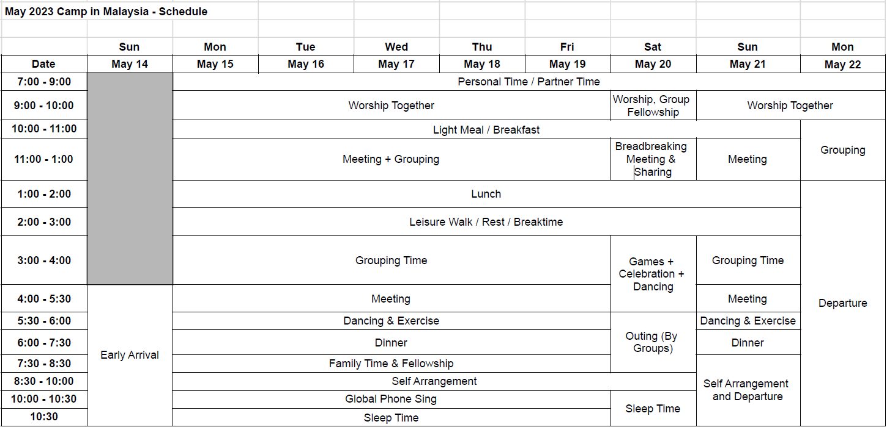
Schedule

Slide 4
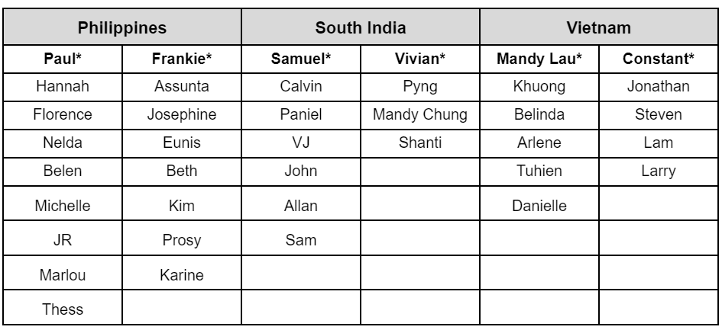
Pursuing Teams

Slide 5
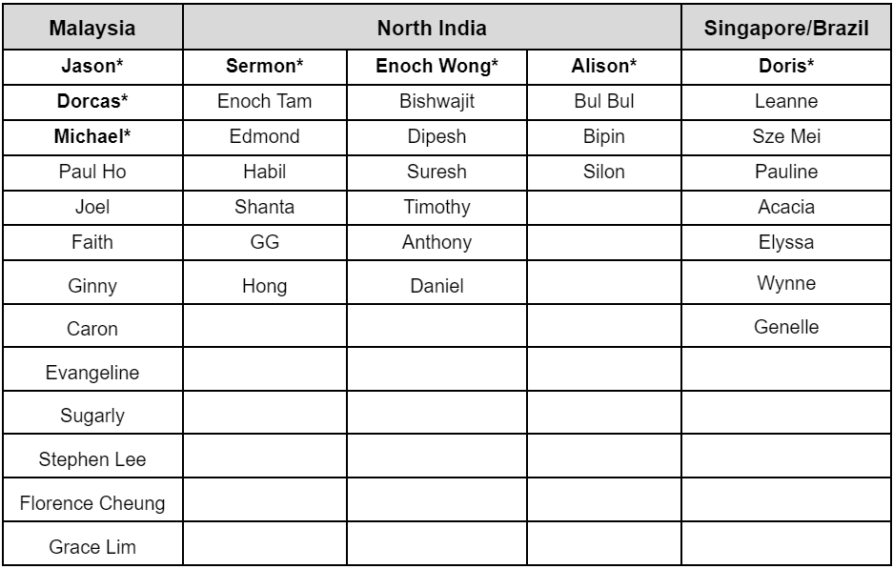
Pursuing Teams

Slide 6
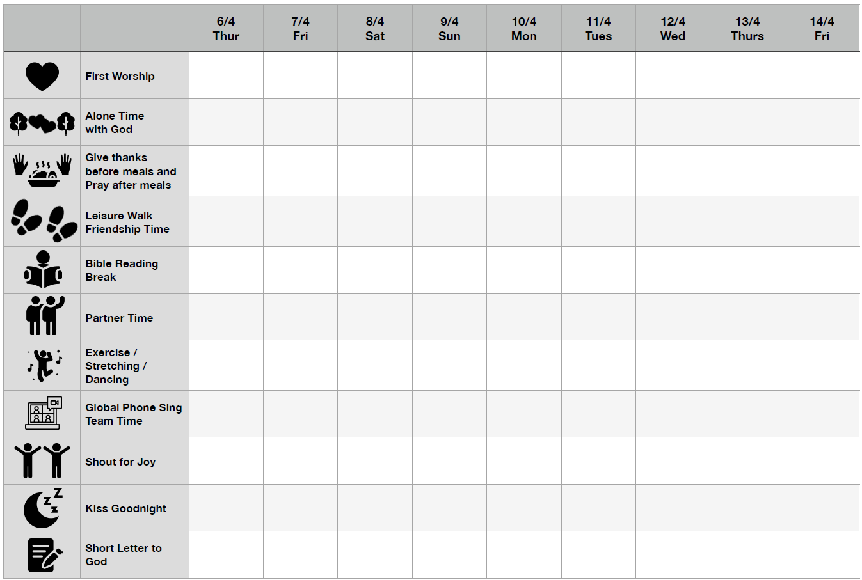

Slide 7
Meals (General)
Breakfast (Available after 10am)
- Soy milk (with lower sugar)
- Porridge (plain porridge/porridge with meat)
- Powdered drinks (e.g., multi-grain powder with lower sugar)
- Black coffee/tea
- Fruits
Lunch and Dinner (Catering)
- Greater variety for dinner: with meat/local snacks or pastries
*Catered meals: will avoid fried and oily foods
*Snacks (e.g., biscuits) will not be provided

Slide 8
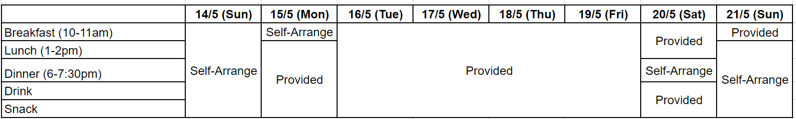
Meals

Slide 9
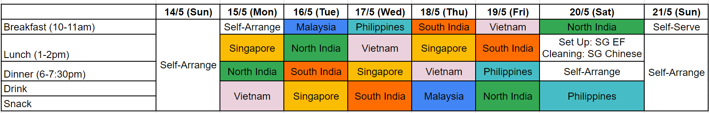
Meals Duty List (By Pursuing Groups)
Breakfast, Lunch & Dinner
- set up the meal
- wash the dishes
- clean the place
Snack and Drink
- boil the herbal tea
- prepare the fruit

Slide 10




10 Points Challenges
Phone Jail - set time for checking on the phone and replying messages
During meeting — no phone texting or reading messages
During alone time with God — no phone contact with anyone or anything
Before morning meeting ?
After meeting and lunch time?
Time to reply and keep the contact with family or about work?
Do stretching to help your body to be more flexible for 10-15 minutes. Time and place?
Pray for your ministry with someone.
Review and do better plan and prayers daily. Can be anytime during the day and can be a quick review.

Slide 11






10 Points Challenges
Friendship time with God. Just enjoy being with Him for some moment.
Make joyful noise yourself to praise or to refresh.
Be on time for every meeting.
Know one new b/s and talk for awhile daily (can take a picture together).
Try not to forget your things: water bottle, Bible, song books etc.
Ask a question about what you observed or heard.

Slide 12
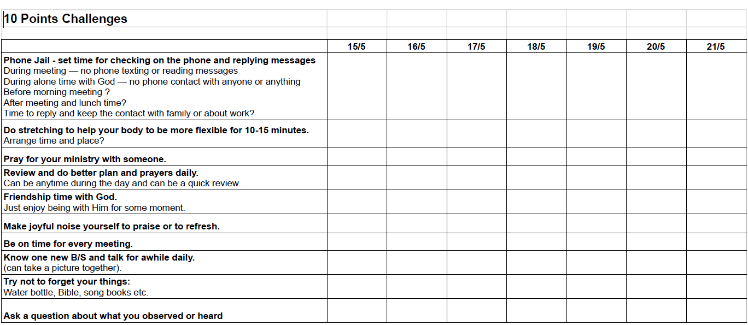

Slide 13
Biblical Truth Video Topics List
1. Why do we need to read the Bible? | 2. Is the Bible the word of God? | 3. Why do we need to have meetings? | 4. Why do we need to pray?
5. How to overcome Satan? | 6. Where do people go after they die? | 7. When will the Lord come to take the Church? | 8. Our true identity
9. What is Church? | 10. What is “in the name of the Lord?” | 11. Why should we give offering? | 12. What should a believer do if he stumbles?
13. Let’s come together to remember the Lord | 14. Know the true God–the wonderful love fellowship | 15. Am I a sinner? | 16. The Lord’s commission
17. Servants of God | 18. What is heaven like? | 19. God created male and female | 20. Baptism
21. Why are they so poor? Why is their life so difficult? | 22. Laying on of hands and spiritual gift | 23. Why has God not destroyed the devil? | 24. Important daily prayers
25. Why do sisters have to cover their heads?

Slide 14
Gospel Chatroom Topics 2020-2023
2020
Apr - Aug
Peace beyond understanding
Stay Healthy Be Happy
Amazing Grace
Dec
Love till today: The origin of love
Love till today: Expressions of love
Sacrificial Love
Love plan
2021
Jan
A new living way
A new bonding and relationship
Strength Renewed
A new commandment – brotherly love
A new lifestyle
Feb
Embrace a new day
Peace and harmony
Moving up
World peace
Mar
Let the flowers speak
The secret of the bleeding heart
Spring rains that water the earth
Eternal spring
Apr
Story of Easter
Evidence of resurrection
Power of resurrection
Life at the dead end

Slide 15
Gospel Chatroom Topics 2020-2023
May
Closest Ties
Unconditional Love
Return of the Lost Son
Expectations of Love
Family Reunion
Jun
What do I eat?
What should I learn?
What do I do?
Should I believe?
Jul
Moodiness in the good weather
Ugly duckling or beautiful swan?
It’s so boring
Never Good Enough
Me, Myself and I
Aug–I have found it:
I am still searching
I don’t know what I’m looking for
I found true love
I found full acceptance
Sept–The storms hit again
Pandemic waves?
Migrate away?
Weather changes?
Vote again
Oct–The goodness of grace
There’s no free lunch
Forgive and forget
The best welfare
Rank and acceptance
Icing on the cake and timely help

Slide 16
Gospel Chatroom Topics 2020-2023
Mar–Difficult words to say
Sorry I was wrong
Your sins are forgiven
Go in peace
I won’t do it again
Apr–The Lord’s promises
“Truly, I say to you, today you will be with me in paradise.” (Luke 23:43)
“I am ascending to my Father and your Father, to my God and your God.” (John 20:17)
“I am with you always, to the end of the age." (Matthew 28:20)
“And if I go and prepare a place for you, I will come again and will take you to myself, that where I am you may be also.” (John 14:3)
“But you will receive power when the Holy Spirit has come upon you.” (Acts 1:8)
2022
Jan–Happy new year
The greatest blessing
The best life
The most perfect family
The most glorious accomplishment
The greatest guarantee
Feb
Wealth and prosperity
Family problems
Family harmony–how to have good relationships in your family
Respect the elderly–honour your parents
Nov–Inspirations of the fall leaves:
Birth
Aging
Illness
Death
Dec– Merry Christmas
Who are we celebrating
The best holiday arrangements
Who will be celebrating?
I have it!

Slide 17
Gospel Chatroom Topics 2020-2023
May–The meaning behind all relationships
Mother’s love
True born child
Only child
Many siblings
Jun–God uses problems
Unstable situations
I am sick
Say goodbye
Unemployed
Jul–Glorious changes
From darkness to the marvelous light
I can lift up my head!
Leaving a lustful life
From superstitions to the truth
From selfishness to loving my neighbours
Aug–Questions in my heart
Who can I depend on?
Who can understand me?
Why do they have more money than me?
Why am I so unfortunate?
Sep
Big achievements
Fantastic love
Loving families
Fun and excitement
Oct–World trends and us
The Digital Age
Popularity of social media
Virtual reality
Fantasy world of anime
World of misinformation

Slide 18
Gospel Chatroom Topics 2020-2023
2023
Jan–Acquaint yourself with God, and be at peace
Does God smile?
What provokes God’s anger?
Does God grieve?
Does God communicate with man?
Feb–Insights from past experiences
Achieving the success I wished for
My failures in the past
Changes overnight
Feeling trapped
Nov–Man’s Words and God’s Words
Be content (1 Tim 6:6)
Enjoy the present (Ecc. 11:9)
Failures and setbacks are stepping stones to success, not stumbling blocks (Rom. 8:28)
Cherish the ones you have (1 Thess 4:13-17)
Dec–Love is here (charity presentations)
Zambia
South Africa
Nepal
Songs and photos
Good deeds will be rewarded
Mar–Beyond human power
Can a leopard change its spots?
Evil cannot prevail
Who is in control?
Life and death experiences
Apr–I don’t want to be a Christian because…
I don’t want to change the way I live
I don’t want to be bored
My family may not accept it
I’m afraid of losing friends
I may not meet the standard

Slide 19
Gospel Chatroom Topics 2020-2023
May–Requests that are somewhat difficult
“Whoever loves father or mother more than Me is not worthy of Me…” (ref Matt 10:37)
“...love one another as I have loved you” (ref John 15:12)
“Let what you say be simply ‘Yes’ or ‘No’” (ref Matt 5:37)
“Selling…possessions and belongings and distributing the proceeds to all, as any had need” (ref Acts 2:45)
Jun–Bound without chains
Unbreakable habits
I can’t speak nicely
I lose heart, or lose my temper
I don’t like myself for being lazy
Jul–A better life
Love in God’s family
Satisfied without competing
No unkind thoughts
Seeking to benefit others
Enjoy the blessing of God’s presence

Slide 20
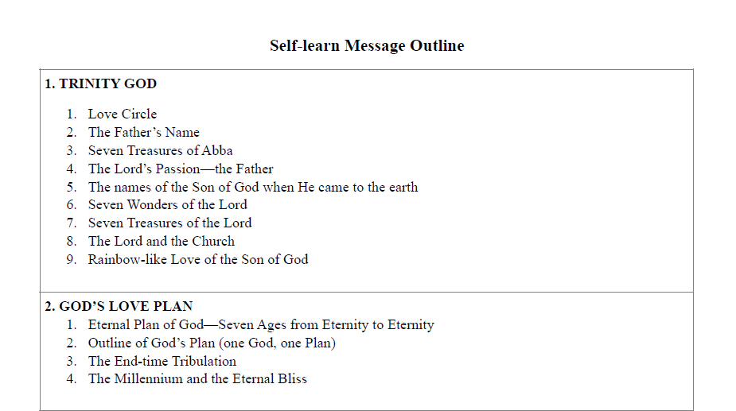

Slide 21
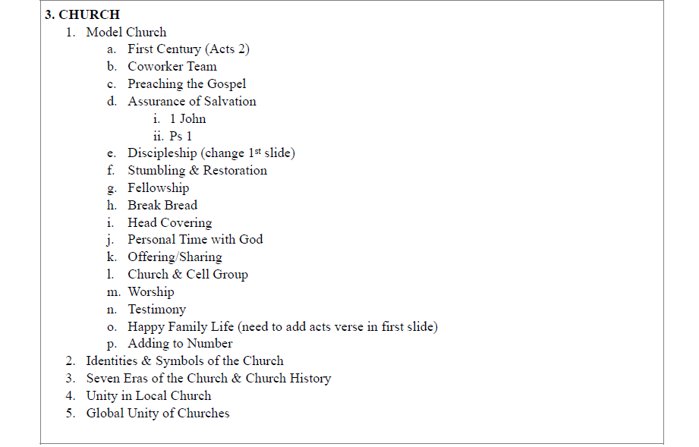

Slide 22
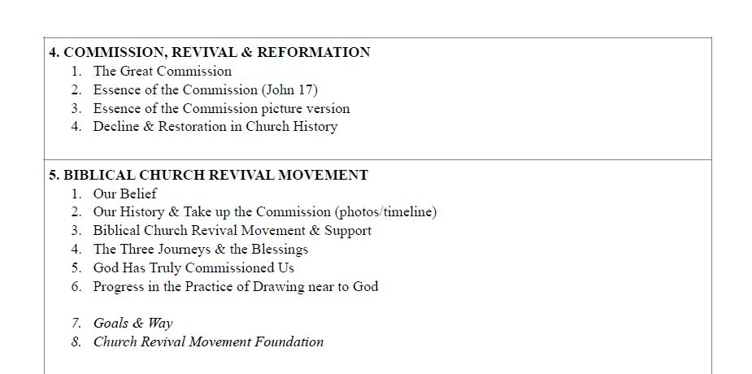

Slide 23
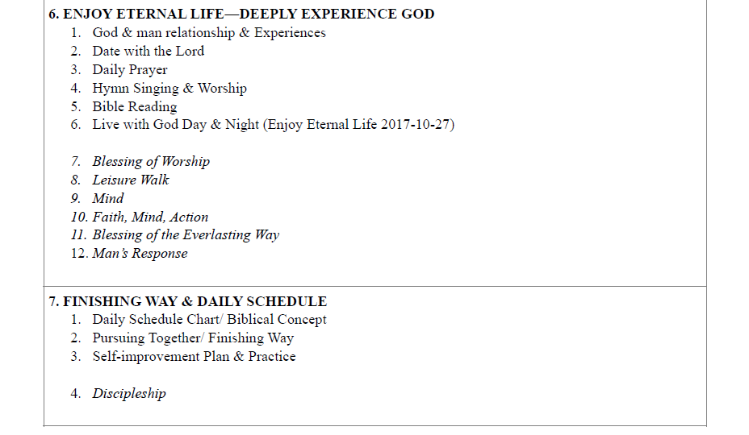

Slide 24
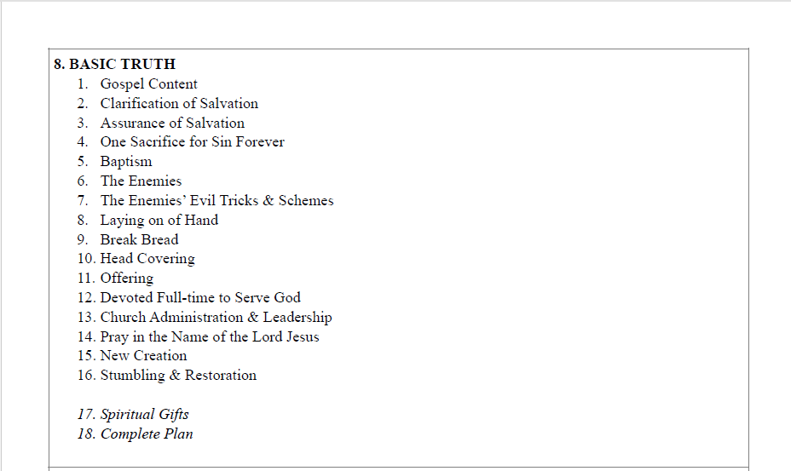

Slide 25
