Slide 1

Romans
The Gospel of Grace
September 6, 2026

Slide 2
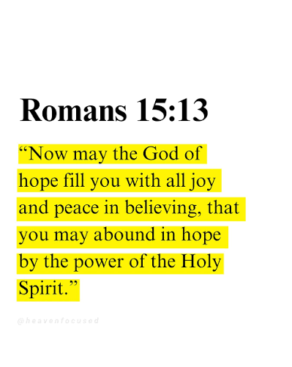
Let’s Set The Context for the Book of Romans
Paul was writing to Christians in the church at Rome.
He was in Corinth at the time.
Paul had never been to Rome, so who founded this church?
We don’t know! But we have a likely answer.
Romans were in Jerusalem on the Day of Pentecost in 30-31 AD.
Christians had been “tolerated” by the government till the early ‘50’s.
A shift in leadership resulted in greater brutality toward Christians.
Paul wrote to the church at Rome in about 57 AD.
Roman Emperor Nero went mad by 64 AD.
The persecution of Christians was merciless!
The believers in Rome desperately needed encouragement.
2

Slide 3




Significance of the Book of Romans
A clear, organized statement of Christian doctrine, theology, and practice
“The Christian Constitution”
A structured statement of doctrine
Some have called Romans the constitution of the Christian faith — a doctrinal charter for the church.
Written as an organized presentation of theology, doctrine, and practice. It sets forth the doctrine of justification by faith in a systematic manner.
A roadmap for grace and faith
It dispels the big lie
It is a foundational guide for how believers live out grace and faith day by day.
The lie that sin does not have to be dealt with is dealt with in Romans.
3

Slide 4

Romans Has A Message for All!
To the unsaved it offers a clear exposition of their sinful, lost condition and God's righteous plan for saving them.
New believers learn of their identification with Christ and of victory through the power of the Holy Spirit.
Mature believers find never-ending delight in its wide spectrum of Christian truth: doctrinal, prophetical, and practical.”
— William MacDonald, Believer's Bible Commentary
4

Slide 5
The Use of Key Words in Romans
Repetition reveals the underlying messages
78
66
62
30
“Law”
“Righteousness”
“Faith”
“Justify /
justification”
times
times
times
times
These four words carry the message of the Book of Romans
The law exposes sin and God justifies the sinner by faith alone in Christ alone — declaring him righteous.
5

Slide 6
Theme of Romans:
The Righteousness of God in Christ Jesus
1
The Wrath of God
Righteousness needed – The whole world is guilty!
1:18–3:20
2
The Grace of God
Righteousness imputed – Justified as a gift by God through Christ Jesus
Righteousness imparted – Because of our union with Christ, we have died to sin and are alive to God in Christ Jesus
3:21–8:39
3
The Plan of God
His plan is for all who believe
He is NOT finished with Israel
9–11
4
The Will of God
Righteousness practiced in relation to the church, society, government, other believers.
Be imitators of Christ!
12–16
6

Slide 7
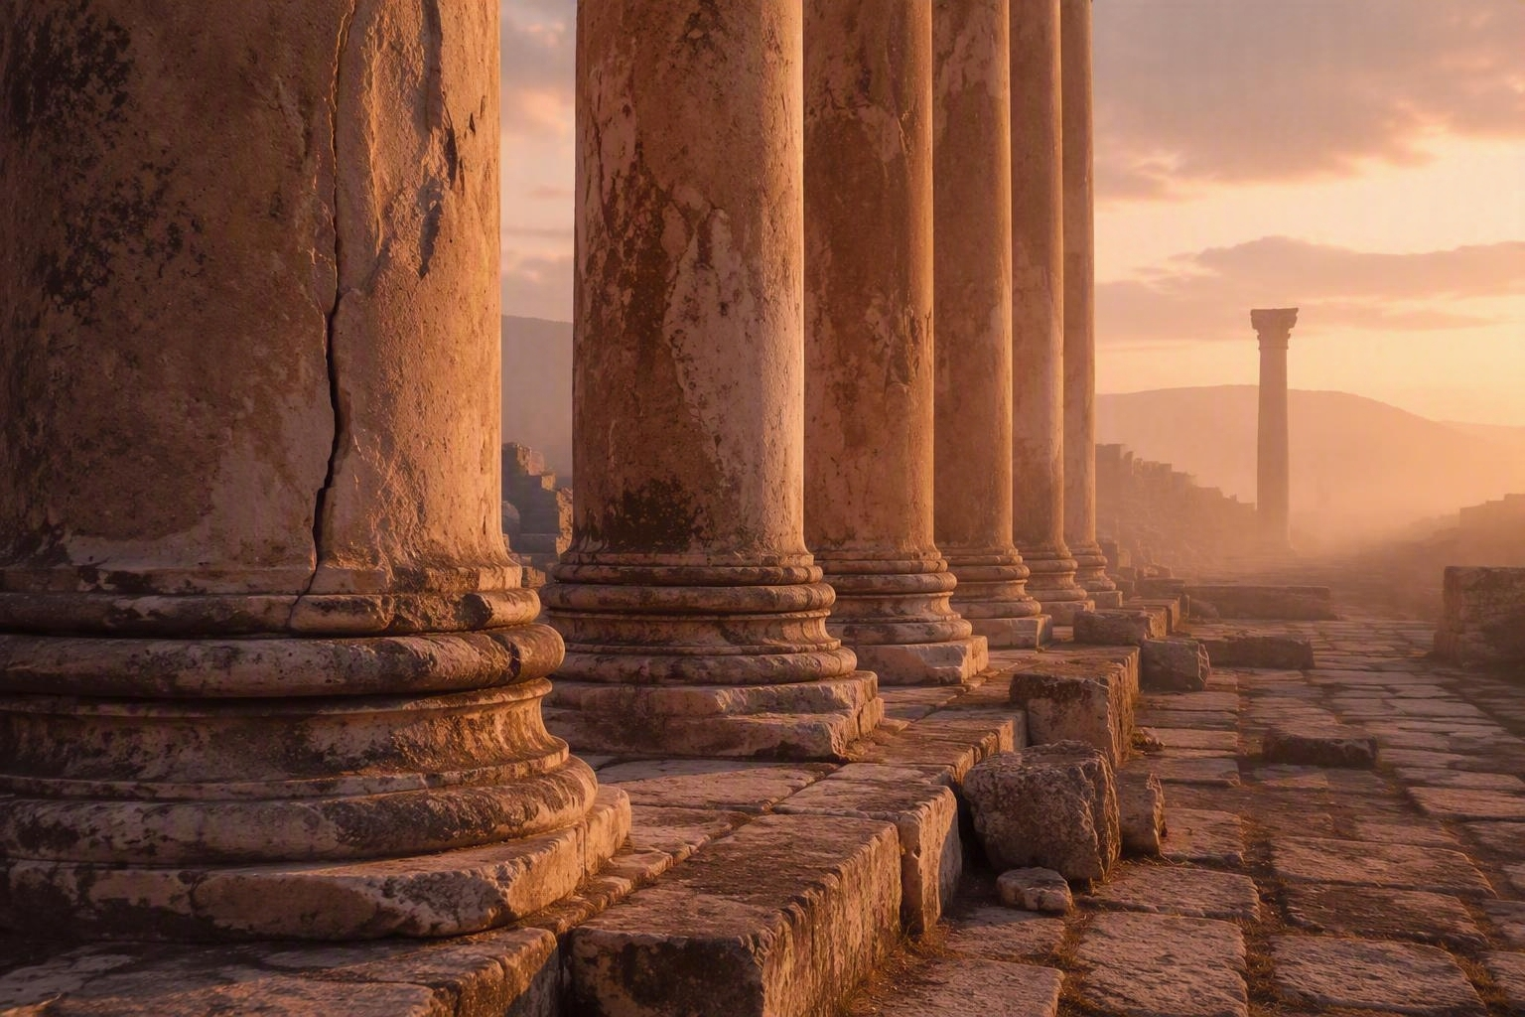
Paul’s Salutation & Interest
Romans 1:1–12
“Bond servant” refers to one who voluntarily takes the position of a slave, with no rights or will of his own. He does always and only the will of the Master. In the case of Paul, who had been a Pharisee and persecutor of Christians, his life was turned around on the road to Damascus about 24-26 years earlier (Acts 9). He was sold out to Jesus!!
Paul's Salutation
Paul’s Interest and Desire to Lift Their Spirits
1. He affirmed them (V. 8)
2. He assured them that he was praying for them (V. 9)
3. He expressed his desire to be with them (V. 10)
4. He promised to assist them in 2 ways (VV. 11-12)
“For I want very much to see you, so that I may impart to you some spiritual gift to strengthen you, that is, to be mutually encouraged by each other’s faith, both yours and mine.” Romans 1:11-12
7

Slide 8
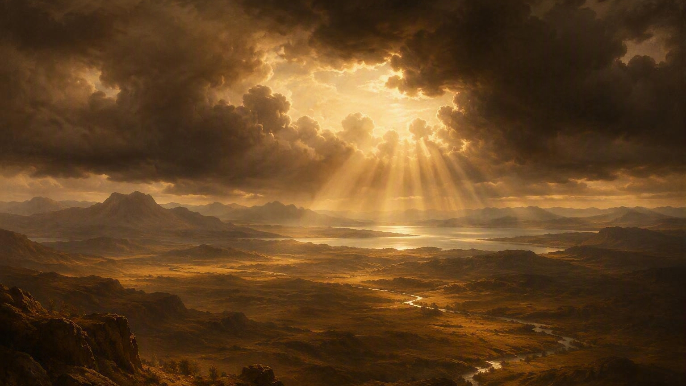
Our Bible Study For This Week
“True Power”
Romans 1:13–25
8

Slide 9


Gospel Power
Romans 1:13–17
A fruitful ministry
An obligation to preach
Paul desired evangelism and discipleship among the believers in Rome.
Paul believed he was obligated to preach the Gospel to all people.
Not ashamed of the Gospel
The righteous will live by faith
Paul was undeterred by the fear of what others thought. He recognized the Gospel as being “the power of God for salvation” AND “in it was the righteousness of God is revealed.”
God does NOT justify people by their works!
“It’s NOT your grasp on Christ that saves you! It’s Christ!” Charles Spurgeon
“We are righteous when we are (1) right with God, (2) right with man, (3) right with self, and (4) right with the environment.” Richard Rogers
9

Slide 10

Divine Revelation
Romans 1:18–20
God's holy / righteous anger toward sin
How is God’s wrath being revealed in 2026?
God has a constant and insistent displeasure with sin.
Truth was given to man (vv. 19–20), but he rejected it (vv. 21–32).
God’s wrath is revealed in the Old and New Testaments: the Great Flood (Gen 7), Sodom and Gomorrah (Gen 19), the punishment of Korah, Dathan, and Abiram (Num 16:32).
His eternal power and divine nature have been clearly seen by all mankind.
His attributes are apparent to those who will seek Him — people ignore His power and nature in creation and are without excuse.
It has continuously been revealed to mankind.
He has given men over to uncleanness (1:24)
He has given men over to vile affections (1:26)
He has given men over to reprobate minds (1:28)
He breaks through into human history to show His displeasure through disease, disasters, and other forms of havoc - - while man continues in sin.
“God is love, which is why He will not stand idly by while evil consumes His creation.” Chuck Swindoll
Question: Why do men need the Gospel? They are lost without it and the wrath of God is evident.
10

Slide 11
Worthless Thinking
Romans 1:21–25 — Mankind’s 7 downward steps
1
They knew God
2
They did not glorify Him as God
3
They did not show gratitude
4
Their thinking became worthless
5
Their senseless hearts were darkened
6
They claimed to be wise, but became fools
7
They exchanged the glory of the immortal God for images resembling mortal man, birds, four-footed animals, and reptiles
11

Slide 12
Applications for Today's Scriptures
Romans 1:13–25
1
2
3
4
God's Righteousness Imputed
Share the Gospel's power
Point others to God
Rejection has consequences
The righteousness we need is not earned but credited to us by God through faith in Christ.
We must seek opportunities to share the power of the Gospel with the lost.
We can point others to God through what He has revealed in His creation.
Rejecting God ultimately leads to devastating consequences.
“The righteous will live by faith.” — Romans 1:17
12

