Slide 1

John 3:16 Diagram
August 28, 2023

Slide 2

John 3:16
For God so loved the world that He gave His only begotten Son, that whoever believes in Him should not perish but have everlasting life.
Let’s understand the CONTEXT of the Gospel
Notes:
Starting with the “context” we read John 3:16…
[Read John 3:16]
[Context] It is helpful to know that it all starts with God.
[Click blue box]
[Content] and know what He did.
[Click blue line]
[Response] Our part…
[Click blue box]
[The Result]
[Click blue line]

Slide 3


Perfect / Pure
HOLY
GOD
Righteous
Just
Us
World
Psalm 99:9 Exalt the Lord our God, And worship at His holy hill; For the Lord our God is holy
Notes:
We start drawing John 3:16 by showing God in heaven.
[1 Click “Us” in the “World”]
[Click “Holy”]
[Click “Perfect / Pure”]
And, not only is God holy…
[Click “but heaven is also holy”][1 Click “Righteous” and “Just”]
[Click Psalm 99:9]

Slide 4
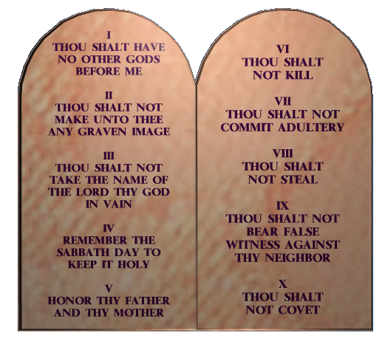
Liar
Thief
Rebel
Envious
Idolater
Hateful
Fornicator
Blasphemer
Not lie
Not steal
Not disobey parents
Not covet
No idols
Not murder
Not adultery
Not Lords name in vain
Perfect / Pure
Holy
HOLY
GOD
Righteous
Just
Us
World
Notes:
God gave Israel the 10 Commandments to express His Holiness
It shows us in the rest of the world how we fall short of His moral standards, as well.
[2 Clicks - thru the 10 Commandments]

Slide 5
Liar
Thief
Rebel
Envious
Idolater
Hateful
Fornicator
Blasphemer
Not lie
Not steal
Not disobey parents
Not covet
No idols
Not murder
Not adultery
Not Lords name in vain
Perfect / Pure
Holy
10 sins / day
3,650 sins / year
36,500 sins in 10 years
73,000 sins in 20 years
146,000 sins in 40 years
250k sins if you live to be 80!
HOLY
GOD
Righteous
Just
1
Us
World
Notes:
Doing a little math….
[6 Clicks calculating sins]
Do you think someone with a 250k sins deserves to go to heaven?
How many sins did it take to kick Adam and Eve out of the garden?
[Click “1”]
Everyone is way over the limit!

Slide 6
Liar
Thief
Rebel
Envious
Idolater
Hateful
Fornicator
Blasphemer
Not lie
Not steal
Not disobey parents
Not covet
No idols
Not murder
Not adultery
Not Lords name in vain
Perfect / Pure
Holy
HOLY
S I N
GOD
Righteous
Just
Romans 3:23 for all have sinned and fall short of the glory of God.
Us
Romans 6:23 For the wages of sin is death, but the gift of God is eternal life in Christ Jesus our Lord.
World
Sinner
Guilty
HELL
Deserves Death
Notes:
[Read “Sinner”]
[Click the Bible says that we are “Guilty”]
[Click we have this “Sin” barrier between sinful man and a holy God]
[Click Rom 3:23]
[Click “Deserves Death”]
[Click Hell – separated from the love of God for all eternity]
[Click Rom 6:23]

Slide 7
Question
In light of God’s perfect holiness, do you see that we all are sinners deserving of God’s judgment of death or separation in Hell and will never be good enough to go to Heaven?
Notes:
[Review Question]

Slide 8
John 3:16
For God so loved the world that He gave His only begotten Son, that whoever believes in Him should not perish but have everlasting life.
Let’s understand the CONTENT of the Gospel (God’s Good News)
Notes:
Understanding the Context of the Gospel, move onto the Content of the Gospel
[Reread John 3:16]

Slide 9
Liar
Thief
Rebel
Envious
Idolater
Hateful
Fornicator
Blasphemer
Not lie
Not steal
Not disobey parents
Not covet
No idols
Not murder
Not adultery
Not Lords name in vain
Perfect / Pure
Holy
WRATH
ALL
SINS
HOLY
S I N
GOD
Righteous
PAID IN FULL
Just
E
Love
Satisfied!
Jesus
I
Christ
V
G
A
1 Corinithians 15:3-4 Christ died for our sins according to the Scriptures. And . . . He was buried, and . . . He rose again the third day according to the Scriptures . . .
D
I
E
D
Us
World
Romans 5:8 But God demonstrates His own love toward us, in that while we were still sinners, Christ died for us.
Sinner
Guilty
HELL
Deserves Death
Notes:
Thankfully, God is also a God of “Love”.
[Click “Gave” and “Jesus Christ”]
[Click “Died” and “Rose Again”]
[Click He died the death that we deserve]
[Click “All Sins” and “Paid in Full”]
[Click God’s Justice was satisfied when He poured His wrath on Jesus Christ on the cross]
[Click Rom 5:8]
[Click 1 Cor 15:3-4]
John 19…

Slide 10
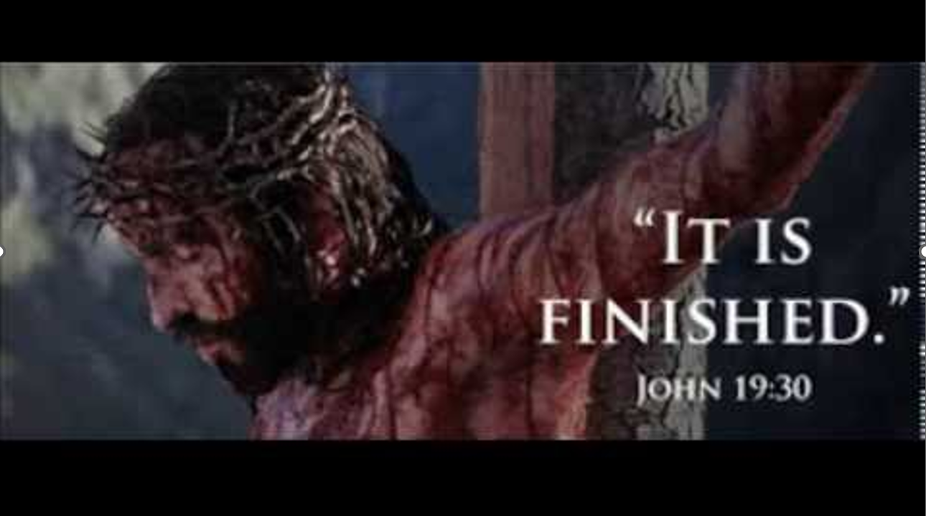
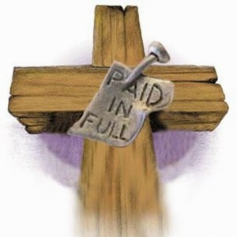
Notes:
John 19:30 So when Jesus had received the sour wine, He said, “It is finished!” And bowing His head, He gave up His spirit.
[Click “Paid in Full”]

Slide 11
Religion Says
You must do 10%
Jesus Christ did 90%
This is salvation by works
God Says
Jesus Christ did 100%
This is salvation by God’s grace
Notes:
[Read “Religion says…”]
[Click “God says”…]
Salvation is fully by grace alone, through faith alone, in Christ alone in His finished work alone.
John 5:24 indicates that anyone who simply believes / trusts in Jesus Christ alone for their salvation has eternal life:

Slide 12
John 5:24
“Most assuredly, I say to you, he who hears My word and believes in Him who sent Me has everlasting life, and shall not come into judgment, but has passed from death into life.
EL
Notes:
[Read v24]
[Click “Death into Life”]

Slide 13
Question
If Christ died for you and paid in full for all your sins – past, present, and future
(and He did!),
what must you now do to earn or work your way to Heaven?
Notes:
[Review Question]

Slide 14
John 3:16
For God so loved the world that He gave His only begotten Son, that whoever believes in Him should not perish but have everlasting life.
The only right RESPONSE to the Gospel
Notes:
Moving on from the Content of the Gospel, move onto the Response of the Gospel
[Reread John 3:16]

Slide 15
Liar
Thief
Rebel
Envious
Idolater
Hateful
Fornicator
Blasphemer
Not lie
Not steal
Not disobey parents
Not covet
No idols
Not murder
Not adultery
Not Lords name in vain
Perfect / Pure
Holy
WRATH
ALL
SINS
HOLY
S I N
GOD
Righteous
PAID IN FULL
Just
E
Trust
Rely on
Love
Satisfied!
I
V
Because Christ paid for your sins . . .
Jesus
Christ
G
A
FAITH
Romans 4:5
But to him who does not work but believes on Him who justifies the ungodly, his faith is accounted for righteousness.
Receive
D
I
E
D
Us
World
Ephesians 2:8–9 For by grace you have been saved through faith, and that not of yourselves; it is the gift of God, not of works, lest anyone should boast.
Sinner
Guilty
HELL
Deserves Death
Notes:
The only correct response is faith in Jesus Christ for Who He is and What He has done.
[Click that means to “Trust”, “Rely” or “Depend” upon His finished work]
[Click that is all you need to do to “Receive” salvation]
[Click “Because Christ…” God declares you righteous and no longer sees you in your sin]
All your sins have been forgiven.
[Click Eph 2:8-9]
[1 Click 2 “not’s”]
[Click Rom 4:5]
[Click it is all by God’s “Grace”]

Slide 16
Isaiah 64:6
But we are all like an unclean thing,
And all our righteousnesses are like filthy rags;
We all fade as a leaf,
And our iniquities, like the wind,
Have taken us away.
Notes:
[Read Isa 64:6]

Slide 17
Galatians 2:21
"I do not set aside the grace of God; for if righteousness comes through the law, then Christ died in vain."
Notes:
[Read Gal 2:21]

Slide 18
Question
How can you know for sure that you will go to Heaven?
Notes:
[Review Question]

Slide 19
John 3:16
For God so loved the world that He gave His only begotten Son, that whoever believes in Him (1) should not perish but (2) have everlasting life.
2 guaranteed RESULTS when you believe in Christ alone as presented in the Gospel
Notes:
Understanding the Response of the Gospel, we next see the Result of the Gospel
[Reread John 3:16]

Slide 20

Liar
Thief
Rebel
Envious
Idolater
Hateful
Fornicator
Blasphemer
Not lie
Not steal
Not disobey parents
Not covet
No idols
Not murder
Not adultery
Not Lords name in vain
Perfect / Pure
Holy
WRATH
ALL
SINS
HOLY
S I N
GOD
Righteous
PAID IN FULL
Just
E
Satisfied!
Trust
Rely on
V
Love
Jesus
I
Christ
FAITH
G
A
Receive
D
I
E
D
Eternal Life
Us
World
1 John 5:13 These things I have written to you who believe in the name of the Son of God, that you may know that you have eternal life.
Sinner
Guilty
HELL
Deserves Death
Notes:
The moment you believe, you will not perish, but have eternal life
[Click – Eternal Life]
Since you will not perish, we can cross out Hell
[Click - X Hell]
[Click blue line]
This blue line visualizes that we have come through the sin barrier
We have eternal life and can be with God
He has provided us life, through the life of another
You come through the barrier at a point in time when you believe
[Click 1 John 5:13]

Slide 21
Psalm 99:9 “Exalt the LORD our God, And worship at His holy hill; For the LORD our God is holy.
Romans 3:23 “For all have sinned and fall short of the glory of God.”
Romans 6:23 “For the wages of sin is death.”
Romans 5:8 “But God demonstrates His own love toward us, in that while we were still sinners, Christ died for us.”
Ephesians 2:8-9 “For by grace you have been saved through faith, and that not of yourselves, it is the gift of God, not of works, lest anyone should boast.”
1 John 5:13 “These things I have written to you who believe in the name of the Son of God, that you may know that you have eternal life.”
John 5:24 “Most assuredly, I say to you, he who hears My word and believes in Him who sent Me has everlasting life, and shall not come into judgment, but has passed from death into life.”
100%
.
Notes:
As we diagram John 3:16 on the left side of the page, we circle some key words that help reinforce the message when we connect them.
So, let’s connect them on the slide now.
[6 Clicks]
Here are some blank John 3:16 diagrams.

Slide 25
Family of God
August 8, 2023

Slide 26


Family of God
Fellowship with God
SIN
Family of God
If we confess our sins, He is faithful and just to forgive us our sins and to cleanse us from all unrighteousness. (1 John 1:9)
No child will ever penetrate through this wall!
Fellowship
with God
Yield / Confess
There is only one way to be born again – by faith in Jesus Christ alone
Joy
SIN
The way of transgressors is hard (Proverbs 13:15)
Misery
Baptism by the Holy Spirit 1 Cor 12:13
SINS
Faith
For you are all sons of God through faith in Christ Jesus (Galatians 3:26).
Lost Sinner
Notes:
Start by asking them to read Gal 3:36.
[Read Gal 3:26]
If they stated in the survey that they needed to “confess their sins” or “confess Jesus” have them read 1 John 1:9 for the Biblical place for confession.
Emphasize that the Christian life is not focused on recording and confessing sins…
Use the circle to illustrate the difference between Family and Fellowship.
Try to make it clear that teaching ES is not teaching license and state to do so would be to discount the entire counsel of the WOG.
Here are nine (9) consequences for on-going sin:

Slide 27
If You Cannot Lose Salvation - What Can You Lose?
Joy
(Psalm 51:12)
Testimony
(Matt 5:13-16, Phil 2:13-16)
Ministry
To Others
(Matt 20:28, Heb 6:10)
Fruitfulness
For The Lord
(John 15:1-8, 2 Peter 1:8)
Direction
In Life
(Mark 8:34-38)
Assurance
Of Salvation
(2 Peter 1:9)
Faith
(2 Tim 2:11-13, 4:1-5)
Civil Rights
(John Law!)
Reward
(1 Cor 3:11-15)
Notes:
[Slide Title]
We have seen that you can lose fellowship.
[9 Clicks]
By the grace of God, your salvation is secure.
But there is tremendous value in yielding to the Lord.
It can also be helpful to review the three (3) tenses of salvation diagram.

Slide 28
3 Tenses of Salvation
August 8, 2023

Slide 29
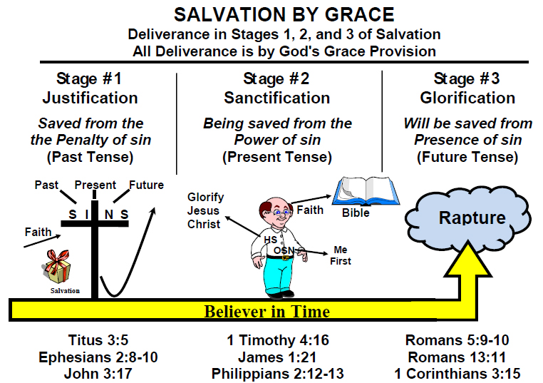
Notes:
It often helps to explain the 3 Tenses of Salvation.

Slide 30
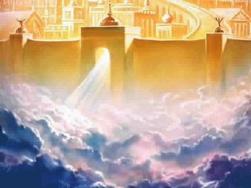

3 TENSES OF SALVATION
 | 1 | 2 | 3
TENSE: | PAST | PRESENT | FUTURE
FROM WHAT:
DIAGRAM:
SCRIPTURE:
THEOLOGICAL DESCRIPTION:
TIME FACTOR:
CONDITION(S):
PENALTY of sin
(in Hell)
POWER of sin
(in your life)
PRESENCE of sin
(in Heaven)
Walk by Faith
Faith
Glorify Jesus Christ
HS
Heaven
OSN
Me First
Eternal Life
Titus 3:5
Ephesians 2:8-10
1 Corinthians 1:21
John 3:17
1 Timothy 4:16
James 1:21
Philippians 2:12-13
James 5:20
Romans 5:9-10
Romans 13:11
1 Corinthians 3:15
James 2:17 Thus also faith by itself, if it does not have works, is dead.
JUSTIFICATION
SANCTIFICATION
GLORIFICATION
POINT OF TIME
When you trust Christ alone.
PROCESS OF TIME
While you walk in the Spirit.
POINT OF TIME
When you die or are raptured.
By God's grace alone through faith alone in Christ alone. (Acts 16:31)
By God's grace through yielded and daily dependence on the Lord via the Holy Spirit.
(Romans 6:1-14; 8:1-4)
By death (2 Cor. 5:10)
or by Rapture
(1 Thess. 4:13-18)
Notes:
It looks like this in table form.
It helps to address questions, such as..
[Click James 2:17]
Who is James talking to?
Multiple times he refers to “my brethren”.
He is talking to believers.
Which tense is that?
[Click blue arrow]
James is referring to your personal testimony before man.
It is helpful to use the diagram to clarify frequently asked questions such as that.

Slide 31
Short Survey
August 8, 2023

Slide 32
A Condensed Four (4) Questions (“elevator pitch”):
No. | Question | Biblical Perspective
1 | Is heaven an earned reward or a free gift?
2 | What % chance do you have of going to heaven?
3 | Why would God let you into heaven?
4 | What can you do to lose heaven?
Notes:
[Slide Title]
[Review 1., 2., 3., 4.]

Slide 33
A Condensed Four (4) Questions (“elevator pitch”):
No. | Question | Biblical Perspective
1 | Is heaven an earned reward or a free gift? | Free gift
2 | What % chance do you have of going to heaven? | 0% or 100%
3 | Why would God let you into heaven? | You were justified when you placed your trust in Jesus Christ
4 | What can you do to lose heaven? | Nothing. You did nothing to earn your salvation and you can do nothing to keep it!
Notes:
[Review Biblical Perspective 1., 2., 3., 4.]

