Slide 1
CONFIRMATION
St. Stephens Lutheran Church & School
Notes:
Welcome Pastor Dave

Slide 2
OPENING PRAYER
Notes:
Pastor Dave

Slide 3
PURPOSE & GOALS
Notes:
Pastor Shea

Slide 4
At St. Stephens, we see God at work in us, among us, and through us
Connecting People with Jesus by
Nurturing Faith (in us)
Building Relationships (among us)
Serving Neighbors (through us)
Notes:
Pastor Shea

Slide 5
“Building relationships in Christ to develop and strengthen faithful followers for life.”
YOUTH MINISTRY MISSION
Notes:
Pastor Shea

Slide 6
What is the purpose of Confirmation?
Notes:
Pastor Shea
What is confirmation?
Confirmation is a public rite of the church preceded by a period of instruction in which baptized Christians learn about the confession, life, and mission of the Christian Church.

Slide 7
PURPOSE AND GOALS OF CONFIRMATION
Confirmation is when a Christian is instructed on their baptismal faith and publicly confirms this faith as their own.
Goal #1: Make Confirmation more self-directed for personal accountability.
Notes:
Youth Director Randall

Slide 8
PURPOSE AND GOALS OF CONFIRMATION
Confirmation is a community event in which young Christians become active members of the congregation.
Goal #2: Involve more adults in the process, especially the students’ parents.
Notes:
Youth Director Randall

Slide 9
PURPOSE AND GOALS OF CONFIRMATION
Confirmation is a priority for students and their families, but modern schedules make it difficult for them to prioritize.
Goal #3: Provide flexibility without
watering down the curriculum.
Notes:
Youth Director Randall

Slide 10
PURPOSE AND GOALS OF CONFIRMATION
Confirmation is a priority for parents, who “uniquely serve as God’s representatives” for their children (Small Catechism 2017 edition, page 81) – See Deuteronomy 6:4-9.
Goal #4: Equip and empower parents to nurture the faith of their children.
Notes:
Pastor Shea

Slide 11
CONFIRMATION CURRICULUM
Notes:
Youth Director Randall

Slide 12
SCOPE AND SEQUENCE
Bible Instruction
Catechism Instruction
Regular Worship Attendance
LifeGroup Participation
Notes:
Youth Director Randall

Slide 13

ONE-YEAR BIBLE INSTRUCTION
Beginning in 7th grade
Complete assignments at home
Six Unit Check-Ins
Only one absence allowed
Memory verses, faith project
*SSLS student(s) who complete middle school religion are exempt
Notes:
Youth Director Randall

Slide 14
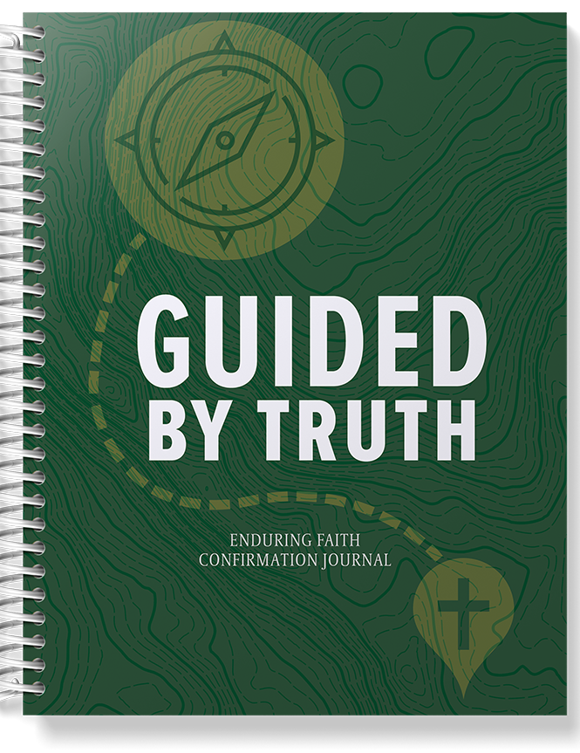
ONE-YEAR CATECHISM INSTRUCTION
Beginning in 8th grade
Complete journal at home
Seven Unit Check-Ins with parents, mentors, and prayer partners
Only one absence allowed
Statement of faith, verse banner
Celebration interview
Notes:
Youth Director Randall

Slide 15
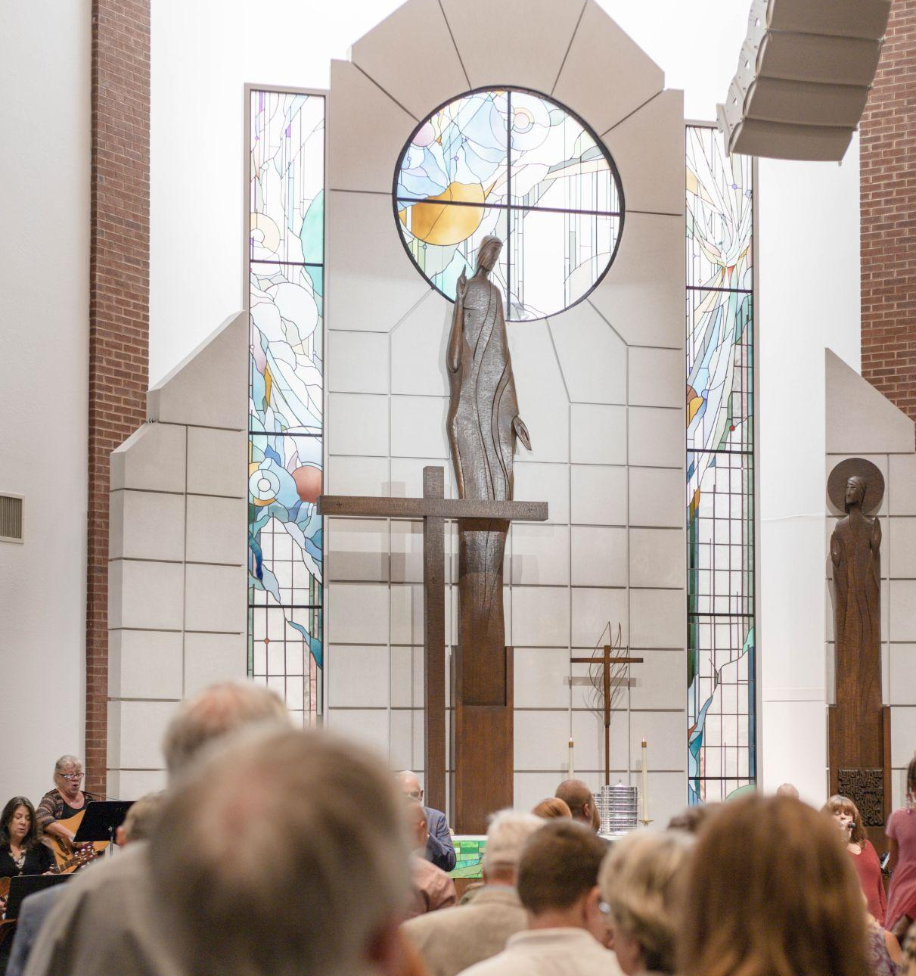
REGULAR WORSHIP ATTENDANCE
Any of three services (5:30, 8:00, 10:30)
Midweek (10:30, 6:30)
Eight sermon notes
Notes:
Youth Director Randall

Slide 16
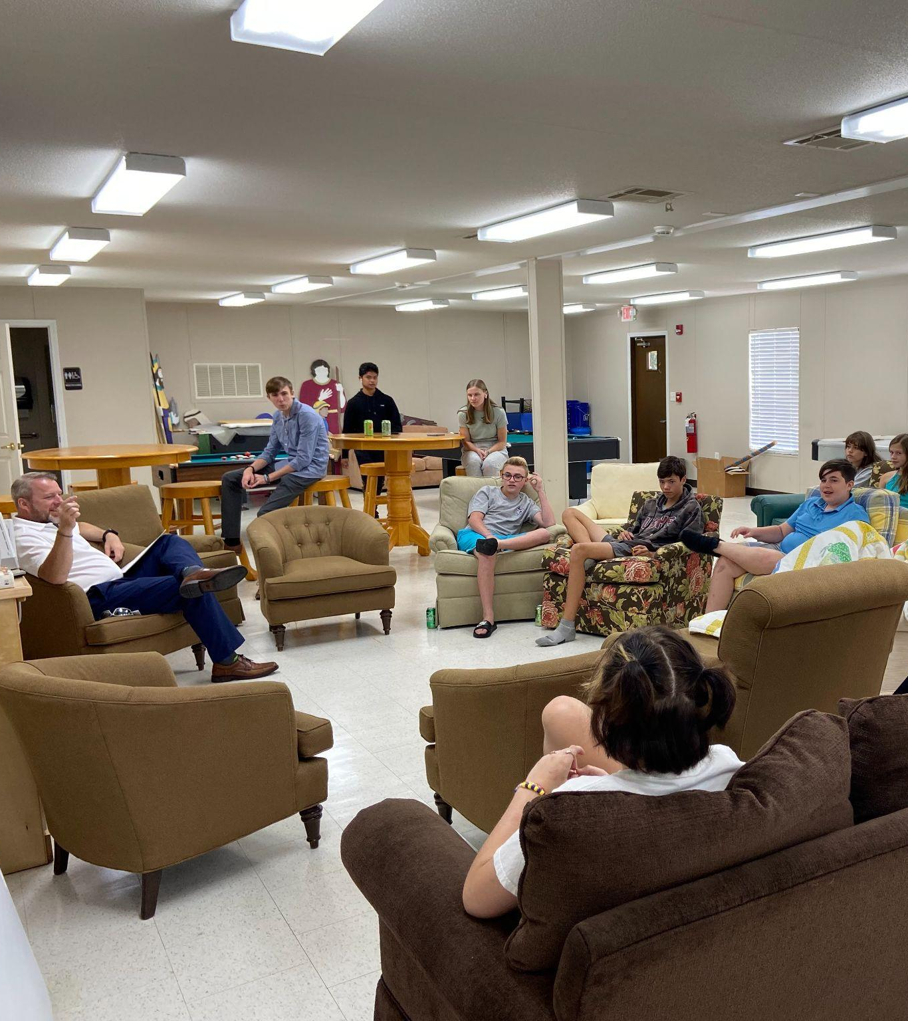
LIFEGROUP PARTICIPATION
Junior High LifeGroup (Sun at 9:15am)
High School LifeGroup (Sundays at 9:15am)
Focus on apologetics and life application
Emphasis on small group discussion
Notes:
Youth Director Randall

Slide 17
MENTORS &
PRAYER PARTNERS
Notes:
Youth Director Randall

Slide 18
MENTORS
Complete journal assignments
Attend every Unit Check-In and
meet with 3-4 students
Review work, ask/answer questions
Be available, encourage, and pray
Notes:
Youth Director Randall

Slide 19
PRAYER PARTNERS
Pray daily for students and families
Attend every Unit Check-In to pray individually with students
Notes:
Youth Director Randall

Slide 20
EXPECTATIONS
Notes:
Youth Director Randall

Slide 21
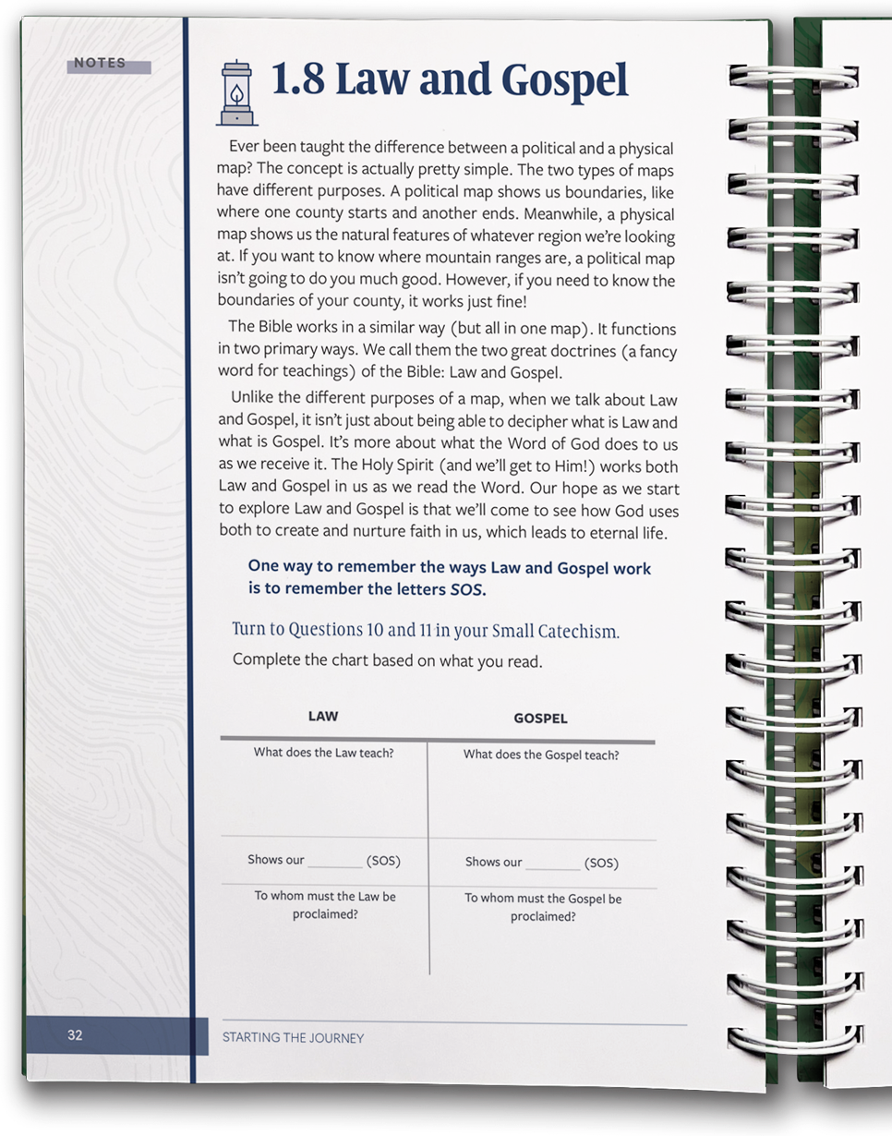
STUDENTS
Complete all assignments
Attend every Unit Service and Check-In, including Celebration Interview
Attend Worship regularly
Attend LifeGroup regularly
Ephesians 6:1-3
Notes:
Youth Director Randall
Eph 6…Pastor She

Slide 22
PARENTS
Remember your God-given role as parent – Deut. 6:7.
Help students complete all assignments
Attend every Unit Check-In and
meet with pastors
Attend Worship regularly
Attend LifeGroup/Bible Study regularly
Notes:
Pastor Shea & Youth Director Randall

Slide 23
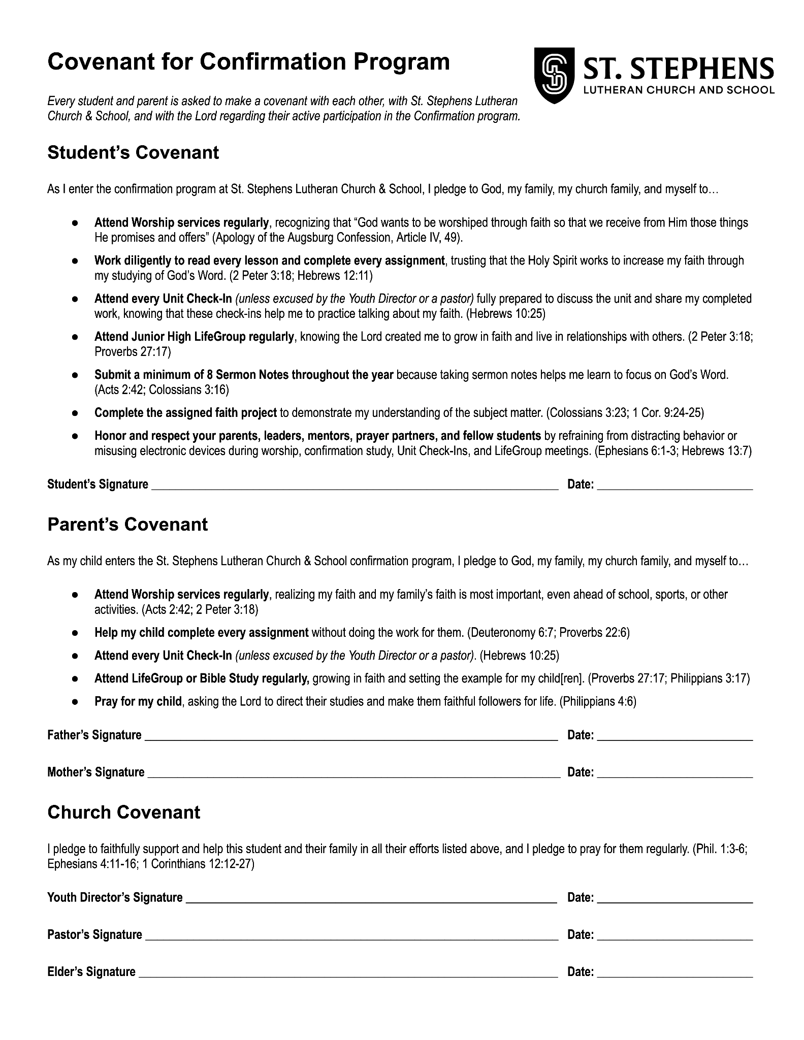
COVENANT
Notes:
Youth Director Randall

Slide 24
QUESTIONS?
Notes:
Youth Director Randall

Slide 25
SERMON NOTES
Notes:
Youth Director Randall
Sermon Notes
It is our prayer that completing these sermon notes provides families with a guide for reflection and discussion of their worship experience.
FULL NAME
GRADE:
DATE OF SERVICE
NAME OF PREACHER
SERMON TITLE (If there is no title, what title would you give it?)
SERMON TEXT (Bible verses the sermon is based on)
WHAT DOES THIS SERMON SAY ABOUT GOD? (Who is Jesus?)
WHAT DOES THIS SERMON SAY ABOUT ME AS A CHILD OF GOD? (Who am I?)
WHAT DOES THE SERMON SAY ABOUT HOW I SHOULD LIVE IN THIS WORLD? (Why am I here?)

Slide 26
SCHEDULE:
Unit Check-in’s
Communion Instruction
Confirmation Retreat
Notes:
Youth Director Randall

Slide 27
QUESTIONS?
Notes:
Youth Director Randall

Slide 28
NEXT STEPS
If you’re ready to commit, sign the Covenant, receive your materials, and lets get started
If you’re not quite ready, Pray for discernment and speak with Youth Director, Randall, or the pastors with questions
Notes:
Youth Director Randall

Slide 29
CLOSING PRAYER
Notes:
Luther’s Evening Prayer

