Slide 1


Biblical Counseling Fundamentals Summary
April 30, 2025

Slide 2
INTENT AND PURPOSE
Sanctification: Our’s and One Another’s
To understand our sanctification
To learn what the Bible teaches about the issues and challenges of life.
To learn how to use the Bible to address the issues and challenges of life.
To develop confidence in accurately handling the Word of Truth
To learn how to examine yourself through the lens of Scripture.
To help Christian men and women learn how to minister the Word to other brothers and sisters in Christ in discipleship and counseling.
Develop and enhance biblical skills in addressing and solving problems biblically, as a disciple-maker, a shepherd, mentor or as a trained lay counselor.
To understand the conflict between secular counseling reasoning and a biblical worldview and how to recognize the difference and address it through a biblical lens.
To work towards and achieve certification as a Biblical Counselor

Slide 3

Psychological Questions
All people in every society and culture asks these questions:
Who are we?
What happened?
Why do we do the things we do?
What motivates people?
What are the causes of our psychological ills?
How do we change?
How do we heal?
What is the goal of change?
We propose to answer these questions from a biblical worldview!

Slide 4
Biblical Counseling: Defined
Biblical counseling is the personal discipleship ministry of God’s people to others under the oversight of God’s church, dependent upon the authority and sufficiency of God’s Word through the work of the Holy Spirit.
Biblical counseling seeks to reorient disordered desires, affections, thoughts, behaviors, and worship toward a God-designed anthropology, in an effort to restore people to a right fellowship with God and others.
This is accomplished by speaking the truth in love and applying Scripture to the need of the moment by comforting the suffering and calling sinners to repentance, thus working to make them mature as they abide in Jesus Christ.
Dale Johnson and Samuel Stephens:
The Association of Certified Biblical Counselors (ACBC)

Slide 5
Biblical Foundations in Overcoming Sin and Suffering
Romans 15:14
And concerning you, my brethren, I myself also am convinced that you yourselves are full of goodness, filled with all knowledge and able also to admonish one another.
God’s people are called to minister to one another, to care for one another, to confront and restore one another in sin, to comfort and to build one another up in suffering.
We are called to admonish, exhort, encourage, and instruct one another.
Why would we send a brother or sister out into the world for help when God’s people are competent to help?

Slide 6
Romans 8:28-29 And we know that God causes all things to work together for good to those who love God, to those who are called according to His purpose. For those whom He foreknew, He also predestined to become conformed to the image of His Son, so that He would be the firstborn among many brothers and sisters
Ephesians 5:1 Therefore, be imitators of God, as beloved children
Colossians 1:28 We proclaim Him, admonishing every man and teaching every man with all wisdom, so that we may present every man complete in Christ.
Q: What is our our goal in sanctification?
Q: What is our goal in ministering to one another in sanctification?
A: To become like Christ; to imitate God; to be complete/mature in Christ, to restore to fellowship with God and one another.

Slide 7
How do we minister to one another?
Authority and sufficiency of Scripture
The Bible, consisting of the sixty-six books of the Old and New Testaments, is the inerrant and complete Word of God, the final authority in all matters of faith and practice. (2 Pet 1:19-21: 2 Tim 3:16-17; Psalm 19:7-14)
God’s Word is sufficient to meet every need of the human soul as David verifies frequently in his psalms.
Psalm 19:7-14 is the most comprehensive statement regarding the sufficiency of Scripture. It is an inspired statement about Scripture as a qualified guide for every situation.
^{(MacArthur)}

Slide 8
Authority of Scripture
1. Scripture is the Word of God and,
2. God is the Ultimate Authority, so
3. The words of God are authoritative.
Conclusion: Scripture is authoritative.

Slide 9
How do we minister to one another?
Authority and sufficiency of Scripture
God’s Word is sufficient to meet every need of the human soul.
Psalm 19:7-14 is the most comprehensive statement regarding the sufficiency of Scripture. It is an inspired statement about Scripture as a qualified guide for every situation.
Scripture is comprehensive, containing everything necessary for one’s spiritual life.
Scripture is surer than a human experience that one may look to in proving God’s power and presence.
Scripture contains divine principles that are the best guide for character and conduct.
Scripture is lucid rather than mystifying so that it enlightens the eyes.
Scripture is void of any flaws and therefore lasts forever.
Scripture is true regarding all things that matter, making it capable of producing comprehensive righteousness. Because it meets every need in life,
Scripture is infinitely more precious than anything this world has to offer.
^{(MacArthur)}

Slide 10
Four Purposes of Scripture When Counseling Others
2 Timothy 3:16-17 - All Scripture is inspired by God and profitable for teaching, for reproof, for correction, for training in righteousness; so that the man of God may be adequate, equipped for every good work.
- Teach
- Reproof
- Correction
- Training in Righteousness
These four purposes of Scripture combine to produce one intended result:
that the man of God may be complete, equipped for every good work” (2 Tim. 3:17
The usefulness of God’s Word is meant to produce maturity and godliness in the lives of those we counsel, but also a growing capacity for ministry in the lives of other people.
God speaks in His Word to instruct, to reprove, to confront, and to train so that those we counsel would bear fruit that leads to further disciple-making, for God’s glory (2 Timothy 2:2).

Slide 11
God’s people have all we need in Scripture, their justification and sanctification, the indwelling Holy Spirit, and the Church to minister to ourselves and one another in overcoming ALL forms of sin and suffering
2 Peter 1: 3-11 3 for His divine power has granted to us everything pertaining to life and godliness, through the true knowledge of Him who called us by His own glory and excellence. 4 Through these He has granted to us His precious and magnificent promises, so that by them you may become partakers of the divine nature, having escaped the corruption that is in the world on account of lust. 5 Now for this very reason also, applying all diligence, in your faith supply moral excellence, and in your moral excellence, knowledge, 6 and in your knowledge, self-control, and in your self-control, perseverance, and in your perseverance, godliness, 7 and in your godliness, brotherly kindness, and in your brotherly kindness, love. 8 For if these qualities are yours and are increasing, they do not make you useless nor unproductive in the true knowledge of our Lord Jesus Christ. 9 For the one who lacks these qualities is blind or short-sighted, having forgotten his purification from his former sins. 10 Therefore, brothers and sisters, be all the more diligent to make certain about His calling and choice of you; for as long as you practice these things, you will never stumble; 11 for in this way the entrance into the eternal kingdom of our Lord and Savior Jesus Christ will be abundantly supplied to you.

Slide 12
Goal of Biblical Counseling
True biblical counseling has clearly defined and communicated goal of helping a counselee glorify God, beginning at the heart level and extending to every aspect of their life – thought, word, deed, motive.
Counselee’s problems are used to teach and train them at the heart level to think and act in a way pleasing to the Lord. Problems are viewed in light of how God is using them to sanctify us (2 Cor. 5:9, Gal. 1:10).
Solving problems are secondary to the goal of pleasing Christ in every circumstance, resulting in gained hope. Hard circumstances become opportunities rather than insurmountable problems.
This is sanctification! The process of sanctification involves the progression of putting off wrong thinking, behavior, and emotions; renewing the mind by God’s Word; and putting on biblical thinking and acting (Ephesians 4:17-32, Colossians 3).

Slide 13
Hopeful Counseling
Goal, method, focus, target, and tools of intensive discipleship and biblical counseling:
1. The goal is heart transformation and relational restoration (2 Corinthians 5:12-21).
2. The method is truth in the context of grace (John 1:14).
3. The focus is mind, will, emotions, and right behavior—renewed mind, submitted will, informed emotions, and godly behavior.
4. The target is beyond behavior to the desire and motivations of the inner man. (For example: Is it possible that there are cases where mania and depression that have resulted in a bi-polar diagnosis, are a long-standing pattern of foolish behavior and despairing thoughts?)
5. The tools are the Word of God, Spirit of God, community of God (2 Peter 1:3).

Slide 14
Four Levels of Problems
Perception/Perceptual Level: Where the Problem Begins
Mind-set, established attitude, values. Often a conscious choice to adopt a certain PROBLEM
manner of thinking. Interpretation of reality. Idols of the heart STARTS
Preconditioning Level
Learned patterns: unconscious, absorbed patterns from various influences in our lives,
including sinful choices which have become regularized behavior.
Performance Level: How one acts
“Doing level” Ask what, when, how and who questions to discover why this behavior is
characteristic of this counselee. Performance includes a variety of behaviors such as brooding,
being critical, slamming doors, overeating, lying, clamming up.
Presence/Presentation Level - Observable
What is felt: this includes what a person projects – constant frown, rigid muscle tone – and what
he feels and talks about feeling. Depression, listlessness, confusion, fearfulness, relational
problems, suicidal ideations, inability to control anger.
Dealing with it Biblically

Slide 15
Biblical Counseling Goal is Heart Change
Pr. 4:23; Jer 17:9-10; Mark 7:14-23
Heart change = Behavior change
Change of behavior without heart change is temporary and hypocritical
The Christian life is a dynamic life!
The Christian life is about change – healthy, maturing, spiritual growth to become complete in Christ – Christ-likeness (Col. 1:28)

Slide 16
SANCTIFICATION
Prospective – heaven, glory.
Positional – the moment a person is saved, justified.
This is you!
ROM. 8:30
2 Tim. 4:8
2 Cor. 5:5-10

Progressive – the process of changing/growing over time.
Preparatory – all God does in bringing a person to Christ.

Slide 17
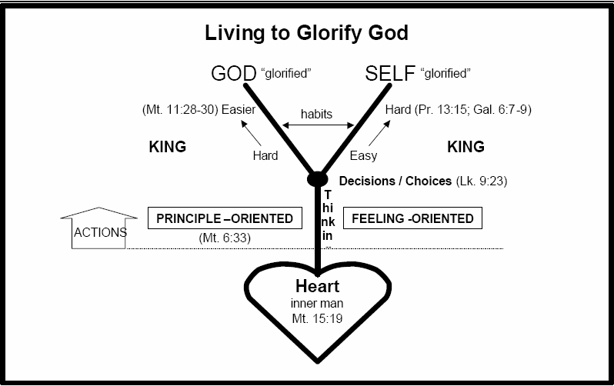
Lk 6:45

Slide 18

Linear Counseling Process

Slide 19

Conclusion
“We proclaim Him, admonishing every man
and teaching every man with all wisdom,
so that we may present every man
complete in Christ.”
Colossians 1:28
And concerning you, my brethren, I myself also am convinced that you yourselves are full of goodness, filled with all knowledge and able also to admonish one another.
Romans 15:14

