Slide 1

Introduction to Biblical Counseling
September 11, 2024

Slide 2
INTENT AND PURPOSE
Sanctification: Our’s and One Another’s
To understand our sanctification
To learn what the Bible teaches about the issues and challenges of life.
To learn how to use the Bible to address the issues and challenges of life.
To develop confidence in accurately handling the Word of Truth
To learn how to examine yourself through the lens of Scripture.
To help Christian men and women learn how to minister the Word to other brothers and sisters in Christ in discipleship and counseling.
Develop and enhance biblical skills in addressing and solving problems biblically, as a disciple-maker, a shepherd, mentor or as a trained lay counselor.
To understand the conflict between secular counseling reasoning and a biblical worldview and how to recognize the difference and address it through a biblical lens.
To work towards and achieve certification as a Biblical Counselor

Slide 3

Psychological Questions
All people in every society and culture asks these questions:
Who are we?
What happened?
Why do we do the things we do?
What motivates people?
What are the causes of our psychological ills?
How do we change?
How do we heal?
What is the goal of change?
We propose to answer these questions from a biblical worldview!

Slide 4
Biblical Counseling Conviction:
A commitment to and confidence in the necessity, sufficiency, authority, and relevancy of Scripture for helping people work through suffering and sin issues in a way that glorifies God and brings spiritual growth – making disciples!
Secular psychologists can make potentially valid descriptions of human experiences, and they can raise questions to spur our thinking. However, they cannot offer complete explanations for those experiences, nor can they offer prescriptions for living.
Biblical Counseling Coalition’s Confessional Statement.

Slide 5
Biblical Counseling: Defined
Biblical counseling is the personal discipleship ministry of God’s people to others under the oversight of God’s church, dependent upon the authority and sufficiency of God’s Word through the work of the Holy Spirit.
Biblical counseling seeks to reorient disordered desires, affections, thoughts, behaviors, and worship toward a God-designed anthropology, in an effort to restore people to a right fellowship with God and others.
This is accomplished by speaking the truth in love and applying Scripture to the need of the moment by comforting the suffering and calling sinners to repentance, thus working to make them mature as they abide in Jesus Christ.
Dale Johnson and Samuel Stephens:
The Association of Certified Biblical Counselors (ACBC)

Slide 6

Comprehensive and Collaborative
Disciple-Making, Shepherding, and Biblical Counseling
In the Local Church
Matthew 28:18-20
- Pulpit Ministry - Public ministry – Proclamation ministry – Preaching ministry of the Word.
- Small group exhortation ministry of the Word.
- Personal ministry of the Word
Pulpit Ministry
Small Groups
Biblical Counseling
Personal Ministry
Discipleship/Shepherding

Slide 7
Biblical Foundations in Overcoming Sin and Suffering
Romans 15:14
And concerning you, my brethren, I myself also am convinced that you yourselves are full of goodness, filled with all knowledge and able also to admonish one another.
God’s people are called to minister to one another, to care for one another, to confront and restore one another in sin, to comfort and to build one another up in suffering.
We are called to admonish, exhort, encourage, and instruct one another.
Why would we send a brother or sister out into the world for help when God’s people are competent to help?

Slide 8
Romans 8:28-29 And we know that God causes all things to work together for good to those who love God, to those who are called according to His purpose. For those whom He foreknew, He also predestined to become conformed to the image of His Son, so that He would be the firstborn among many brothers and sisters
Ephesians 5:1 Therefore, be imitators of God, as beloved children
Colossians 1:28 We proclaim Him, admonishing every man and teaching every man with all wisdom, so that we may present every man complete in Christ.
Q: What is our our goal in sanctification?
Q: What is our goal in ministering to one another in sanctification?
A: To become like Christ; to imitate God; to be complete/mature in Christ, to restore to fellowship with God and one another.

Slide 9
How do we minister to one another?
Authority and sufficiency of Scripture
The Bible, consisting of the sixty-six books of the Old and New Testaments, is the inerrant and complete Word of God, the final authority in all matters of faith and practice. (2 Pet 1:19-21: 2 Tim 3:16-17; Psalm 19:7-14)
God’s Word is sufficient to meet every need of the human soul as David verifies frequently in his psalms.
Psalm 19:7-14 is the most comprehensive statement regarding the sufficiency of Scripture. It is an inspired statement about Scripture as a qualified guide for every situation.
^{(MacArthur)}

Slide 10
Psalm 19:7-14
The law of the Lord is perfect, restoring the soul; The testimony of the Lord is sure, making wise the simple. ⁸ The precepts of the Lord are right, rejoicing the heart; The commandment of the Lord is pure, enlightening the eyes. ⁹ The fear of the Lord is clean, enduring forever; The judgments of the Lord are true; they are righteous altogether. ¹⁰ They are more desirable than gold, yes, than much fine gold; Sweeter also than honey and the drippings of the honeycomb. ¹¹ Moreover, by them Your servant is warned; In keeping them there is great reward. ¹² Who can discern his errors? Acquit me of hidden faults. ¹³ Also keep back Your servant from presumptuous sins; Let them not rule over me; Then I will be blameless, And I shall be acquitted of great transgression. ¹⁴ Let the words of my mouth and the meditation of my heart Be acceptable in Your sight, O Lord, my rock and my Redeemer.

Slide 11
How do we minister to one another?
Authority and sufficiency of Scripture
God’s Word is sufficient to meet every need of the human soul.
Psalm 19:7-14 is the most comprehensive statement regarding the sufficiency of Scripture. It is an inspired statement about Scripture as a qualified guide for every situation.
Scripture is comprehensive, containing everything necessary for one’s spiritual life.
Scripture is surer than a human experience that one may look to in proving God’s power and presence.
Scripture contains divine principles that are the best guide for character and conduct.
Scripture is lucid rather than mystifying so that it enlightens the eyes.
Scripture is void of any flaws and therefore lasts forever.
Scripture is true regarding all things that matter, making it capable of producing comprehensive righteousness. Because it meets every need in life,
Scripture is infinitely more precious than anything this world has to offer.
^{(MacArthur)}

Slide 12
Authority of Scripture
1. Scripture is the Word of God and,
2. God is the Ultimate Authority, so
3. The words of God are authoritative.
Conclusion: Scripture is authoritative.

Slide 13
Four Purposes of Scripture When Counseling Others
2 Timothy 3:16-17 - ¹⁶ All Scripture is inspired by God and profitable for teaching, for reproof, for correction, for training in righteousness; ¹⁷ so that the man of God may be adequate, equipped for every good work.
- Teach
Reproof
Correction
Training in Righteousness

Slide 14
Four Purposes of Scripture When Counseling Others
2 Timothy 3:16-17 - All Scripture is inspired by God and profitable for teaching, for reproof, for correction, for training in righteousness; so that the man of God may be adequate, equipped for every good work.
Every time God’s Word is used it is profitable for:
Teaching: The Bible teaches comprehensive truths about God, people, sin and its effects, and the hope that is found in Christ. Scripture equips people with an accurate and complete framework for rightly understanding all of human life before God. In a culture filled with competing truth claims and alternative narratives for understanding our lives, biblical counselors instruct counselees with God’s Word so that they can know and believe what is true.
Reproof: God’s Word is useful for exposing wrongly held beliefs in one’s life. In response to the snare of wrongly-held beliefs in one’s life, biblical counselors use Scripture to help their counselees through loving and gentle rebuke, so that they might repent of believing what is false and embrace what is true about God and His gospel.

Slide 15
Four Purposes of Scripture When Counseling Others
2 Timothy 3:16-17 - All Scripture is inspired by God and profitable for teaching, for reproof, for correction, for training in righteousness; so that the man of God may be adequate, equipped for every good work.
Every time God’s Word is used it is profitable for:
Correction: Whereas the preceding purpose relates to wrongly held beliefs in our inner person, “to correct” refers to confronting and correcting sinful behavior expressed externally in one’s life. Biblical counselors use Scripture in this way as well, not only to help rescue their counselees from wrong belief but also to demonstrate how our actions reflect the true motivations of our hearts.
Training in Righteousness: Scripture’s usefulness refers not only to growth in the knowledge of God but to the pursuit of godliness and a transformed life. God uses His Word to train us, teaching us what it is like to follow Jesus in daily life so that we will learn to observe all that He has commanded (Matt. 28:20). biblical counselors help their counselees move toward the goal of Christlikeness so that they will not only know what is true but that their lives would reflect this truth as well.

Slide 16
Four Purposes of Scripture When Counseling Others
2 Timothy 3:16-17 - All Scripture is inspired by God and profitable for teaching, for reproof, for correction, for training in righteousness; so that the man of God may be adequate, equipped for every good work.
- Teach
- Reproof
- Correction
- Training in Righteousness
These four purposes of Scripture combine to produce one intended result:
that the man of God may be complete, equipped for every good work” (2 Tim. 3:17
The usefulness of God’s Word is meant to produce maturity and godliness in the lives of those we counsel, but also a growing capacity for ministry in the lives of other people.
God speaks in His Word to instruct, to reprove, to confront, and to train so that those we counsel would bear fruit that leads to further disciple-making, for God’s glory (2 Timothy 2:2).

Slide 17
God’s people have all we need in Scripture, their justification and sanctification, the indwelling Holy Spirit, and the Church to minister to ourselves and one another in overcoming ALL forms of sin and suffering
2 Peter 1: 3-11 3 for His divine power has granted to us everything pertaining to life and godliness, through the true knowledge of Him who called us by His own glory and excellence. 4 Through these He has granted to us His precious and magnificent promises, so that by them you may become partakers of the divine nature, having escaped the corruption that is in the world on account of lust. 5 Now for this very reason also, applying all diligence, in your faith supply moral excellence, and in your moral excellence, knowledge, 6 and in your knowledge, self-control, and in your self-control, perseverance, and in your perseverance, godliness, 7 and in your godliness, brotherly kindness, and in your brotherly kindness, love. 8 For if these qualities are yours and are increasing, they do not make you useless nor unproductive in the true knowledge of our Lord Jesus Christ. 9 For the one who lacks these qualities is blind or short-sighted, having forgotten his purification from his former sins. 10 Therefore, brothers and sisters, be all the more diligent to make certain about His calling and choice of you; for as long as you practice these things, you will never stumble; 11 for in this way the entrance into the eternal kingdom of our Lord and Savior Jesus Christ will be abundantly supplied to you.

Slide 18
Why should we minister to one another?
2 Cor 1:3-7
³ Blessed be the God and Father of our Lord Jesus Christ, the Father of mercies and God of all comfort,
⁴ who comforts us in all our affliction so that we will be able to comfort those who are in any affliction with the comfort with which we ourselves are comforted by God.
⁵ For just as the sufferings of Christ are ours in abundance, so also our comfort is abundant through Christ.
⁶ But if we are afflicted, it is for your comfort and salvation; or if we are comforted, it is for your comfort, which is effective in the patient enduring of the same sufferings which we also suffer;
⁷ and our hope for you is firmly grounded, knowing that as you are sharers of our sufferings, so also you are sharers of our comfort.

Slide 19
Counseling God's Way
"Counseling God's Way"
A commitment to take the Scriptures seriously and to help God's people apply His truth to their personal lives in practical ways.
Genuine biblical counseling doesn't merely sprinkle a few Bible verses here and there to make the counseling appear Bible-centered. Biblical counseling seeks to carefully discover those areas in which a Christian may be disobedient to or unaware of the principles and commands of Scripture and to help him learn how to lovingly submit to God's will.
Effective biblical counselors do not automatically diagnose a counselee's problems as flagrant and willful rebellion and prescribe a couple of verses with the promise of instant healing. However, a genuine Biblical counselor does not assume that every problem is biologically caused, requiring years of intensive psychotherapy and psychotropic drugs.
While recognizing that many problems of thinking and behavior are physically caused, biblical counselors recognize that many physical symptoms are generated by wrong patterns of thinking and action.
Biblical counselors take Colossians 1:28 seriously, presenting Christ without shame, lovingly confronting sin, and teaching biblical principles to produce maturity in the person’s life.

Slide 20
Four Levels of Problems
Perception/Perceptual Level: Where the Problem Begins
Mind-set, established attitude, values. Often a conscious choice to adopt a certain PROBLEM
manner of thinking. Interpretation of reality. Idols of the heart STARTS
Preconditioning Level
Learned patterns: unconscious, absorbed patterns from various influences in our lives,
including sinful choices which have become regularized behavior.
Performance Level: How one acts
“Doing level” Ask what, when, how and who questions to discover why this behavior is
characteristic of this counselee. Performance includes a variety of behaviors such as brooding,
being critical, slamming doors, overeating, lying, clamming up.
Presence/Presentation Level - Observable
What is felt: this includes what a person projects – constant frown, rigid muscle tone – and what
he feels and talks about feeling. Depression, listlessness, confusion, fearfulness, relational
problems, suicidal ideations, inability to control anger.
Dealing with it Biblically

Slide 21
Goal of Biblical Counseling
True biblical counseling will have the clearly defined and communicated goal of helping a counselee glorify God, beginning at the heart level and reaching towards a life that gives a watching world a biblically accurate view of who God is (Colossians 1:28).

Slide 22
Goal of Biblical Counseling
The problems of the counselee’s life are used as a springboard to teach and train him/her at the heart level to think and act in a way that pleases the Lord Jesus Christ. Problems are viewed in light of how God is using them to sanctify us (2 Corinthians 5:9, Galatians 1:10).

Slide 23
Goal of Biblical Counseling
As people realize that solving problems is secondary to the goal of pleasing Christ in every circumstance, hope is breathed into hearts. Difficult circumstances become opportunities rather than insurmountable problems.

Slide 24
Goal of Biblical Counseling
This is sanctification!
The process of sanctification involves the progression of putting off wrong thinking, behavior, and emotions; renewing the mind by God’s Word; and putting on biblical thinking and acting (Ephesians 4:17-32, Colossians 3).

Slide 25
Sanctification
“Sanctify” is to set apart to God, for His use. God works in those whom He claims as His own to conform them “to the image of his Son” (Rom. 8:29).
We are increasingly being changed from what we once were through the agency of the indwelling Holy Spirit .
Sanctification is spiritual growth/maturity/being complete (Colossians 1:28).
The Holy Spirit “works in you, both to will and to work” according to God’s purpose (Rom. 8:28).
Working out our salvation with fear and trembling (Phil. 2:12, 13). Christians become increasingly Christlike, as the moral profile of Jesus (the “fruit of the Spirit”) is progressively formed in them (Gal. 5:22–25; 2 Cor. 3:18).

Slide 26
SANCTIFICATION

John 6:44
Eph. 1:4-6
Eph. 2:4-5
Preparatory – all God does in bringing a person to Christ.

Slide 27
SANCTIFICATION
Positional – the moment a person is saved, justified.
John 1:12-13
Romans 3:24-28
Eph. 1:7
Eph. 2:6-9
Titus 3:4-7

Preparatory – all God does in bringing a person to Christ.

Slide 28
SANCTIFICATION
Positional – the moment a person is saved, justified.
Eph. 2:10
Phil. 2:12-13; 3:13-14
Titus 3:7-8
This is you!

Progressive – the process of changing/growing over time.
Preparatory – all God does in bringing a person to Christ.

Slide 29
SANCTIFICATION
Prospective – heaven, glory.
Positional – the moment a person is saved, justified.
This is you!
ROM. 8:30
2 Tim. 4:8
2 Cor. 5:5-10

Progressive – the process of changing/growing over time.
Preparatory – all God does in bringing a person to Christ.

Slide 30
Hopeful Counseling
Goal, method, focus, target, and tools of intensive discipleship and biblical counseling:
1. The goal is heart transformation and relational restoration (2 Corinthians 5:12-21).
2. The method is truth in the context of grace (John 1:14).
3. The focus is mind, will, emotions, and right behavior—renewed mind, submitted will, informed emotions, and godly behavior.
4. The target is beyond behavior to the desire and motivations of the inner man. (For example: Is it possible that there are cases where mania and depression that have resulted in a bi-polar diagnosis, are a long-standing pattern of foolish behavior and despairing thoughts?)
5. The tools are the Word of God, Spirit of God, community of God (2 Peter 1:3).

Slide 31
Biblical Counseling Statement of Practice
As a biblical expository preaching and teaching church, SMCC holds to this position in regard to counseling, discipleship and ministering the Word:
1. Scripture is sufficient, through the empowering presence of the Holy Spirit, to address all of man’s needs (2 Peter 1:3-4; 2 Timothy 3:16). Therefore, counseling methods, practices, and techniques will be based upon the clear biblical principles and not upon theories of personality, model of man, psychotherapies, or philosophies derived from secular sources (1 Corinthians 3:19).
2. All mankind is in need of personal salvation through faith in Jesus Christ. For counselees who do not possess this salvation, a primary objective of counseling must be clear, Spirit-led communication of Jesus Christ as Savior and Lord (Romans 3:23, 6:23; Matthew 28:19-20).
3. Counsel and teach the lordship of Jesus Christ in order to lead counselees away from a humanistic focus on self to a proper focus on Him (Luke 9:23; Romans 12:1-2).

Slide 32
Biblical Counseling Statement of Practice
As a biblical expository preaching and teaching church, SMCC holds to this position in regards to counseling, discipleship and ministering the Word:
4. Honor the scriptural sanctity of life, marriage, and family and to do the utmost in counseling to reinforce these beliefs (Ps 139:13-14; Gen 2:24; Malachi 2:16; Prov 23:25; Col 3:20).
5. As God empowers us, we will live our life and conduct our relationships in godliness and holiness before Him, with the goal of living out the truths that we are teaching (Philippians 2:12-13).
6. The spiritual authority of the Church is paramount. Counseling in a local church must be evidenced by involvement in a local church and by instructing those whom we counsel to involve themselves in a church also, thus working in concert with it rather than in competition against it (Hebrews 10:25).

Slide 33
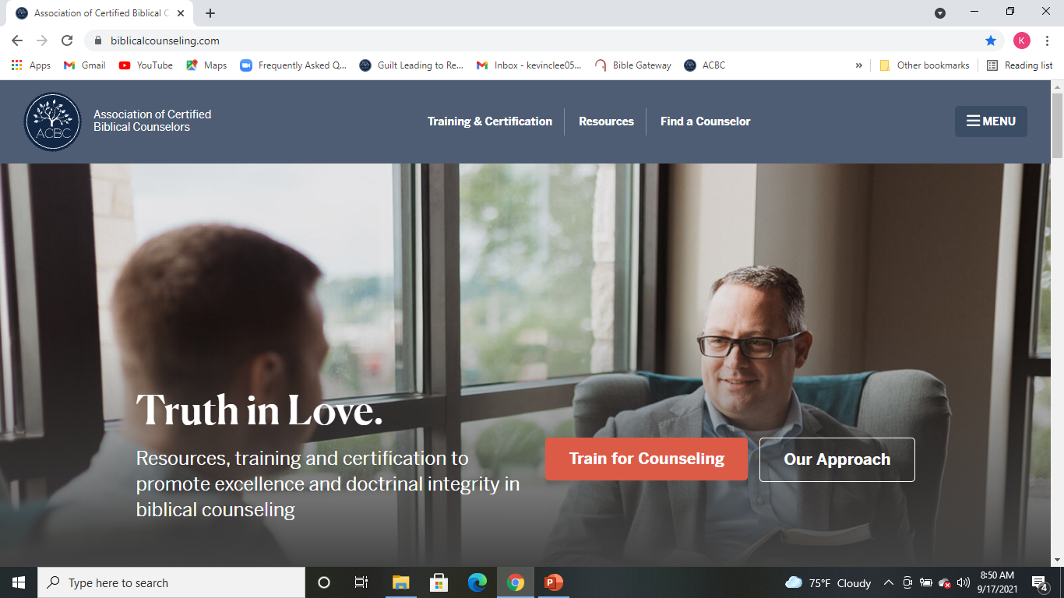
Association of Certified Biblical Counselors (ACBC)
https://biblicalcounseling.com/

Slide 34
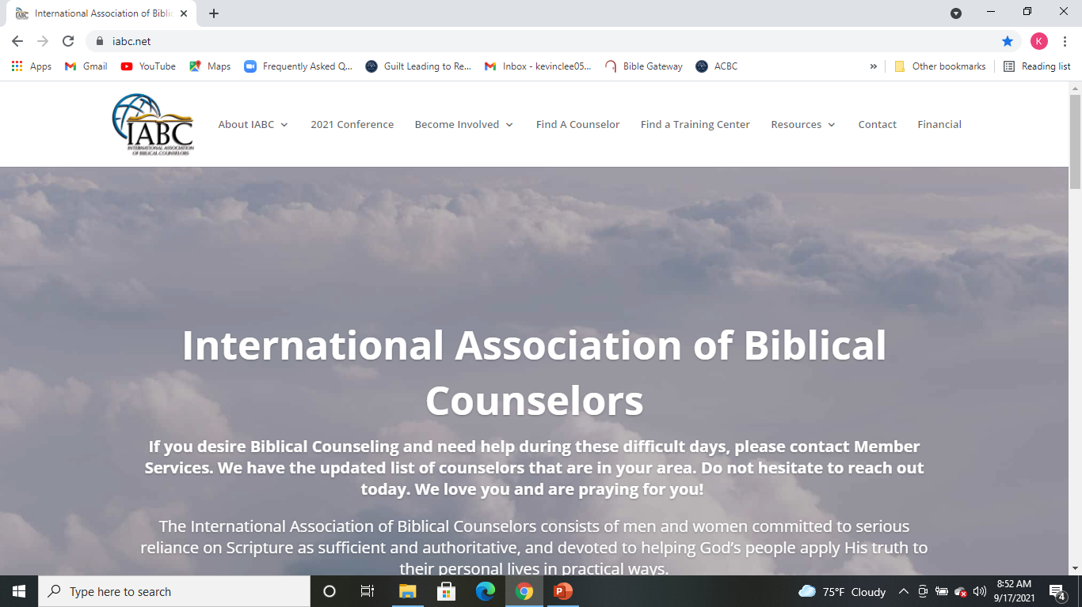
International Association of Biblical Counselors (IABC)
https://www.iabc.net/

Slide 35
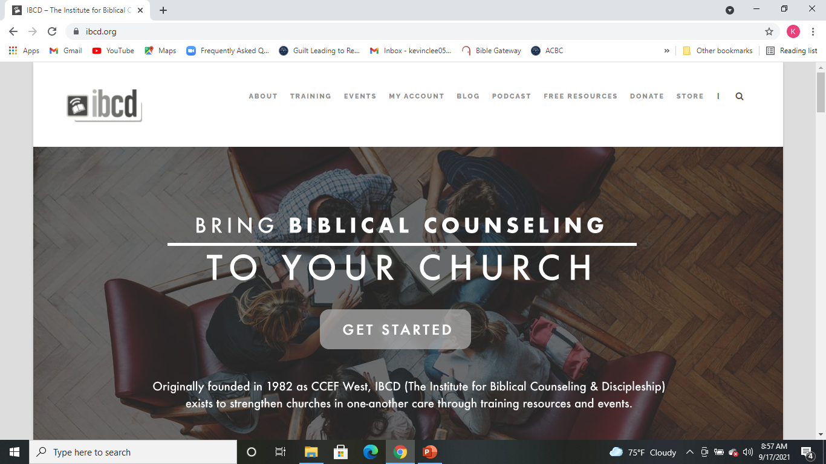
Institute of Biblical Counseling and Discipleship (IBCD) https://ibcd.org/

Slide 36
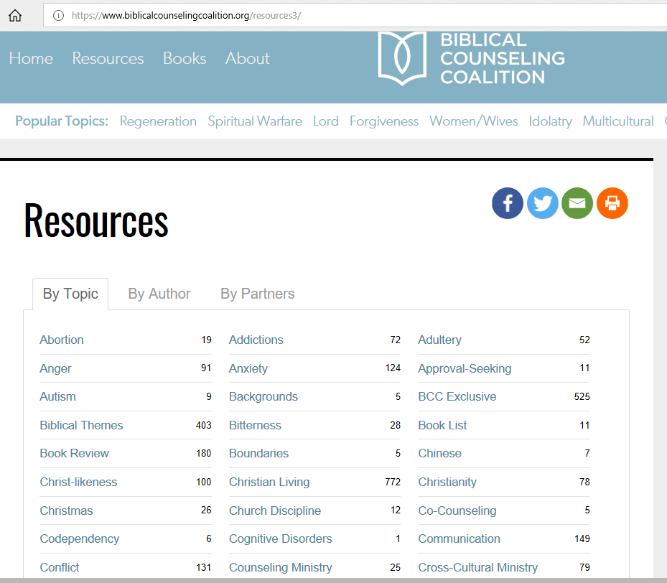
Biblical Counseling Coalition (BCC)
https://www.biblicalcounselingcoalition.org/

Slide 37
Sep 18 – Biblical Counseling Basics
Sep 25 – Distinctives of Biblical Counseling v. Secular/Integrated
Oct 2 – Medical Issues – Psychotrophic Drugs
Oct 9 – No class
Oct 16 – Biblical Response to Trials and Suffering
Oct 23 – Biblical Response to Physical Illness
Oct 30 – Biblical Response to Depression
Nov 6 – Biblical Response to Addictions
Nov 13 – Biblical response to Anger
Nov 20 – Forgiveness
Nov 27 – Thanksgiving – No class
Dec 4 – Guilt and Repentance
Dec 11 – TBD

Slide 38

Conclusion
“We proclaim Him, admonishing every man
and teaching every man with all wisdom,
so that we may present every man
complete in Christ.”
Colossians 1:28
And concerning you, my brethren, I myself also am convinced that you yourselves are full of goodness, filled with all knowledge and able also to admonish one another.
Romans 15:14

