Slide 1
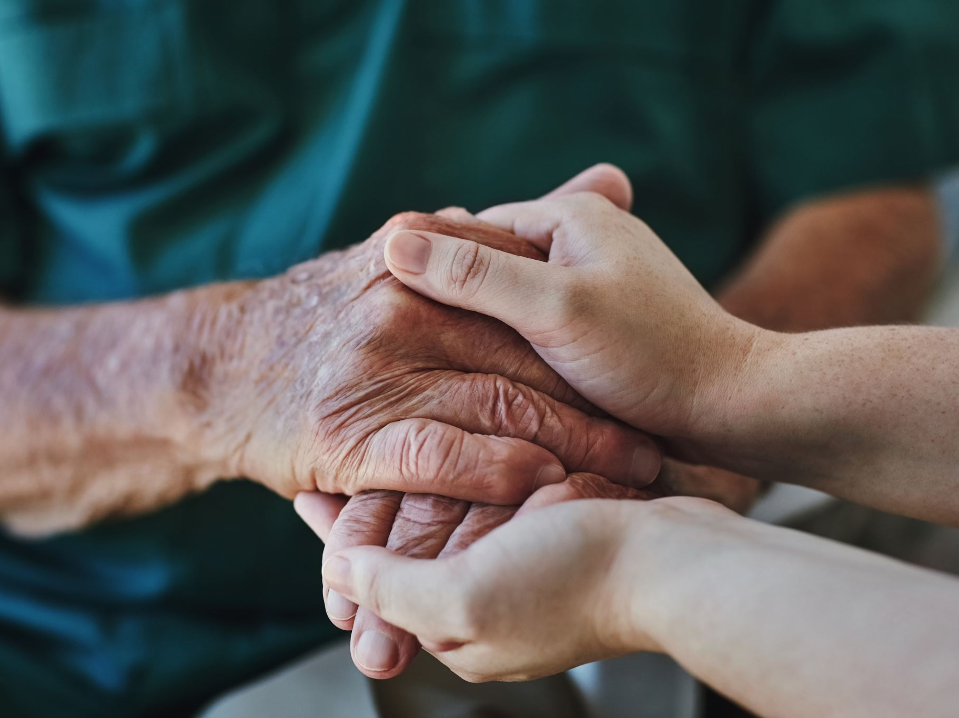
GRIEF / LOSS
AND LAMENT

Slide 2
intense emotional suffering
Grief is ________________________ caused by a loss. The emotional suffering in the Bible is frequently referred to as sorrow (Isa 53:3).
Grieving is like entering the valley of shadows. Grief is painful. It is work. It is a lingering process. It is a healing _______ that can last anywhere from one to three years, and for some a lifetime. Some people never get through the process of grieving.
A sudden death can be more difficult because there is no warning and no chance to say goodbye and begin to prepare for the loss.
Grief is not always just about death. It can also be about divorce, life transitions, disaster, misfortune.
journey

Slide 3
V. Grief is actually a complex set of emotions, all of which are _________. People who are grieving may experience their loss emotionally & mentally through feelings, thoughts, and attitudes; socially as they interact with others; and physically as it affects their health.
VI. Often friends don’t know how to help and may try to “cheer him up” or “get her mind off her loss”. This can actually _______the burden as the person grieving has to either avoid friends or fake it rather than have the chance to share his or her true feelings.
VII. Sometimes loss is cumulative and “awakens memories of early losses” that were never fully grieved.
“normal”
add to

Slide 4
VIII. Someone grieving may experience intense feelings of ______ for aspects of the relationship with the person who has died or the grieving person may feel as if they are being punished.
IX. Sometimes the feelings of anger and sadness are __________ onto God and the grieving person experiences God as distant and uncaring.
X. Often sadness and loss can intensify during certain times of the year, such as the month the person died, family holidays, and the person’s birthday or anniversary.
guilt
projected

Slide 5
Dimensions of Grief
For a Christian there are three broad dimensions to grief. However these dimensions do not necessarily follow in order. They usually look more like the following diagram*:
Disorganization
Acceptance
Reorganization
*Grief – Learning to Live with Loss by Howard Eyrich

Slide 6
Three Demisions of Grief
1. Disorganization – A relationship is deconstructed. The orderliness of life is _________. There is often an infusion of entangled responsibilities (John 11:21-46).
2. Acceptance – There is a realization that life will never be the same again, coupled with a ___________ to engage the new frontiers of life (Luke 24:13-35).
3. Reorganization – The individual will _____ ___ ______ to honor God, others, and self by the reconstruction of relationships, life structures and responsibilities
(Acts 1:12-26).
distorted
willingness
make the choice
*Grief – Learning to Live with Loss by Howard Eyrich

Slide 7
Lament – A Biblical Response to Sorrow
mercy
redemption
sovereignty
“Belief in God’s ______, ___________, and ___________ create lament. Without hope in God’s deliverance and the conviction that he is all-powerful, there would be no reason to lament when pain invaded our lives. Todd Billings, in his book “Rejoicing in Lament”, helps us understand this foundational point: ‘It is precisely out of trust that God is sovereign that the psalmist repeatedly brings laments and petitions to the Lord.… If the psalmists had already decided the verdict—that God is indeed unfaithful—they would not continue to offer their complaint.’ Therefore, lament is rooted in what we _________. It is a prayer loaded with theology. Christians affirm that the world is broken, God is powerful, and he will be faithful. Therefore, lament stands in the gap between pain and promise.”
Mark Vroegop, Dark Clouds, Deep Mercy: Discovering the Grace of Lament (Wheaton, IL: Crossway, 2019), 26.
believe
To cry is human, but to lament is Christian.

Slide 8
Lament can be manifested as a loud cry, a howl, or a passionate expression of grief. However, in the Bible lament is more than sorrow or talking about sadness. It is more than walking through the stages of grief.
Lament is a _______ in pain that leads to ______.
You might think lament is the opposite of praise. It isn’t. Instead, lament is a path to praise as we are led through our brokenness and disappointment. The space between brokenness and God’s mercy is where this song is sung. Think of lament as the transition between pain and promise.
It is the path from heartbreak to _____.
prayer
trust
hope

Slide 9
Lament – A Biblical Response to Sorrow
turn
Four words to help us learn to lament: _____, _________, _____, and ______.
complain
ask
trust
In the address, the heart is turned to God in prayer.
Complaint clearly and bluntly lays out the reasons behind the sorrow.
The lamenter usually makes a request for God to act—to do something.
Nearly every lament ends with renewed trust and praise.
Mark Vroegop, Dark Clouds, Deep Mercy: Discovering the Grace of Lament, 29.

Slide 10
Hurting people are given permission to grieve, but not aimlessly or __________. The biblical language of lament is able to redirect weeping people to what is true despite the valley they are walking through.¹
“I loathe my own life; I will give full vent to my complaint; I will speak in the bitterness of my soul. “I will say to God, ‘Do not condemn me; Let me know why You contend with me. ‘Is it right for You indeed to oppress, To reject the labor of Your hands, And to look favorably on the schemes of the wicked? ‘Have You eyes of flesh? Or do You see as a man sees? ‘Are Your days as the days of a mortal, Or Your years as man’s years, That You should seek for my guilt And search after my sin? - Job 10:1–6
selfishly
¹Mark Vroegop, Dark Clouds, Deep Mercy: Discovering the Grace of Lament, 2019), 36.

Slide 11
Pray Your Struggles – Psalm 77
My soul refuses to be comforted.
When I remember God, I moan;
when I meditate, my spirit faints. Selah
You hold my eyelids open;
I am so troubled that I cannot speak. (Ps. 77:2–4)
He’s praying, but it’s not bringing immediate comfort or resolution. His prayers are not “working.” Yet, he still prays.
You need to know that lament does not always lead to an ___________ solution. It does not always bring a quick or timely answer. Grief is not tame. Lament is not a simplistic formula. Instead, lament is the song you sing believing that one day God will answer and restore. Lament invites us to pray through our struggle with a life that is far from perfect.
immediate
¹Mark Vroegop, Dark Clouds, Deep Mercy: Discovering the Grace of Lament, 2019), 33.

Slide 12
Pray Your Questions – Psalm 77:7-9
This painful search leads to six pointed rhetorical questions:
1. “Will the Lord spurn forever?” (v. 7).
2. “Will [he] never again be favorable?” (v. 7).
3. “Has his steadfast love forever ceased?” (v. 8).
4. “Are his promises at an end for all time?” (v. 8).
5. “Has God forgotten to be gracious?” (v. 9).
6. “Has he in anger shut up his compassion?” (v. 9).
¹Mark Vroegop, Dark Clouds, Deep Mercy: Discovering the Grace of Lament, 2019), 34.

Slide 13
Pray the Gospel – Psalm 77
Psalm 77 concludes with the ultimate moment that defined the people of Israel and their relationship with God: the exodus. The psalmist remembers this defining moment in Jewish history as God demonstrated his faithfulness and love:
“When the waters saw you, O God,
when the waters saw you, they were afraid;
indeed, the deep trembled.…
Your way was through the sea,
your path through the great waters;
yet your footprints were unseen.
You led your people like a flock
by the hand of Moses and Aaron.” (vv. 16, 19–20)
Notice what is happening. The psalmist anchors his questioning, his hurting heart, to the single greatest redemptive event in the life of Israel. This moment defined his understanding of God’s character. The exodus was an anchor for his weary soul. For the Christian, the exodus event—the place where we find ultimate deliverance—is the cross of Christ.
¹Mark Vroegop, Dark Clouds, Deep Mercy: Discovering the Grace of Lament, 2019), 34-35.

Slide 14
Godly Complaint
“Many people I know fall into one of two camps when walking through suffering: anger or denial. Some people are so filled with anger at God that they live in a self-made prison of despair and bitterness for the rest of their lives. Their pain gives rise to rage. And their spiritual life is never the same. Sometimes it even results in a complete rejection of Christianity as pain paves the way for unbelief.”
Biblical lament offers an alternative. Through godly complaint we are able to express our disappointment and move toward a resolution. We complain on the basis of our belief in who God is and what he can do.
¹Mark Vroegop, Dark Clouds, Deep Mercy: Discovering the Grace of Lament, 2019), 44.

Slide 15
Godly Complaint (explaining to your counselee)
Vocalizing your struggle can include ‘why’ questions. Consider:
“My God, my God, why have you forsaken me?
Why are you so far from saving me …?” (Ps. 22:1)
Other examples: Ps. 44:23-24, Ps. 80.12, Ps 88:14
A number of other complaints are connected to ‘how’ question:
How long, O LORD? Will you forget me forever?
How long will you hide your face from me?…
How long shall my enemy be exalted over me? (Ps. 13:1–2)
Consider also: Ps. 35:17, Ps 74:10, Ps. 94:3, Ps. 137:4
¹Mark Vroegop, Dark Clouds, Deep Mercy: Discovering the Grace of Lament, 2019), 44-47.

Slide 16
How to Complain the Right Way
Come Humbly – Come with your pain, not your pride
Pray the Bible – Use the Psalms as the needed boundary to keep your lament on track
Be Honest – Biblical complaints do not work if you aren’t honest with God about your pain, your fears, or your frustrations
Don’t just complain – Complaint is central to lament. But Christians never complain just to complain. Instead, we bring our complaints to the Lord for the purpose of moving us toward Him.
¹Mark Vroegop, Dark Clouds, Deep Mercy: Discovering the Grace of Lament, 2019), 44-47.

Slide 17
Ask Boldly
The writers of lament stake their claim on what God has promised to do.
Psalm 22:2–5 O my God, I cry by day, but You do not answer; And by night, but I have no rest. ³ Yet You are holy, O You who are enthroned upon the praises of Israel. ⁴ In You our fathers trusted; They trusted and You delivered them. ⁵ To You they cried out and were delivered; In You they trusted and were not disappointed.
* Note the “Yet” bridge in v.3 (bridging complaint to bold request). Consider also Hebrews 4:15-16

Slide 18
What Do We Ask For?
1. “Arise, O Lord!” Seven lament psalms call upon God to “arise” or “rise up” (Psalms 3; 7; 9; 10; 17; 74; 94).
2. “Grant us help.” Suffering of any kind confronts our self-sufficiency. (Ps. 60:11-12)
3. “Remember your covenant.” When the Bible calls upon God to remember, it’s not that he has forgotten. Instead, it’s a way of asking God to be true to the promises he’s made. This request tells God, “I’m trusting in what your Word says, Lord!” (Ps. 25:6)

Slide 19
What Do We Ask For? (cont.)
4. “Let justice be done.” (Ps. 83:16-18)
5. “Don’t remember our sins.” The request that God not remember our sins simply asks that God would not treat us as our sins deserve. (Ps. 51:1; 79:8-9)
6. “Restore us!” The big-picture narrative of the gospel anticipates ultimate restoration in the new heavens and the new earth. (Ps. 80:3)

Slide 20
What Do We Ask For? (cont.)
7. “Don’t be silent—listen to me.” If you’ve felt the deafening silence of heaven, reach out to the Lord and ask him for help. (Ps. 28:1-2; 86:6)
8. “Teach me.” What do you need to ask the Lord to teach you through your struggle? Requests like these help us not waste our trials. (Ps. 143:10, 90:12; 86:11)
9. “Vindicate me.” (Ps. 35:23-24). This kind of request can become a balm for your soul as you keep entrusting yourself to One who judges justly (1 Pet. 2:23).

Slide 21
What Do We Ask For? (cont.)
Jesus lived a life of lament. He knows the sorrows of injustice, hypocrisy, false accusations, physical weakness, temptations, betrayal, and feeling abandoned. That becomes the basis for our bold requests.
The wide variety of requests in the lament psalms help us to see that no matter what the pain or how long the struggle, we need to keep asking.

Slide 22
Choose to Trust
But I have trusted in your steadfast love;
my heart shall rejoice in your salvation.
I will sing to the LORD,
because he has dealt bountifully with me.
Psalm 13:5–6
Suffering refines what we trust in and how we talk about it.
Pain can bring clarity.
Loss affirms trust

Slide 23
Choose to Trust
1. Trust = Active Patience. We keep trusting by lamenting!
2. Choosing to Trust – Psalm 13:1–6. Note the pattern. Turning – complaining – asking – trusting.
3. But God – Psalm 13:5 (words like but, however and yet mark the intentional shift from the cause of the lament to trusting in who God is, what he has done and the promises of Scripture. See handout
Note: the turns in the various psalms – Ps. 31:14, Ps. 71:14, Ps 86:15

Slide 24
Choose to Trust – Using Psalm 13
“I have trusted in your steadfast love.” – The psalmist is trusting in what God has done in the past, a confidence that makes it possible to pray in the first place. This statement of trust anticipates a praise that has not yet arrived. Every Christian has a record of steadfast love! Choosing to trust means reinforcing what we know to be true. (e.g., Gal 2:20).
“My heart shall rejoice in your salvation.” Choosing to trust through lament requires that we rejoice without knowing how all the dots connect.
Promises don’t end the pain but they do give it purpose.
“I will sing to the Lord, / because he has dealt bountifully with me.” (Psalm 13:6)

Slide 25
Choose to Trust
Some days trust may sound like confident statements regarding what you know to be true about God as you meditate on some divine attribute. You might say, “God, I know you are in control. I do trust you.” Other days you might simply rehearse the promises in the Word, especially at the end of the lament psalms. They tell you what to say. Echo their confidence.
Lament leads to trust, but the path is not always clear or straightforward. By turning to prayer, laying out our complaints, and boldly asking, we are brought by God to a place of growing trust in him.

Slide 26
Choose to Trust
“Keep trusting the One who keeps you trusting.” – John Piper
Learning to lament gives us the grace to keep trusting.
A broken world will bring its share of grief, but it can also bring wisdom if we are willing to slow down, listen, and learn. Lament is an uncomfortable yet helpful teacher.
It is true: “The heart of the wise is in the house of mourning” (Eccles. 7:4).

Slide 27
Assessment
To determine if grieving process has cycled downward into a debilitating depression ask: “On a scale of 1 to 10, with 1 being doing great to 10 being extremely depressed, where would you put yourself today?”
“Do you have any thoughts of hurting yourself?”
General questions (Provide handout).
Address any issues the person may have about wanting to die or not having any reason to live.
Assess how the person is functioning in daily life and what help he or she might need. Reassure the person that the process will take time and that the range and intensity of emotions being experienced are normal.

Slide 28
Action/Counseling
Be patient.
    Give yourself the time to heal emotionally.
    Keep a routine, get lots of rest, and try not to attempt too much; direct your energies to healing.
Maintain Friendships.
    Let others comfort you and share in your journey.
    Do not become isolated but seek meaningful connections with others.
    Make a list of friends/family to call.
    Biblically-based support group.

Slide 29
Action/Counseling
III. Feel the Pain.
    The intensity of your pain is normal and eventually it will begin to subside. The pain will probably never disappear completely, but it will become bearable.
    Trying to avoid the “terrible pain” only prolongs the grief. Allow God to help bear your sorrow (Is. 53:3-4).
    Trying to avoid a loss by hiding the feelings will only cause problems in other areas – emotionally, spiritually, or physically (2 Samuel 1:17).
    Dealing with a loss in a healthy manner can be a major avenue to growth and life-transforming change.
    Move forward by experiencing the grief at the same time by rejoining the living through acts of giving, serving, and receiving.

Slide 30
Action/Counseling
IV. Realize Grief is Normal.
    Grief encompasses a number of changes. It appears differently at various times, and it comes and goes in people’s lives (waves with the tide).
    It is a normal, predictable, expected, and healthy reaction to a loss.
    Grief is each individual’s personal journey, and his or her manner of dealing with any kind of loss – no matter how minor or severe it may appear to others – must be respected. It should be gently challenged only when prolonged in a manner that is detrimental to the person and his or her relationships.

Slide 31
Action/Counseling
V. Heal.
    Help the grieving person process any guilt and anger he or she is feeling.
    Help him or her redirect energy from excessive “if onlys” and wishing that things could be different, to a focus on healing.
    Help with Truth:
        Psalm 16: 7-11
        John 11:25-27
        2 Corinthians 5:1-10
        1 Thessalonians 4: 13-14
        Revelation 21:4

Slide 32
Action/Counseling
Biblical Insight.
Job 1:20-22; 2:10
  5 things Job did:
      Job arose – he didn’t stay down long.
      Job tore his robe – allow them to suffer and grieve.
      Job shaved his head – Point the person to God’s glory.
      Job fell down – prostrate and totally dependent on God.
      Job worshipped – His attitude and focus was on God

Slide 33
Action/Counseling
Biblical Insight.
Job 1:20-22
  B. 2 things Job said:
      Job acknowledged God’s ownership
      The Lord gives and the Lord takes away; everything on this side is temporary.
C. 2 things Job did not do: Verse 22 – He did not blame God and he did not sin with his lips (2: 10)

Slide 34
Job’s Conclusion
Job 42:1–6
¹ Then Job answered the Lord and said, ² “I know that You can do all things, And that no purpose of Yours can be thwarted. ³ ‘Who is this that hides counsel without knowledge?’ “Therefore I have declared that which I did not understand, Things too wonderful for me, which I did not know.” ⁴ ‘Hear, now, and I will speak; I will ask You, and You instruct me.’ ⁵ “I have heard of You by the hearing of the ear; But now my eye sees You; ⁶ Therefore I retract, And I repent in dust and ashes.”

Slide 35
Resources
Eyrich, Howard A, Grief: Learning to Live with Loss. Phillipsburg, NJ: P&R Publishing, 2010.
Vroegop, Mark, Dark Clouds, Deep Mercy: Discovering the Grace of Lament. Wheaton, IL: Crossway, 2019.
Vroegop, Mark. Dark Clouds, Deep Mercy Devotional Journal. Wheaton, IL: Crossway, 2022.
Kellemen, Bob, Grief: Walking with Jesus – 31 Day Devotionals for Life. Phillipsburg, NJ: P&R Publishing, 2018.

