Slide 1


2. Describe at least six biblical strategies to develop a caring relationship with your counselees. Clearly identify each strategy and ground its use in specific passages of Scripture, explaining its practical utility in building a relationship. (ACBC Counseling Exam) February 11, 2026
SMCC Certified Biblical Counseling Training Center Biblical Counseling Class Association of Certified Biblical Counselors (ACBC) -

Slide 2
2. Describe at least six biblical strategies to develop a caring relationship with your counselees. Clearly identify each strategy and ground its use in specific passages of Scripture, explaining its practical utility in building a relationship
1 Thessalonians 2:7-8 - But we were gentle among you, like a nursing mother taking care of her own children. So, being affectionately desirous of you, we were ready to share with you not only the gospel of God but also our own selves, because you had become very dear to us.
Philippians 1:8 – For God is my witness, how I yearn for you all with the affection of Christ Jesus.

Slide 3
2. Describe at least six biblical strategies to develop a caring relationship with your counselees. Clearly identify each strategy and ground its use in specific passages of Scripture, explaining its practical utility in building a relationship
2 Cor. 1:3-7 - Blessed be the God and Father of our Lord Jesus Christ, the Father of mercies and God of all comfort, who comforts us in all our affliction so that we will be able to comfort those who are in any affliction with the comfort with which we ourselves are comforted by God…. But if we are afflicted, it is for your comfort and salvation; or if we are comforted, it is for your comfort, which is effective in the patient enduring of the same sufferings which we also suffer; and our hope for you is firmly grounded, knowing that as you are sharers of our sufferings, so also you are sharers of our comfort.
Ephesians 4:15-16 - but speaking the truth in love, we are to grow up in all aspects into Him who is the head, even Christ, …. proper working of each individual part, causes the growth of the body for the building up of itself in love.

Slide 4
2. Describe at least six biblical strategies to develop a caring relationship with your counselees. Clearly identify each strategy and ground its use in specific passages of Scripture, explaining its practical utility in building a relationship
Do you care about me? Can I trust you? Can you help me to find answers?
When they know you care about them, they will begin to trust you.
What are some ways we can communicate to our people that we do love and care for them?

Slide 5
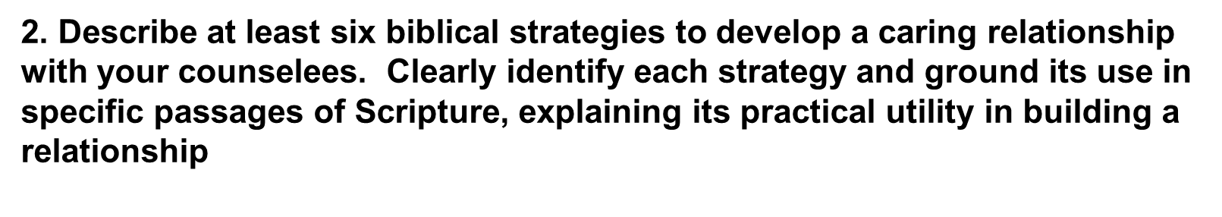
1. Listening well
2. Tell me your story
3. Love deeply by being kind and sacrificial
4. Giving hope
5. Speak truth in love
6. Pray specifically with them and for them
7. Be available

Slide 6
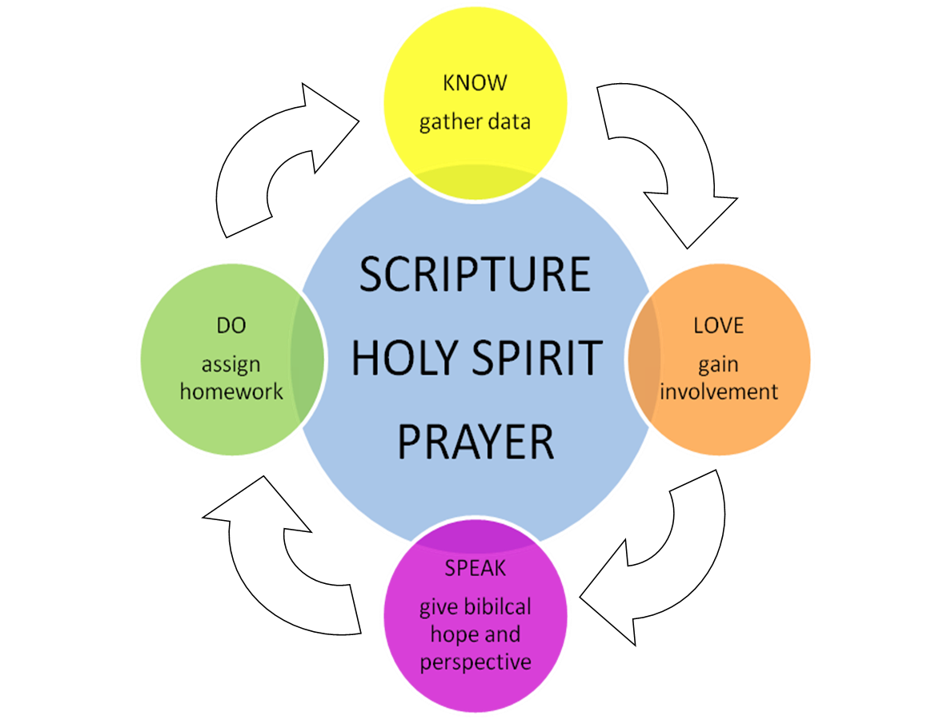
Counseling process demonstrating the development of a caring relationship -

Slide 7



Conclusion
“We proclaim Him, admonishing every man
and teaching every man with all wisdom,
so that we may present every man
complete in Christ.”
Colossians. 1:28
And concerning you, my brethren, I myself also am convinced that you yourselves are full of goodness, filled with all knowledge and able also to admonish one another.
Romans 15:14

