Slide 1
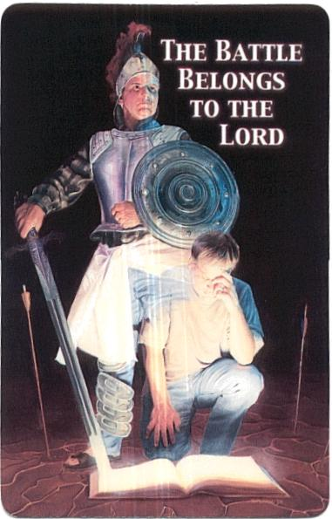
Ephesians
1
2
3
4
6
7
week
5
Ephesians 6:10-23
¹⁰ Finally, be strong in the Lord and in his mighty power. ¹¹ Put on the full armor of God, so that you can take your stand against the devil’s schemes. ¹² For our struggle is not against flesh and blood, but against the rulers, against the authorities, against the powers of this dark world and against the spiritual forces of evil in the heavenly realms. ¹³ Therefore put on the full armor of God, so that when the day of evil comes, you may be able to stand your ground, and after you have done everything, to stand. ¹⁴ Stand firm then, with the belt of truth buckled around your waist, with the breastplate of righteousness in place, ¹⁵ and with your feet fitted with the readiness that comes from the gospel of peace. ¹⁶ In addition to all this, take up the shield of faith, with which you can extinguish all the flaming arrows of the evil one. ¹⁷ Take the helmet of salvation and the sword of the Spirit, which is the word of God.
¹⁸ And pray in the Spirit on all occasions with all kinds of prayers and requests. With this in mind, be alert and always keep on praying for all the Lord’s people. ¹⁹ Pray also for me, that whenever I speak, words may be given me so that I will fearlessly make known the mystery of the gospel, ²⁰ for which I am an ambassador in chains. Pray that I may declare it fearlessly, as I should.
Final Greetings
²¹ Tychicus, the dear brother and faithful servant in the Lord, will tell you everything, so that you also may know how I am and what I am doing. ²² I am sending him to you for this very purpose, that you may know how we are, and that he may encourage you.
²³ Peace to the brothers and sisters, and love with faith from God the Father and the Lord Jesus Christ. ²⁴ Grace to all who love our Lord Jesus Christ with an undying love.
sit
Our Identity in Christ
Walk
Living Our Identity
Stand
Defending Our Identity
Kingdom Advancers:
You are being sent out from this place with the confidence of heaven. You aren’t sent out in your own strength to stand for Jesus in your own ingenuity and cunning, but with strict orders from the Lord, “be strong in the Lord and in His mighty power.” So, stand.
Kingdom Advancers
You are be being sent out from this place with the confidence of heaven. You aren’t sent out in your own strength to stand for Jesus in your own ingenuity and cunning, but with strict orders from the Lord, “be strong in the Lord and in His mighty power.” So, stand.
The Challenge!
[Ephesians 6:10]
“Finally be strong in the Lord and. In His mighty power.”
  Human Power Is Inadequate.
It’s a loosing battle to fight the devil with boxing gloves – we shouldn’t underestimate the power of the devil.
The book of Job shows what his power can do to a man’s body, home, wealth, and friends.
On our own, we are “objects of wrath” [2:3].
  Divine Power Is Invincible.
It is the power of the resurrection [1:19-23]
It enables Christians to fight from a place of victory
We are not fighting FOR victory, but FROM victory
To be “strong in the Lord and in His mighty power” implies that this strength and power are available to us.
Nothing is held back! [1:3]
Being filled with the Spirit is a repeatable event [5:18]
The strength of the Lord is found in a life of submission [5:21-6:9]
8.

Slide 2
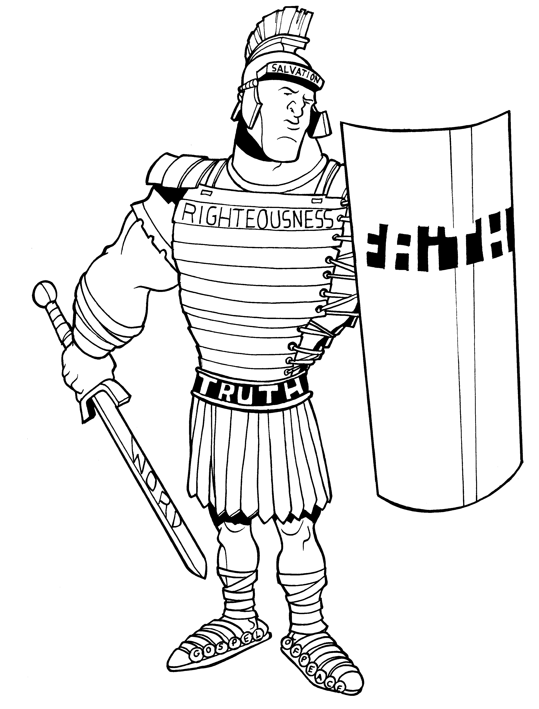
Identifying the Enemy
[Ephesians 6:11-12]
“Put on the full armor of God so that you can take your stand against the devil's schemes. For our struggle is not against flesh and blood, but against the rulers, against the authorities, against the powers of this dark world and against the spiritual forces of evil in the heavenly realms.”
Identifying the Enemy
[Ephesians 6:11-12]
“Put on the full armor of God so that you can take your stand against the devil’s schemes. For our struggle is not against flesh and blood, but against the rulers, against the authorities, against the powers of this dark world and against the spiritual forces of evil in the heavenly realms.”
The Devil
Devil means “accuser” [Rev 12:7-11]
Satan means “adversary” – he is the enemy of God
He is also called the tempter [Matt 4:3]
He is a murderer and liar [John 8:44]
He is compared to a lion [1 Peter 5:8]
He is a serpent [Gen 3:1; Rev 12:9]
He masquerades as an angel of light [2 Cor 11:13-15]
He is called the “god of this age” [2 Cor 4:4]
The Devil’s Schemes
He has come to steal, to kill and destroy [John 10:10]
He is crafty and subtle. We cannot afford to be ignorant [2 Cor 2:11]
He is behind the cunning and scheming of men [Eph 4:14]
As a false angel of light, he seeks to blind men’s minds to the truth of God’s Word
He wants to engage us in “hand to hand” battle. [Eph 6:12] – “struggle” means to “wrestle”
He uses our external enemies: the world and the flesh, to try to defeat us [Eph 2:1-3]
Not Flesh and Blood - Where did the devil come from?
He is “Lucifer, son of the dawn.” [Is 14:12-15] – He was cast down from heaven because of his pride and his desire to occupy God’s throne
He is a created being – not eternal
He is not all-knowing, all-powerful, or everywhere-present
Break Away Group
Pray on the armor of God as seen in Ephesians 6:14-17.
Discuss the idea that the armor of God reflects our identity as believers.
What are the consequences of not putting on the “full armor” of God?
Discuss the “belt of truth.” How is this piece of armor essential for holding up the rest of the armor?
7.

Slide 3
example – learn to handle life without the armor on – fight with worldly weapons – fight the devil with his games, his agenda, his style? Never win – for a few years of ministry, I didn’t understand spiritual warfare, would put on my boxing gloves and take on the enemy – I got desperately beat up.
2 Cor 10:3, “For though we live in the world, we do not wage war as the world does. The weapons we fight with are not the weapons of the world. On the contrary, they have divine power to demolish strongholds. We demolish arguments and every pretension that sets itself up against the knowledge of God, and we take captive every thought to make it obedient to Christ.”
To stand against the day of evil, we must wear the full armor. – again the same word for “full armor” – If we wear only a partial armor, we’ll have a chink – an invitation – for evil to enter. Isn’t it true – people who wear partial armor run into problems?
“I’ll accept salvation God, but I want to choose what righteousness is.”
  Rejecting the Spirit’s work within us to sanctify us
  Saved but not bearing fruit
“I’ll wear salvation and righteousness God, but I am going to set my own agenda for life – I’m not going to wear the sandals of peace and be a peace maker for you.”
  Having a problem letting God be in control – we’d rather be in control – makes for an incomplete Christianity – functioning on human call and not divine call
  Hurtful to others when we try to take from God but not let him lead.
“I’ll use the shield of faith, but I’m not going to wield the sword of the Spirit, the word of God”
  power without the word – out of balance. Walking in the power of the Spirit upon us to give us faith, but not letting the Spirit use the sword to change us in sanctification.
Rulers, authorities, powers of this dark world, spiritual forces of evil the heavenly realms
An army of demonic creatures that assist Satan in his attacks against believers [Rev 12:4; Dan 10:13-20]
Paul’s battle in Ephesus was not against people, but against this demonic army [Acts 19:21-41]
We fight on three levels
Personal [Acts 19:11-12]
Occult [Acts 19:17-19]
Strategic [Acts 19:23-41]
Break Away Group Interaction
What does it mean to fight spiritual warfare “from” victory and not “for” victory?
The devil is the “accuser” or the one who “condemns”. God, on the other hand, convicts us of sin. What is the difference between “condemnation” and “conviction.”? See Romans 8:1.
Give some examples of spiritual warfare in your own lives.
It is dangerous to go to extremes with regard to spiritual warfare – it can put our life with Christ out of perspective. Extremes might be: seeing the devil around every corner or (to the other extreme), totally ignoring him. What does Ephesians 6:10 teach us with regard to these extremes?
6.
3.

Slide 4
Kingdom Advancers:
Have you been putting the armor on? Would you go into a battle in the desert without wearing clothes? Of course not, today, you’d have all the latest battle armour. The Lord has done the same for you as church planters going into the world – he’s given you the clothes you need to fight
Kingdom Advancers
Have you been putting the armor on? Would you go into a battle in the desert without wearing clothes? Of course not, today, you would have all the latest battle armor. The Lord has given you all the battle armor you need to engage in his battles.
Use the Armor Correctly
“Therefore put on the full armor of God, so that when the day of evil comes, you may be able to stand your ground, and after you have done everything to stand.” [6:13]
Take up our armor - αναλαμβανω, v {an-al-am-ban'-o}
1) to take up, raise 2) to take up (a thing in order to carry or use it)
A progression: In v. 11 Paul speaks of putting on something you already have – wear your armor given you in Christ. Now, here in v. 13, we see Paul challenging us to use the armor in the appropriate way. Take it up – wear the armor correctly, hold up the sword, the shield – wear it as if ready for battle. Why? What would be the need to be ready for battle? If the armor speaks about whom we are in Christ? Why do we need to even worry about battle?
Why wear our armor appropriately? In 1655 a Puritan minister, William Gurnall published a treatise titled, “the Christian in Complete Armor.” The treatise is 1,472 pages long and 261 chapters – all on 11 verses here in Eph. 6. Gurnall writes, “In heaven we shall appear not in armour but in robes of glory; but here they are to be worn night and day; we must walk, work and sleep in them, or else we are not true soldiers of Christ. In this armour we are to stand and watch, and never relax our vigilance, for the saints sleeping time is Satan’s tempting time; every fly dares venture to creep on a sleeping lion.” Then he goes on the give Samson (whose hair was cut be Delilah while he slept), King Saul (whose spear David stole while he was asleep), Noah (who was in some way abused by his son while he was in a drunken sleep) and Eutychus (who slept while Paul preached.)
Why must we wear this armor and never sleep?
The day of evil – πονηροσ, a {pon-ay-ros'}
1) full of labours, annoyances, hardships 2) bad, of a bad nature or condition 2a) in a physical sense: diseased or blind 2b) in an ethical sense: evil wicked, bad
  The day of evil is every day – we have ethical pressures every day – every day we need to be able to stand. Living in today’s world we need to have a “daily put-on” relationship to the armor
A Daily Put-On
  Put on the Full Armor
“Put on the full armor of God so that you can take your stand against the devil’s schemes.” [6:11]
It is Your Identity – ενδυω, v {en-doo'-o}
to sink into (clothing), put on, clothe one's self
  “Put on” - speaks of “sinking” into our clothes. It means putting on something you already have – wear your armor given you in Christ. Sink into the clothing that is yours in Christ. Sink into the truth that is yours in Christ; the righteousness attested to you through Christ’s blood; the peace found by your life resting in Christ; the faith given you through the work of Christ and the Holy Spirit; salvation found in you only through Christ; the sword of the Spirit – the word of God, you\rs to grow in intimacy in with Christ. So put on this armor – it is your identity in Christ Jesus.
It is “Full” armor – πανοπλια, n {pan-op-lee'-ah}
full armour, complete armour 1a) includes shield, sword, lance, helmet, greaves, and breastplate
  We aren’t partially dressed. We’re not partially saved in Christ, we aren’t partially righteous, or partially have peace, or partially have faith or partially have truth, or partially have the sword of the Spirit – in Christ we have all these things in full.
  Did Christ partially die; did he partially rise from the dead? No, all this has been done perfectly – when Jesus spoke, “It is finished.” He didn’t mean almost finished, he meant completely finished.
4.
5.

