Slide 1

DAN Instructor Qualification Course (IQC)
CORE Part 2
Version 3.0
Rev. 1/23

Slide 2



Welcome and Introductions

Slide 3
Core Part 2 Module Topics
Topics to be Covered
E-Learning Platform
Logging in
E-learning Tabs
Resources
Inviting and Managing Students
Moving Students
Marketing DAN Courses*
Steps to Teach the Course
Skills Workshop
Skill Teaching Presentations
* Optional material your Instructor Trainer may include.

Slide 4

DAN E-Learning Platform
dan.diverelearning.com
There are two ways of accessing the DAN e-learning platform
directly go to dan.diverelearning.com
via your DAN membership profile
DAN recommends you and your students log directly into the e-learning platform by going to dan.diverelearning.com.
Instructors MUST use the email address associated with their DAN Membership profile.

Slide 5
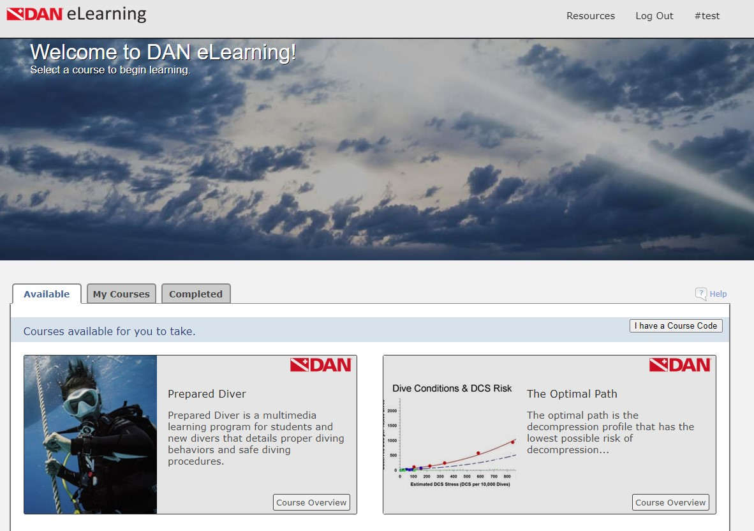
dan.diverelearning.com
E-Learning Page Course Tabs
Once you are in e-learning, you will see several “tabs”. These tabs are associated with the courses and are found near the middle of the page. They are:
Available
My Courses
Completed
Teaching (when available)
When one opens the e-learning profile, the program defaults to the "Available" tab for students and defaults to the "Teaching" tab for Instructors and those able to offer other DAN courses.

Slide 6
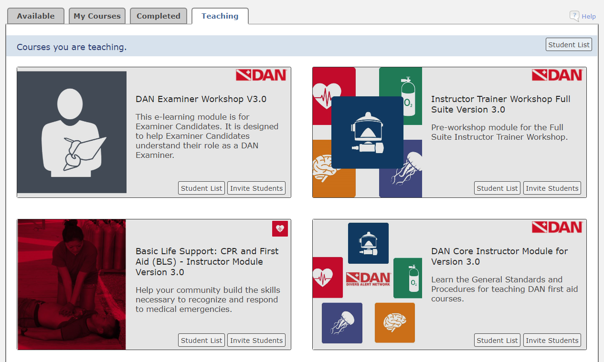
dan.diverelearning.com
E-Learning Page Course Tabs
Available
The Available tab shows the user what courses they have available to them to take.
My Courses
When the "My Courses" tab is selected, this will take the student to the courses they have **started** but not completed.
Completed
Once a given course is **completed**, it will then move into the "Completed" tab.
This is also where you will find your credential cards
Teaching (when available)
In this tab, you will find all the courses you are authorized to 'teach’.

Slide 7
dan.diverelearning.com
E-Learning Page Resourses
You will also see some other links. They are located near the top of the e-learning page in the grey box. They are:
Resources
When you click on the "Resources" link, it takes you to a page with some documents about the e-learning platform and e-learning FAQ's.
Log Out
This link will log the user out of the e-learning platform and takes them back to the log in screen.
#(username)
This link has the "#" followed by their User Name. Clicking on this takes you to a page where you can change your name, set your preferred language*, change your password, and review past orders.
My Students (when available)
This will be covered in a later slide
* Not every e-learning module has multiple languages

Slide 8
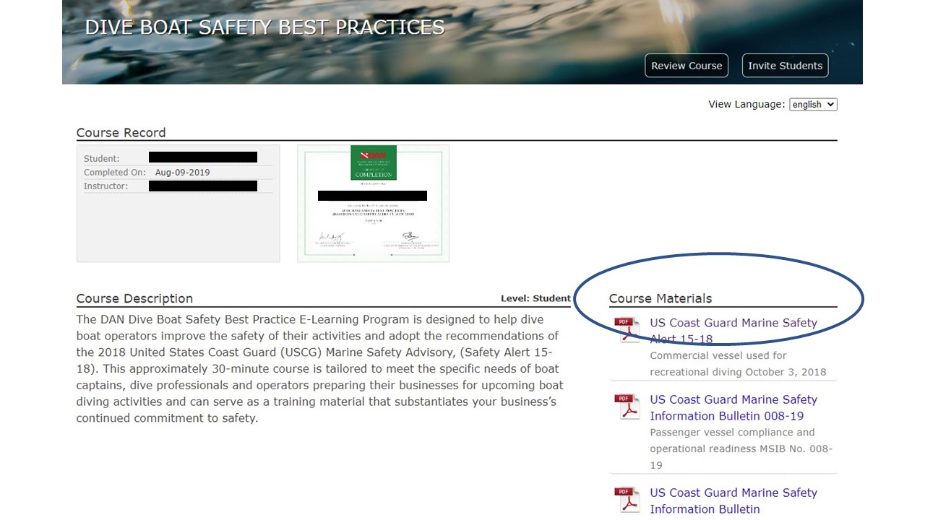
dan.diverelearning.com
Course Materials
Some courses have documents that are referenced in the course content. In these cases, the materials can be downloaded from the title page of the particular e-learning module.
To access those materials, open the e-learning module and scroll slightly down. If there are course materials for that course, they will be on the right hand side, under the heading of "Course Materials".
To open a given document, simply click on the link and the document will open up in a new window. If the material is a PowerPoint or similar type of file it will then be found where your system downloads such files.

Slide 9
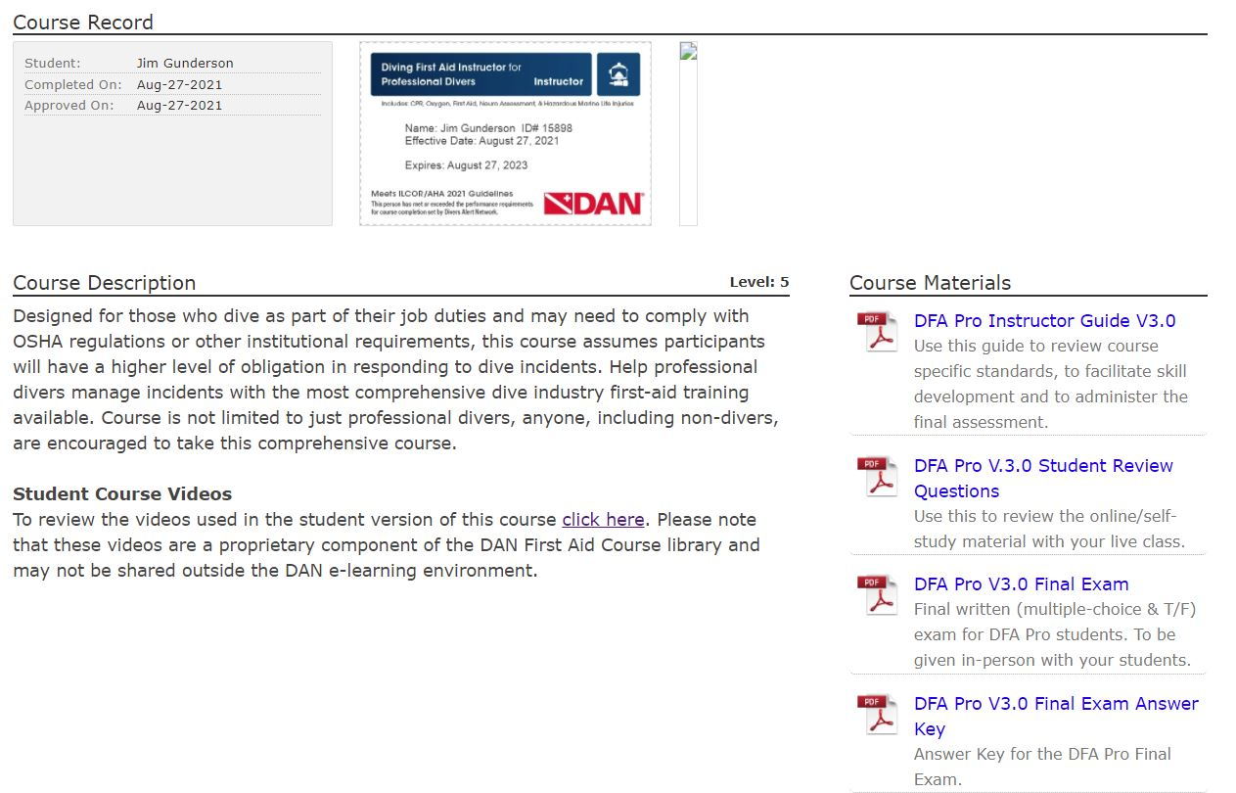
dan.diverelearning.com
Instructor Resources
All course materials available for download on the individual course overview page
Instructor also has access to all student modules and materials

Slide 10
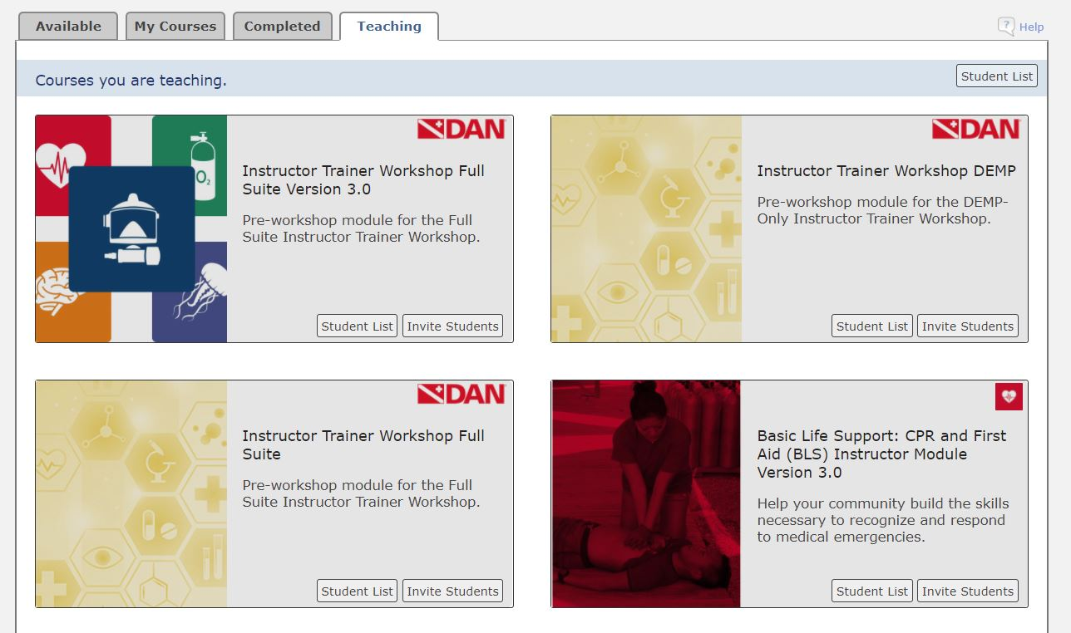
dan.diverelearning.com
Inviting and Monitoring Students
Once you become an instructor, you will see the “Teaching” tab in e-learning.
Under that tab, you will see all the courses in which you are qualified to teach.
Scroll through the list until you find the course you want to send to your students then click on it.
When you click on the course you wish to teach, it will take you to a page to invite students to take the course you selected.
Or, click the “Invite Students” button on the desired course.

Slide 11
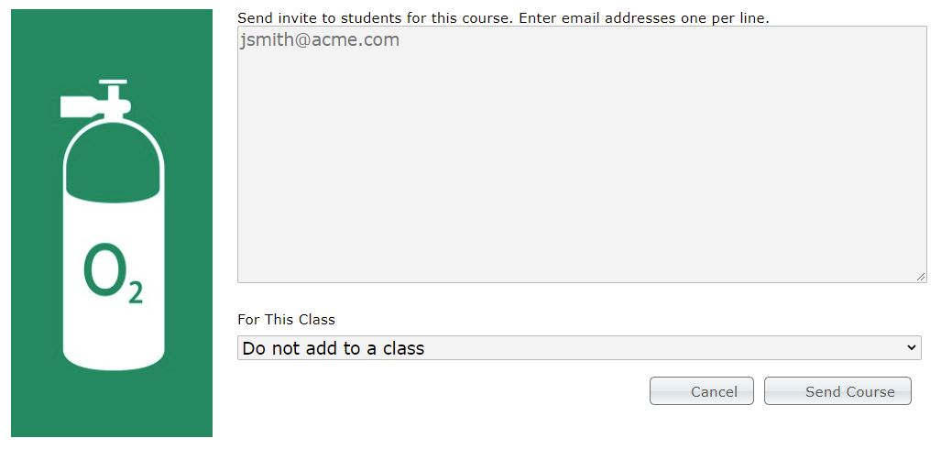
dan.diverelearning.com
Inviting Students
Ensure correct email address
One email address per line
Virtually unlimited how many invitations you can send at once
Add to a class if desired
Highly recommended
Then click “Send Course”

Slide 12
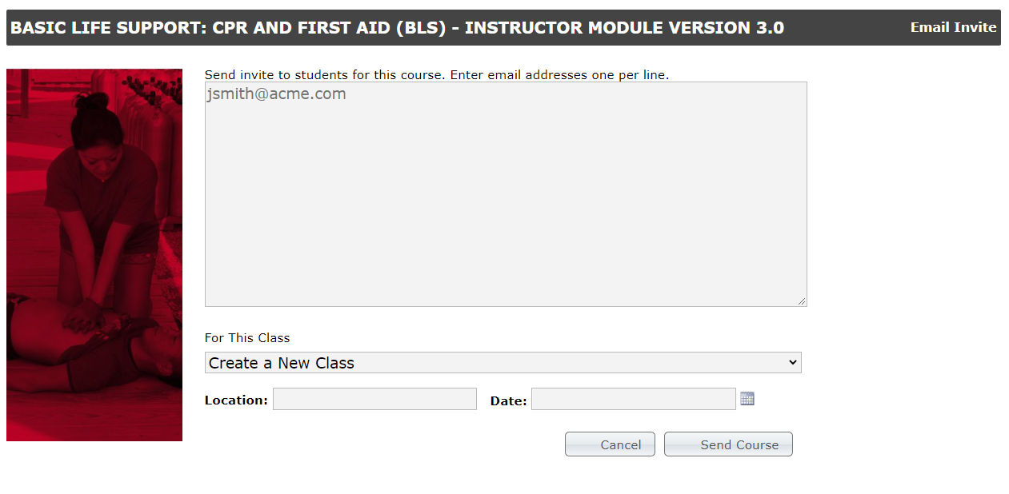
dan.diverelearning.com
Inviting Students – Adding a Class
After you have entered the students’ email addresses
Click on the down arrow to the right of “Do not add to a class.”
Select “Create a New Class”
Put in the location (or course name) and date
Then “send course”

Slide 13

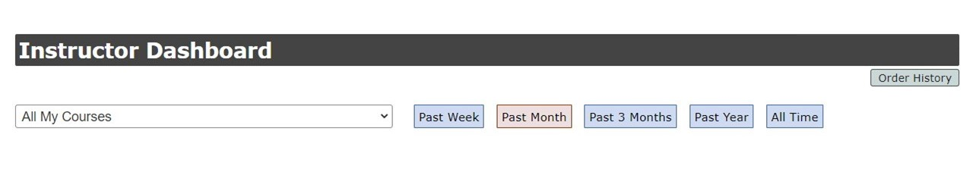
dan.diverelearning.com
Monitoring Your Students’ Progress
The "My Students" link is in the grey bar to the left of the "Resources" link. Clicking on this will take you to the Instructor Dashboard section where you can monitor your students' progress.
Instructor Dashboard
filter by "All My Courses", or by using the dropdown menu, select one specific course.
The default setting is "Past Month".
if you are looking for a student from a previous class, or the invitation was sent longer than a month ago, select the time period appropriate for your query

Slide 14
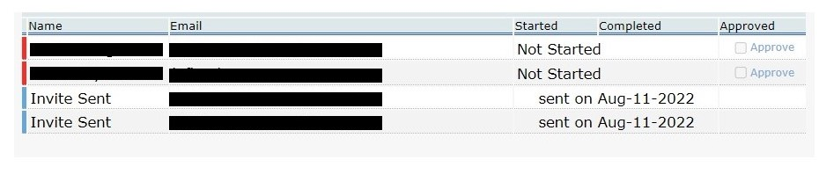
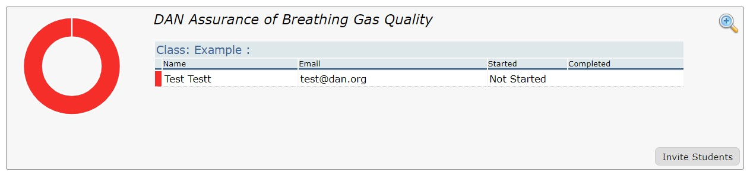
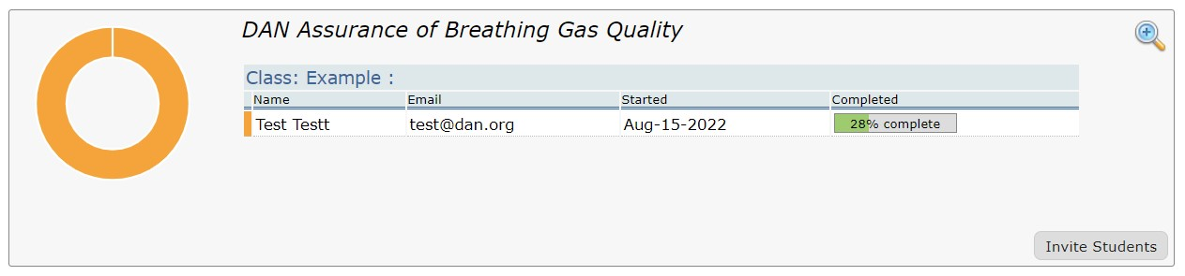
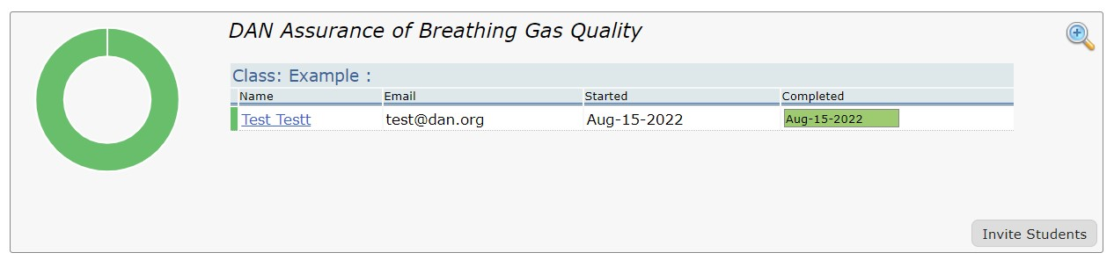
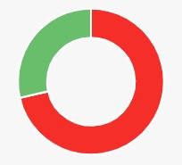
dan.diverelearning.com
Monitoring Your Students’ Progress
When you select a course, you may see several different statuses for your students:
Invitation Sent, but not opened
Course Not Started
In Progress
Course Completed
With multiple students, the ring will show the different colors, as appropriate.

Slide 15
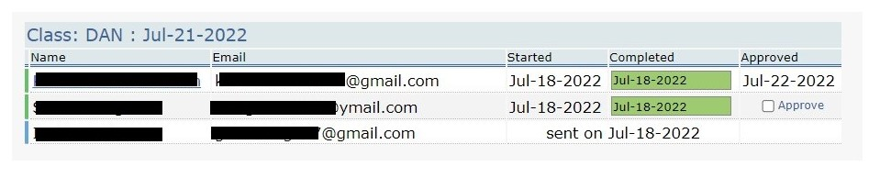
dan.diverelearning.com
Course Completion and Approval
Once the student has completed the e-learning, AND, the hands-on portion of the course is done, you can then approve the student(s).
If the e-learning is not complete, you will not be able to approve the course
To approve, check the approve box for each student
Once the students are selected, click the “Approve ‘x’’ student(s)” button and pay the credentialing fee.

Slide 16
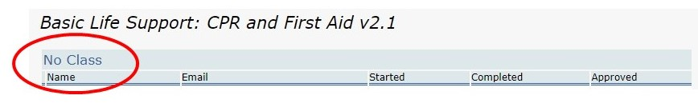
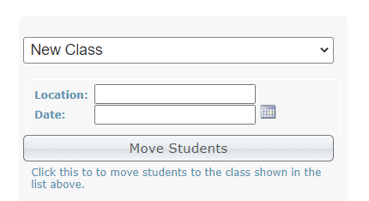
dan.diverelearning.com
Moving Students
If you did not create a class for your student(s), or want to move them from one class to another:
First, go to your "My Students" menu as discussed above
Then, find the course you desire, Click on the "No Class" link, or the name of the established class
When you do that, the list of students will appear
Select the name(s) of the student(s) you wish to move
Then create the new class in the same manner as discussed above
Or select an existing class from the dropdown menu
Click on “Move Students”

Slide 17
dan.diverelearning.com
A “Discard” Class
Sometimes you will send an invitation to a student and for some reason they don't start, or complete, the course.
It is suggested you create a "discard" class.
Just move the student(s), as mentioned just above, into a "Discard" class

Slide 18
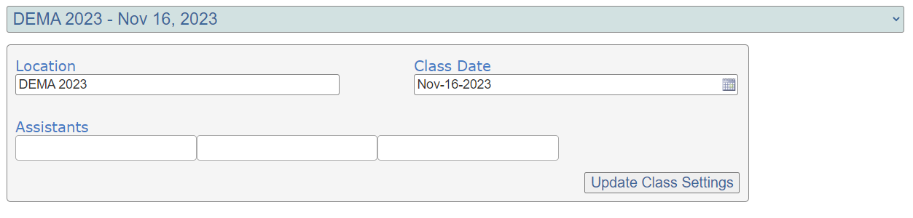
dan.diverelearning.com
Adding Assistants
Sometimes you might be team-teaching a given course. Assistants also get credit for teaching.
To add an assistant to a class:
Go to “My Students” as described above
Select the particular class as you did to “Moving Students”
You can add up to three assistants.
Click “Update Class Settings”
Note: If the course is named “No Class” you cannot add assistants.
Adding assistants MUST be done PRIOR to approving students. Once the students are approved, there is no way to add assistants.

Slide 19
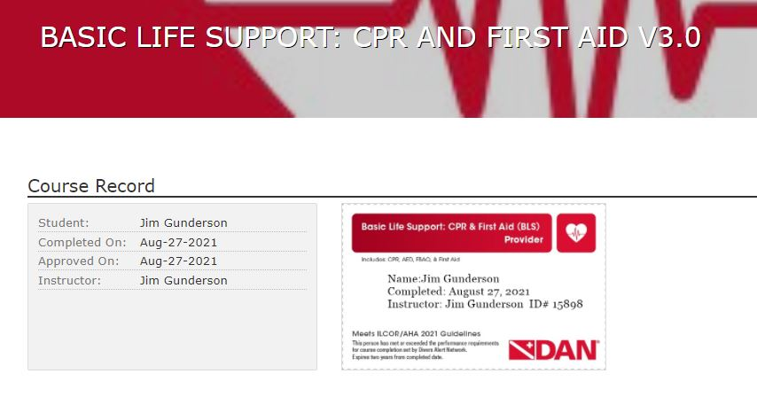
dan.diverlearning.com
Credential Cards
Credential Cards are found under the “Completed” Tab for the desired course.
Provider-level and Instructor-level
For Instructor-level card(s) use the initial module.
Updates don’t have cards
Click on the card to expand it in a new window
Can print or save as an image file.
Cards are “wallet” sized
Certificates, where available, are 8,5” x 11” (21.6cm x 28cm)

Slide 20

Core Part 2
Oxygen Window
e-Newsletter for DAN Instructors, Instructor Trainers and Examiners
Resource for news and information
Includes standards and curriculum updates
Comes out quarterly

Slide 21

Core Part 2
Marketing DAN Courses
Active interest in training
Pair DAN courses with diving courses
Slow season training
Benefits
Add-on classes
Trips
Gear

Slide 22
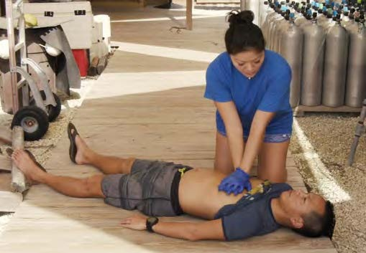
Core Part 2
Marketing DAN Courses – Community Opportunities
CPR & First Aid – especially
Scouting programs
Religious groups
Camping associations
Babysitting programs
Health Care Providers
Lifeguards
Other water sports activities
Resort hotel staff

Slide 23

Core Part 2
Marketing DAN Courses – Get the Word Out
In-House
DMs/Instructors
Current (and former) students
Media
Social Media
Newsletters
Word of Mouth
Website
Be open to future options/possibilities

Slide 24

Core Part 2
Post it
In store
Online
Flyers, etc…
Commit to it
Make it visible
Make it special
Hold it!
Even if just one
Build trust, loyalty and reputation
Marketing DAN Courses – Scheduling

Slide 25

Core Part 2
Calculate your costs
Overhead
Classroom/Building
Utilities
Long term (used for multiple classes)
Instructor materials/fees
Manikins and trainers (AED, Tourniquet)
Oxygen equipment
Per class
Oxygen fills
First-aid moulage supplies
Time
Per student
Supplies
Completion cards
What to Charge

Slide 26

Core Part 2
Calculate Final Cost
Long-term expenses / # of classes/ # students
+ Per-class expenses / # students
+ Per-student expense
=
Final charge per student
What to Charge

Slide 27

Core Part 2
Before the Course
Budget and course fees
Verify all equipment and supplies available
Acquire needed supplies and equipment
Send course invitations through e-learning
Direct students to complete chapter review questions
Remind students to bring completed review questions to class for discussion
Steps to Teach a Course

Slide 28
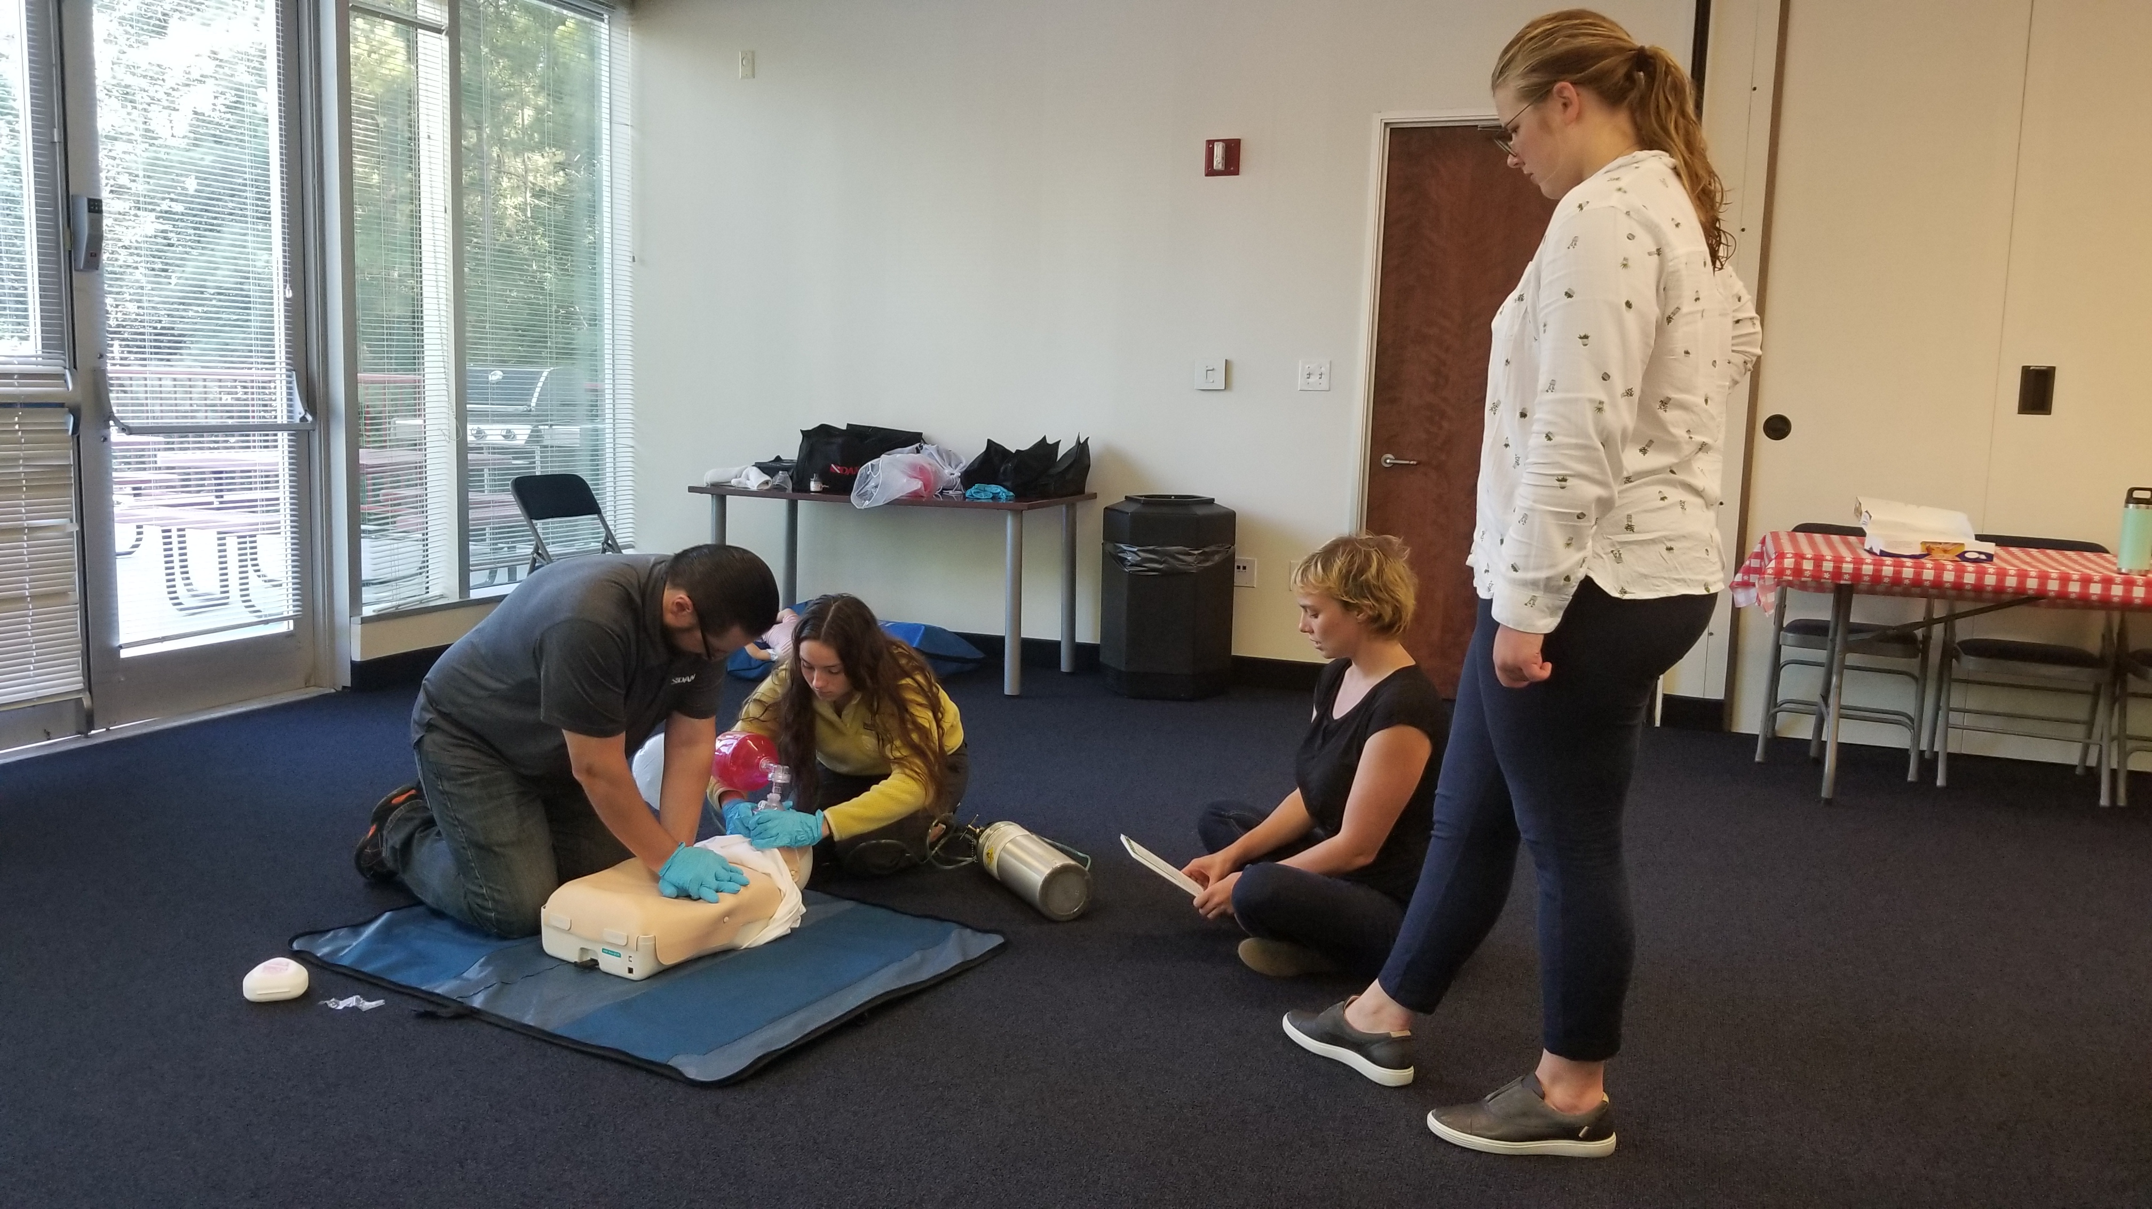
Core Part 2
Conducting the Course
Registration forms and introductions
Discuss Chapter Review Questions
Answer any student questions
Clarify information
Address any misconceptions and misunderstandings
Conduct Skill-Development Sessions
Final Assessment
Conducting the Course

Slide 29
Core Part 2
After the Course
“Approve” successful completions under ‘My Students’ in e-learning
Clean manikins
Refill cylinders
Restock supplies
Reminder: Retain records for 7 years (or longer if local laws dictate)
After the Course

Slide 30
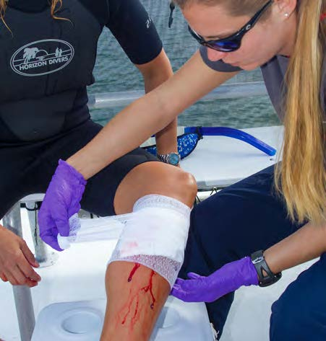
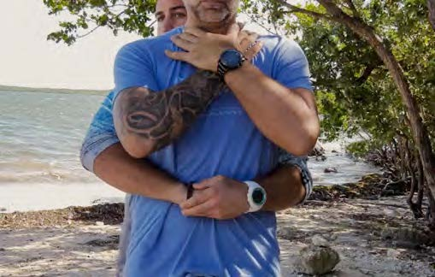
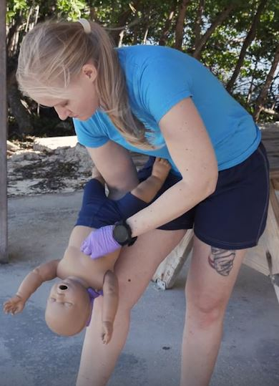
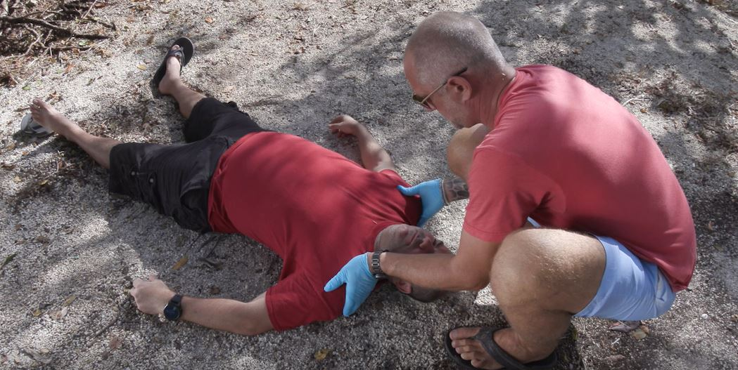
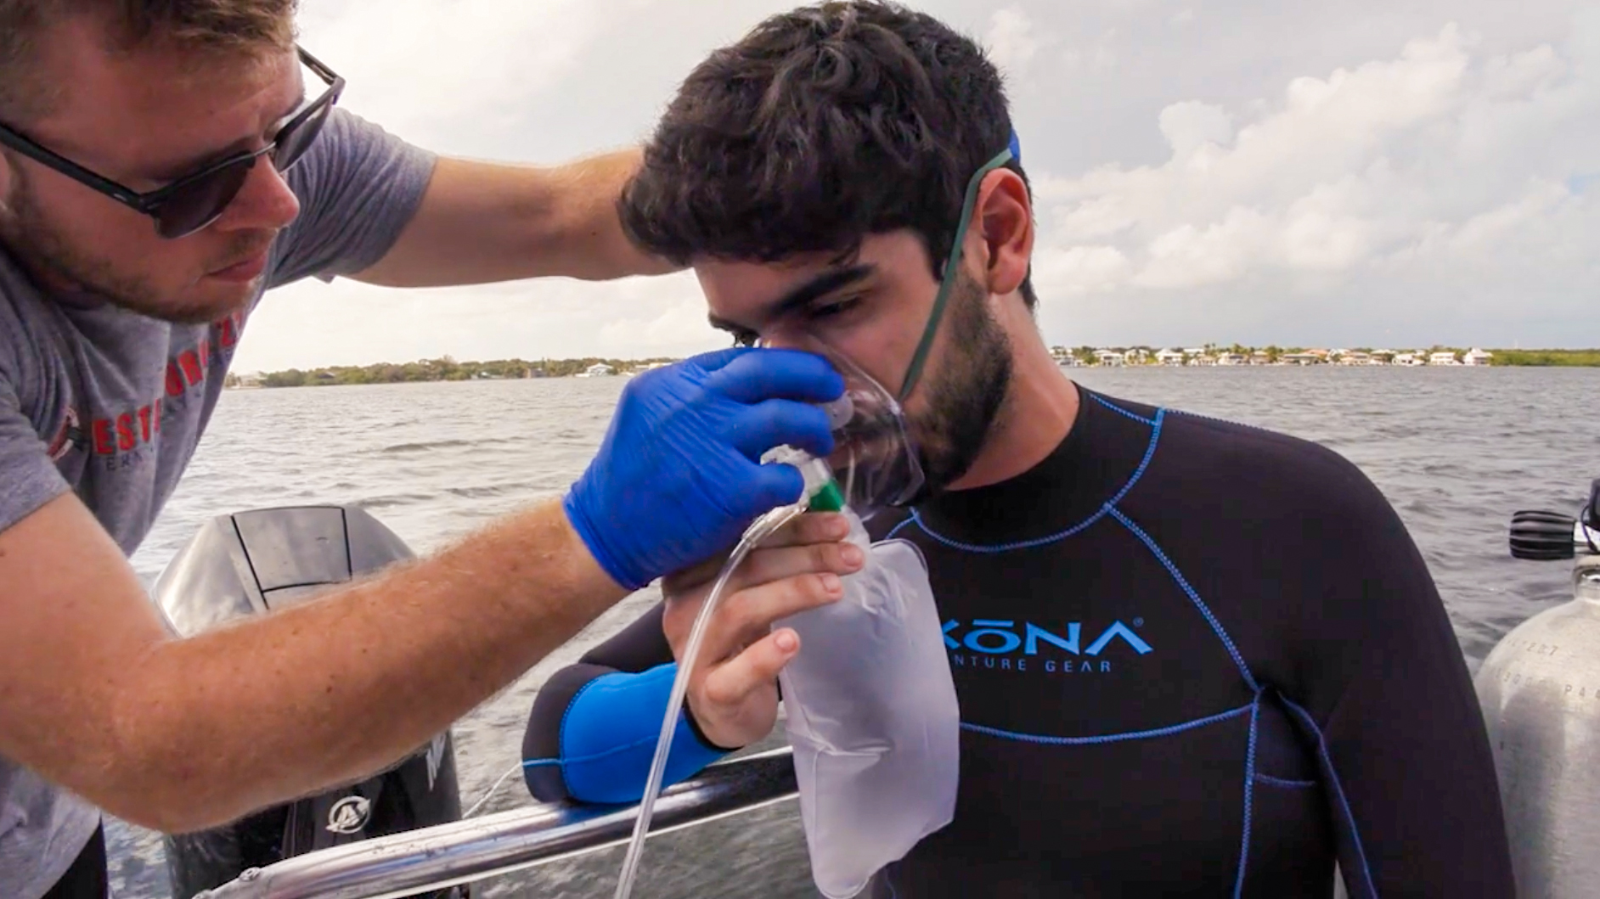
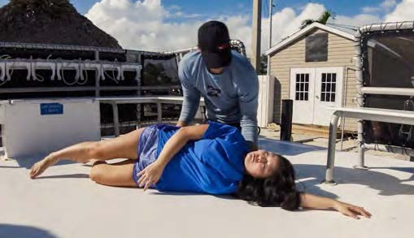
Core Part 2
Skills Workshop

Slide 31
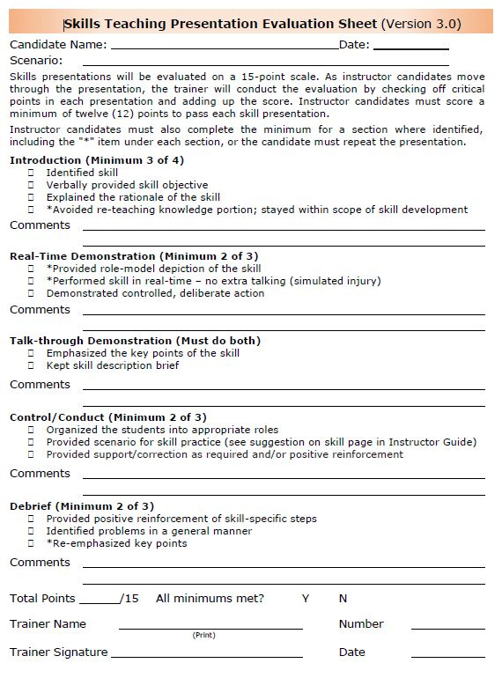
Core Part 2
Skill Teaching Presentations
Five Elements
Introduction
Real-time Demonstration
Talk-through Demonstration
Conduct/Control (Student Skill Practice)
Debriefing
All elements are outlined for each skill in course Instructor Guides.
Follow the written text in the Instructor Guide to assure inclusion of each element.

Slide 32
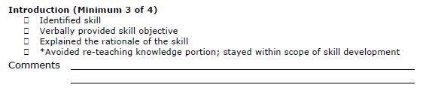
Core Part 2
Skill Teaching Presentations - Introduction
Five Elements
Introduction
Real-time Demonstration
Talk-through Demonstration
Conduct/Control (Student Skill Practice)
Debriefing
Includes:
Name of skill
Performance Objective
Rationale
*Avoid re-teaching knowledge portion
Each is written out in the Instructor Guide
*required skill

Slide 33
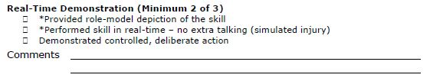
Core Part 2
Five Elements
Introduction
Real-time Demonstration
Talk-through Demonstration
Conduct/Control (Student Skill Practice)
Debriefing
Includes:
Simulates an actual event
*Perform in real-time
No explanations
*Provides role-model depiction of the skill
Research on first-aid training has consistently confirmed first-aid students benefit from seeing how a skill looks in action before learning the performance steps.
Skill Teaching Presentations - Introduction
*required skill

Slide 34

Core Part 2
Five Elements
Introduction
Real-time Demonstration
Talk-through Demonstration
Conduct/Control (Student Skill Practice)
Debriefing
Includes:
Explain each step
Skill step-by-step descriptions are included in the Instructor Guide
*Keep skill description brief
*Highlight Key points/steps
Key points of each skill are both bold and color-highlighted
Can be accomplished by either
Repeating entire demonstration in ‘stop-action’, or
Focusing on key points only with reference to real-time demonstration
Answer Student Questions
Skill Teaching Presentations - Introduction
*required skill

Slide 35
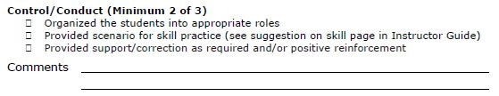
Core Part 2
Five Elements
Introduction
Real-time Demonstration
Talk-through Demonstration
Conduct/Control (Student Skill Practice)
Debriefing
Includes:
Divide class into practice groups
Assign specific roles to each student
Provider, injured person/assistant and coach
Encourage the use of the course slates to guide practice
Rotate students through each role
Provide a scenario
Sample scenarios are provided
Provide positive reinforcement/constructive correction
Skill Teaching Presentations – Control/Conduct
*required skill

Slide 36
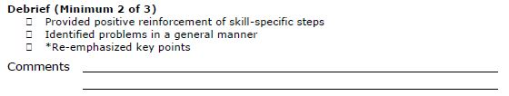
Core Part 2
Five Elements
Introduction
Real-time Demonstration
Talk-through Demonstration
Conduct/Control (Student Skill Practice)
Debriefing
Includes:
Conduct as a group after skill practice is completed
Include steps everyone did well, plus general reminders for any problems encountered
Generalize comments to avoid singling out any one participant
*Re-emphasize key points
Listed at end of skill in the Instructor Guide
Skill Teaching Presentations - Debrief
*required skill

Slide 37
Core Part 2
Teaching Presentation Evaluations
Follow skill evaluation sheet while presenting
Use as a checklist for presentations
Minimum score of 12 required to pass
Must meet minimum score on each section
Items with an “*” must be included

Slide 38
Core Part 2
Teaching Presentation Evaluations
Teaching Presentation Demonstration

Slide 39

Questions?
Let’s get started!

