Slide 1
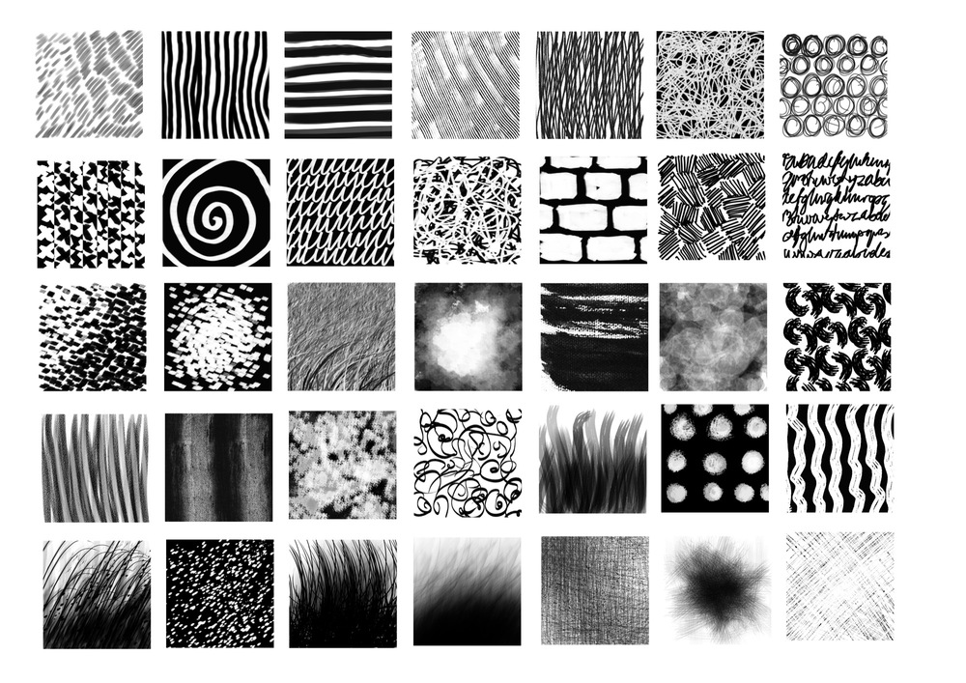
Art Independent Learning Project
‘Thinking outside of the box and creative risks’

Slide 2
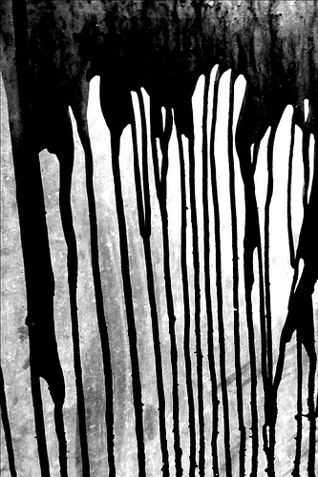
Task 1a: Using liquids available to you, drip splash, splatter, fling and dribble them in this box.
HINT: See what patterns you can create intentionally and unintentionally.
Extension Challenge: Look at the work of Abstract Expressionist Artist Jackson Pollock. On the back of this page stick one of his pictures, and try to recreate it with your own splatter patterns. Annotate your work and his, outlining key themes and your opinions.

Slide 3
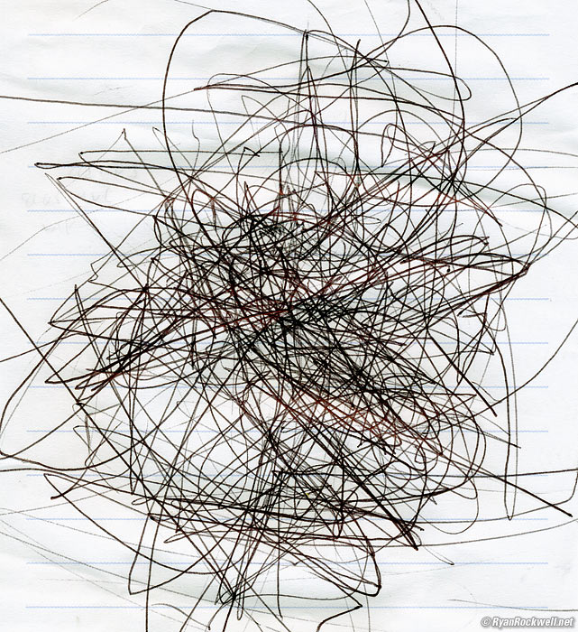
Task 1b: This is a Motion Log. Using a pen or pencil, apply gentle pressure to the box. Allow the pencil to record your journey.
HINT: Try different modes of transport, walking, car, train or bus journeys. You might also consider other movements, e.g. Jumping.
Sample 1
Sample 2
Sample 3
Sample 4
Sample 5
Sample 6
Sample 7
Sample 8
Sample 9
Sample 10
Sample 11
Sample 12
Evaluate your findings: Using descriptive words such as FRANTIC, FLOWING, ROUGH, SPARADIC etc, express your thoughts on each sample.

Slide 4

Task 2a: using whatever drawing tool you have to hand, draw a circles...u
As if your pen had exploded
As if you have never drawn before
As if you were stranded on a desert island
With corners
That makes you laugh
That flies
As a piece of furniture
That scares you
That has a rough texture
That moves
That you can consume
That is furry

Slide 5

Task 2b: Artist Bruno Munari created hundreds of drawings of the sun. Using any materials see how many ways you can also draw the sun.
HINT: Try paint, Collage, string, pencil, crayon, oil pastel etc. The results will be very different! (ask your teacher for help with materials)
Extension Challenge: Look at how other artist have used the sun in their work. On the back of the sheet make a collage of artists examples and label them. Annotate how they make you feel.

Slide 6
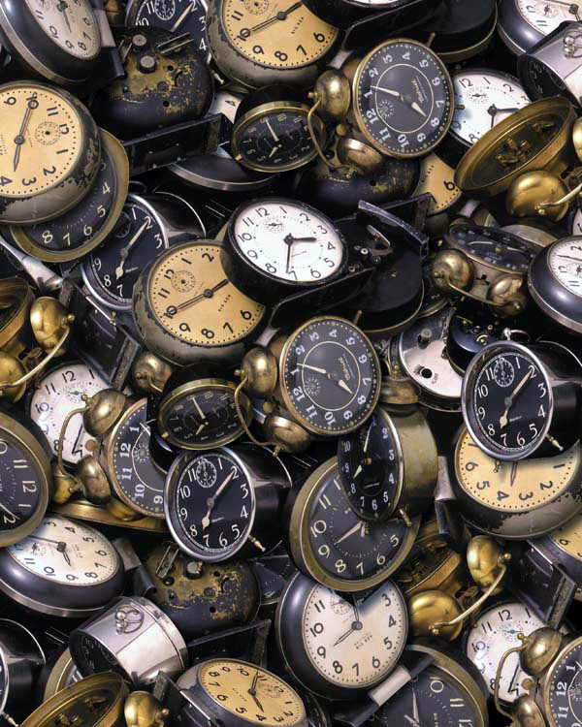
Task 3a: The 10 second challenge. Chose 8 small objects. Time yourself. In 10 seconds draw the complete item. This quick recording tasks speeds up the connection between eyes and hands.
HINT: Small objects such as drawing pins, paper clips and pencil sharpeners work well.
Label each picture (just in case we can’t tell what it is).
Go to Task 3b.........

Slide 7
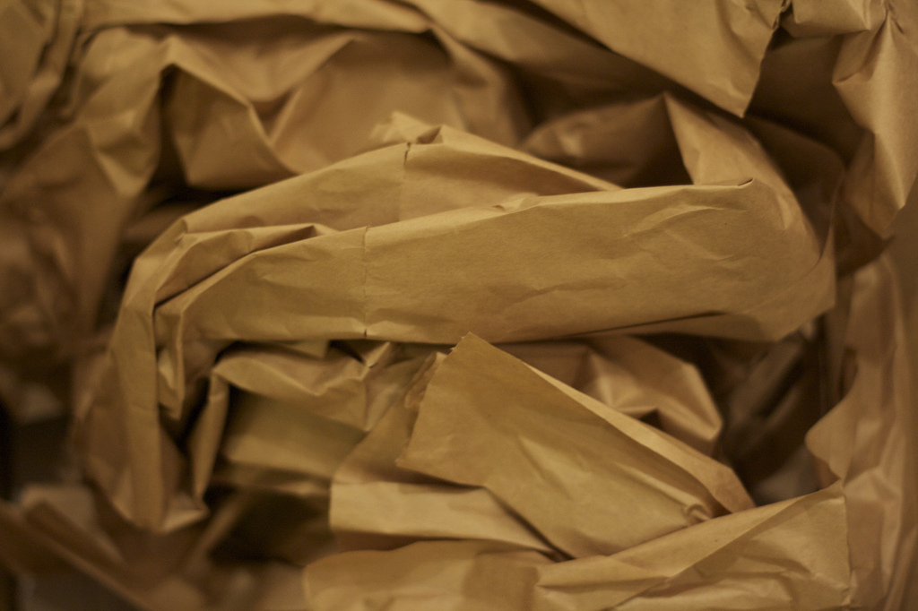
Task 3b: Select the most successful object out of the 10 (from task 3a). Using your left and right hand create 2 tonal studies of this object.
HINT: Remember the different methods of shading; block, linear, cross hatching, pointillist.
Right Hand
Left Hand

Slide 8
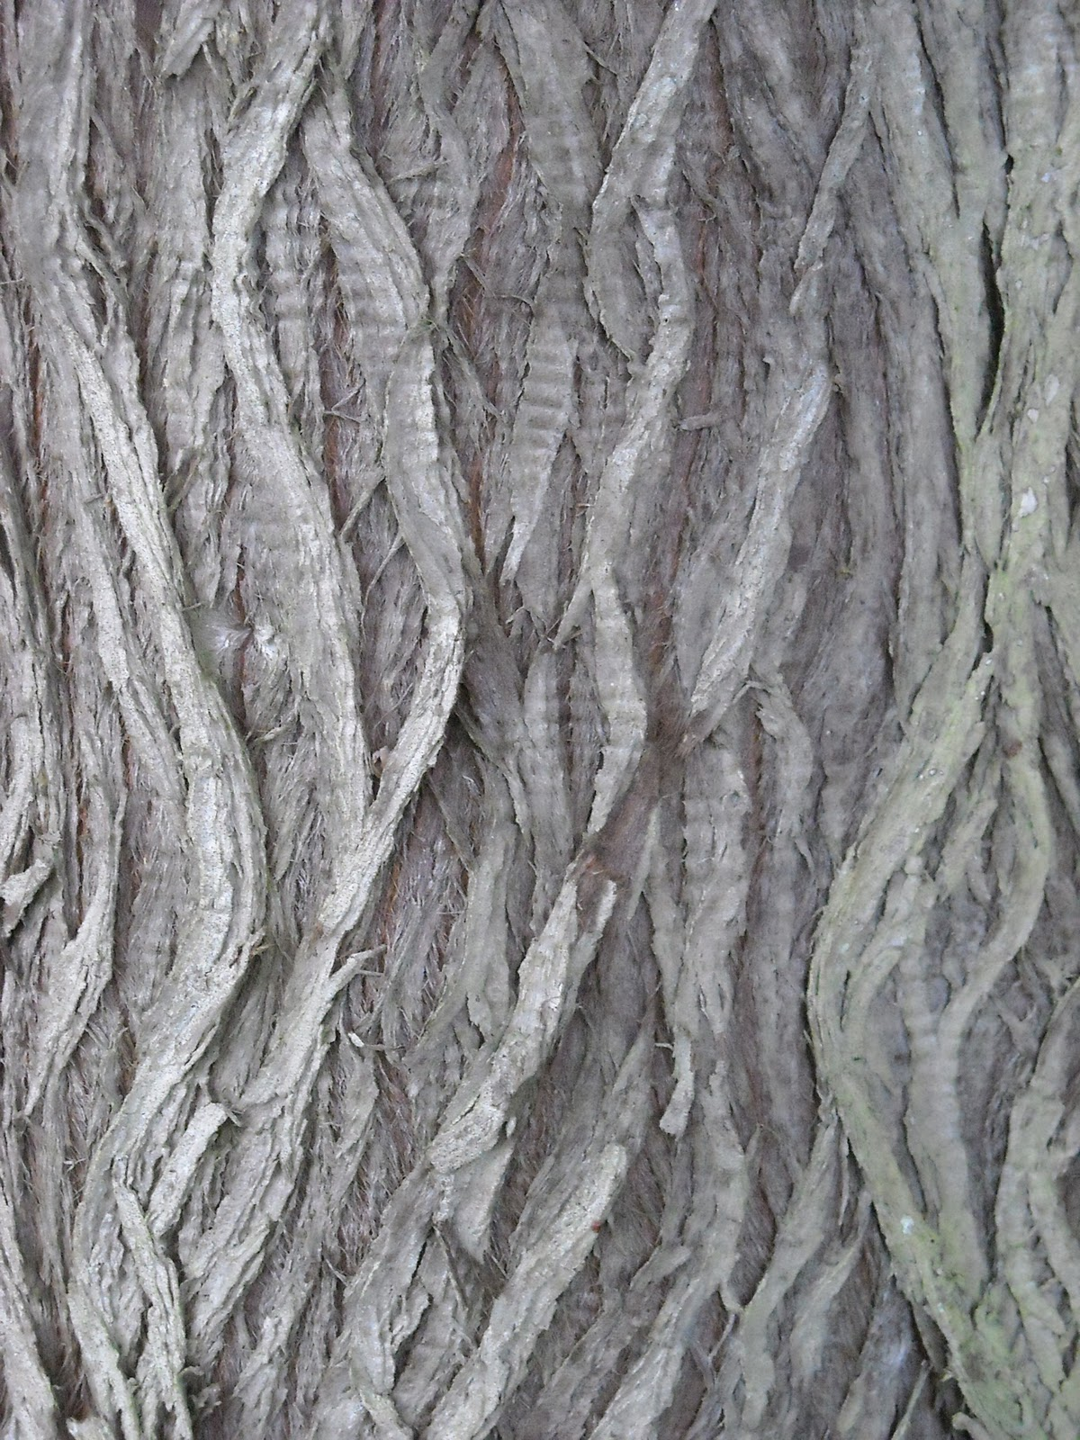
Task 4a: Using pencil, crayon, chalk or charcoal, collect at least 5 texture rubbings. Vary the colour or keep it black and white. Try alternative papers to make it more interesting.
HINT: try different surfaces from bark to grave stones.

Slide 9
Task 4b: Cut out interesting shapes from your rubbings in task 4a. Arrange and tick them into a collage. This can make a picture or a pattern the choice is yours.
HINT: cut different sizes and shapes to create interesting layers of texture.

Slide 10
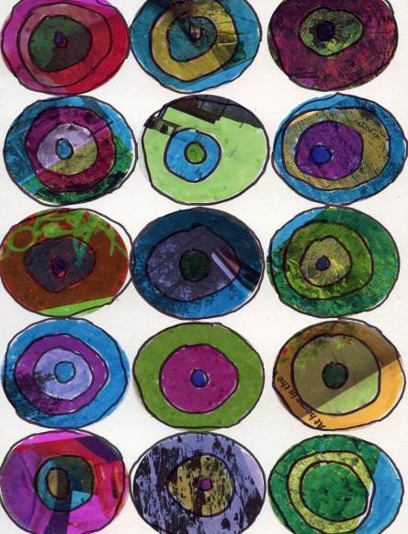
Task 5a: Using pictures from magazines cut out shapes and produce a repeated pattern. You can continue the pattern started in the bottom left corner, or start your own.
HINT: Layer up different sizes versions to create colour variation. Cut through several layers to get lost of the same shape.

Slide 11
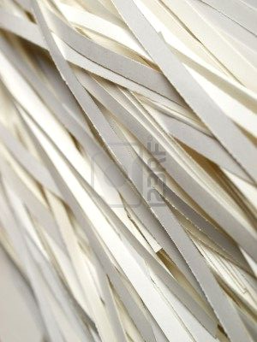

Task 5b: Cut small thin strips of text (newspapers or magazines). Spread the box with glue and sprinkle the strips like confetti.
HINT: Avoiding pictures makes the arrangement more confusing to the eye. The smaller the strips the more effective the randomness.
Extention task: Do a detailed drawing from a small section of your random arrangement. Include a full tonal range.

Slide 12

GLOSSARY
Task 6a: Complete the definitions of the following words.
Extension Challenge: There are 5 spaces for you to add in some of your own key words .
Risk | Intentional | Unintentional
Motion | Frantic | Smooth
Rough | Sporadic | Expressive
Abstract | Gestural | Observation
Texture | Collage | Layers
Repeat Pattern | Typography

Slide 13
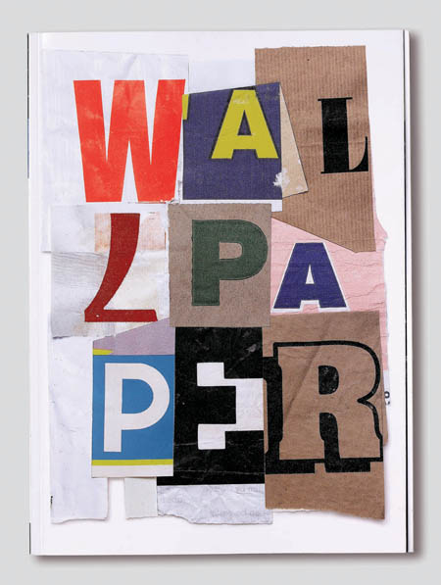
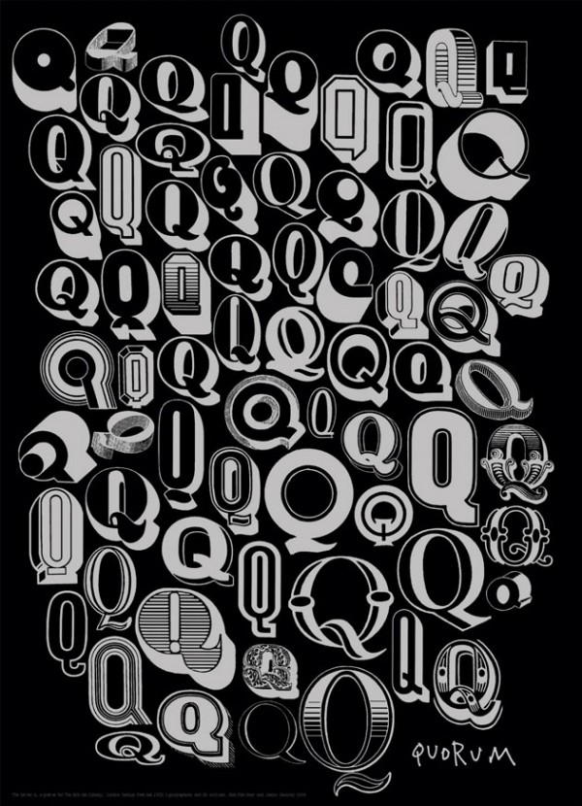
Task 6b: Look at the typography work of Alan Fletcher. Using the key words from the Glossary (Task 6a), create your own unique piece of word art.
HINT: Think about different shape letters, maybe look at fonts on the computer to inspire you.

