Slide 1

Unlocking the Secrets of SharePoint User Adoption
Susan Hanley
SharePoint Fest Chicago
December 10, 2015
www.susanhanley.com

Slide 2
User Adoption
User Engagement

Slide 3

But wait, then why are we here?
Secret # 1: Adoption is not the end game
RESULTS

Slide 4
Results mean …
The average time to on-board a new employee went from 3 months to 3 weeks
Customer satisfaction scores increased by 20%
Average profitability per client engagement increased by 10%
Revenue increased by 10% with no increase in headcount
RESULTS
ADOPTION

Slide 5



We built it, why don’t users just come?
Adoption rarely happens all at once
WIIFM
The solution has to be worth adopting

Slide 6

Secret # 2: Adoptable solutions solve measurable problems

Slide 7

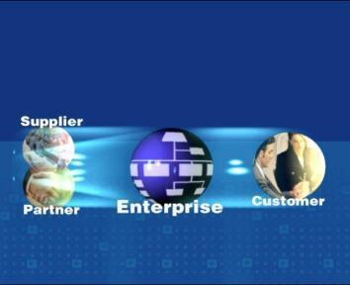
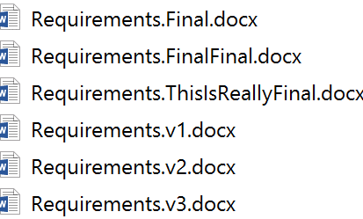
Real World Collaboration Challenges
Curing Versionitis
Finding Expertise
Sharing with Partners and Customers

Slide 8

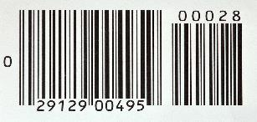


Real World Enterprise Social Challenges
Sales
Product Development
Resource Planning
Customer Support
Sales team on-boarding
Sales team training and mentoring
Engineer struggling with a problem – find answers quickly
Feedback “crowd-sourcing”
PM looking for the most qualified resources for a project – expertise location
Services agent working trying to solve an unusual customer problem
“Organic” knowledge base

Slide 9

Secret # 3: It’s personal

Slide 10
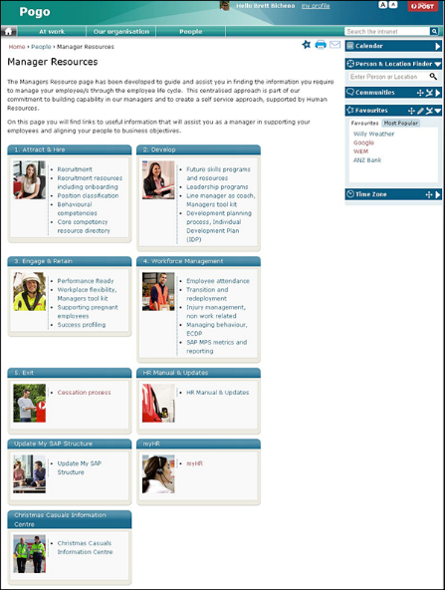
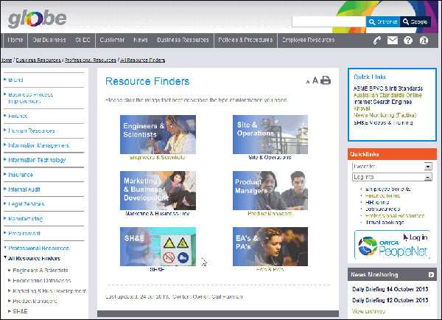
All about ME!

Slide 11
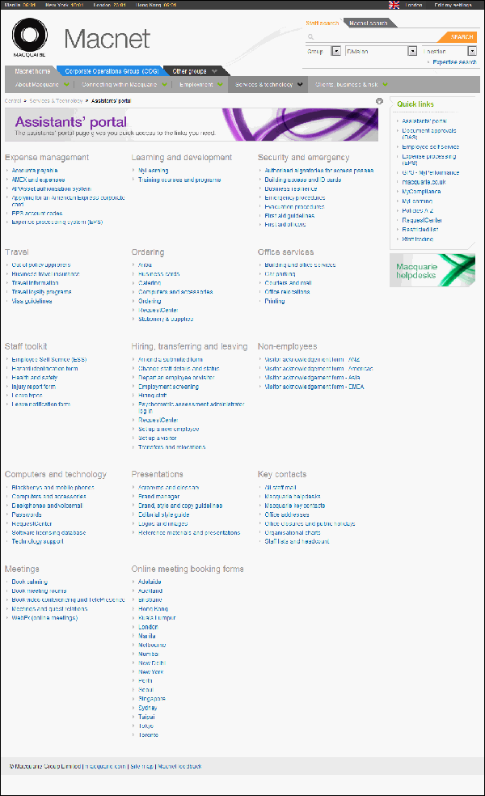
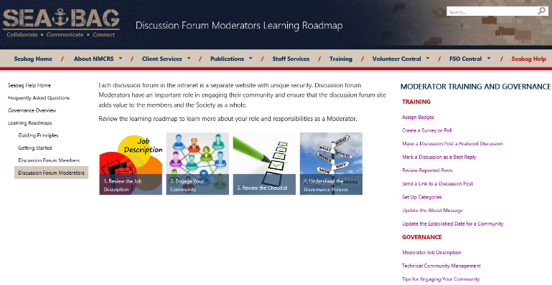
All about my ROLE!

Slide 12


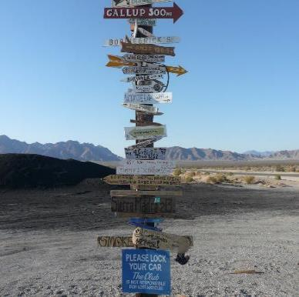
Easy to consume!
Well written
Written for the web
Accurate, useful, timely, relevant

Slide 13

Don’t make it hard and painful … keep it simple and easy … don’t make people have to think!

Slide 14

Secret #4: Plan for the unexpected

Slide 15


Why is it difficult to adopt new technologies?
Delayed Gratification
No Guarantees
Squishy Benefits

Slide 16

Secret # 5: It’s about change

Slide 17


Why is change so hard?
Comfort with the status quo
Discomfort with being forced to change
No personal benefit
“This is how we’ve always done it
… and it works for me.”
“I’m not broken, why are you trying to fix me?”
“Sure, I see why the they would want this, but what’s in it for me?”

Slide 18
Ease in to change …
Start small
Keep it simple
Consider your culture
Consider the “long wow” – help users create new habits

Slide 19
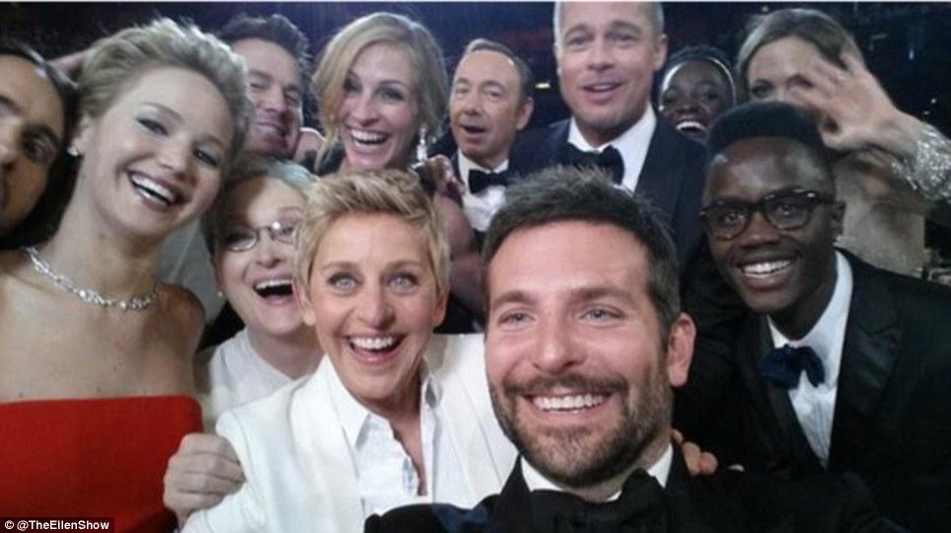
… and engage some helpers

Slide 20

Leaders model the behavior
“No involvement by leaders,
no commitment by employees.
No exceptions.”
Vala Afshar, Chief Marketing and Customer Officer at Enterasys

Slide 21
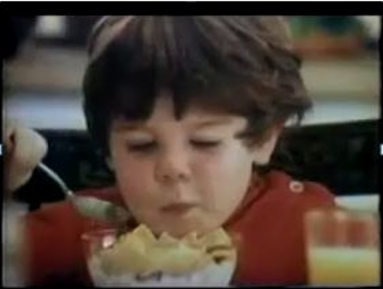
But it’s not just the leaders …
Identify and engage your Mikeys

Slide 22

Why does this work?
“Organizations can’t change their culture unless individual employees change their behavior – and changing behavior is hard. Many change programs focus on providing strategies, technologies, and training – but often this is not enough. When it comes to modifying deeply ingrained behavior, 12-step programs have a superior track record. They use incentives, celebration, peer pressure, coaching to adopt new habits, negative reinforcement, and role models – things organizations can draw on.”
Nothing happens without a readiness to change.
It’s important to replace old habits with new ones.
Peer support and pressure drive change.
Sponsorship deepens commitment and sparks results.
Community without hierarchy is a catalyst for change.
You are the company you keep.
Continuous introspection is key.
Changes in practice may represent breakthroughs.
It pays to acknowledge small wins.
The goal is progress, not perfection.
Harvard Business Review: Managing Change One Day at a Time, July-August 2014
http://hbr.org/2014/07/managing-change-one-day-at-a-time/ar/1

Slide 23

Secret # 6: It’s all about comfort

Slide 24



Plan a training roadmap – for comfort
Don’t assume it’s intuitive
One size does not fit all
Don’t try to train all at once

Slide 25

Secret # 7: It’s about communications

Slide 26
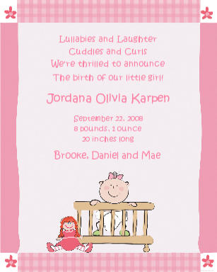
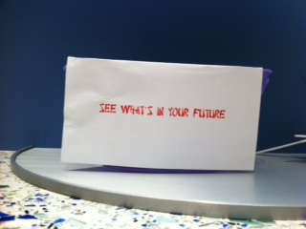

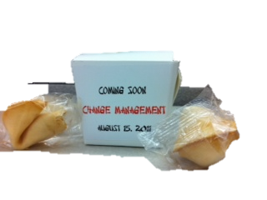

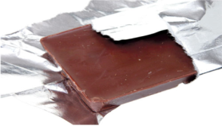
Launch ideas that worked … mostly

Slide 27

Photo Booth

Slide 28
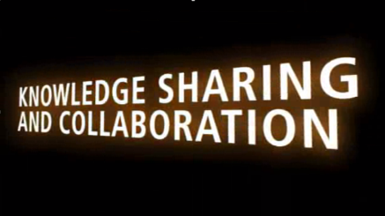
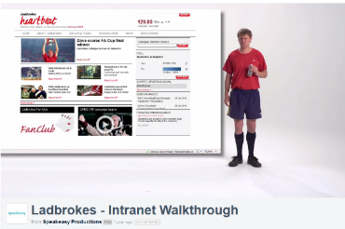
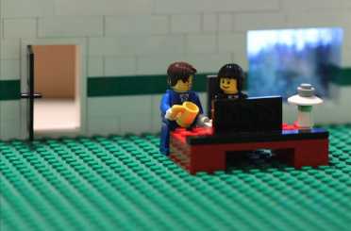
Launch Videos
http://www.scoop.it/t/intranet-launch-videos-and-teasers - comprehensive collection compiled by Ellen Van Aken
Additional examples: http://tiny.cc/ThreeSampleVideos
http://www.youtube.com/watch?v=PN1IyDvyA2o
MAN Diesel
http://vimeo.com/60729239
http://youtu.be/SinFM8hNcOg
Dartmouth-Hitchcock Intranet Home Redesign – watch the end for outtakes

Slide 29
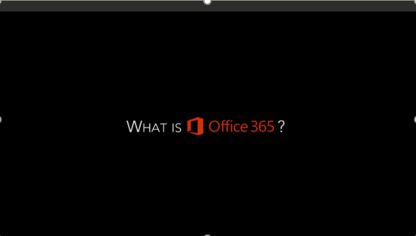
What is Office 365 Launch Video (Regis)
https://vimeo.com/regiscorp/review/125078501/68cd7832a8

Slide 30
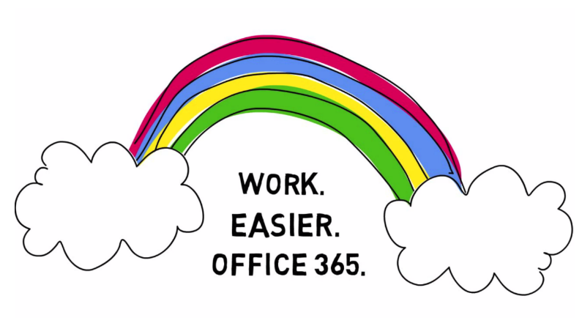
OneNote Introduction (Regis)
https://vimeo.com/124350398

Slide 31



Persistent communications that worked
30 for 30
Intranet Learning Cafés
(with great coffee)
Get Sharp on SharePoint

Slide 32
Other ideas for your communications plan
Create (and use) an “anecdote” bank
Regular “on site events” – Polls on Mondays, Conversation Topic of the Week on Tuesdays, Employee Spotlights on Wednesdays, Trivia on Fridays
Leverage existing meetings and events
Target your messages
Did you know …? (tip of the day)
Portal Minute at the start of company meetings
Weekly recap
“Look what they did” success stories
Cafeteria table toppers
Message board/break room announcements or posters
Desktop wallpaper
Usability testing

Slide 33
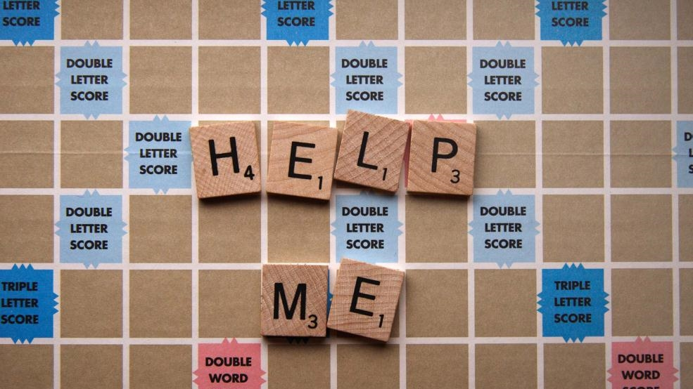
Secret # 8: It’s about support

Slide 34



It takes a village
Seed the organization with evangelists
Plan ongoing support
Make sure the help desk is prepared
  Pilot team
  Volunteers
  Employee advocates
  Office Hours
  Center of Excellence
  (Just-in-Time) Training and Documentation

Slide 35
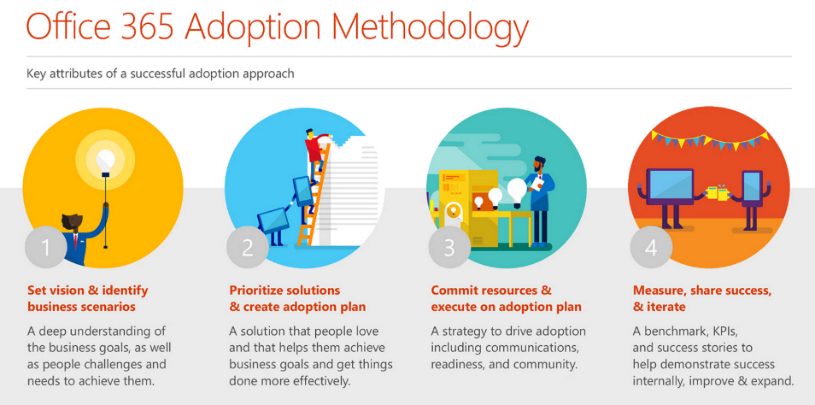
You are not alone – lots of help from Microsoft: fasttrack.office.com

Slide 36
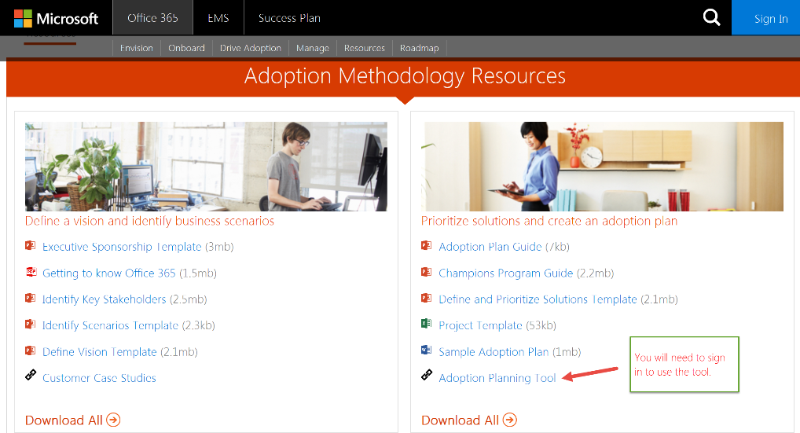
Adoption Planning Tool
fasttrack.office.com

Slide 37

Secret # 9: Don’t forget the fun!

Slide 38
Incentives and rewards help kick-start
Scavenger Hunt
Points, Badges, Prizes
Five for Five
“Profile Week”
FOOD!

Slide 39


Fun with a theme
SharePointoberfest - inebriate while you collaborate!
CollaBOOration - A Ghoulish Guide to Metadata
SharePointgiving –
Give thanks to document workflow and approval

Slide 40

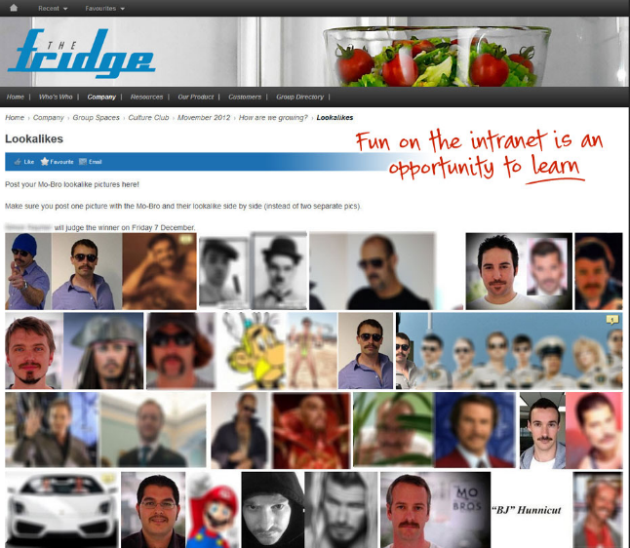
Movember mustache contest

Slide 41

Secret # 10: It’s about listening, and …

Slide 42
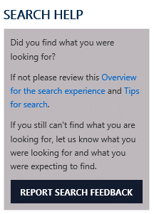


...allow users to provide feedback …
Feedback identifies challenges
Ask for feedback-everywhere
Conduct
usability tests,
LISTEN and OBSERVE

Slide 43

… but don’t be afraid to enforce

Slide 44

Secret # 11: You’re never done

Slide 45

Not everyone will be happy (initially) - look for the wins!
Keep it “organic” - have a plan for change.
It’s not “once and done.”

Slide 46

Secret # 12: It’s about sharing

Slide 47





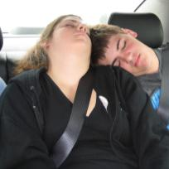






The Secrets
Adoption is not the end game
Adoptable solutions solve real problems
It’s personal
Plan for the unexpected
It’s about change
It’s about comfort
It’s about communications
It’s about support
It’s about fun!
It’s about listening, but …
You’re never done
It’s about sharing

Slide 48

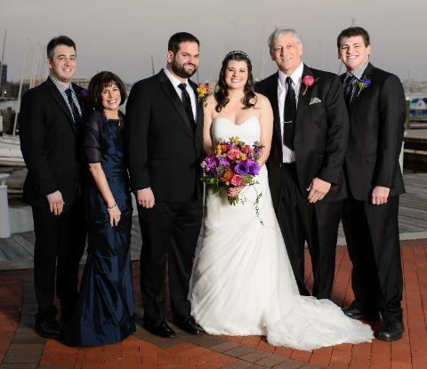



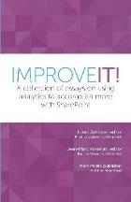



About Me
President, Susan Hanley LLC
National Practice Lead: Portals, Management Collaboration, and Content practice at Dell
Director of Knowledge Management at American Management Systems
Information Architecture
User Adoption
Governance
Metrics
Knowledge Management
Intranets & Portals
Collaboration Solutions
sue@susanhanley.com
susanhanley
www.susanhanley.com
www.networkworld.com/blog/essential-sharepoint

Slide 49
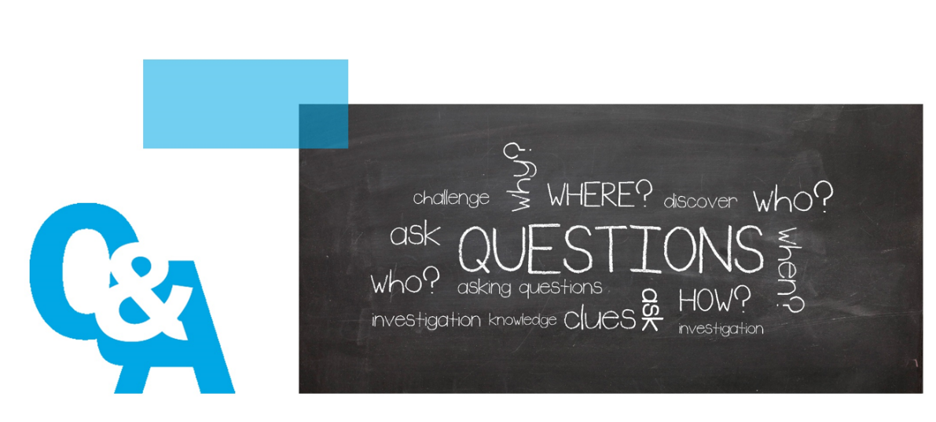

Slide 50
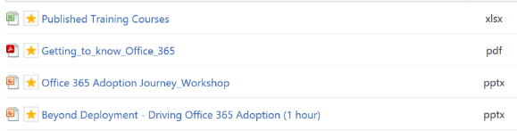
User Adoption Resources
General
  Read User Adoption Strategies: Shifting Second Wave People to New Collaboration Technology by Michael Sampson
  Jakob Nielsen’s Alertbox: http://www.useit.com/alertbox/ (Current Issues in Web Usability)
    Reference article about social features on intranets: http://www.nngroup.com/articles/intranet-social-features/
SharePoint and Office 365
  Fasttrack.office.com
  Office 365 Network on Yammer: Driving Office 365 Adoption group
  Essential SharePoint 2013
  Practical Framework for SharePoint Metrics
  ImproveIT

